Slide 1
AI in fintech
JIFENG LI

Slide 2
PART 1 BASIC ANALYSIS
Data from AAPL & AEO

Slide 3
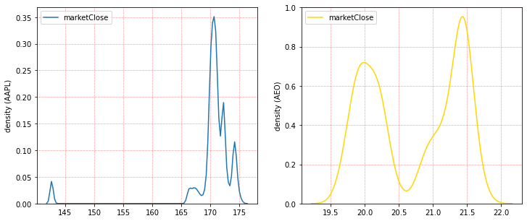
Compare p.d.f of AAPL and AEO AAPL has a higher trading frequency

Slide 4
Kurtosis Checking kurtosis is a measure of tails, or extreme values
AAPL Kurtosis: 22.29743440888108
AEO kurtosis: -1.6773208966726922
AAPL is subject to the leptokurtic distribution for its large kurtosis
It means AAPL can be riskier and has more outliers than the others

Slide 5
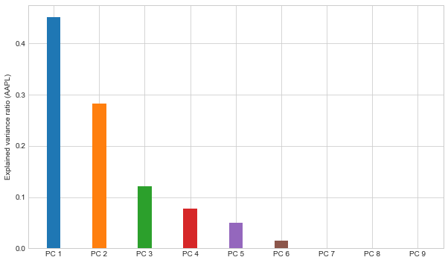
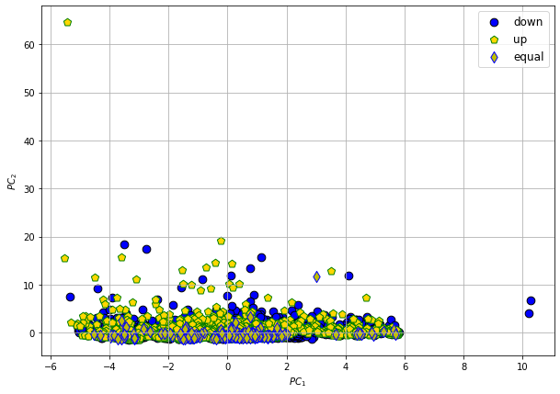
Normalization and PCA Explained variance ratio and biplot (AAPL)

Slide 6
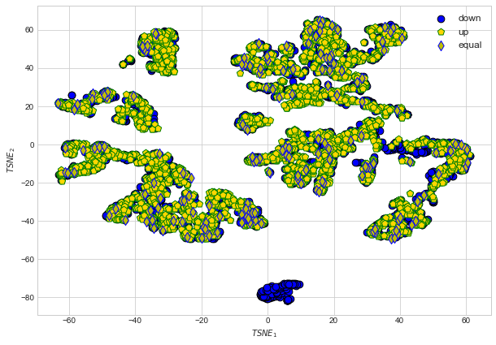
TSNE Partition data

Slide 7
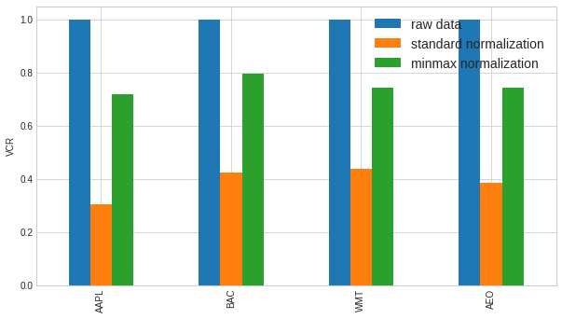
Variance Concentration Ratio (VCR)

Slide 8
PART 2 COMPARE 4 METHODS
Data from WMT

Slide 9
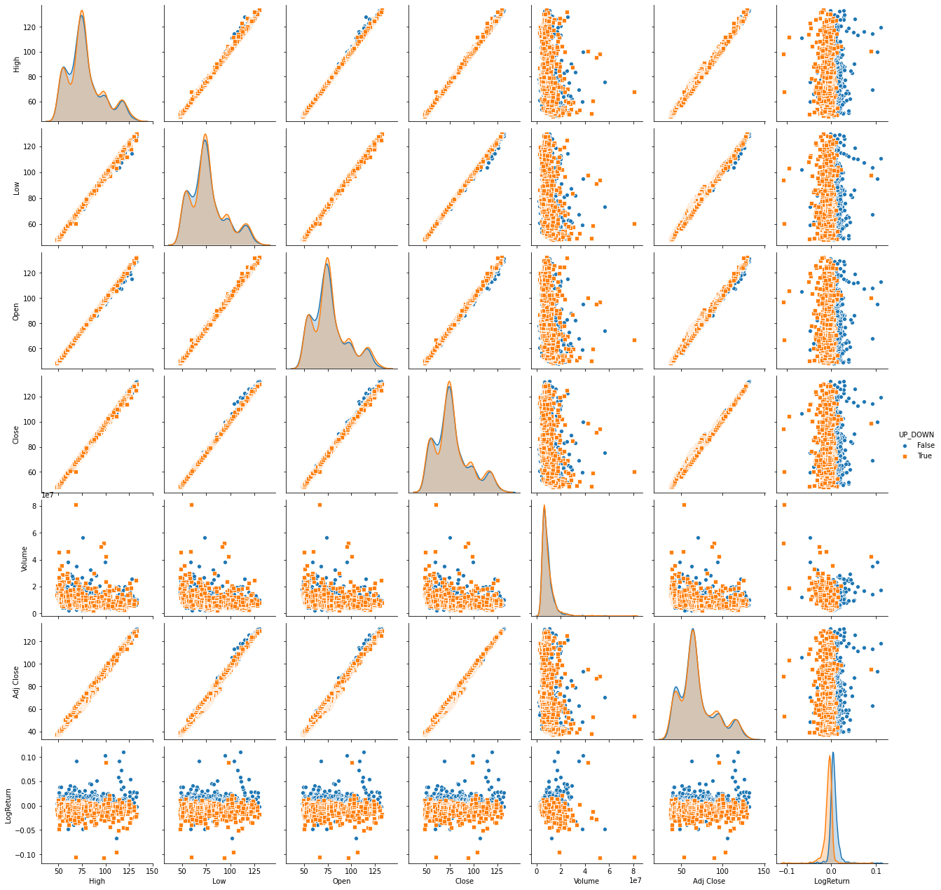
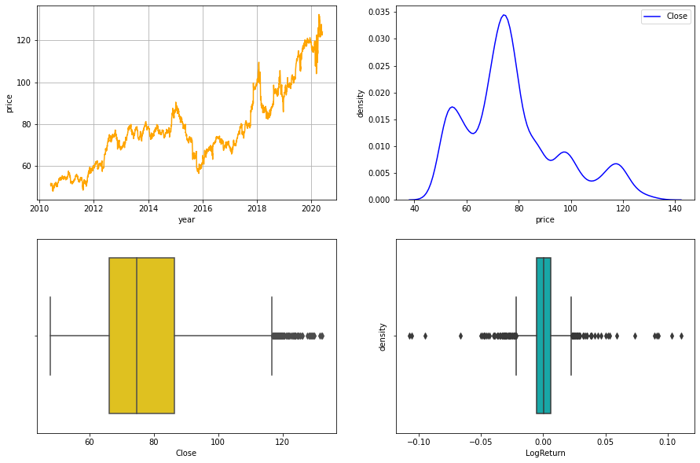
Data Description

Slide 10
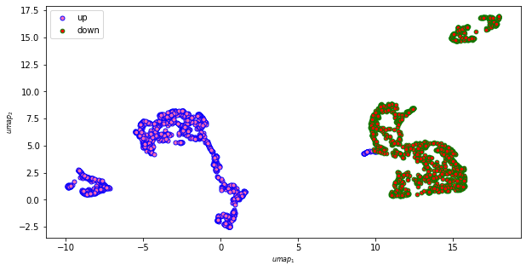
UMAP

Slide 11
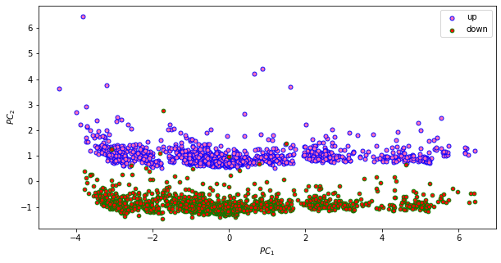
PCA

Slide 12
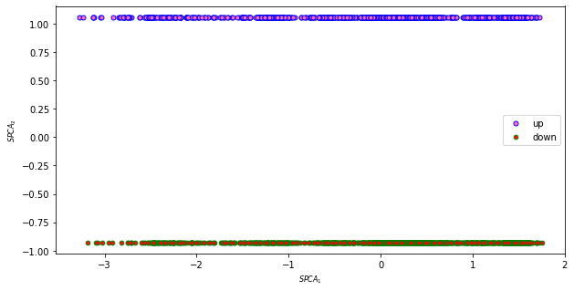
SPCA

Slide 13
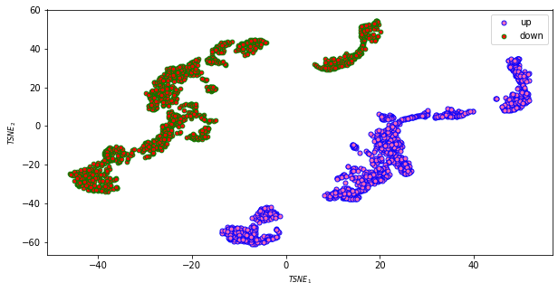
tSNE

Slide 14
PART 3 STOCK ANALYSIS
Data from SP100

Slide 15
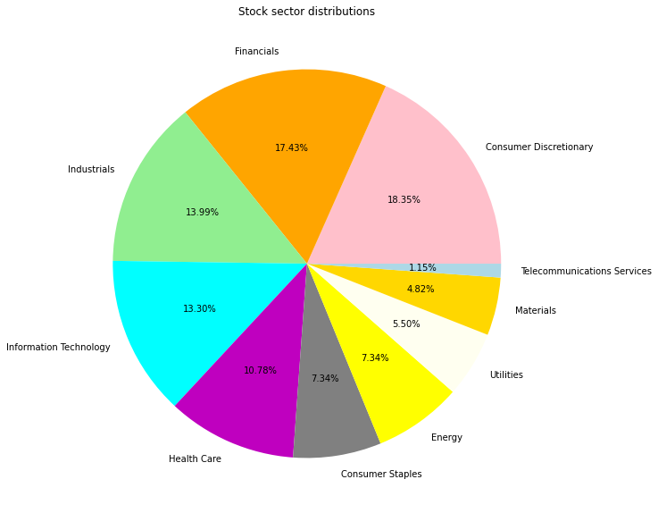
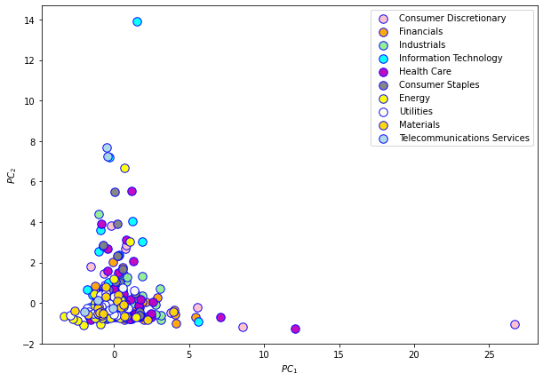
Check Sector Information

Slide 16
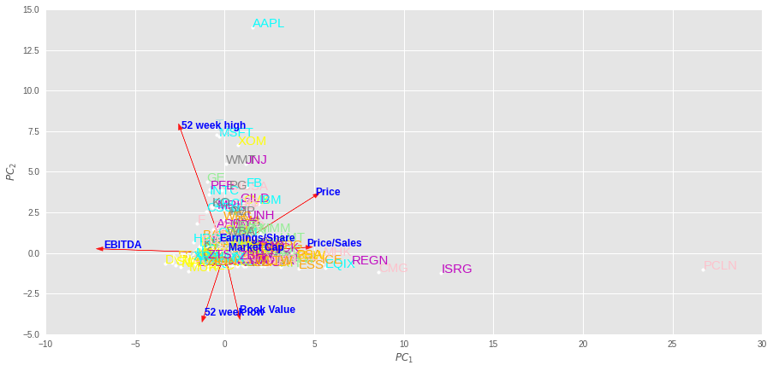
Better Biplot

Slide 17
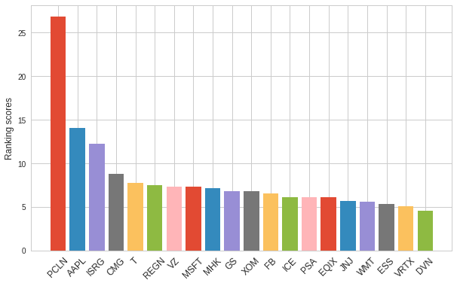
Dimension Reduction & Rankings

Slide 18
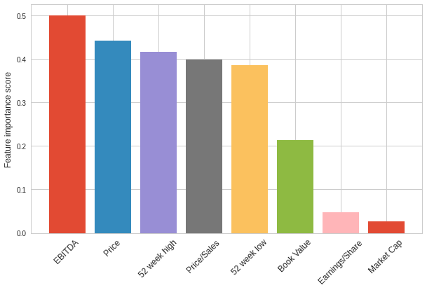
Feature Selection By PCA

