Slide 1
Republican or Democrat
Which Subreddit is it?

Slide 2
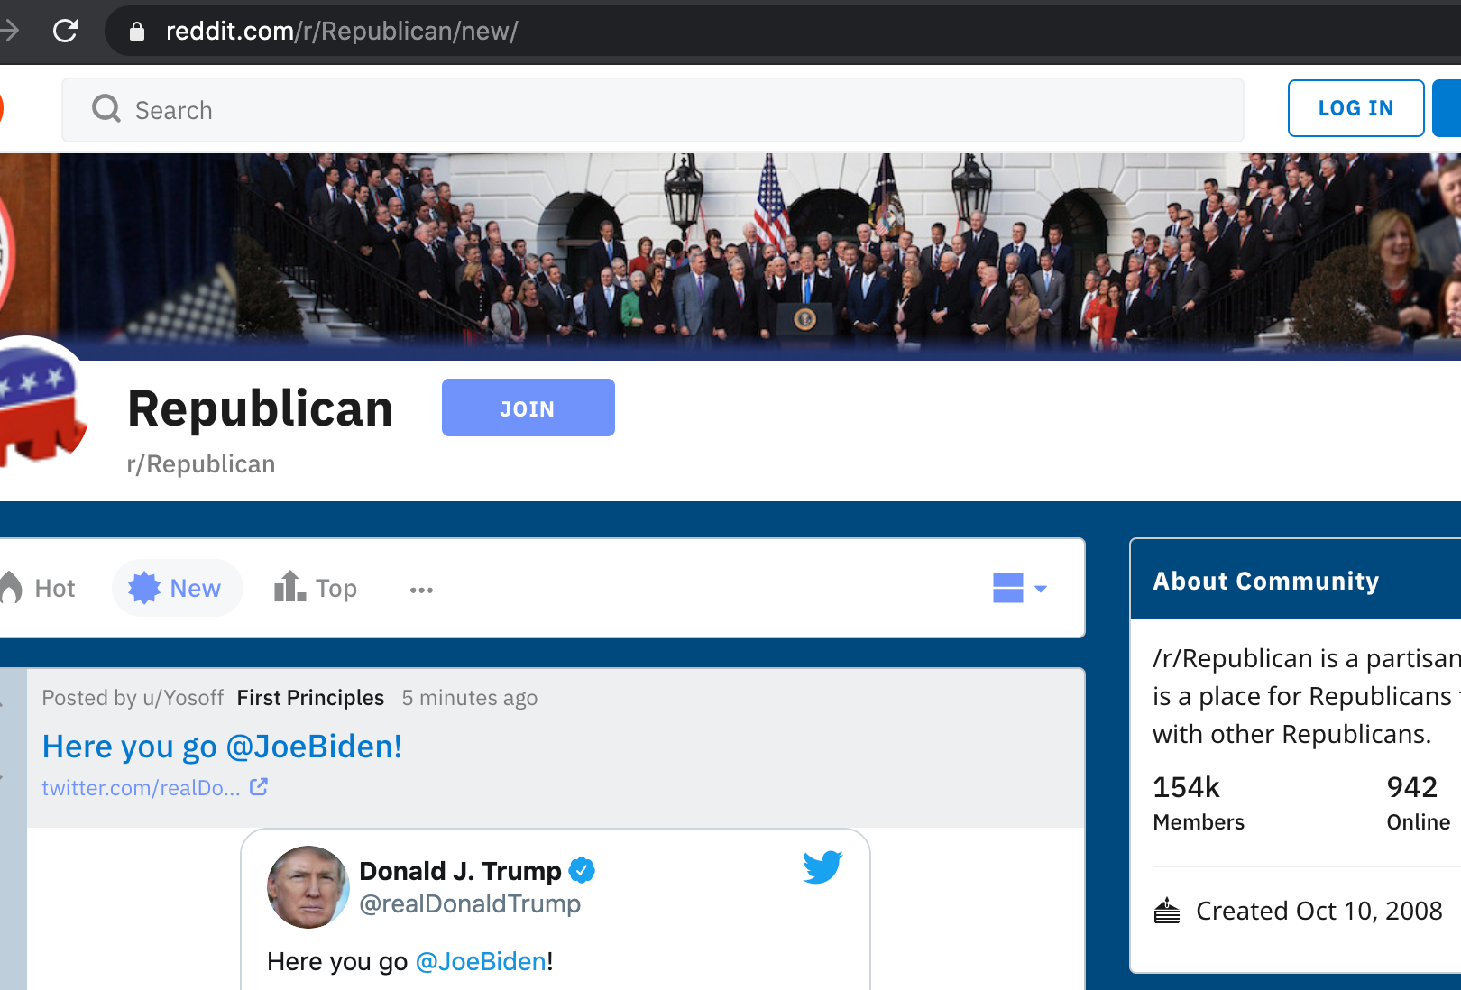

Background
r/Republican
154k members
Republican group with most members
90,351 submissions from last 8 years
r/democrats
146k members
Democratic group with most members
123,668 submissions from last 8 years

Slide 3
Two Goals:
Predict the subreddit
Unique?
Surprises?
Frequencies?
Common?
Understand word appearances

Slide 4
Methodology
Downloaded 8 yrs data from two subreddits
Over 90,000 submissions from each one
Analyzed words in titles of submissions
Common, Unique, Tone
Analyzed urls
Common, Frequency
Analyzed title word count, title length
Created models to predict
Reviewed prediction results
Reviewed predictions to see if they matched previous analysis
Understand Word Appearances
Predict the Subreddit

Slide 5

Understand Word Appearances

Slide 6
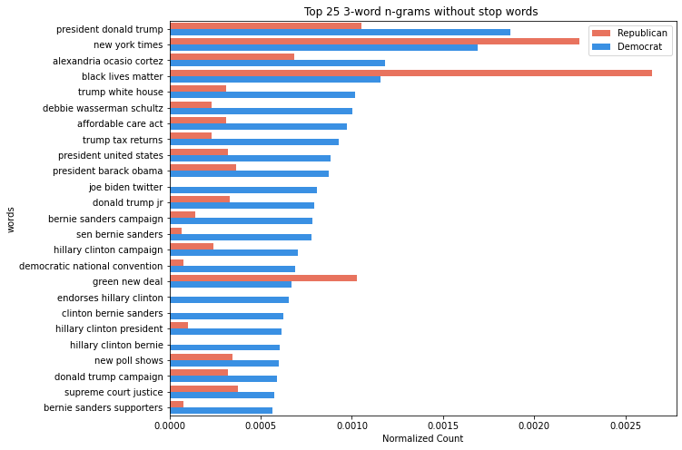
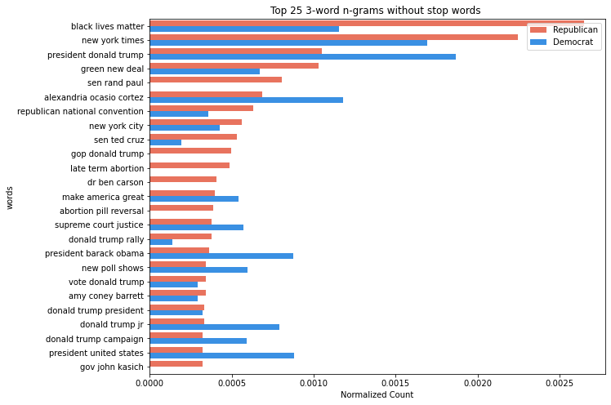
c
c
Common Words
One of top words for both is president donald trump
Very dissimilar distributions – some are missing from one party
Mostly key names/causes in each party
3 n-gram words
Took top 900 for each and compared
Does not include stop words
Normalized Counts

Slide 7
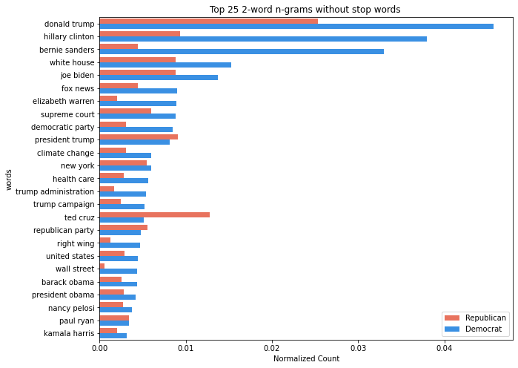
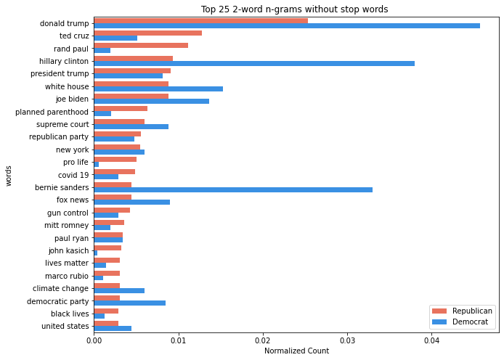
c
c
Common Words
Top words for both is Donald trump, but this is disproportionately referenced by Democrat
Generally dissimilar distribution
Mostly key names in each party
2 n-gram words
Took top 900 for each and compared
Does not include stop words
Normalized Counts

Slide 8
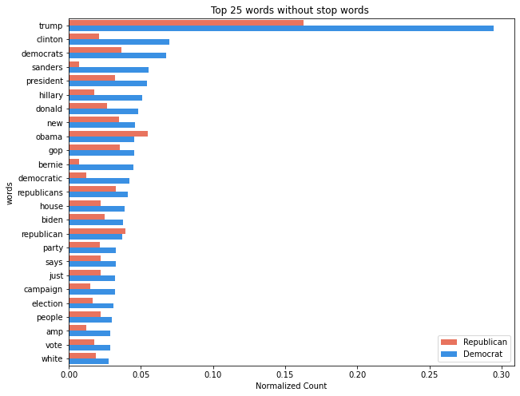
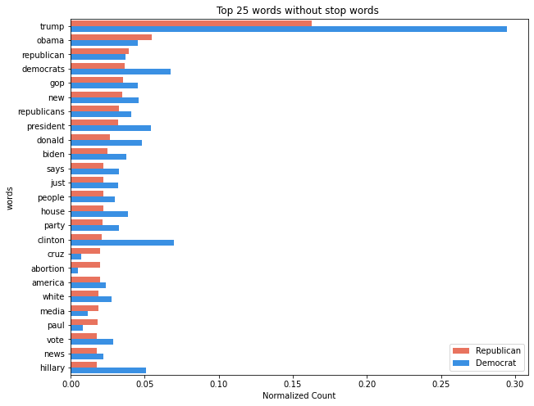
c
c
Common Words
Top words for both is Trump, but this is disproportionately referenced by Democrat
Generally similar distribution
1 n-gram words
Took top 900 for each and compared
Does not include stop words
Normalized Counts

Slide 9
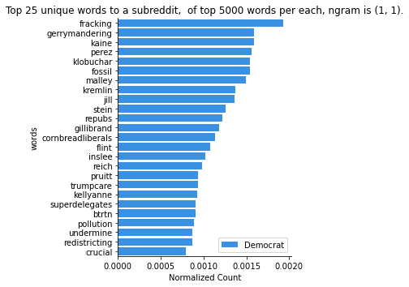
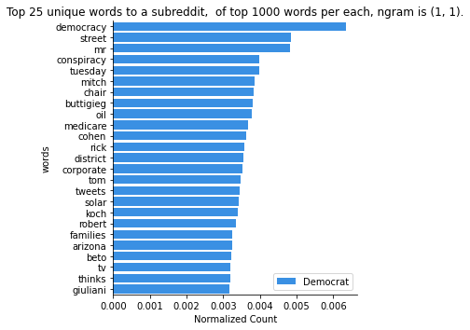
Unique Words
Took top 5000 and 1000 for each and compared
Includes stop words
Normalized Counts
Terminology is interesting

Slide 10
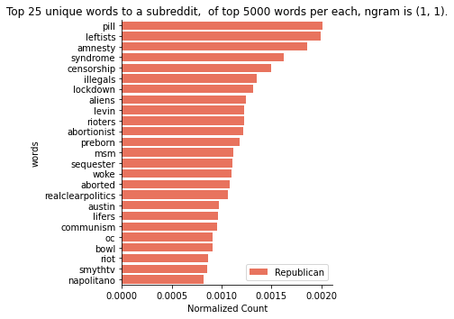
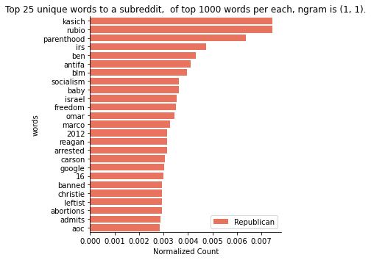
Unique Words
Took top 5000 and 1000 for each and compared
Includes stop words
Normalized Counts
Terminology is interesting

Slide 11
Understand Other Appearances

Slide 12
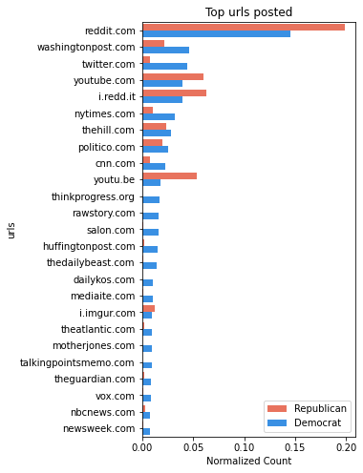
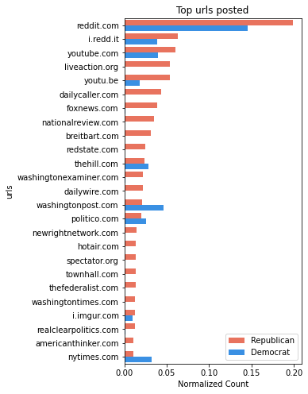
URLs
Mostly National News Organizations

Slide 13
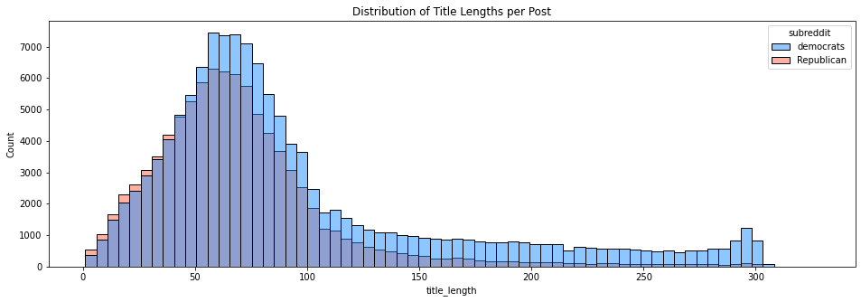
Democrat has both a higher mean and median title length per post
 | Democrat | Republican
Overall Count | 123,668 | 90,351
Mean | 95.6 | 70.0
Median | 74 | 64

Slide 14
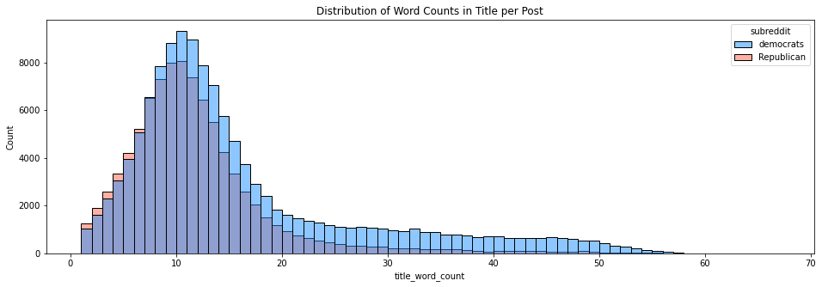
Democrat has both a higher mean and median word count per post
 | Democrat | Republican
Overall Count | 123,668 | 90,351
Mean | 15.6 | 11.3
Median | 12 | 10

Slide 15
Predictions

Slide 16
Modeling Criteria:
Performed a GridSearch for three types of Models
Multinomial Naïve Bayes
Logistic
RandomForestClassifier
Tried two vectorizers:
CountVectorizer
Term Frequency-Inverse Document Frequency
Also tried with and without urls, and with and without status length, title count

Slide 17
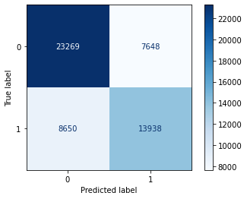
Best Model – NLP only:
CVEC, Logistic Regression
Baseline score:
57.8% are Democrats
Accuracy:
Cross-Val: 69.0%
Train: 71.4%
Test: 69.5%
Sensitivity: 61.7%
Specificity: 75.3%

Slide 18
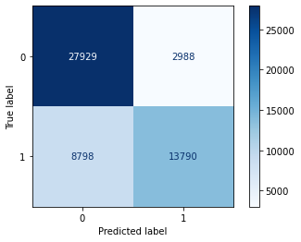
Best Model – URLs only:
TVEC, Logistic Regression
Baseline score:
57.8% are Democrats
Accuracy:
Cross-Val: 77.6%
Train: 79.7%
Test: 78.0%
Sensitivity: 90.3%
Specificity: 61.1%

Slide 19
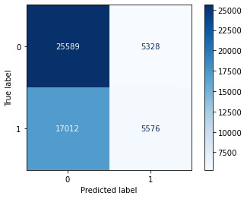
Model – Counts:
Logistic Regression
Baseline score:
57.8% are Democrats
Accuracy:
Cross-Val: XXX%
Train: 58.5%
Test: 58.2%
Sensitivity: 82.8%
Specificity: 24.7%

Slide 20
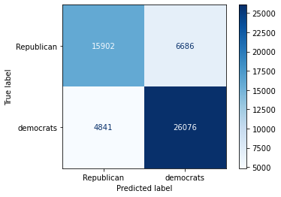
Best Model – Overall:
Logistic Regression
Baseline score:
57.8% are Democrats
Accuracy:
Train: 80.0%
Test: 78.5%
Sensitivity: 70.4%
Specificity: 84.3%

Slide 21
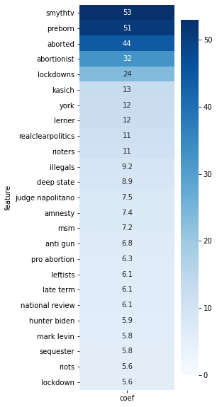
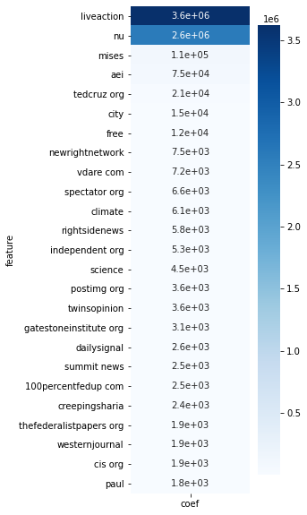
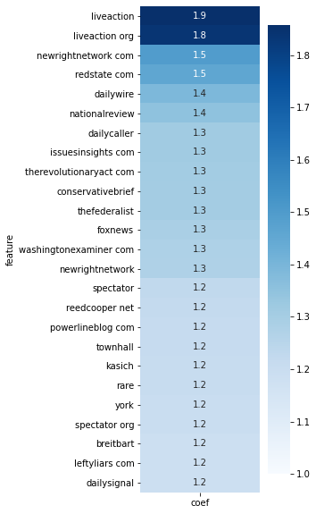
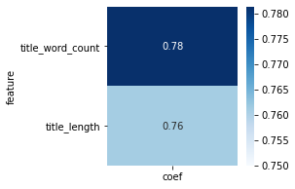
Review Features
c
Title - words
Urls
Title - counts
All
Urls dominate the combined model

Slide 22
Conclusions
‘Trump’ is mentioned almost twice as often in Democrats vs Republicans
Democrats like to write more words
Urls tell more about the subreddit than the words in the title
Combining the words, Urls, and title description is the best
Next Steps
Explore the relationships in the words more
What ranking of words count for each least are the features in each model
Explore similar subreddits – libertarian, conservative, progressive, liberal
VOTE!!!

