Slide 1
Animal Rescue Center System
Qing Mu 001225391

Slide 2
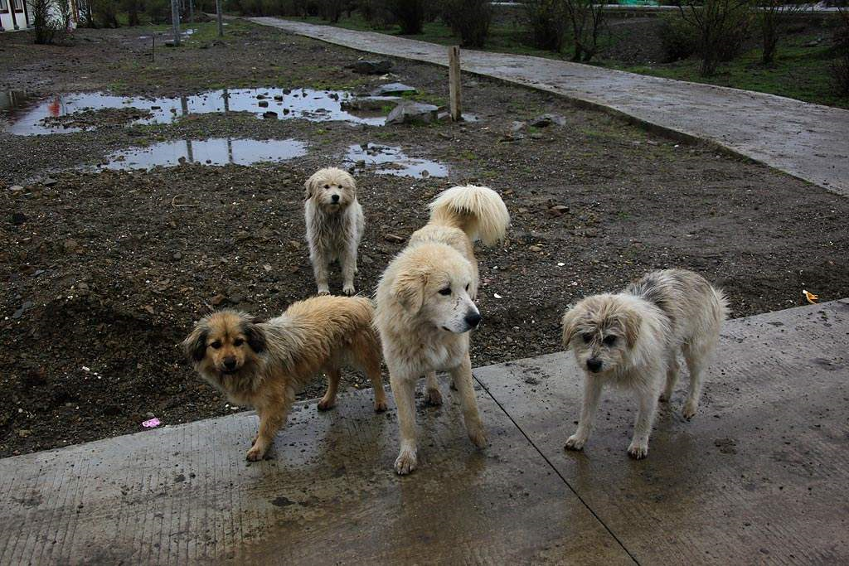
Background
More and more stray animals in the street
Rescue centers need a system to manage rescued animals and adoption

Slide 3
Brief Summary
Development tools:
STS
MySQL Database
The techniques used in the project:
Spring MVC
Hibernate (Annotation, Entities mapping, Queries, Criteria)
Filter
JSTL
Bootstrap

Slide 4
Functionality Summary
Admin
Registrator
Veterinarian
Adoption Superviser
Adopter

Slide 5
Functionality Summary
All Users:
Sign up as adopters
Login their accounts
Log out
Admin Role:
See statistic reports, including total quantity of the animals rescued, percentage by type, percentage by gender, and so on.
Registrator Role:
Browse all the rescue records
Register new animals and record their information, including type, gender, color and photo

Slide 6
Functionality Summary
Veterinarian Role:
Browse all the rescue records
Treat animals that haven’t been treated yet
Once the animals are treated, they are then automatically added into an adoption list, which can been seen by adopters
Adoption Supervisor Role:
Browse all the pending adoption applications
See details of an application and evaluate whether the adopter is certificated.
Adopter Role:
Browse and edit their information
Browse their own adoption histories
Browse adoption list and see the detail information of an animal
Apply for adopting an animal

Slide 7
1
System Demonstration

Slide 8
Extensions
Add employee management functionality
Improve the veterinarian role by adding vital signs to Animal
Improve the adoption supervisor role by adding comments and period visits
Add more statistics reports, including data related to time, position and health status in order to find out the reason of abondon.
Improve the system to an eco-system that can manage all the animal rescue centers in a particular region.

Slide 9
THANK YOU

