Slide 1

CryptoAnalyzer
Analysis on Bitcoin Trading History
Team 8

Slide 2
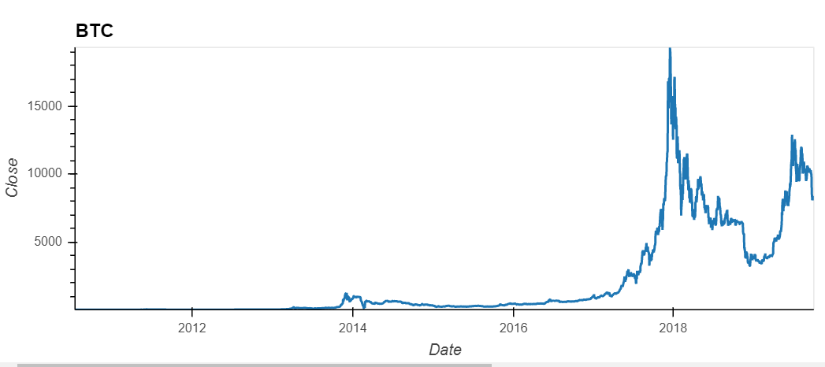

Does Bitcoin's trading prices behavior more closely resemble that of a risky asset class or currency?

Slide 3
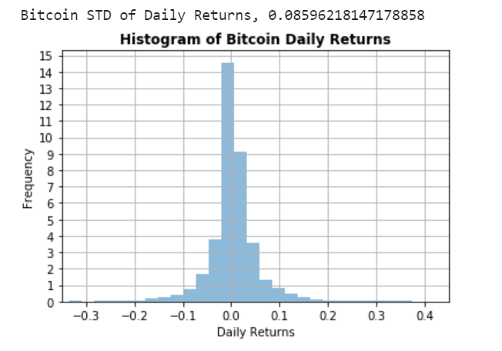
Is it possible to apply traditional statistical analysis used in analyzing financial security price data series to Bitcoin's trading history?
Based on the plot visuals, we can assume Bitcoin follows a normal distribution and therefore, can be analyzed with traditional statistical analysis

Slide 4
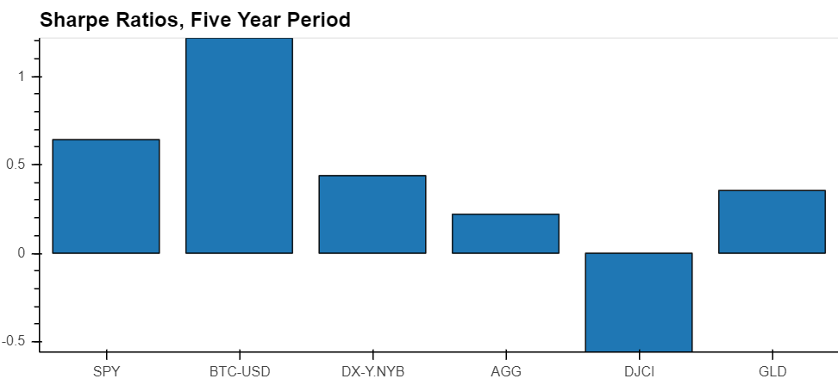
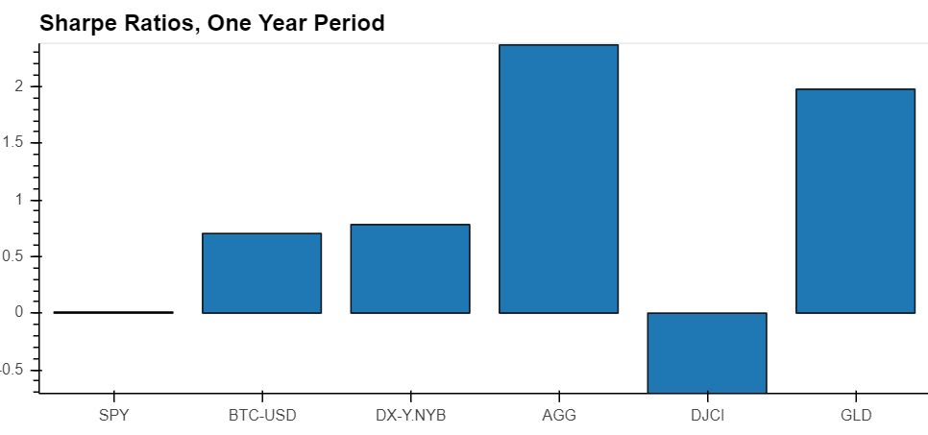
How does Bitcoin’s return and risk profile compare to other risky assets?

Slide 5
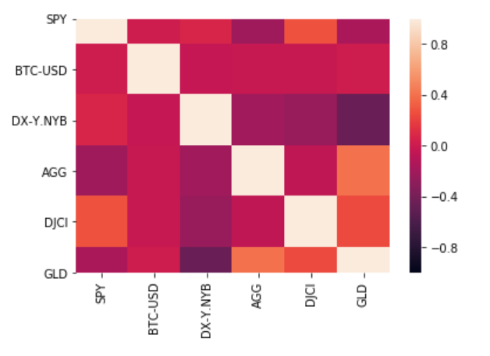
Is Bitcoin correlated with other asset classes, or is it an idiosyncratic risk factor?
Bitcoin effectively has no discernible correlation with the range of risky assets we selected and over any of the periods we selected. Bitcoin appears to be a unique idiosyncratic risk factor

Slide 6
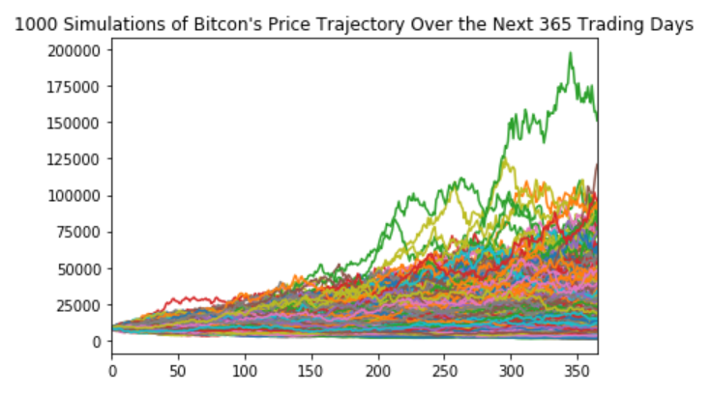
If Bitcoin’s daily trading history were to continue its pattern and purely price movements are a predictor of future results, what is Bitcoin’s expected forward return, and range of outcomes within a given confidence interval?
95% chance that an initial investment of $10,000 in Bitcoin will end within the range of $4,330.64 and $78,209.97
This would represent a 1-yr forward return as low as negative 56% and as high as positive 682%.

Slide 7
Factors that may affect investor sentiment on Bitcoin

