Slide 1

CryptoAnalyzer
Analysis on Bitcoin Trading History
Team 8

Slide 2
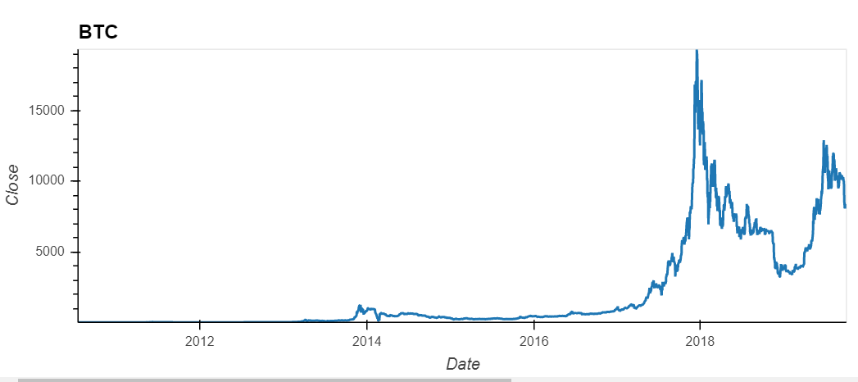

Does Bitcoin's trading prices behavior more closely resemble that of a risky asset class or currency?

Slide 3
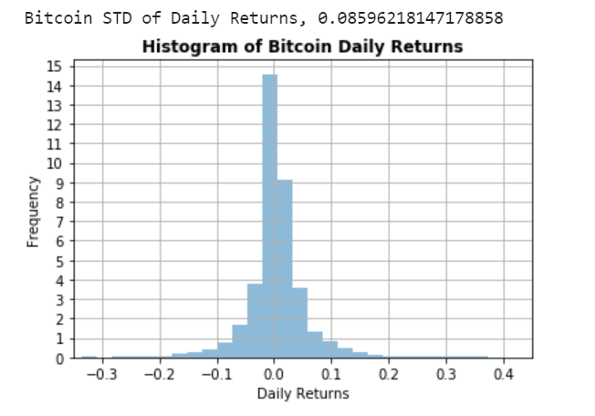
Is it possible to apply traditional statistical analysis used in analyzing financial security price data series to Bitcoin's trading history?

Slide 4
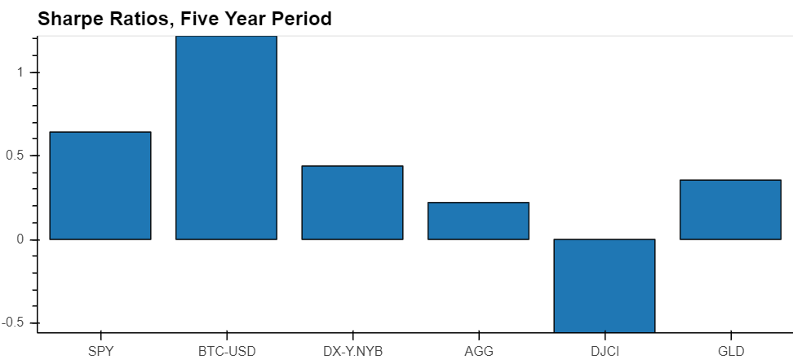
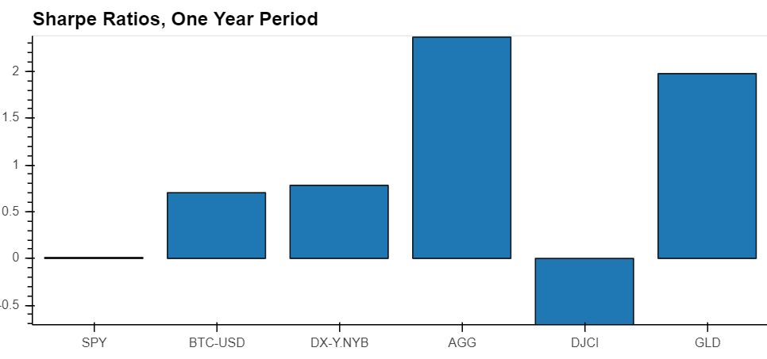
How does Bitcoin’s return and risk profile compare to other risky assets?

Slide 5
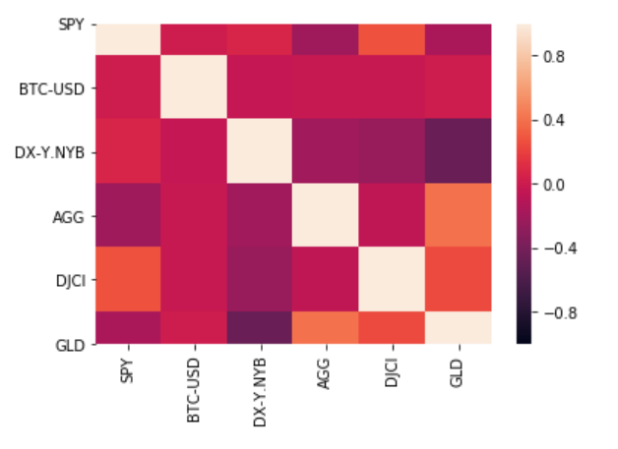
Is Bitcoin correlated with other asset classes, or is it an idiosyncratic risk factor?

Slide 6
If Bitcoin’s daily trading history were to continue its pattern and purely price movements are a predictor of future results, what is Bitcoin’s expected forward return, and range of outcomes within a given confidence interval?

Slide 7
Factors that may affect investor sentiment on Bitcoin

