Slide 1

CryptoAnalyzer
Analysis on Bitcoin Trading History
Team 8

Slide 2
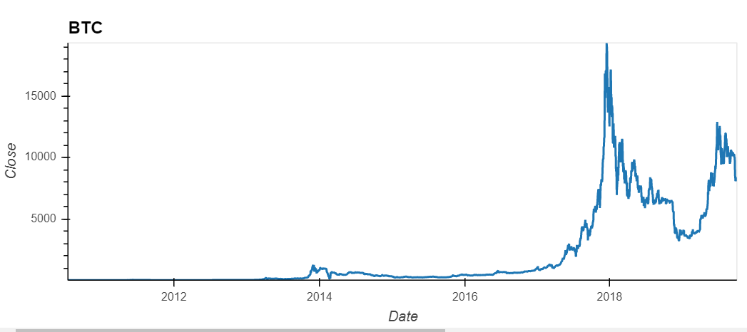

Does Bitcoin's trading prices behavior more closely resemble that of a risky asset class or currency?

Slide 3
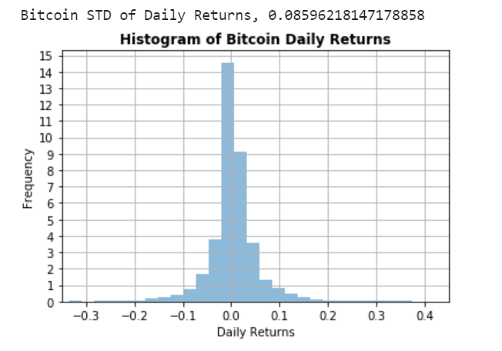
Is it possible to apply traditional statistical analysis used in analyzing financial security price data series to Bitcoin's trading history?
Based on the plot visual, we can assume Bitcoin follows a normal distribution and therefore, can be analyzed with traditional statistical analysis

Slide 4
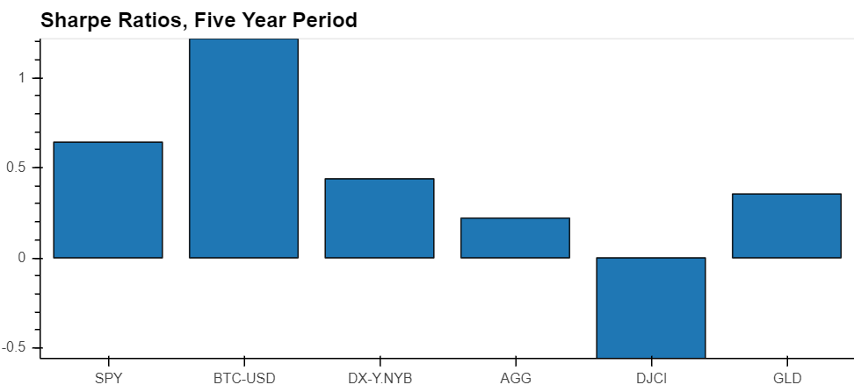
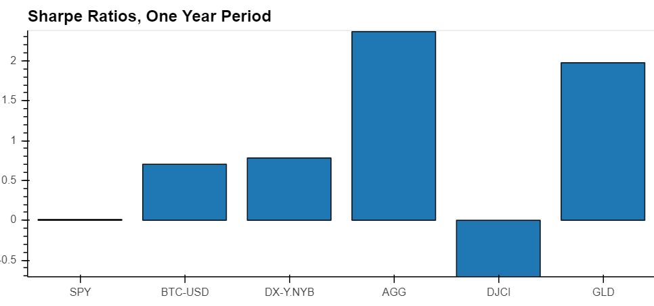
How does Bitcoin’s return and risk profile compare to other risky assets?

Slide 5
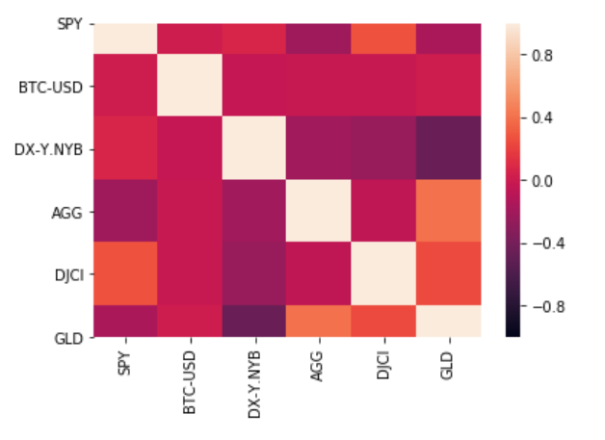
Is Bitcoin correlated with other asset classes, or is it an idiosyncratic risk factor?
Bitcoin effectively has no discernible correlation with the range of risky assets we selected and over any of the periods we selected. Bitcoin appears to be a unique idiosyncratic risk factor

Slide 6
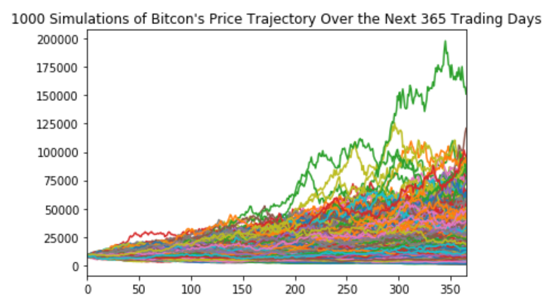
If Bitcoin’s daily trading history were to continue its pattern and purely price movements are a predictor of future results, what is Bitcoin’s expected forward return, and range of outcomes within a given confidence interval?
95% chance that an initial investment of $10,000 in Bitcoin will end within the range of $4,330.64 and $78,209.97
This would represent a 1-yr forward return as low as negative 56% and as high as positive 682%.

Slide 7
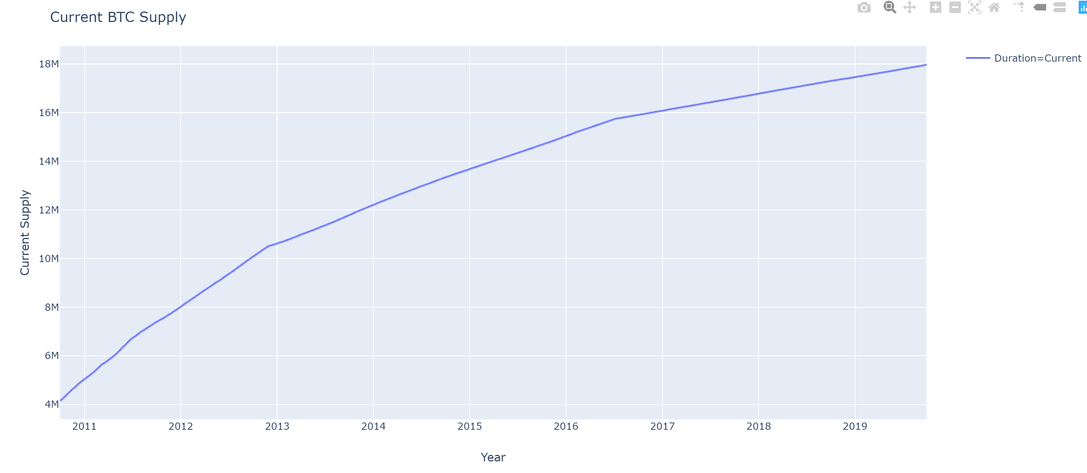
Factors that may affect investor sentiment on Bitcoin
Bitcoin supply is capped at 21 million, once it is reached no more bitcoin will be mined. As of January 2017 80 % of the supply is already available. Once the cap is reached then it's value will be determined on how popular and attractive other cryptocurrencies will be.

Slide 8
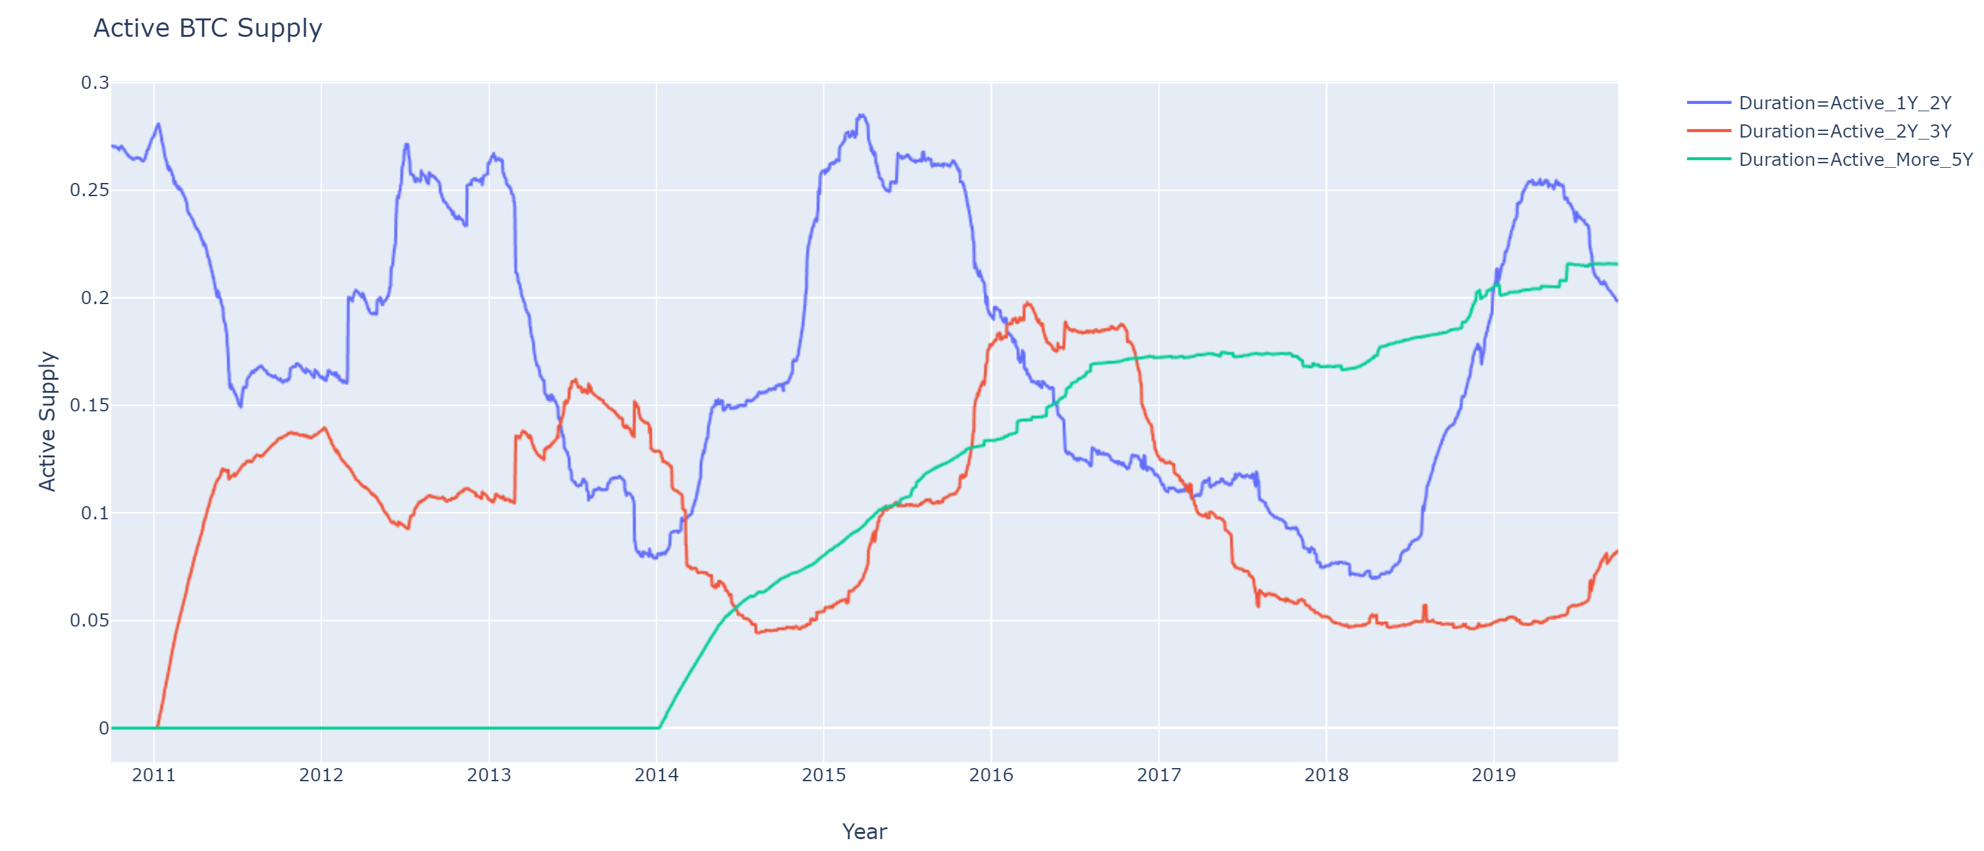
Factors that may affect investor sentiment on Bitcoin

Slide 9
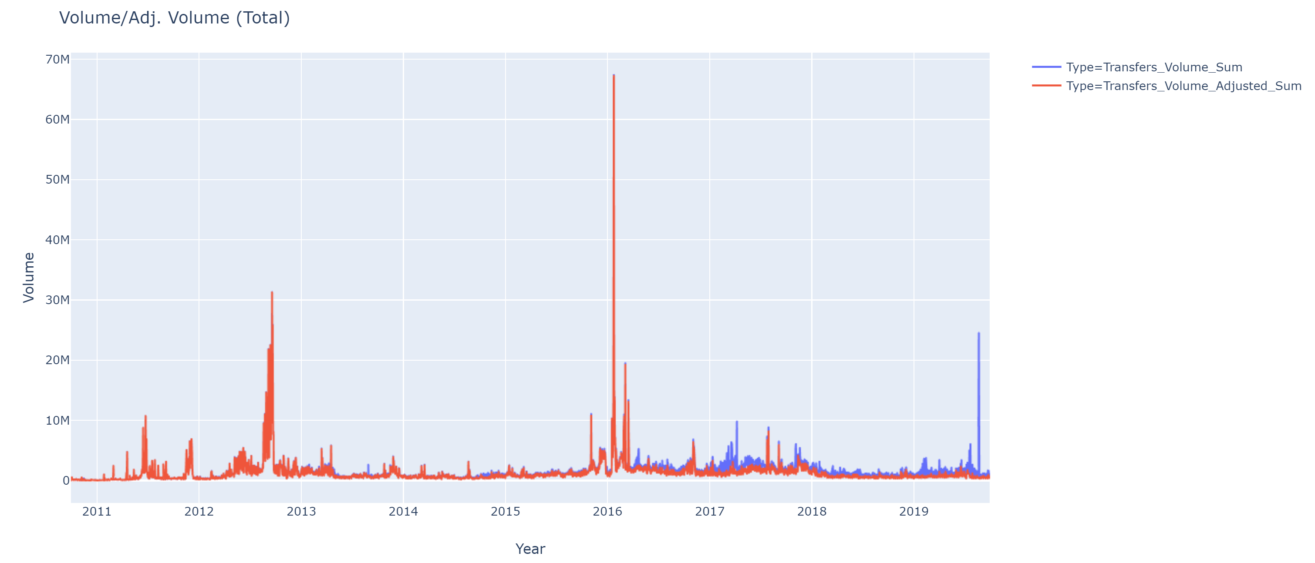
Factors that may affect investor sentiment on Bitcoin
The total amount of coins transferred on-chain.

Slide 10
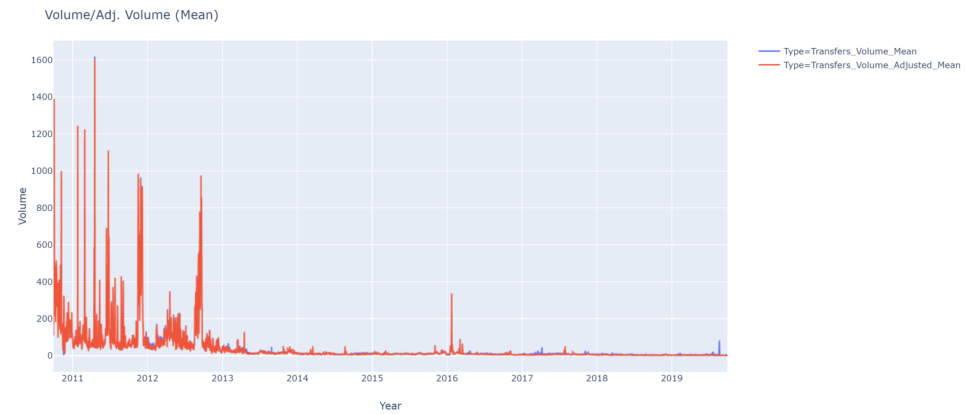
Factors that may affect investor sentiment on Bitcoin
The mean value of a transfer has diminished compared to early years.

Slide 11
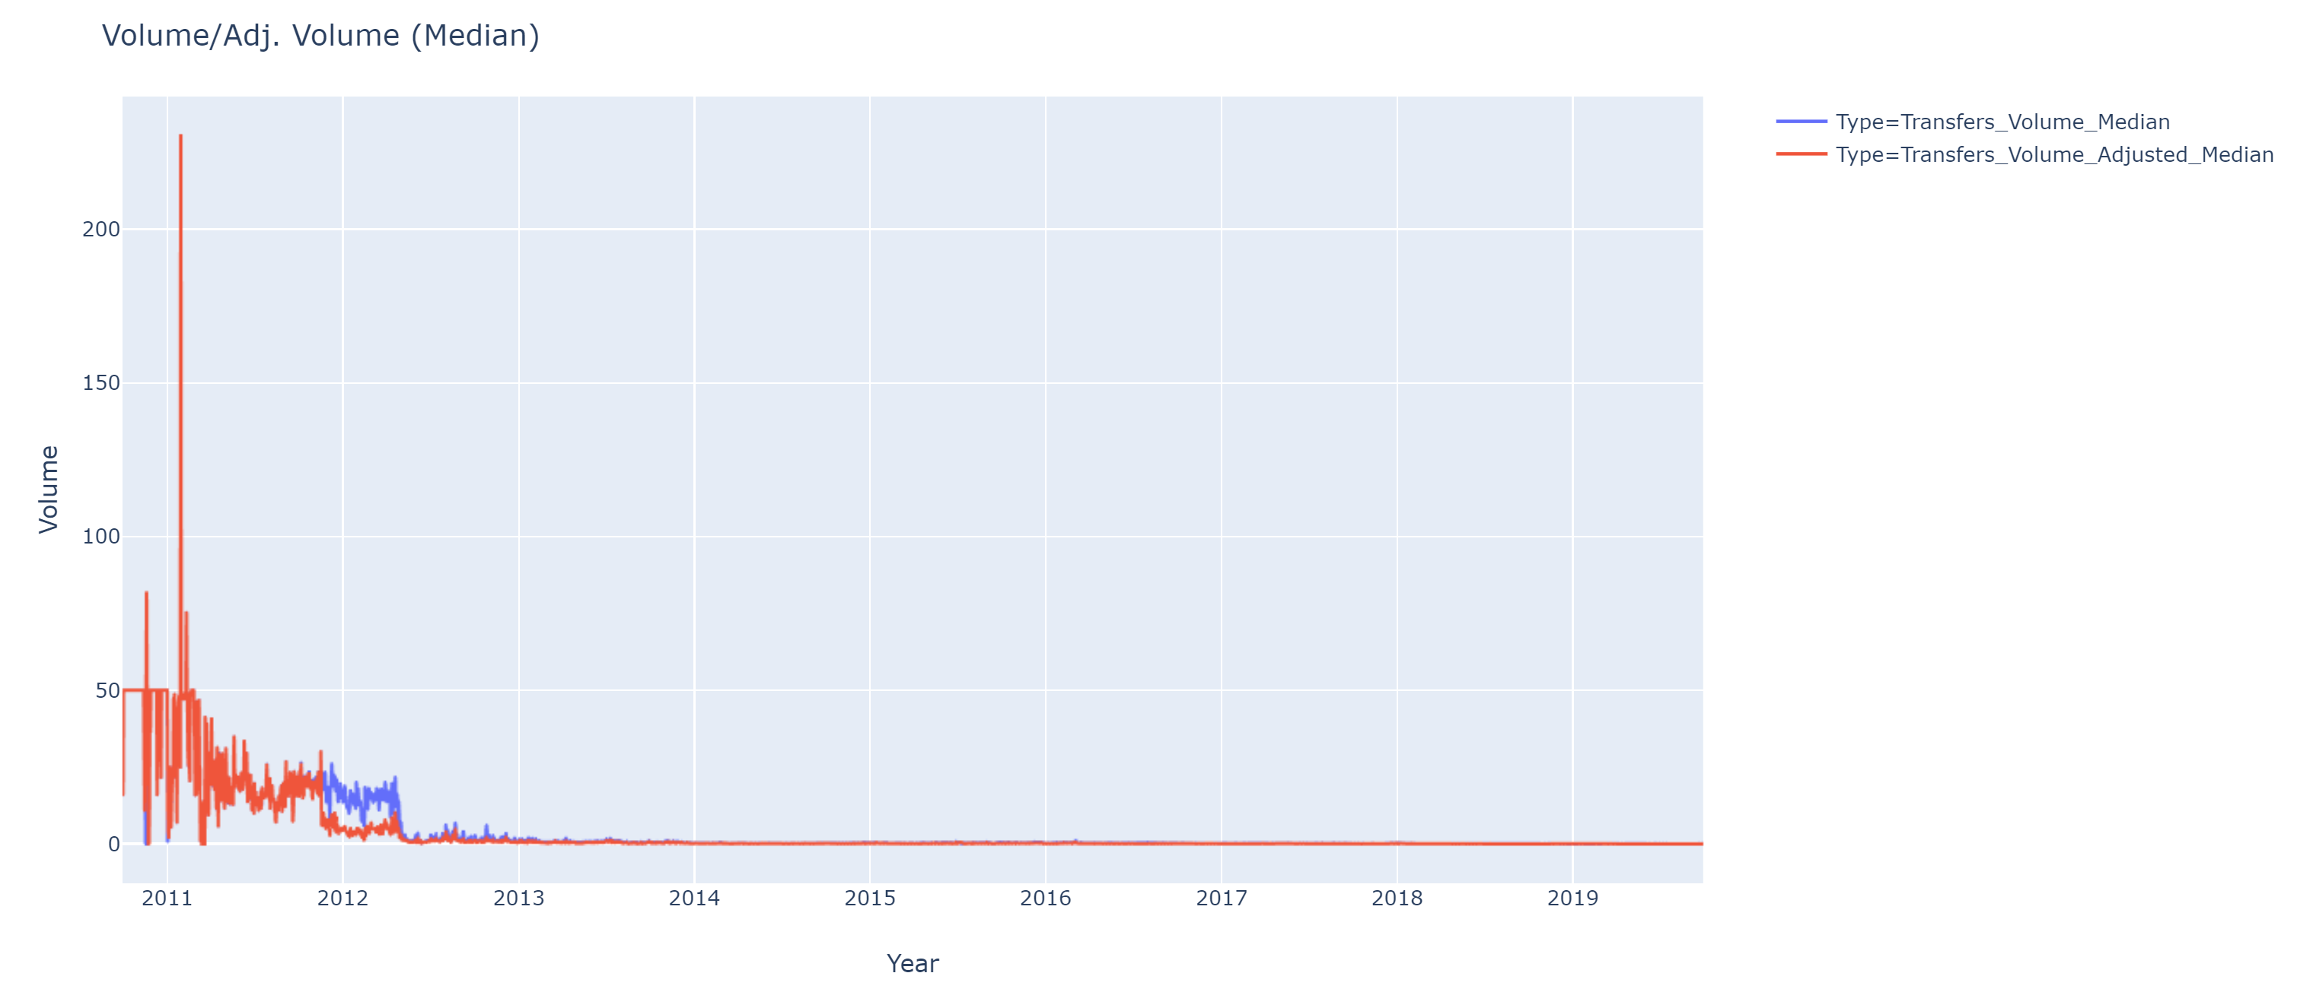
Factors that may affect investor sentiment on Bitcoin
The median value of a transfer.

Slide 12
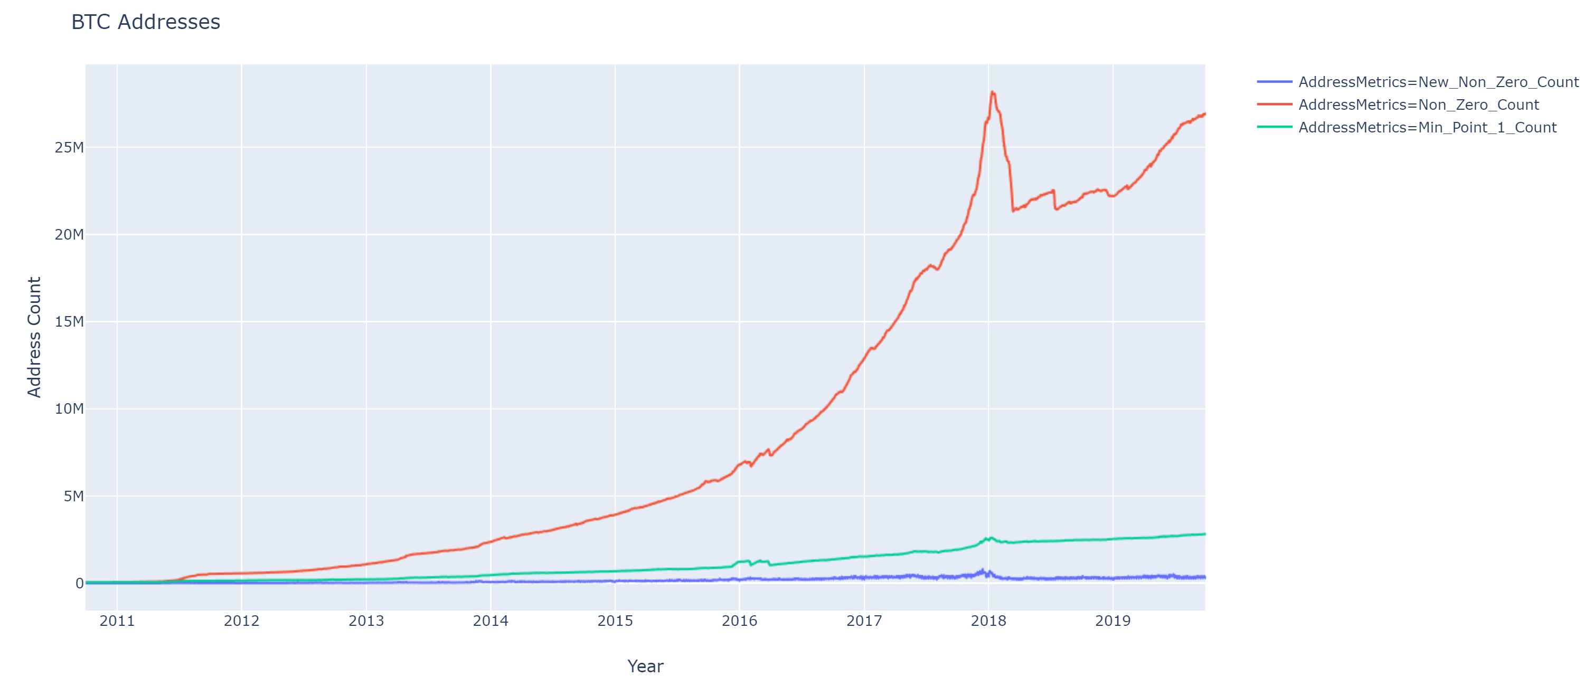
Factors that may affect investor sentiment on Bitcoin
Non-Zero_Count represents the number of unique non-zero addresses holding a positive (non-zero) amount of coins.
Min_Point_1_Coin represents the number of addresses that holds at least 0.1 coin.

Slide 13
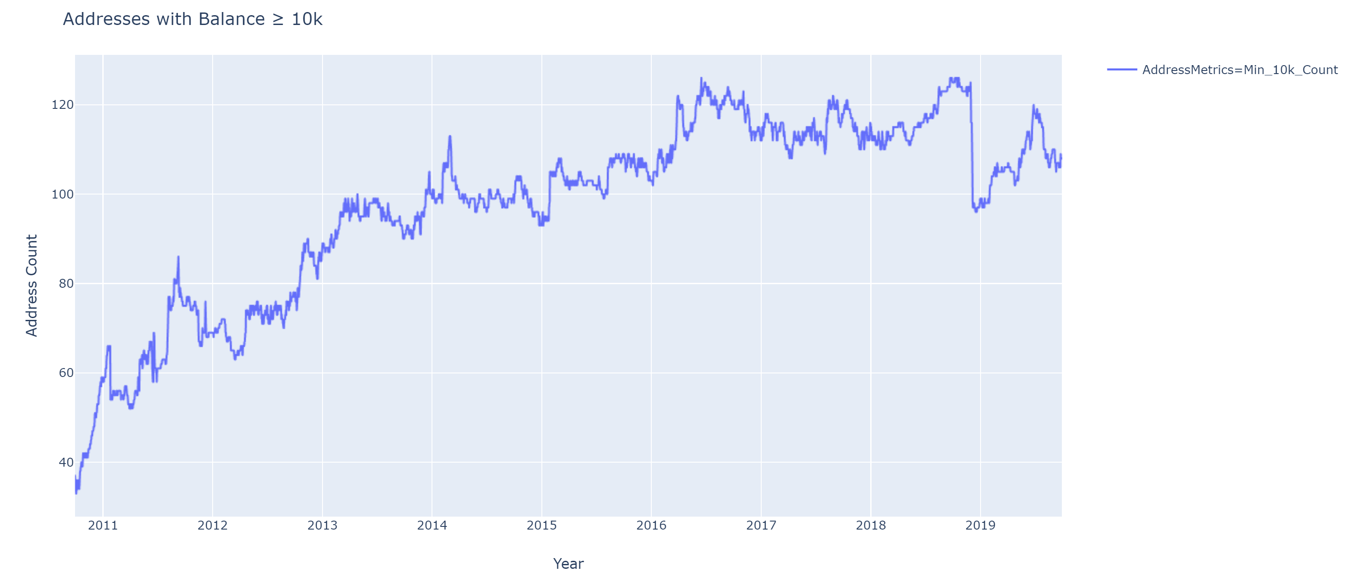
Factors that may affect investor sentiment on Bitcoin
Bitcoin addresses that holds at least 10,000 coins.

Slide 14
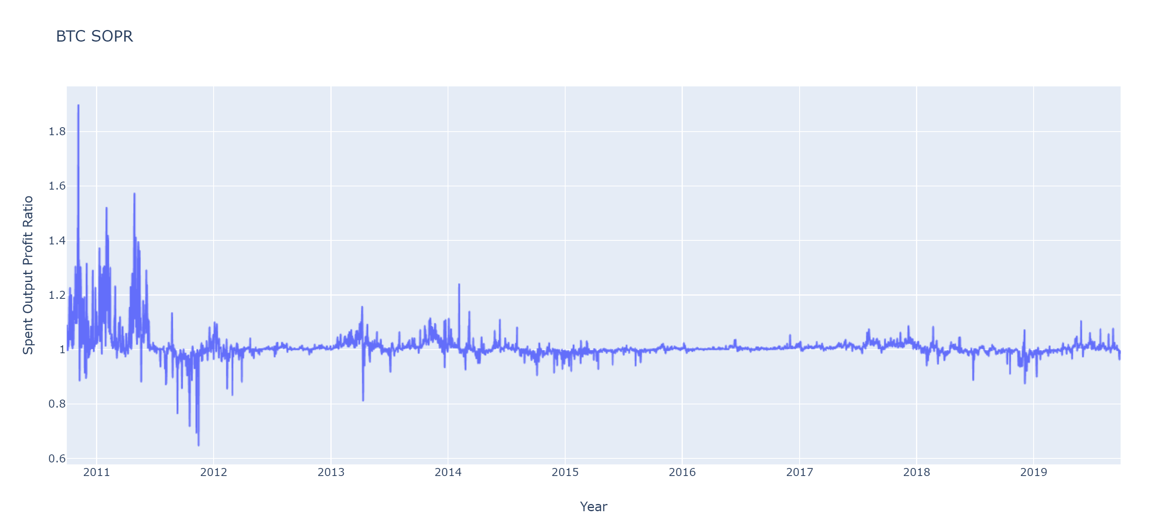
Factors that may affect investor sentiment on Bitcoin
The SOPR shows bitcoin’s price sold / price paid and it seems flat compared to 2010-2011

Slide 15
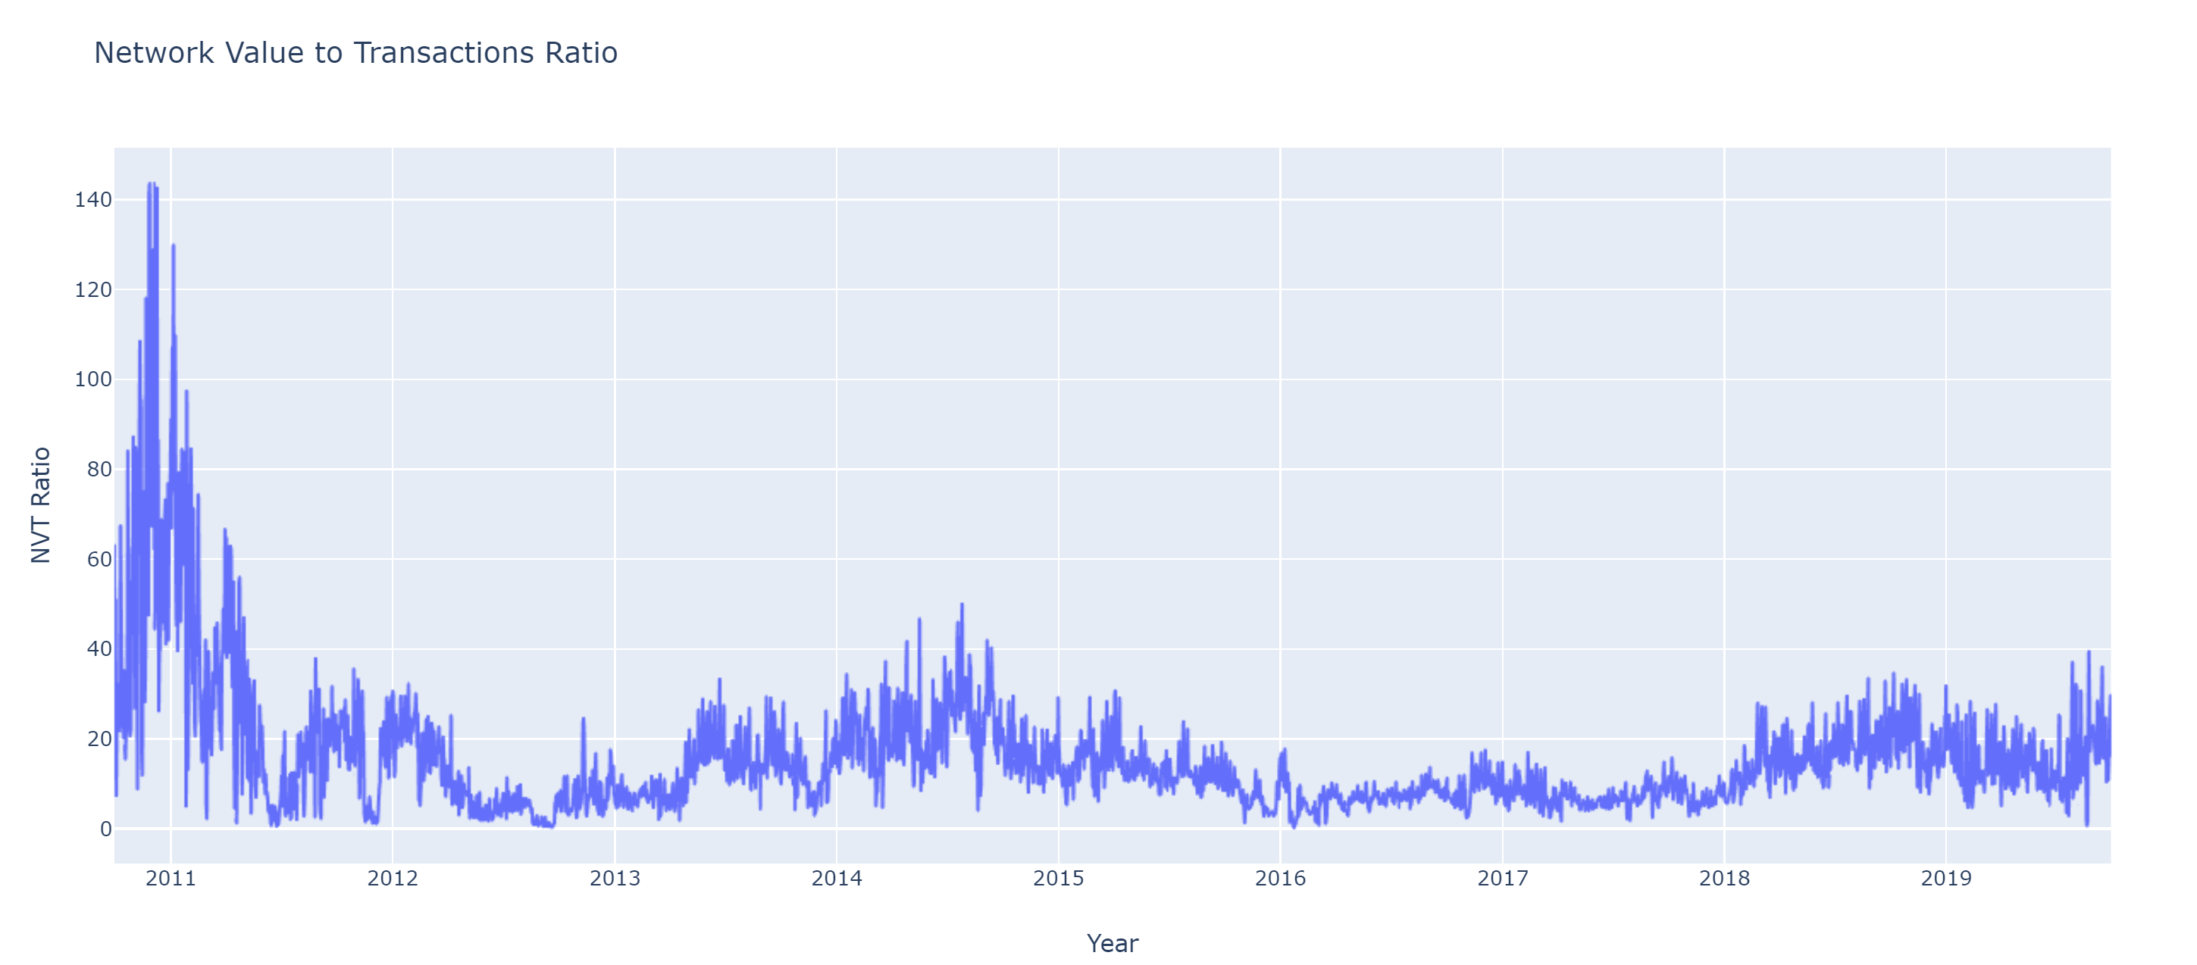
Factors that may affect investor sentiment on Bitcoin
The NVT Ratio is computed by dividing the market cap by the transferred on-chain volume measured in USD.

Slide 16
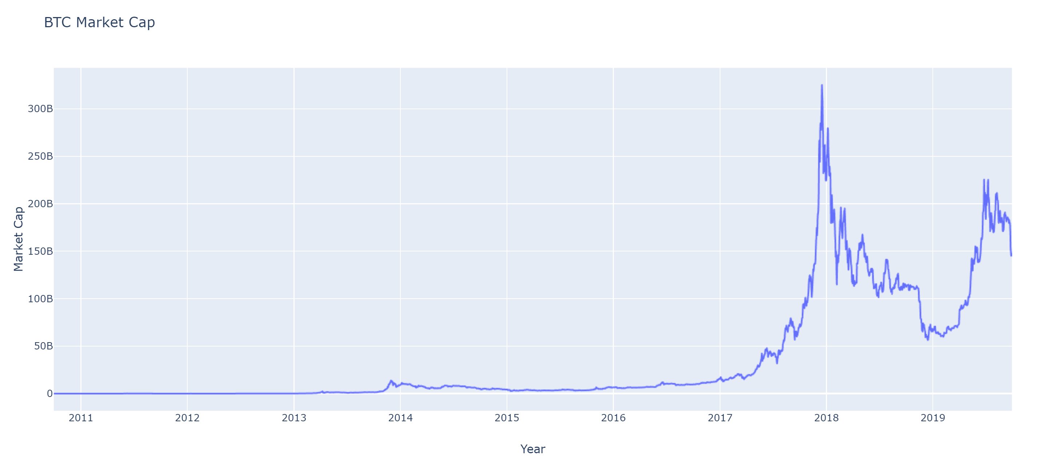
Factors that may affect investor sentiment on Bitcoin
The market capitalization (or network value) is defined as the product of the current supply by the current USD price.

