Slide 1
PORTFOLIO SELECTOR
ML driven sector specific portfolio selector

Slide 2
TABLE OF CONTENTS
Company Profile
Current Industry
Our Approach
Live Demo
Product Roadmap

Slide 3
COMPANY PROFILE
DRAFT
Notes: Intro to company and team (combination of business/finance/engineering/product)

Slide 4
CURRENT INDUSTRY
DRAFT
Notes: Current industry situation (No ML) and how things need to change

Slide 5
OUR APPROACH
DRAFT
Notes: How we are different. Opportunity to walk through data sources/process/notebook/results etc

Slide 6
LIVE DEMO
DRAFT
Notes: Product demo

Slide 7
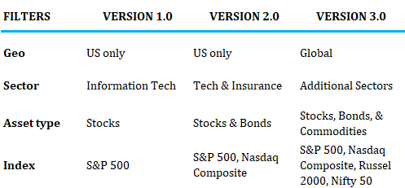
PRODUCT ROADMAP
DRAFT
Notes: Subscription based model

