Slide 1
Introduction to Git/Github
Zach Cobell
05/04/2017

Slide 2
Agenda
Why Git?
Introduction to Git
Moving from svn to git
Thinking in terms of git
Hands on session

Slide 3
Why Git?

Slide 4
Why Git?
Git developed by Linux author Linus Torvalds to manage Linux Kernel project
Found SVN/CVS to be clunky
Branching and merging was difficult
History not guaranteed
Very slow since all commands need server access
Could not work away from internet connection

Slide 5
Why Git?
Git has become the benchmark for code repositories
Because of its popularity, infrastructure has sprung up around it
Github – Centralized hosting services
Bug reporting
Pull Requests
Managed releases
TravisCI – Automated code building and testing (CircleCI, Codeship)
ZenHub – Project management integration
…and many, many more

Slide 6
Why Git?
Switching to Git allows ADCIRC development to take advantage of free services to create a more robust model
Code testing
Code review
Bug tracking
More ability to experiment

Slide 7
Moving from SVN to Git

Slide 8
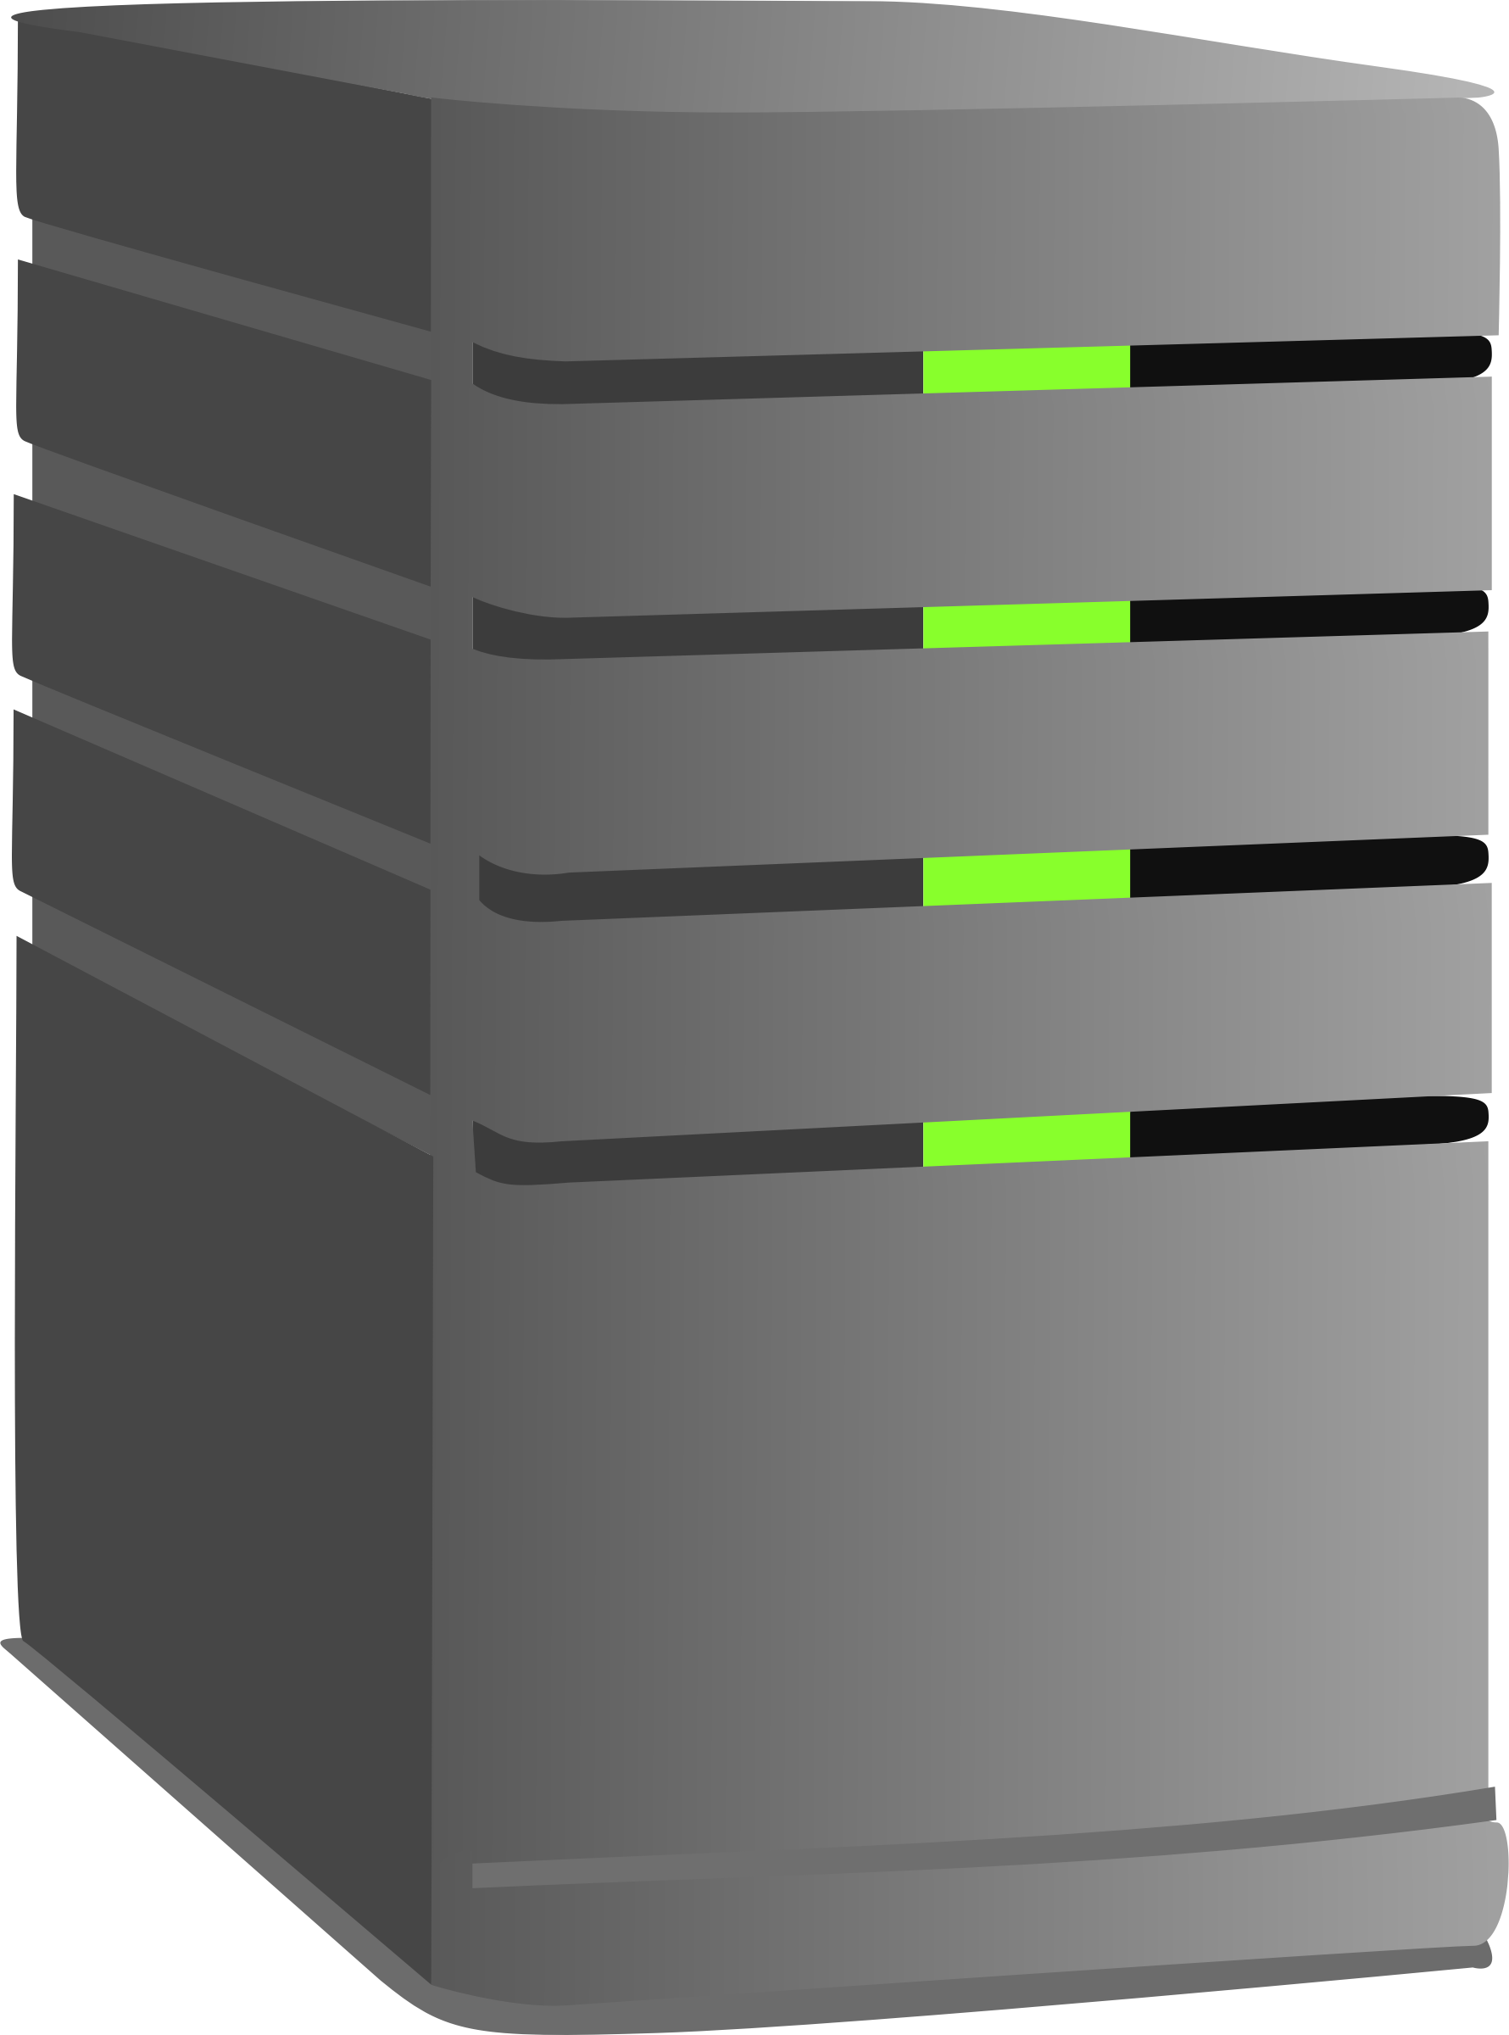

Moving from SVN to Git
SVN uses centralized server to manage commits
Work occurs on local machine and is committed to the server
Internet
svn commit

Slide 9
Moving from SVN to Git
SVN uses centralized server to manage commits
Work occurs on local machine and is committed to the server
Internet
svn update

Slide 10
Moving from SVN to Git
Internet

Slide 11
How is Git different?
Git is decentralized
Every user’s clone contains an entire copy of the repository and history
No centralized server needed unless collaboration is desired
You can create commits and branches without an internet connection
When collaborating, each user has entire copy of repository
Functions as n implicit backups
Allows full use of repository offline
Extremely fast since no remote server or internet required

Slide 12
How is Git different?
Everything in git is an object
A commit is an object
A file is an object
A branch is an object
This is where svn “thinking” breaks down. Train yourself to think of everything as objects moving between locations
Moving marbles analogy

Slide 13
How to obtain repository?
Repositories are obtained by “cloning”
git clone https://username@github.com/adcirc/adcirc-cg
The “cloned” repository is known as the origin
i.e. where the repository originated

Slide 14

How is Git different?
Local Machine
Staging Area
Local Repository
git add
git commit
git checkout

Slide 15
How is Git different?
Local Machine
read_input.F
timestep.F
Staging Area
Local Repository
git add
git commit
git checkout

Slide 16
How is Git different?
Local Machine
Staging Area
c
Local Repository
git add
git commit
git checkout

Slide 17
How is Git different?
Local Machine
Staging Area
Local Repository
git add
git commit
c
git checkout

Slide 18
How is Git different?
Local Machine
Remote Repository
Staging Area
Local Repository
git push
git pull
origin

Slide 19
How is Git different?
Local Machine
Remote Repository
Staging Area
Local Repository
c
git push
git pull
origin

Slide 20
How is Git different?
Local Machine
Remote Repository
Staging Area
c
Local Repository
c
git push
git pull
origin

Slide 21
How is Git different?
Remote Repository
Local Repository
c
git push
c
git pull
User 1
git push
git pull
origin
Local Repository
c
User 2

Slide 22
Why is Git Powerful?
Branching/Merging is an extremely simple operation
This tends to be ugly and complicated in SVN
Git is built to branch
Make tons of branches
Experiments
Tests
I wonder if…
It costs nearly nothing to make a new branch and merging is very, very simple and robust

Slide 23
Branching Workflow
HEAD
master
>> git clone https://github.com/adcirc/adcirc-cg

Slide 24
Branching Workflow
master
newfeature
HEAD
>> git branch newfeature
>> git checkout newfeature

Slide 25
Branching Workflow
master
newfeature
HEAD
>> git checkout –b newfeature

Slide 26
Branching Workflow
master
newfeature
HEAD
>> git commit

Slide 27
Branching Workflow
master
newfeature
HEAD
>> git commit

Slide 28
Branching Workflow
HEAD
master
newfeature
>> git checkout master

Slide 29
Branching Workflow
HEAD
master
newfeature
>> git merge newfeature

Slide 30
A More Realistic Branching Workflow
master
newfeature
HEAD
>> git commit

Slide 31
A More Realistic Branching Workflow
master
newfeature
HEAD
>> git pull

Slide 32
A More Realistic Branching Workflow
master
newfeature
HEAD
Note: If there are conflicts, like SVN, you’ll see them here and be asked to correct them
>> git merge master

Slide 33
A More Realistic Branching Workflow
master
newfeature
HEAD
>> git checkout master

Slide 34
A More Realistic Branching Workflow
master
newfeature
HEAD
Note: If there are conflicts, like SVN, you’ll see them here and be asked to correct them
>> git merge newfeature

Slide 35
What is a Rebase?
master
newfeature
HEAD
>> git pull

Slide 36
What is a Rebase?
master
newfeature
HEAD
Rebase changes the branch point and replays the work that occurred on your branch on top of the new “base”. This isn’t strictly necessary, but does make a cleaner history (i.e. no “merge” commits). Unless you’re comfortable with it, you can probably avoid rebasing in most cases.
Note: If there are conflicts, like SVN, you’ll see them here
>> git rebase master

Slide 37
What is a Tag?
HEAD
master
v51
v52
newfeature
A tag is just a label, like HEAD, applied to a commit. Labels are used by git describe and to find specific, meaningful, points in history
>> git tag v52 –m “Version 52”

Slide 38
What is a Tag?
HEAD
master
v51
v52
newfeature
A tag is just a label, like HEAD, applied to a commit. Labels are used by git describe and to find specific, meaningful, points in history
>> git tag v52 –m “Version 52”

Slide 39
But What is a Fork?
A fork is a personal copy of a repository
Forking is a single button procedure from the web interface on Github

Slide 40
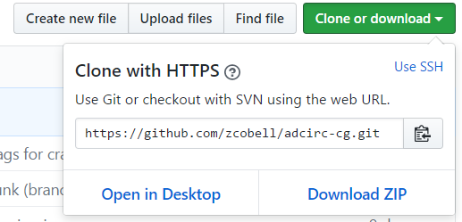
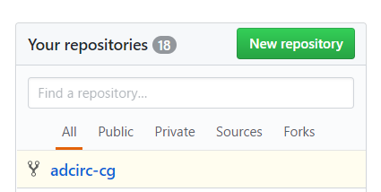
But What is a Fork?
After forking, you now have a custom repository URL on your Github account
Clone this repository
This is “origin”
The repository you forked from is “upstream”
git remote add upstream https://username@github.com/adcirc/adcirc-cg.git

Slide 41
How to obtain commits made to upstream?
Use fetch
git fetch upstream
Gets list of commits made to the upstream
git merge upstream/MyBranch
Merges commits made to upstream to your local repository
git push
Moves commits to origin

Slide 42
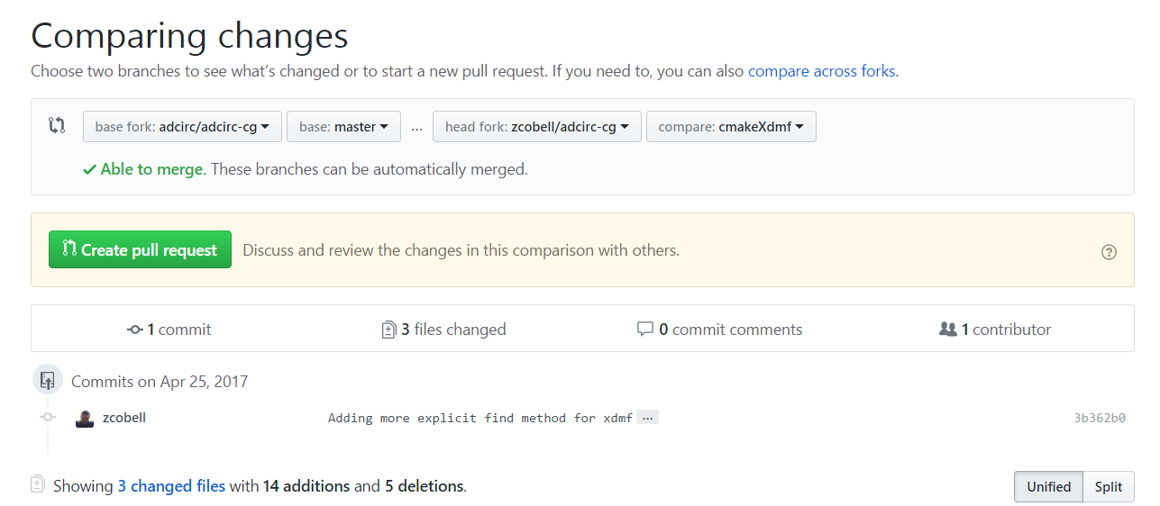
How to merge commits to upstream?
Use Pull Request
Pull requests are initiated from the web interface
Requests are reviewed by other developers and CircleCI build server before they can be merged

Slide 43
But What is a Fork?
GitHub
git push
origin
aka. My Fork
upstream
aka. Main Repository
Pull Request
Local Repository
git pull
git fetch

Slide 44
What is CircleCI?
CircleCI is a Continuous Integration (CI) server
Uses a set of commands to compile and run ADCIRC and ADCIRC+SWAN
A test suite is currently defined to perform checks to ensure solution does not change when a commit occurs

Slide 45
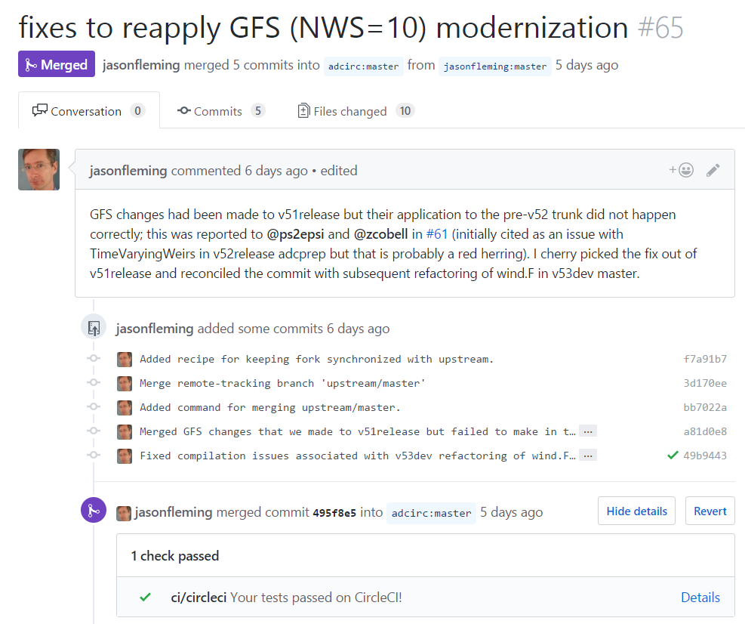
What is CircleCI?

Slide 46
CircleCI
We need more tests!
Current test suite runs 16 cases
Some take too long
We need more tests to exercise more of the code
Long tests need to be scaled back
Ideal test is < 5 minutes
Current test cycle time is 2 hours
Some tests take ~30 minutes
We need a better adccmp
Limited set of files that it can be used for
Cannot process netCDF or XDMF format output files

Slide 47
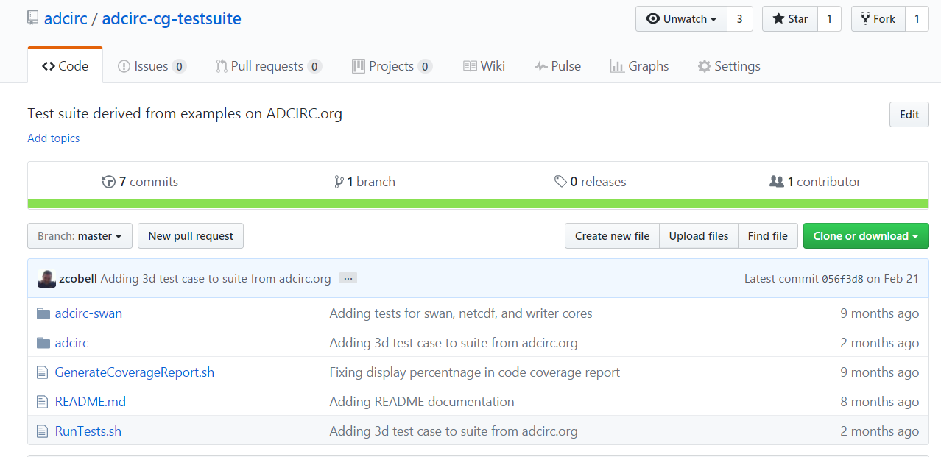
CircleCI
Tests are easy to add

Slide 48
CircleCI
Modify RunTests.sh with your new test

Slide 49
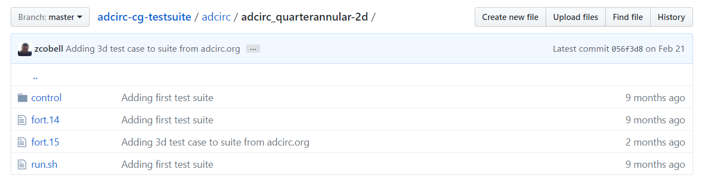
CircleCI
A template run.sh script should be used
A folder with the control solution for comparison should be included

Slide 50
Hands On Session
Hands on session will simulate workflow
Please fork the following:
https://github.com/zcobell/adcirc2017_sandbox.git

