Slide 1
Effects on NYC Public Transportation
Jennifer Kim

Slide 2
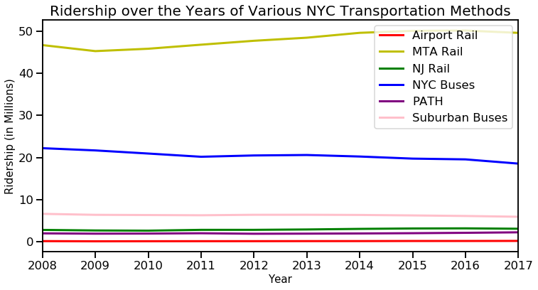
General Ridership over Years
Here we see that the NYC Buses and MTA Rail have the greatest use compared to the other four transportation methods.

Slide 3
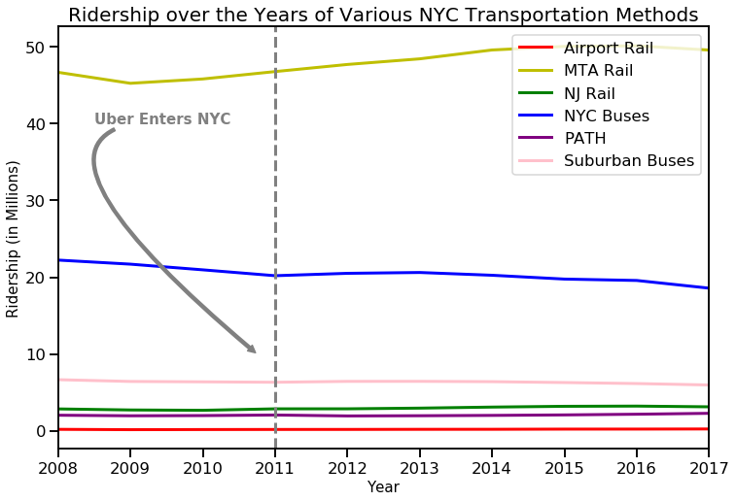
When Uber Enters
It seems as though there is no obvious change to the eye just by this graph.

Slide 4
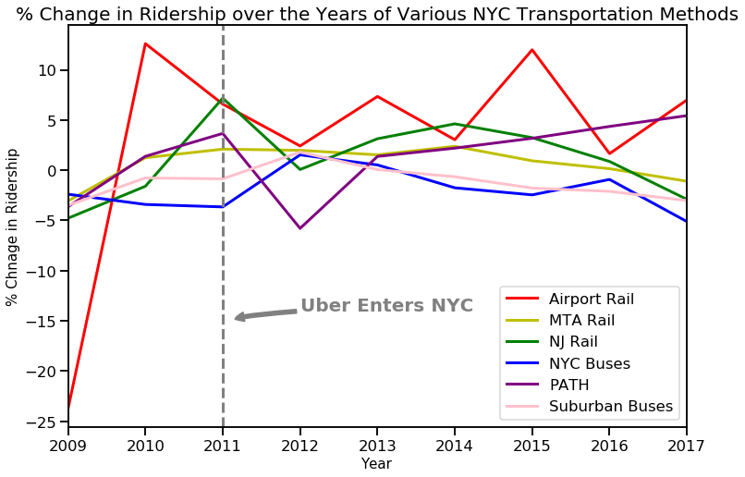
% Change in Ridership over the Years
It seems that immediately after, most transportation use went down, except for Suburban buses and NYC buses. Perhaps this is because those who ride buses are usually those who do not have the means to pay for a private car.
Overall, it looks as though the Airport Rail is the most volatile, while others, especially the NYC buses, MTA rail, and suburban buses usage stay pretty constant.
However, we cannot draw any real conclusions from this and still do not know if the changes are significant.

Slide 5
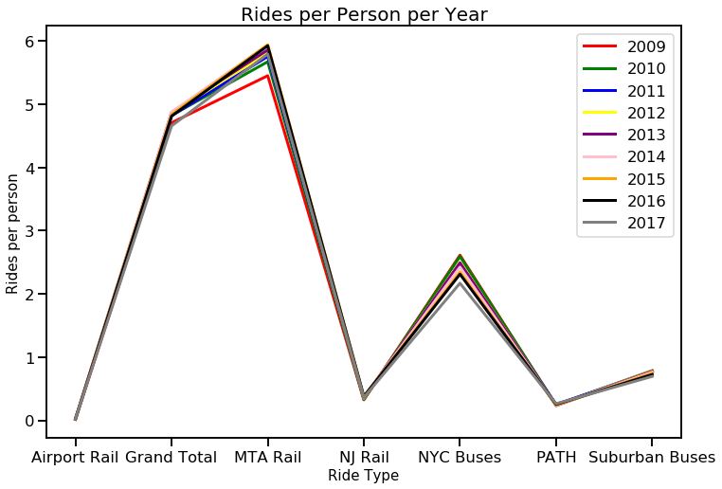
Rides per person per year for each type
To take away effects of people moving in and out of the city, we can take into account changes in population. Recently, there has been a decrease in population due to a migration of people outside of cities. We can see if that applies here by graphing ridership per person in Manhattan.
We can see that ridership per person appears to be constant over the years. Since these methods of transportation go in and out of the city and into the suburbs, it appears that maybe migration to the suburbs over the years hasn't affected public transport use.

Slide 6
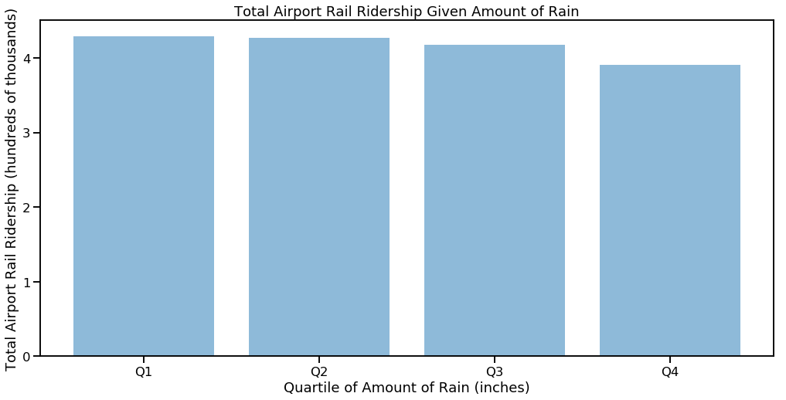
Ridership and Weather: Airport Rail with Precipitation
Moving on from the effects of Uber and population, I was also interested in seeing how the weather, or more specifically, the amount of precipitation and snowfall, affects ridership.
First, since airport rail ridership seems to be the most volatile, I want to see how this category's ridership has been affected by the amount of precipitation.
It appears that airport ridership does seem to decrease with more rain. It would be interesting to see how all the transportation types are affected with both rain and snow.
A bar graph isn't very telling of significance; let's look at some regressions.

Slide 7
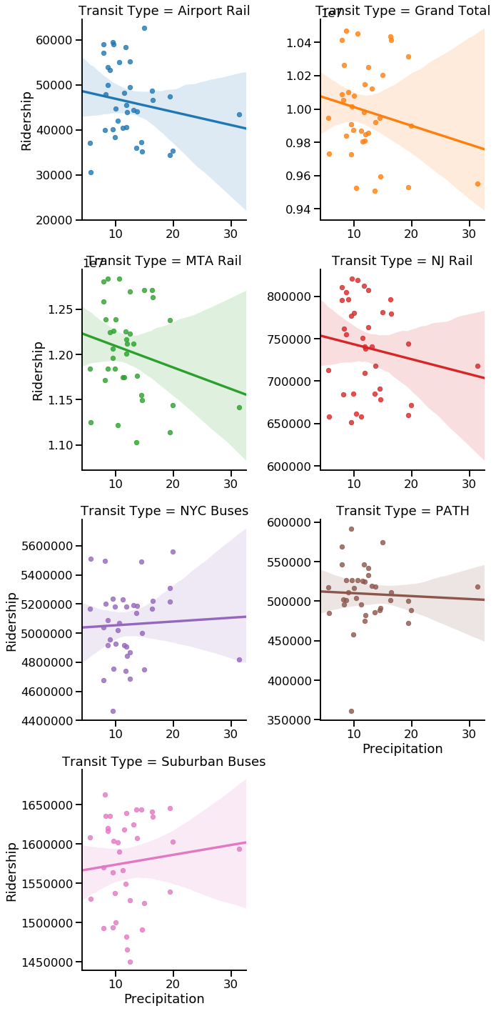
Regression of Ridership with Rainfall
These are graphs of how ridership is affected by rainfall. In general, transportation seems to decrease with increased rain; however, there are some exceptions, including both buses and the PATH.
But in general, we see that the Grand Total decreases with an increase in rainfall, suggesting public transportation use goes down with more rain (although this may be heavily influenced by MTA rail, which has the highest use).
In addition, the shaded region indicates confidence interval. We see that the confidence interval is very wide especially as the amount of rainfall increases, so this conclusion must not be taken as fact.

Slide 8
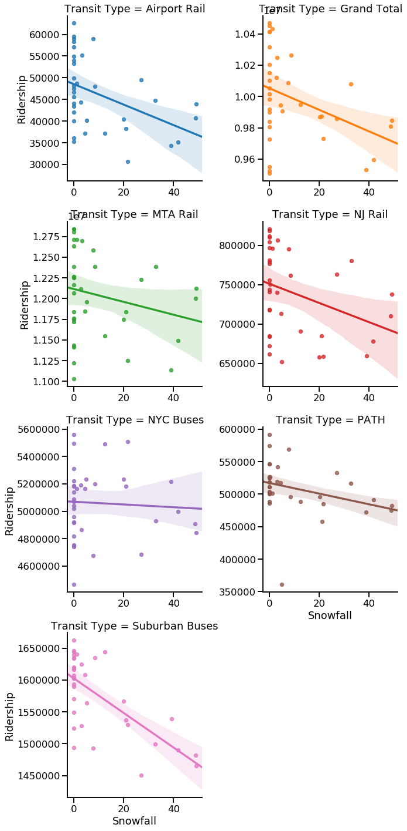
Regression of Ridership with Snowfall
Here, we see that snow seems to affect transit more than rain. All the categories of transportation have downwards sloping regression lines, and the confidence intervals are significantly narrower. This seems to confirm what we already know: snowfall means we do not want to get out of the house, let alone take public transportation.

Slide 9
Conclusion
This project set out to answer the question: What effects ridership of NYC Public Transportation?
We looked at Uber, population, and weather.
Becuase Uber does not release any large amounts of their data on ridership, it is hard to draw conclusions on what happened to public transportation based on just their date of entrance.
We then looked at population. It seems that all the transportation types are affected by population changes equally over the years.
Finally, we looked at weather data. This is where we could really draw some conclusions. We saw that both rainfall and snowfall affects ridership, but snowfall more so, as there are strong correlations between the amount of snow and decrease in ridership across all the transportation categories. This is likely because of the presence of snow days, which means public transportation also shuts down.

