Slide 1



Pardot Email Performance
Last 2 Weeks
July 3 - July 17, 2026 | Prepared for MOPS | Generated 2026-07-18

Slide 2
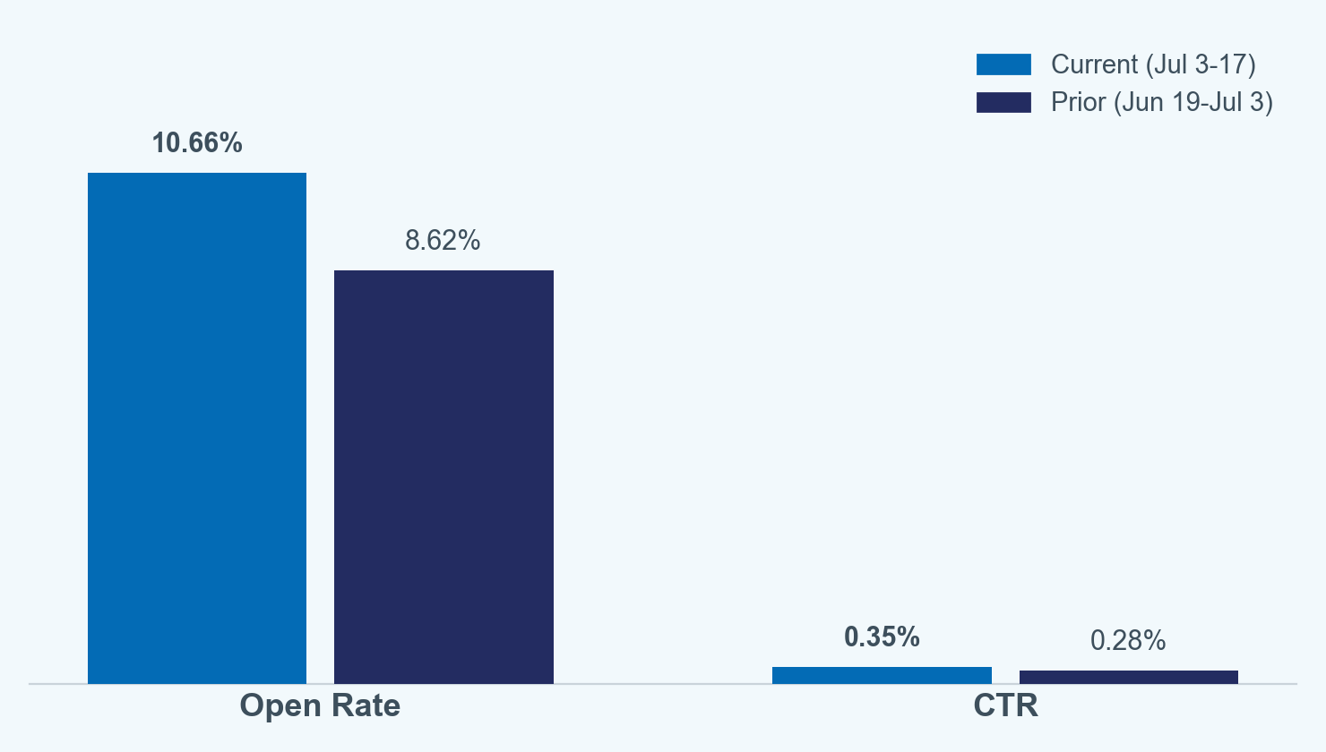
CORE METRICS
Email Performance - Jul 3-17, 2026
Open rate rose 2.0 pts to 10.7% on 27% less send volume than the prior two weeks.
- Total delivered: 24,491 (vs 33,680 prior, -27.3%). Unique opens: 2,610 (vs 2,904 prior, -10.1%).
- Delivery rate is not computable this run - Salesforce's NumberSent field is unsynced from Pardot org-wide (SUM(NumberSent) = 0).
- 9 campaigns delivered this window vs. 6 in the prior two weeks - fewer, more targeted sends drove the higher rate, not a broader blast.
- 2-week windows carry real volatility - a single large send (60% of this window's volume) can swing the blended rate.
Open rate = unique opens / delivered. CTR = unique clicks / delivered. Source: Salesforce Campaign SOQL, queried 2026-07-17.

Slide 3
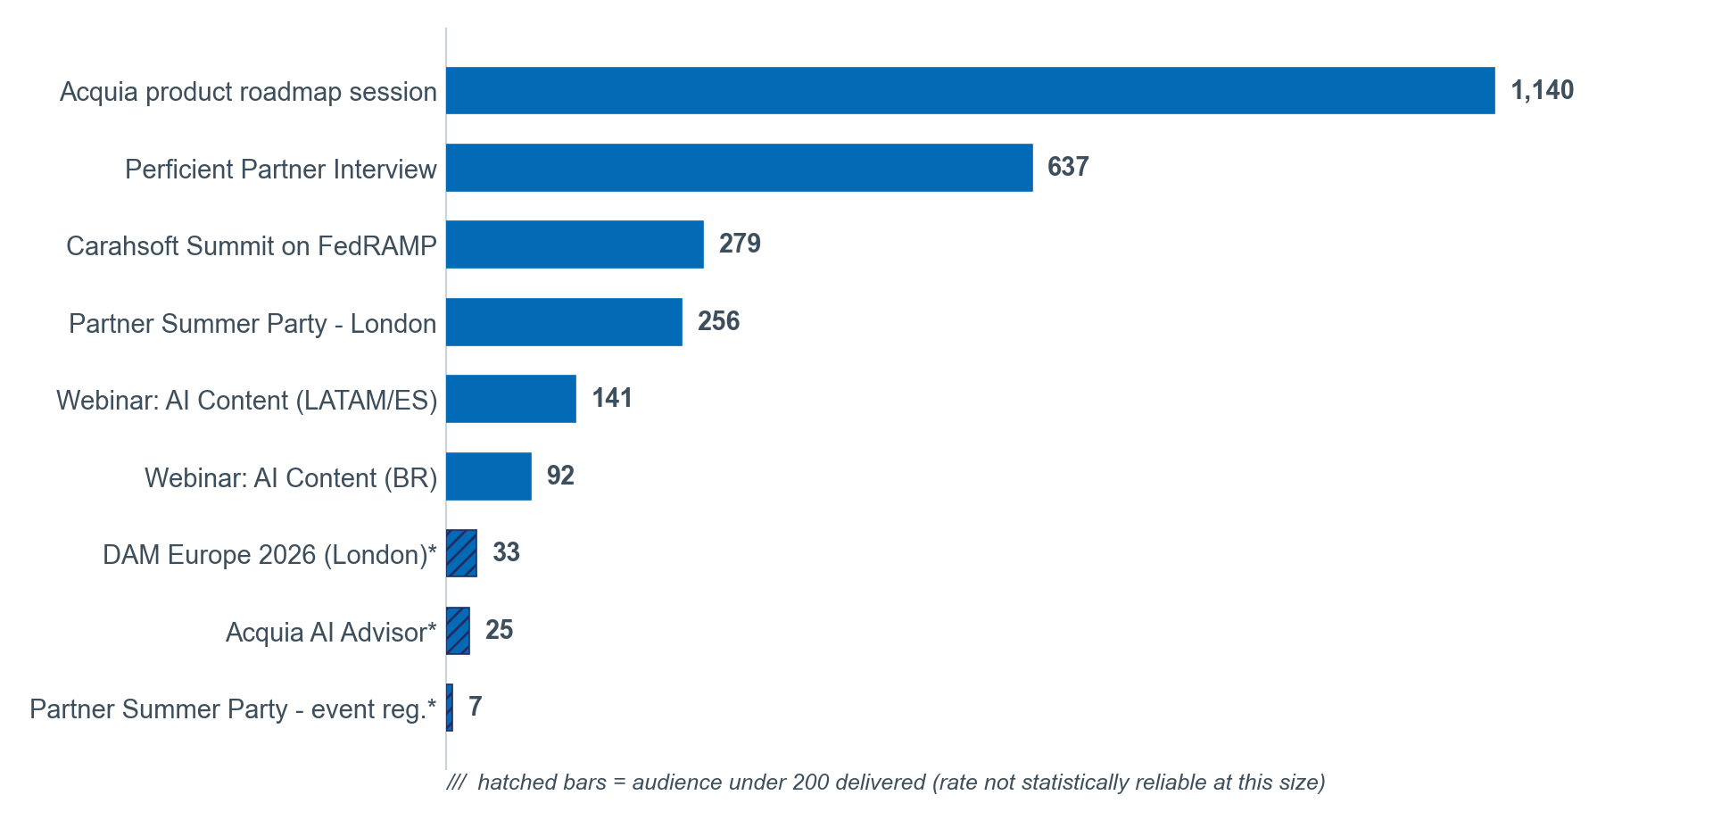
TOP PERFORMING EMAILS
Ranked by Unique Opens
The Q3 product-roadmap session alone drove 1,140 opens - 44% of all opens in the window.
- Ranked by absolute unique opens per this run's request, not CTR (the skill's default lens).
- 3 sends (hatched) had fewer than 200 recipients - high rates there aren't statistically reliable.
- Subject lines aren't synced to Salesforce - campaign name used as a labeled proxy.
Source: Salesforce Campaign SOQL (TotalEmailsDelivered, UniqueEmailOpens), queried 2026-07-17.

Slide 4
NAMING PATTERN ANALYSIS
What Drove Opens (Campaign-Name Proxy)
The single highest open RATE came from a named partner interview send, not the largest blast.
What Worked This Window
Recommendations for Next Cycle
- Perficient Partner Interview: 37.4% open rate, the standout, at real volume (1,702 delivered)
- Largest send (roadmap session, 60% of volume) had the LOWEST open rate (7.79%)
- Event/webinar-titled sends cluster in a 7.7-12.5% band - steady, not exceptional
- 3 small-audience sends (<200) showed 28-64% rates - directionally interesting, not reliable
- Segment the next large/broad send instead of one blast to the full list
- Test more 1:1/interview-styled subject framing on mid-size sends (1,000-2,000 recipients)
- Add subject-line sync to Salesforce - this analysis is a campaign-name proxy today

Slide 5
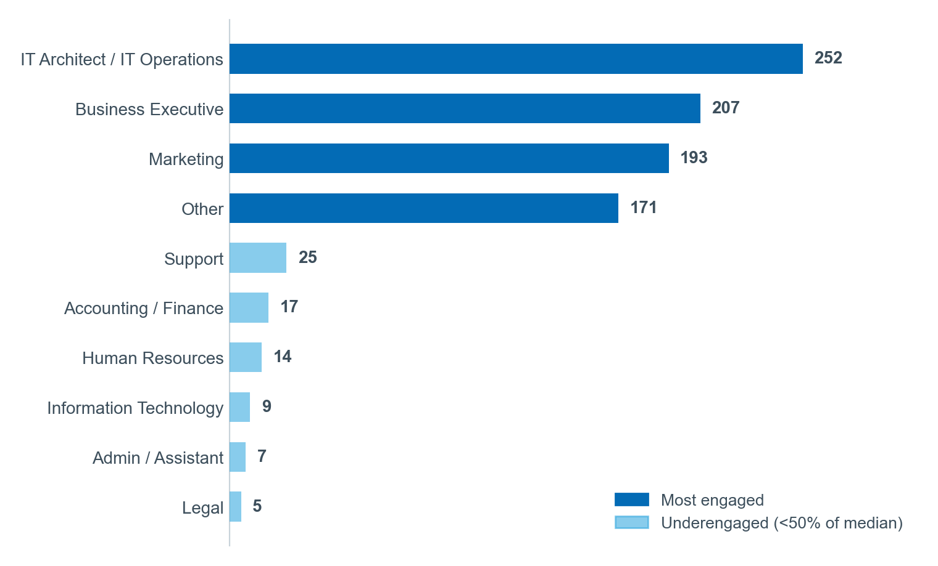
PERSONA ENGAGEMENT
Prospect vs. Customer, by Job Function
Engagement this window skews heavily to existing Contacts (79%) over net-new Leads (21%).
- 2,473 synced members (~10.1% of 24,491 delivered) - Lead (Prospect) 527 / 21%, Contact (Customer) 1,946 / 79%.
- "Underengaged" = below 50% of portfolio median (median 57).
- 1,042 of 2,473 members (42%) have no Job Function on file - the single biggest data gap.
CampaignMember syncs only the responder-biased ~10% of delivered volume - within-sample volumes, not true per-persona rates. Field: Job_Function__c, confirmed 2026-07-17.

Slide 6
TAKEAWAYS
Recommendations for the Next Two Weeks
Five prioritized actions, each tied to a number from this window.
- Segment the next large/broad send - the roadmap-session send (60% of volume) pulled the lowest open rate (7.8% vs. 10.7% average).
- Replicate the Perficient Partner Interview pattern (37.4% open rate) for Marketing/Sales next cycle.
- Backfill Job_Function__c for the 42% of synced members missing it.
- Increase prospect-targeted (Lead) sends - engaged audience skews 79% existing Contacts vs. 21% net-new Leads.
- Add subject-line sync to Salesforce - naming-pattern findings rely on a campaign-name proxy today.
Methodology: 2-week window (2026-07-03 to 2026-07-17), 9 campaigns, 2,473 synced CampaignMembers. Small samples mean directional hypotheses, not final conclusions. Source: Salesforce SOQL, queried 2026-07-17.

