Slide 1



Pardot Email Performance - Q2 2026
Quarterly email engagement review · April 1 - June 1, 2026
Generated July 18, 2026 · Data: Pardot (Account Engagement) connected-campaign metrics via Salesforce · 56 in-scope sends

Slide 2
CORE METRICS
Email Performance · Q2 2026
Send volume fell 22% quarter-over-quarter and click-through halved - Q2's problem is engagement quality, not just scale.
1.01M
8.2%
0.50%
n/a
▼ 22.5% QoQ
▼ 0.5 pt QoQ
▼ 0.64 pt QoQ
no data
emails delivered (56 sends · 49 programs)
unique open rate
click-through rate (unique clicks / delivered)
delivery rate - total-sent not synced from Pardot
What moved
- Opens held roughly steady (8.75% → 8.24%) while clicks collapsed (1.13% → 0.50%): recipients still open, but content isn't converting attention into action.
- One send - the 565K-recipient DAM governance blast - was 56% of all Q2 volume at 7.0% open / 0.45% CTR, dragging the portfolio average down.
- Q1's CTR was lifted by early Engage-invite sends to fresh lists; by Q2 the same lists were on their 8th-9th touch (see slide 4).
Definitions: open rate = unique opens/delivered; CTR = unique clicks/delivered; delivery rate = delivered/total sent (unavailable - Pardot doesn't sync NumberSent). QoQ compares Q1 window Jan 1-Mar 1, 2026 (50 sends, 1.30M delivered). Opens inflated by Apple Mail Privacy Protection; treat CTR as the reliable signal. Excluded: 3 seed/test sends (<10 recipients) and operational campaigns.

Slide 3
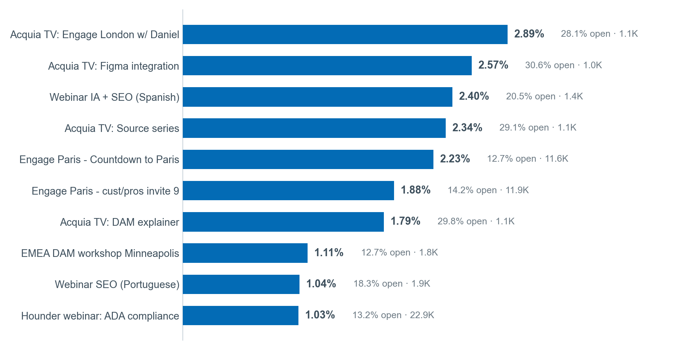
TOP PERFORMING EMAILS
Ranked by Click-Through Rate
Acquia TV content episodes and event-countdown emails earned 1.8-2.9% CTR - four to six times the portfolio average of 0.5%.
Small-sample standouts
- Excluded from ranking (n < 200): registrant logistics emails - "see you tomorrow" 23.8% CTR, "see you next week" 17.6% CTR - tiny engaged audiences, but proof late-stage logistics content clicks.
Product mix (top 10)
- 5x Acquia Source content · 4x DXP events/webinars · 1x Content Cloud (DAM)
Ranked by CTR (primary) with open rate secondary; volume floor 1,000 delivered. Value labels: CTR · open rate · audience size. Source: Salesforce Campaign Pardot rollups, queried 2026-07-18.

Slide 4
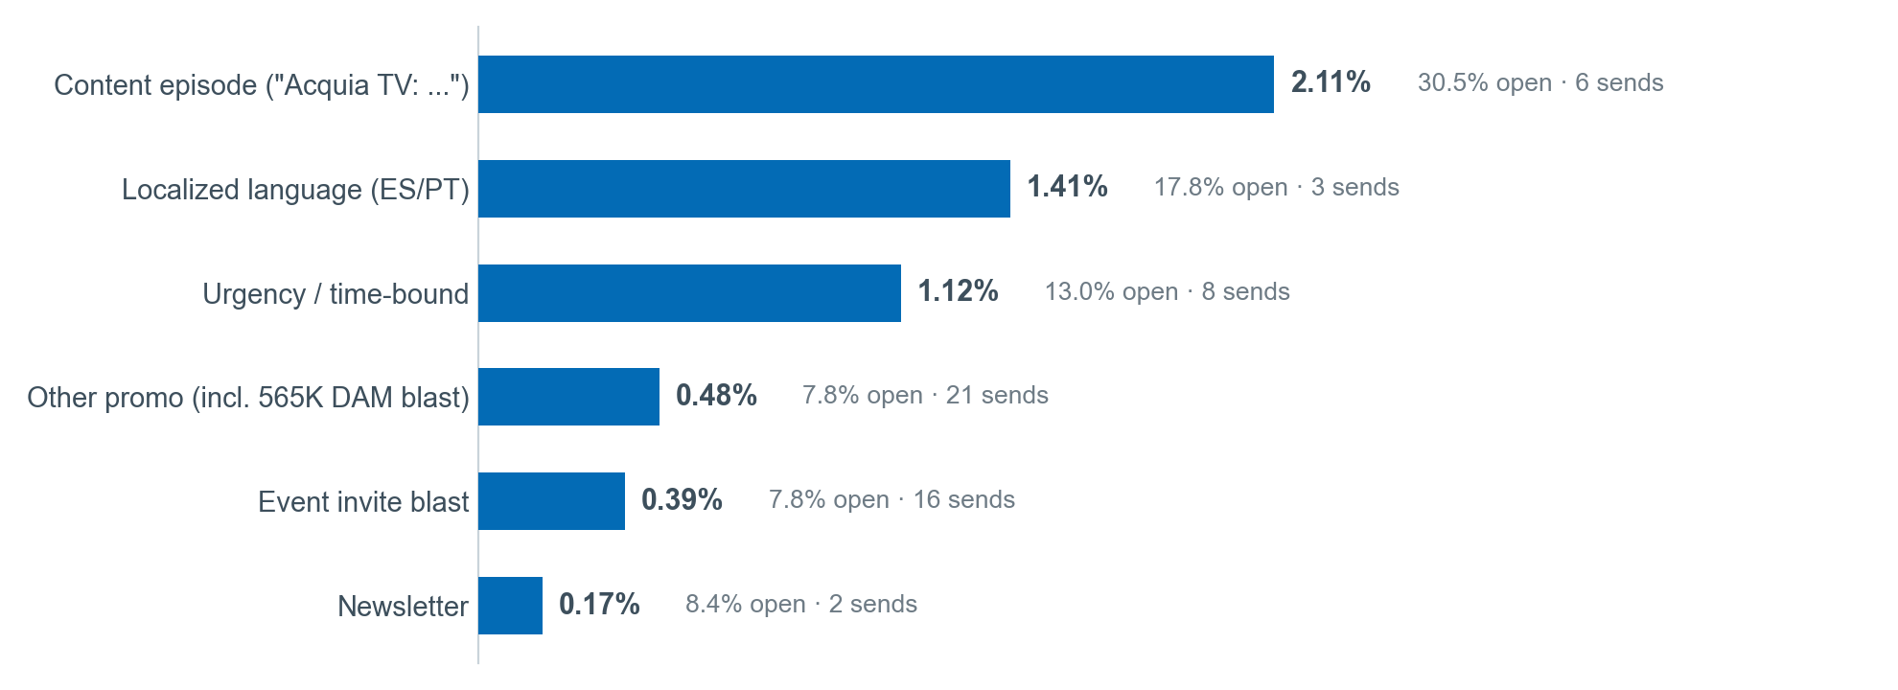
SUBJECT-LINE PATTERNS
What Drove Clicks (Campaign-Name Proxy)
Time-bound, localized, and content-first framing beat generic invite blasts by 3-5x on click-through.
Testable recommendations for Q3
- 1. Lead with the content, not the ask: "episode/insight" framing hit 30.5% open vs 7.8% for invite framing - A/B a content-first subject on every event promo.
- 2. Add a concrete time anchor to final event touches ("Countdown to Paris" 2.23% CTR vs 0.39% invite-blast average).
- 3. Localize subject + body for LATAM/EMEA: ES/PT sends clicked ~3x the portfolio average - expand to FR/DE and measure.
- 4. Stop numbering repeat invites past touch 2-3 - measurable fatigue, not creative (touch-8/9: 0.19-0.54% CTR on ~193K emails).
Caveat: Pardot subject lines aren't synced to Salesforce; analysis uses email titles from campaign naming as a proxy. Instrumentation fix: sync subject lines next quarter. GTM Play attribution unavailable - GTM_Playbook__c blank on all 59 Q2 campaigns.

Slide 5
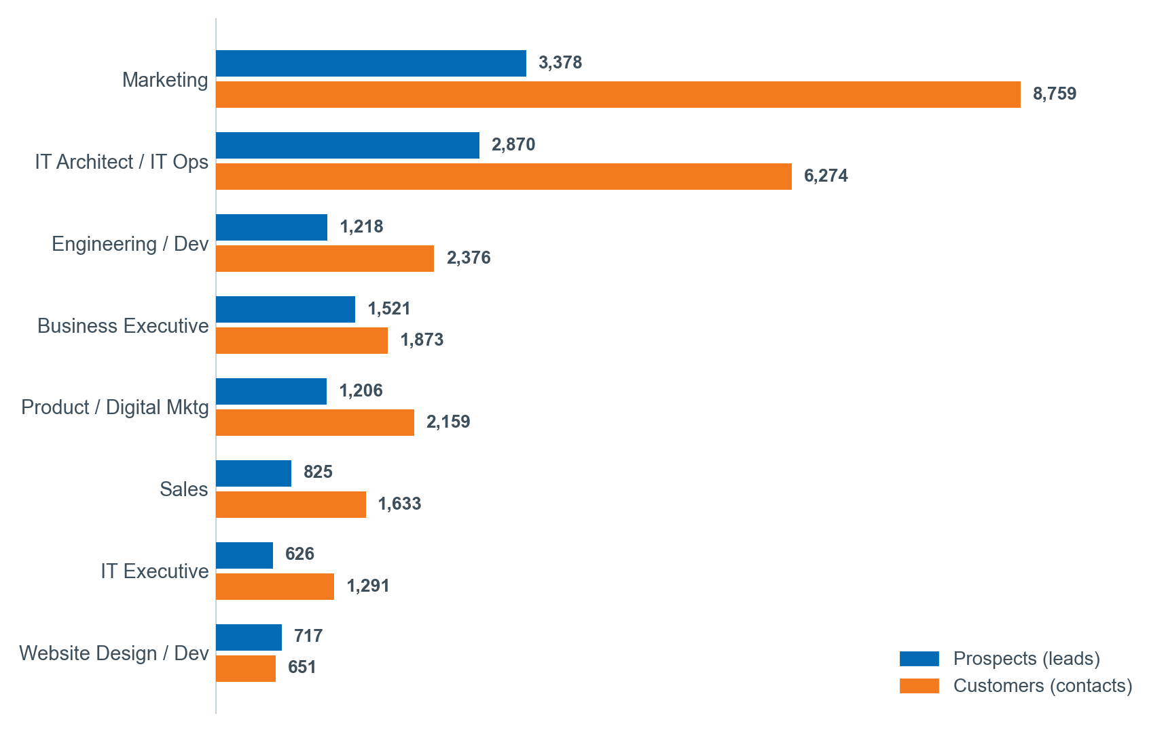
PERSONA ENGAGEMENT
Prospect vs. Customer, by Job Function
Marketing and IT personas drive engagement for both prospects and customers - but three high-volume personas click below threshold, and 35% of engaged customers have no persona set.
Prospect vs customer
- Customers are 73% of engaged members (53.8K vs 20.3K).
- Customer-only sends: 12.0% open / 0.80% CTR - best of any audience. Event logistics & agenda content resonates.
- Prospects click content & webinars (Acquia TV, localized SEO webinars), not invite blasts.
- Partner sends open (9.5%) but don't click (0.25% CTR, 18 sends) - audience worth rebuilding.
Underengaged flags (≥500 members, >5 pts below 87.9% median)
- Product / Digital Marketing - customers 75.0%, prospects 81.5% (4.4K members)
- Website Design / Development - customers 73.5% (core Drupal persona!)
- IT Executive - customers 79.2% (1.6K members)
Persona field: Job_Function__c (Lead & Contact). Sample: 74K synced members ≈ 7% of delivered - within-sample rates, not true per-persona open rates. Blank persona: 35% of customer, 12% of prospect members.

Slide 6
Q3 PLAN
Recommendations & Roadmap
Cut fatigued blasts, scale the three formats that click, and fix four instrumentation gaps.
1 · Cap event-invite sequences at 3 full-list touches
Touch 8-9 sends burned ~193K emails for 0.19-0.54% CTR; replace with engaged-only segments (9-24% CTR). Expected: recover ~0.3-0.5 pt portfolio CTR.
2 · Prune the 565K DAM-governance list before next send
56% of Q2 volume at 7.0% open. Suppress 6-month non-openers (est. 60%+ of list). Expected: higher deliverability, cleaner metrics, no measurable pipeline loss.
3 · Scale what clicks: content episodes, countdowns, localization
Prospects: weekly Acquia TV-style sends (2.1% CTR) + ES/PT (now FR/DE) webinars. Customers: agenda/logistics content (0.8% CTR). Expected: 2-4x CTR on migrated volume.
4 · Rebuild 3 underengaged personas with format tests
Product/Digital Marketing, Website Design/Dev, IT Executive (≈8K engaged members clicking below threshold). Test persona-specific content per audience.
5 · Instrumentation: make Q3 fully measurable
Populate GTM_Playbook__c at creation (0 of 59 tagged); sync subject lines & total-sent; backfill blank Job Function (35% of customer members). Owner: MOps intake checklist.
Priorities 1-3: send-strategy changes (MOps + campaign owners, start immediately). 4-5: audience/instrumentation work (Q3 intake board). Source: Salesforce Campaign Pardot rollups + CampaignMember persona joins, queried 2026-07-18 17:00-17:20 UTC.

