Slide 1
Transforming-and-Analyzing-Data-with-SQL
May 17, 2023 Jennifer Zhao

Slide 2
Overview
This database provides data on revenue by products, as well as visitor interactions with the products (including the timing of their visits, their geographic location, the number of pages they viewed, the duration of their visit, and the number of transactions they entered
The objective of this project is to build up our skills in data cleaning, data transformation, and data analytics. By analyzing the data, we aim to uncover some patterns, trends, and insights that can inform decision-making and drive business value.

Slide 3

Assumption
There are some values that lack clear definitions, and some columns have similar names, making it difficult to determine the correct field to use in a query. In these cases, I just compare them and make assumptions, which can impact the accuracy of the results.

Slide 4
Process
Create the database, and imported the CSV files.
Explore the data
Conduct data cleaning
Implement data QA process
Analyzed the data
Make insights

Slide 5

Create the database
create the ecommerce database, set the primary key and column datatype
import the data

Slide 6

Exploring the data
identify the schema of the database, the datatype of tables, and primary key
discover the relationships between different tables
find out the meaning of each column

Slide 7
Data Cleaning
Data cleaning is the process of fixing or removing incorrect, corrupted, incorrectly formatted, duplicate, or incomplete data within a dataset.
Data type conversion:
convert the datatype: time and visit start time from string type to timestamp;
total transaction revenue to a numeric type
Inaccurate value: Find the inaccurate data and correct it: unit_price, product price need to be divided by 1,000,000
Missing value:
Drop userid /itemrevenue /itemquantity/productrefundamount columns
auto-filling: USD for currency code for transaction in United stated'Home/Appare/Women's' as productcategory when productname contains 'Women's
set 'Home/Apparel/Men's' as the product category when the product name contains ‘Men’s , set the city null value as a country

Slide 8
Data Cleaning
Unique data: productsku, fullvisitorid, visitid
Identify the outlier and anomalies: remove max (timeonsite) is 4661, change category '${escCatTitle}’ Check range constraints: Sentiment score, Sentiment magnitude Make the data set understandable:
Update 'not available in demo dataset’ and '(not set)’ to null, and ‘Not Socially Engaged' to ‘no’, sales_report table to monthly_sales_report
Create a new table including visitid, sentiment score, sentiment magnitude, and sentiment ratio, delete sentiment related information from products table and sales_report table

Slide 9
QA process
Checking if there are any unexpected empty entries, and writing subqueries on your query to see if it gives you the expected results.
Unique value: productsku null value. fullvisitorid is unique, get the duplicates of fullvisitorid.
Accuracy: Check the revenue value is accurate. Verify revenue = unit_price * units_sold * 1.05%
Distinct categories: check distinct category counts.
Numerical value: check the max/min/average It should give you a result that makes sense and is consistent with your other queries/results.

Slide 10
Findings and insights
Increase stock for top 3 products

Slide 11
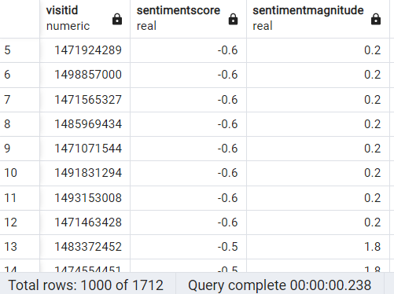
Findings and insights
82% visitors are satisfied. We can also find the users who are dissatisfied, so the sales group might want to contact the users to find out the reasons and make improvements.

Slide 12
Findings and insights
"Home/Apparel/Headgear“, "Home/Bags“,and "Home/Bags/Backpacks" "Home/Accessories/Stickers" appear to be popular categories in multiple countries. We might add new products to these categories to increase sales.
13% of visitors make a purchase.
Organic search, direct, and referrals are the top 3 channels customers use.
the top-selling product from each city/country:
Mountain View (United States): Kick Ball (75,850)
- India: Custom Decals (49,218)
- United Kingdom: Custom Decals (37,860)
- San Francisco (United States): Kick Ball (30,340)
- New York (United States): Kick Ball (30,340)
- Chicago (United States): Kick Ball (30,340)
- Germany: Custom Decals (26,502)
- Palo Alto (United States): Cam Outdoor Security Camera - USA (19,033)
- Canada: Twill Cap (18,982)
- Sunnyvale (United States): Cam Outdoor Security Camera - USA (16,314)

Slide 13
Future Goals
Perform further data cleaning, split allsessions table into multiple tables, make it more readable and accurate, reduce data redundant and data inconsistency
Conduct a more in-depth analysis: analyze data with multiple dimensions and make more useful insights

Slide 14
Thank you!

