Slide 1
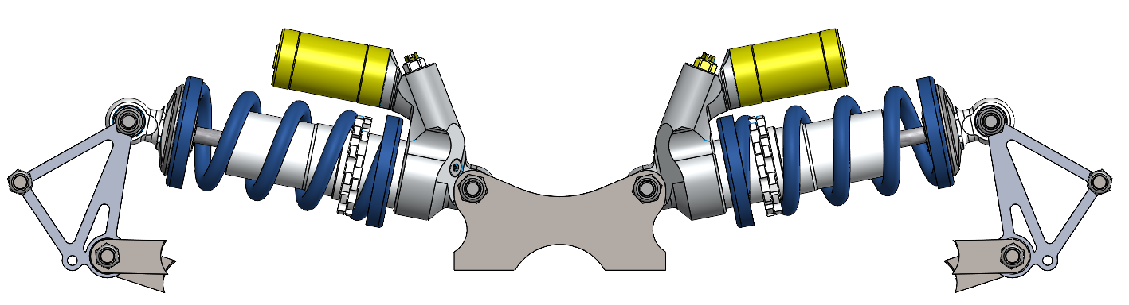
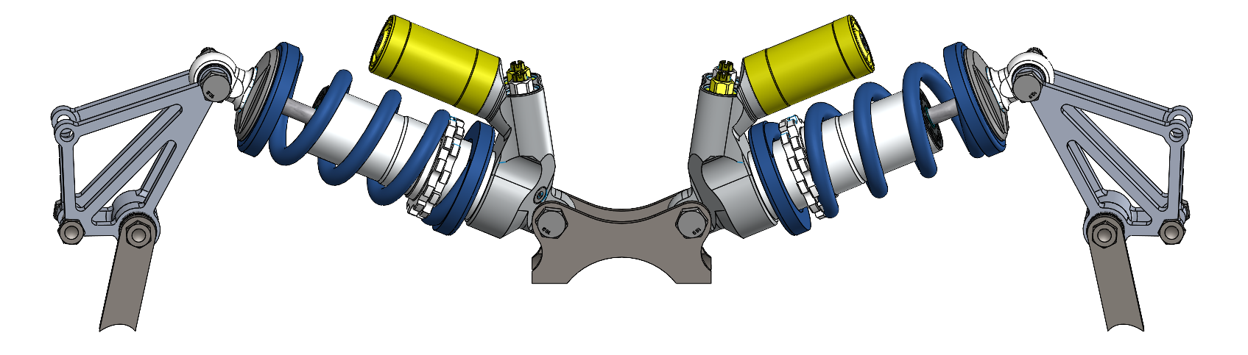
Bellcranks and Dampers CDR
System Lead: Jennifer Yang
Captain: Gabriel Botero

Slide 2
DESIGN REVIEW ATTENDANCE
CDR attendance: (on day of review)
Andrew
Luis
Danny
Kai
Gabe B.
Nico
Ashira
Mahlet
Stella

Slide 3
AGENDA
Design Goals/Criteria Recap
Rules Requirements
Schedule Status Update
Design Overview
Analysis
Jigging
Manufacturing & Assembly
Validation
Manufacturing Timeline
Documentation

Slide 4
MOTIVATION
&
CONSTRAINTS

Slide 5
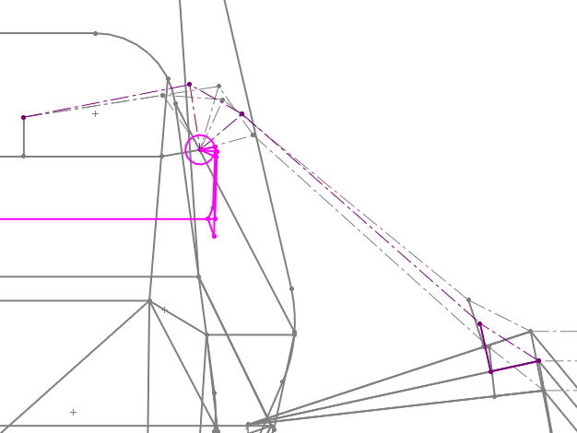
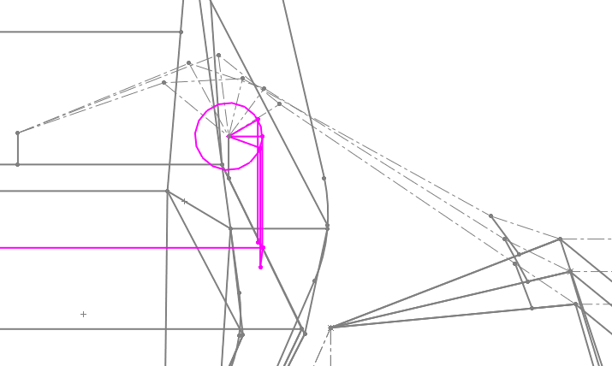
DESIGN GOALS/CRITERIA RECAP
Optimize for a constant motion ratio
Keep ARB placement in mind
Reduce tab size/complexity
Selected Geometry
Front: In Plane
Rear: Out of Plane

Slide 6
DESIGN CRITERIA: RULES REQUIREMENTS
V.3.1.4 - Fasteners in the Suspension system are Critical Fasteners, see T.8.2
T.8.2.3 - All Critical Fasteners must be secured from unintentional loosening by the use of Positive Locking Mechanisms see T.8.3
Full list of relevant rules here

Slide 7
DESIGN CRITERIA: FSAE HYBRID RULES
No differences between FSAE and Hybrid rules
Full list of relevant rules here (same sheet as before)

Slide 8
SCHEDULE STATUS UPDATE
Date | Deliverable | Tracking
9/30 | Finish motion ratio analysis on all the current geometries to begin optimization | Behind; Done
10/5 | Finalize geometry and begin mechanical design and FEA | Behind; WIP
10/12 | Finish mechanical design, start jigging | Behind; WIP
10/15 | Finalize design, jigging, tabs | Behind; WIP
10/22 | Design Freeze | TBD
To Do: FEA, finalize mechanical design, jigging

Slide 9
SYSTEM
DESIGN

Slide 10
DESIGN OVERVIEW
You must show that you don’t have any interference issues!
Sit down with your subteam manager a few days before CDR
Your manager should “sign off” on this slide.
Any clearance concerns? | Tightest Running Clearance | Where | Manager signature
NO | 0.068 in | Between rear bellcrank bolt and chassis tube | Gabe

Slide 11
Front Bellcranks and Dampers

Slide 12
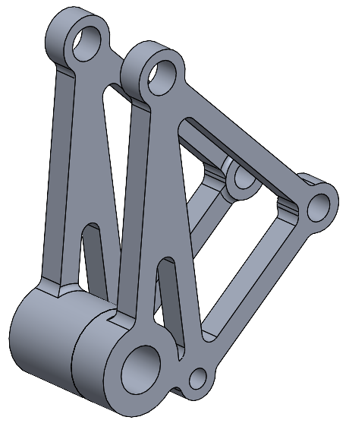
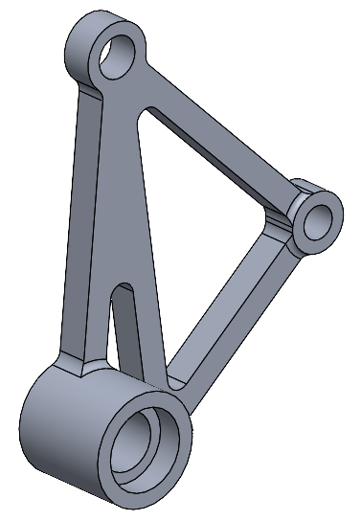
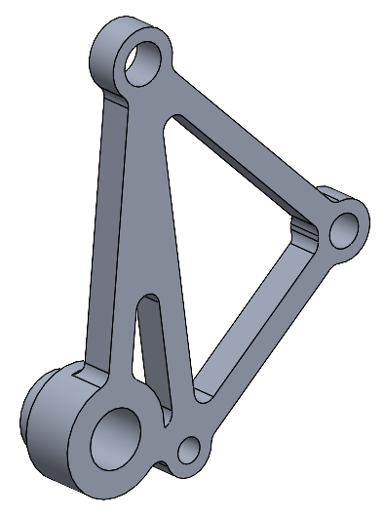
Front Bellcranks
CNC in house
Two piece press fit
ARB pickup point pending finalized placement
Possibly incorporate spherical washer for rod end into model

Slide 13
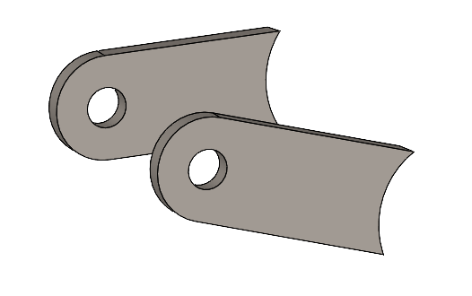
Front Bellcrank Tabs
Connect bellcrank to chassis tube
Waterjet in house or NREC

Slide 14
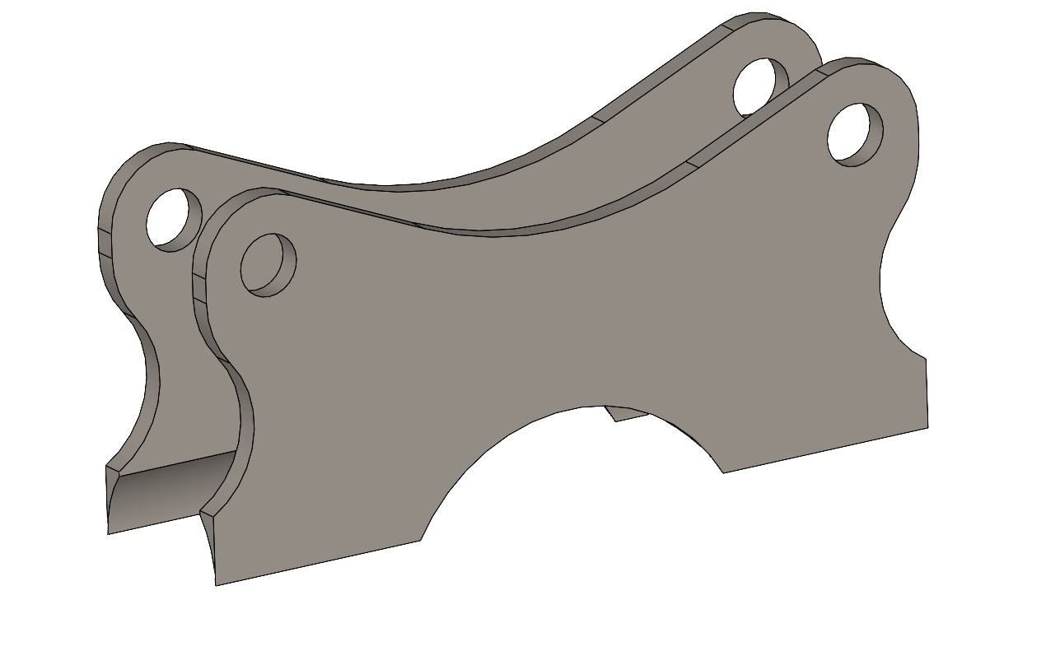
Front Damper Tabs
Connect damper to chassis tube
Waterjet in house or NREC

Slide 15
Rear Bellcranks and Dampers

Slide 16
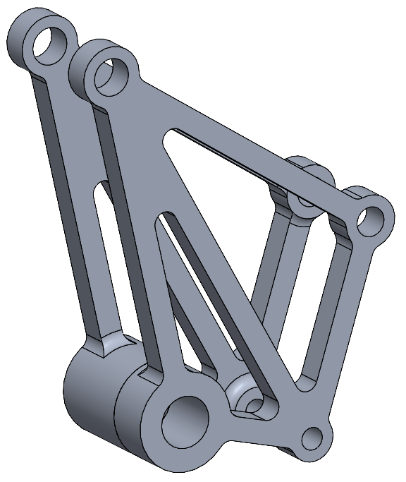
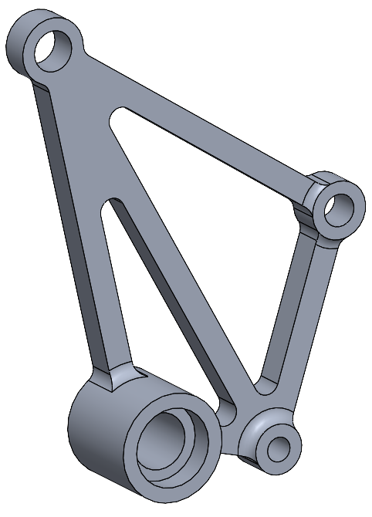
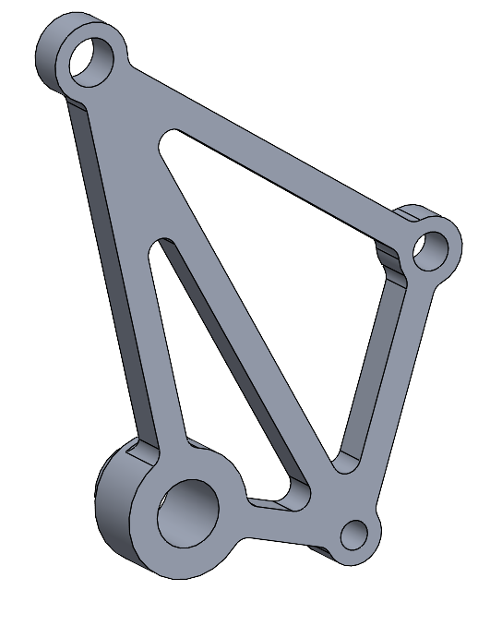
Rear Bellcranks
CNC in house
Two piece press fit
ARB pickup point pending finalized placement
Possibly incorporate spherical washer for rod end into model

Slide 17
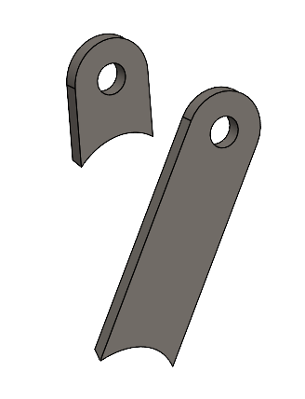
Rear Bellcrank Tabs
Connect bellcrank to chassis tube
Waterjet in house or NREC

Slide 18
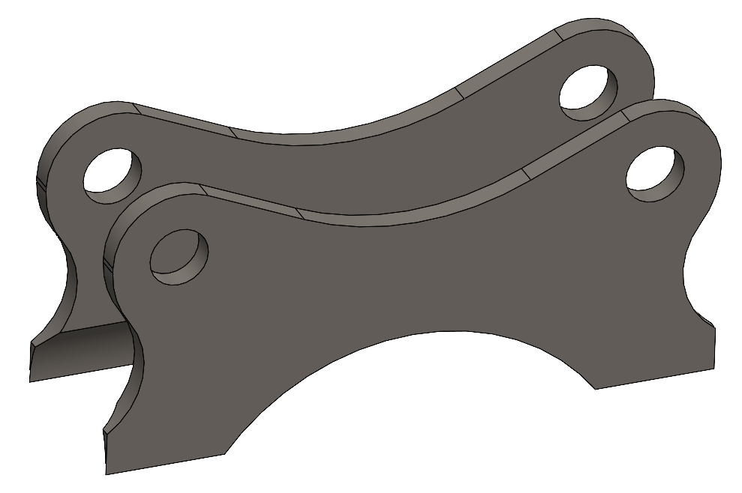
Rear Damper Tabs
Connect damper to chassis tube
Waterjet in house or NREC

Slide 19
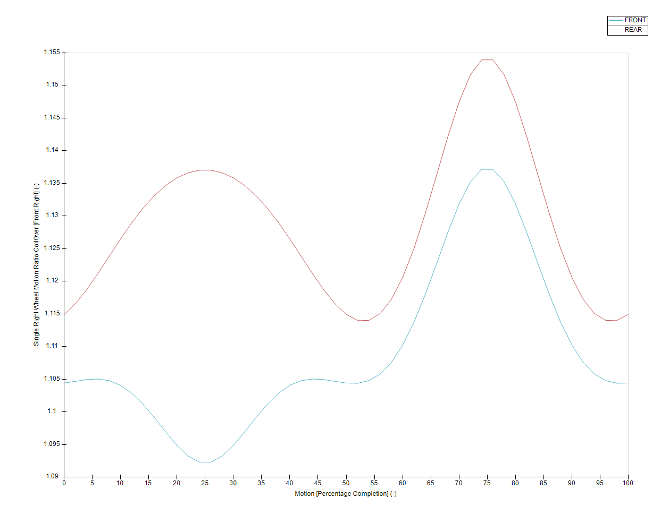
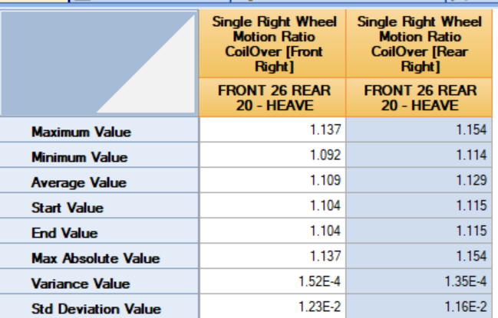
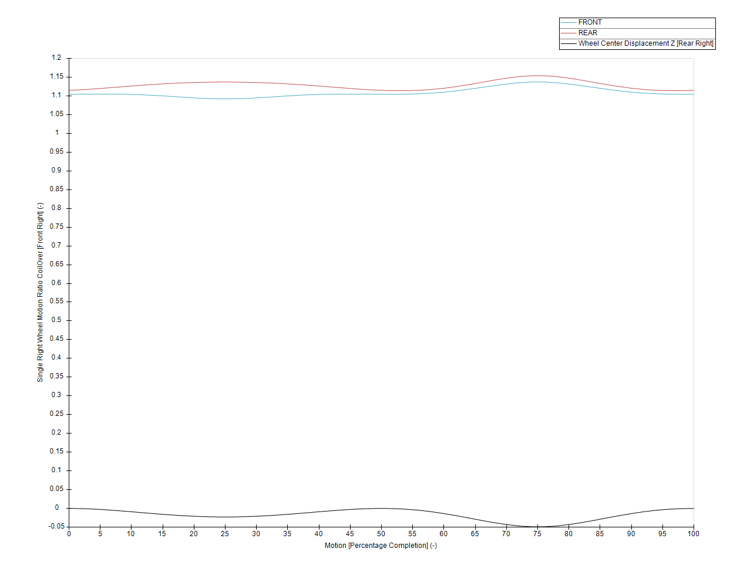
Motion Ratio
Goal: Constant motion ratio
Range ~0.045 in front and rear
Analyzed in OptK w/points exported from Solidworks

Slide 20
Motion Ratio Post CDR Updates
Geometry change -> motion ratio change
Geometry changes due to control arm to pushrod tab shortening so need to re optimize geometry for motion ratio
Stayed under 0.1
Wanted to keep as much of geometry consistent as possible
Changing the front tab did not result in needing to redo any of the other points to stay under 0.1 so even though not as great as previous, did not optimize further
Changing rear tab did require re optimization since just changing the tab point resulted in a motion ratio of ~0.2

Slide 21
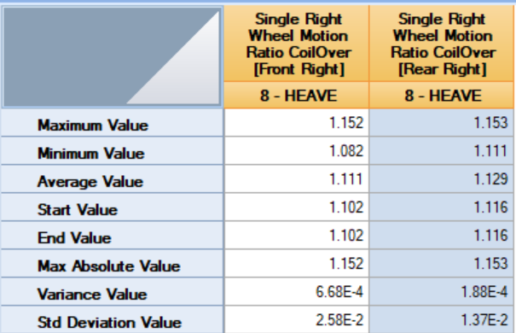
Motion Ratio Post CDR Updates
All optK related data and the macro can be found here
Front Range: 0.070
Rear Range: 0.042
Motion ratio graphs on next

Slide 22
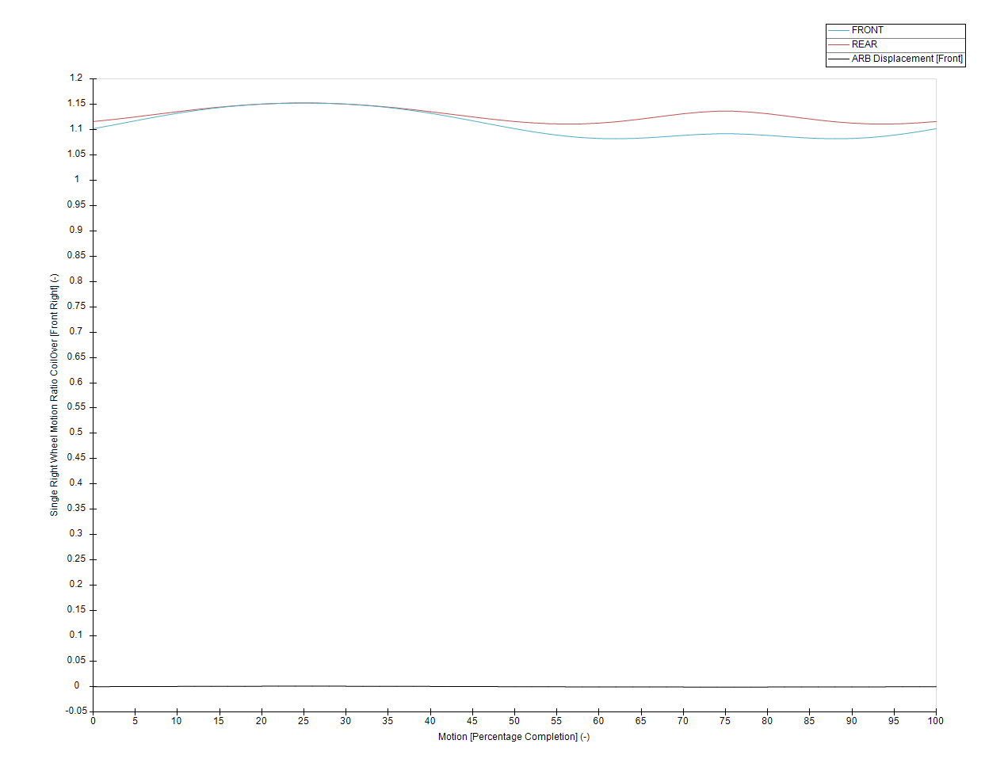
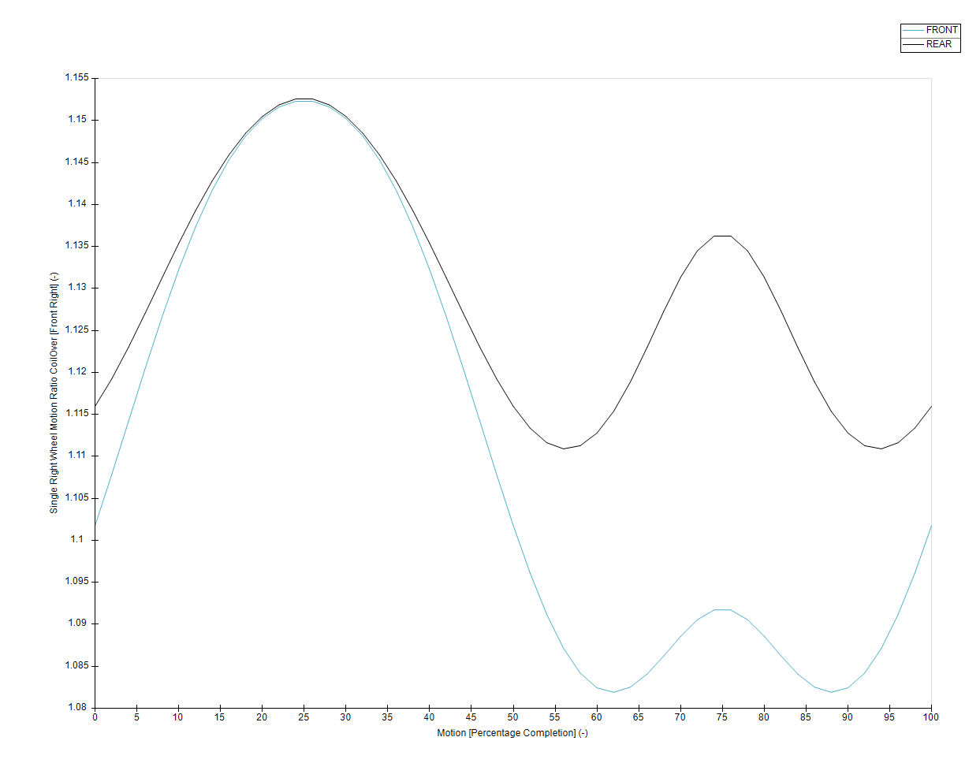
Motion Ratio Post CDR Updates

Slide 23
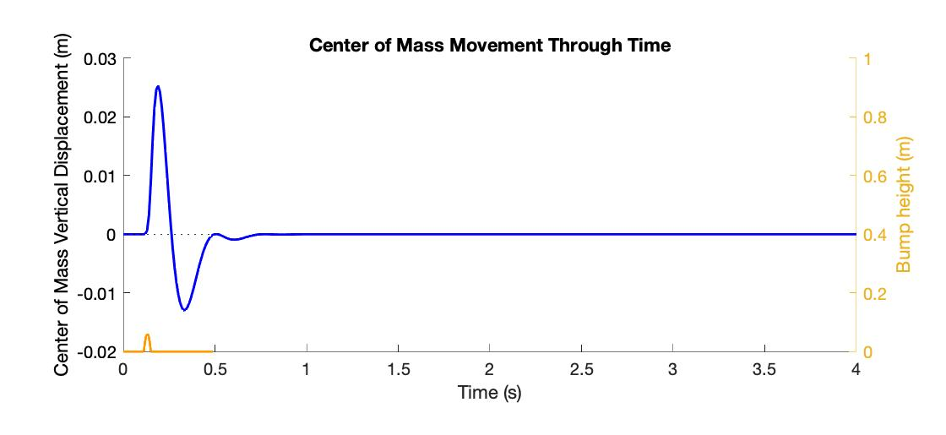

Springs
Target Damping Ratio: 0.8
Fancy bump sim calculator (thanks Nico!)
Input damping coefficients (estimated from KazTech dyno graphs) and springs (guess and check existing)
Uses calculated COM movement to determine motion ratio

Slide 24
Springs
Front SS | Compression Damping Coefficient (Ns/m) | 5575
 | Tension Damping Coefficient (Ns/m) | 3236
 | Spring (lbf/in) | 200
Rear SS | Compression Damping Coefficient (Ns/m) | 5575
 | Tension Damping Coefficient (Ns/m) | 3236
 | Spring (lbf/in) | 300
Overall | Damping Ratio | 0.7985

Slide 25
ANALYSIS

Slide 26
FACTOR OF SAFETY
FOS Target: 2.5 - 3
Yield Strength: 40,000 psi
Target stress: 13,333 to 16,000 psi
Fatigue Strength: 14,000 psi
Want to stay under or near it

Slide 27
Stress Analysis
Hand calcs and FEA pending for bellcranks and for tabs
Tabs
Use tab spreadsheet for all hand calcs
FEA in solidworks
Butterfly tabs
Rear long tabs

Slide 28
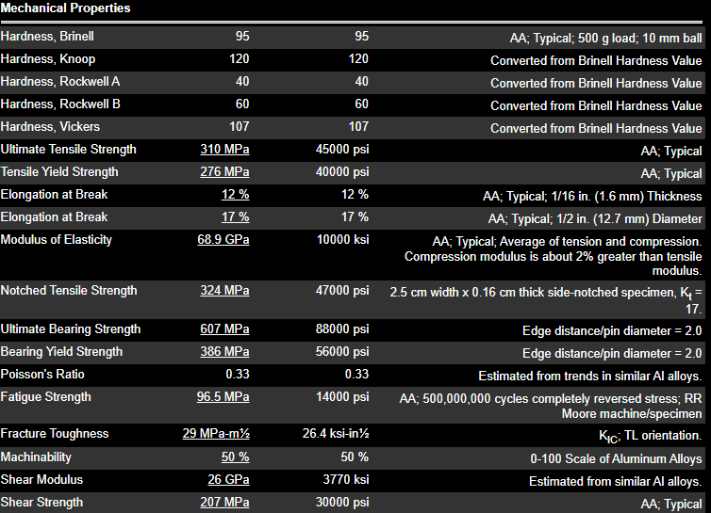
Bellcranks Analysis
Model
Made assembly of bellcranks halves put together
Added dummy pins to represent bolts in their respective holes
Did not include dummy pin for bellcrank tab pickup point
Material: Aluminum 6061 T6

Slide 29
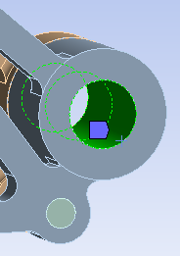
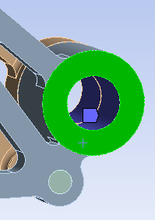
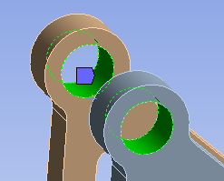
Bellcranks Analysis
Connections
Treat bellcrank halves as bonded
Pins contacts are frictionless
Supports
Radially constrained at bellcrank pickup point
Remote displacement on outer face
Fixed support at damper pickup point
Tried to fix the pin at the damper pickup point but ansys said no

Slide 30
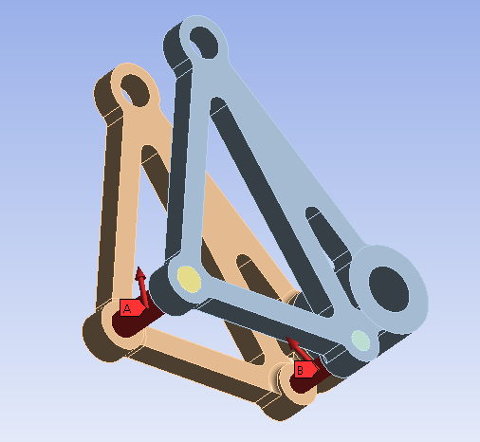
Bellcranks Analysis
Loads
Use pushrod and ARB loads on their respective pickup points and angles
Will present analysis results in an addendum

Slide 31
Analysis Results
Results for tabs and bellcranks can be found summarized here
Analysis files and tab calculator spreadsheets can be found here

Slide 32
MANUFACTURING & ASSEMBLY

Slide 33
MANUFACTURING
Name of Part | Mfg Method(s) | Location(s) | Lead time
Bellcranks | CNC in house | ICE or Techspark | 1 day (when I get to it)
Tabs | Waterjet in house | Techspark | 1 day (when Gabe gets to it)
Washers | Lathe in house | ICE or Techspark | 1 day (freshie)

Slide 34
MASS TRACKING
 | Front Bellcrank | Rear Bellcrank
20E | 0.1535 lbm | 0.1598 lbm
22E | 0.1473 lbm | 0.1711 lbm
Difference | 0.0062 lbm lighter than 20E | 0.0113 lbm heavier than 20E

Slide 35
TAB JIGGING
This will be done post CDR

Slide 36
HARDWARE SELECTION
M8 bolts to be used for dampers from Misumi
Washers to be made in house
¼” bolts used for pushrods and tabs
OTS washers from Summit Racing
#10 bolts to be used for drop links
OTS washers from Summit Racing
All nuts from aircraft spruce

Slide 37
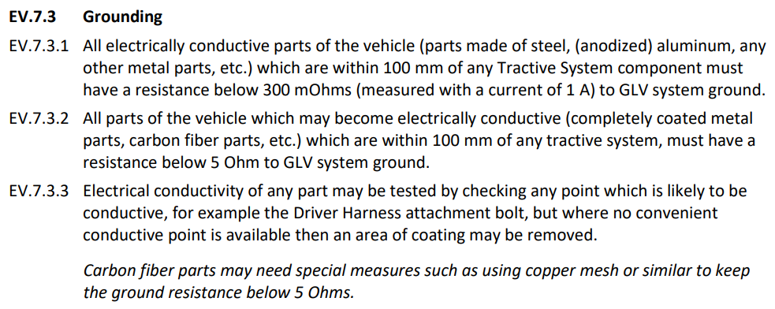
SPECIAL CONSTRAINT: GROUNDING!
FSAE EV.7.3 Rule
Anodize/powder coat will block a grounding path
We will send our bellcranks out to be anodized

Slide 38
ASSEMBLY
Bellcranks will be press-fit together
Use bolts to jig to ensure alignment
Make sure not to overtighten thrust needle bearings

Slide 39
BILL OF MATERIALS
Link here

Slide 40
LOGISTICS

Slide 41
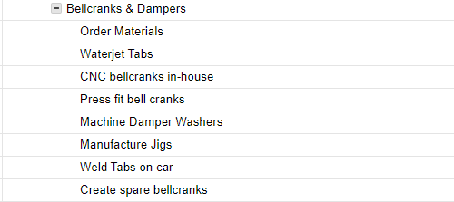
SCHEDULE
Deadlines TBD

Slide 42
DOCUMENTATION
I need to write this up in confluence still
I’ve been updating drive with all of my analysis (yay optK)

Slide 44
NOTES AND CONCERNS
Mass tracking with bolts (not required for CDR, but preferably have by design freeze)
Mask all internal holes of bellcranks (not only for grounding, but also because they add “thickness” to the hole so your bolts won’t fit)
FEA results - add to slides when they’re done for posterity
See slides linked here
Front bellcranks not machinable - small slot
More notes

