Slide 1
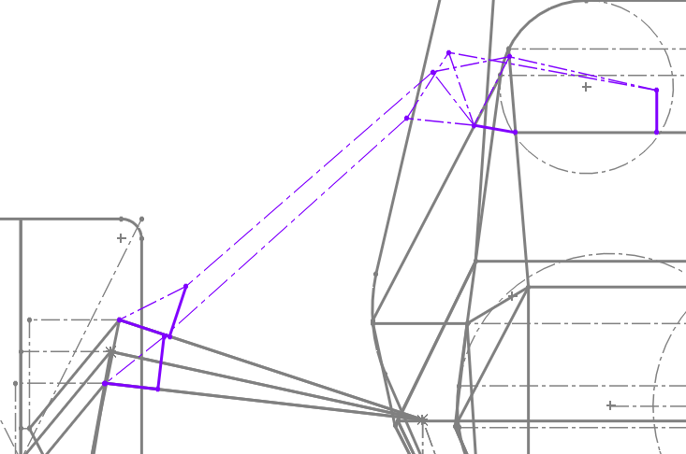
Bellcranks and Dampers PDR
System Lead: Jennifer Yang
Captain: Gabriel Botero

Slide 2
AGENDA
Design goals
Design Criteria: Rules requirements
Design Criteria: Constraints/Considerations
Design Concepts
Manufacturing/Assembly
Mass Tracking
Timeline

Slide 3
DESIGN GOALS
Make front and rear systems out of plane
Lower CG
Avoid blocking driver visibility in the front
Optimize for a constant motion ratio
Keep ARB placement in mind
Reduce tab size/complexity
Ideally pushrod and tabs are angled within 10-20 degrees of each other

Slide 4
DESIGN CRITERIA: RULES REQUIREMENTS
V.3.1.4 - Fasteners in the Suspension system are Critical Fasteners, see T.8.2
T.8.2.3 - All Critical Fasteners must be secured from unintentional loosening by the use of Positive Locking Mechanisms see T.8.3
Full list of relevant rules here

Slide 5
DESIGN CRITERIA: CONSTRAINTS/CONSIDERATIONS
Kinematic Considerations
Bellcrank positioning (location and plane) drives ARB geometry
Spatial Constraints
Front chassis is now smaller
Hub motors take up space - mounting to top A-Arms (like 20e)
Physical Loading:
Assume max load as the force experienced by full spring damper compression to determine loads
Out of plane geometry increases loading in front and rear

Slide 6
DESIGN CRITERIA: CONSTRAINTS/CONSIDERATIONS
Sourcing Constraints:
Dampers - Sold by KazTech
We could rebuild our dampers (send to KazTech), pull them off old cars, or grab one of the many spares
Springs are sold by JensonUSA, Cane Creek, essex, Kaz Tech
Design for Manufacturing/Assembly:
In house manufacturing on CNC (as we have done in the past)

Slide 7
FRONT DESIGN - IN PLANE
Pros
In plane is simple
Cons
Potential to block driver visibility

Slide 8
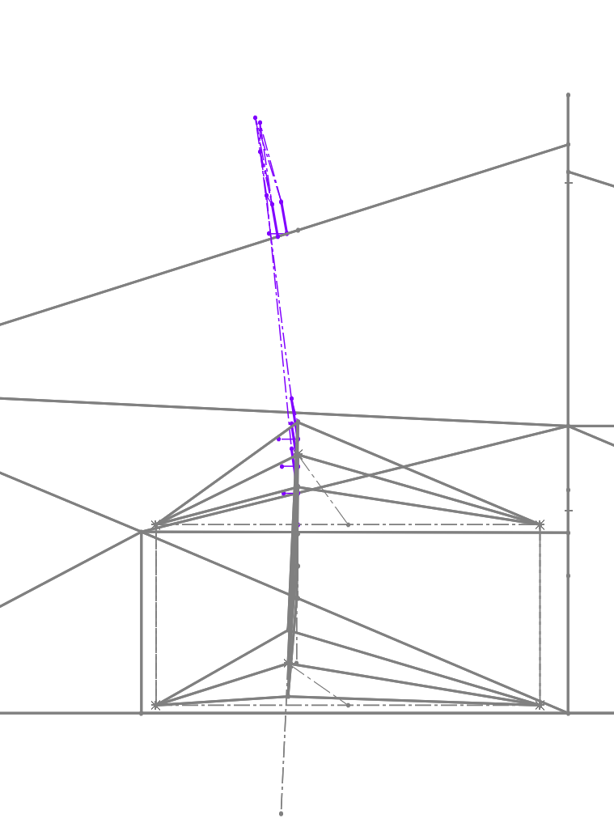
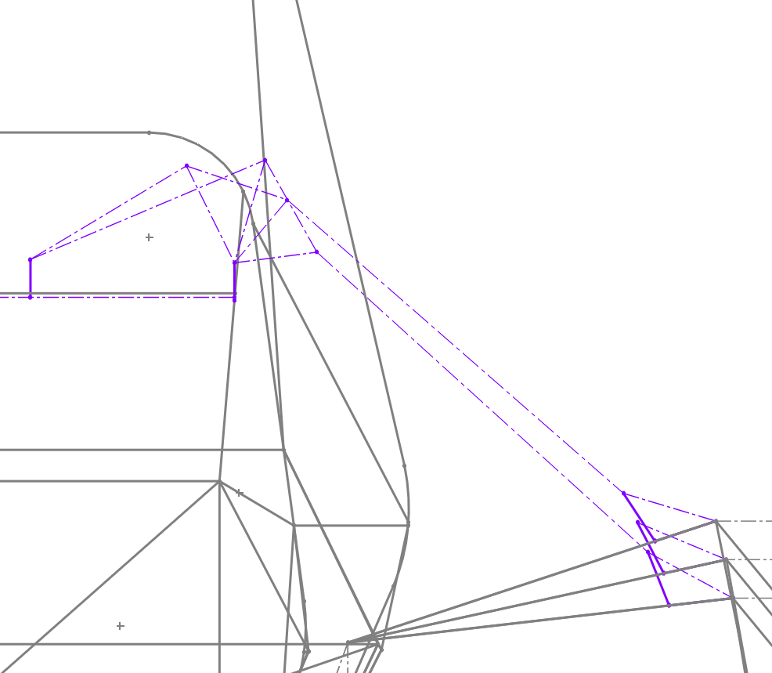
FRONT DESIGN - OUT OF PLANE
Bellcrank damper tube moved 10mm and angled at 80 degrees (both forward)
Pros
Lower CG
Theoretically will reduce visibility issues
Cons
Visibility issue needs to be played around with more

Slide 9
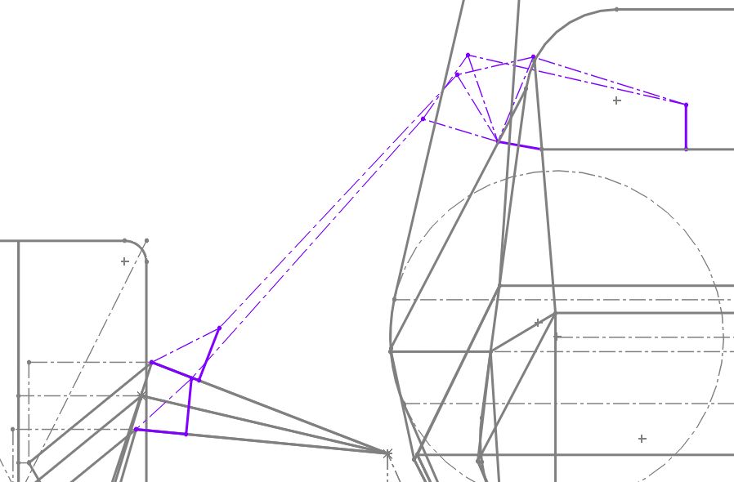
REAR DESIGN - IN PLANE
Pros
In plane is simple
Cons
Higher CG

Slide 10
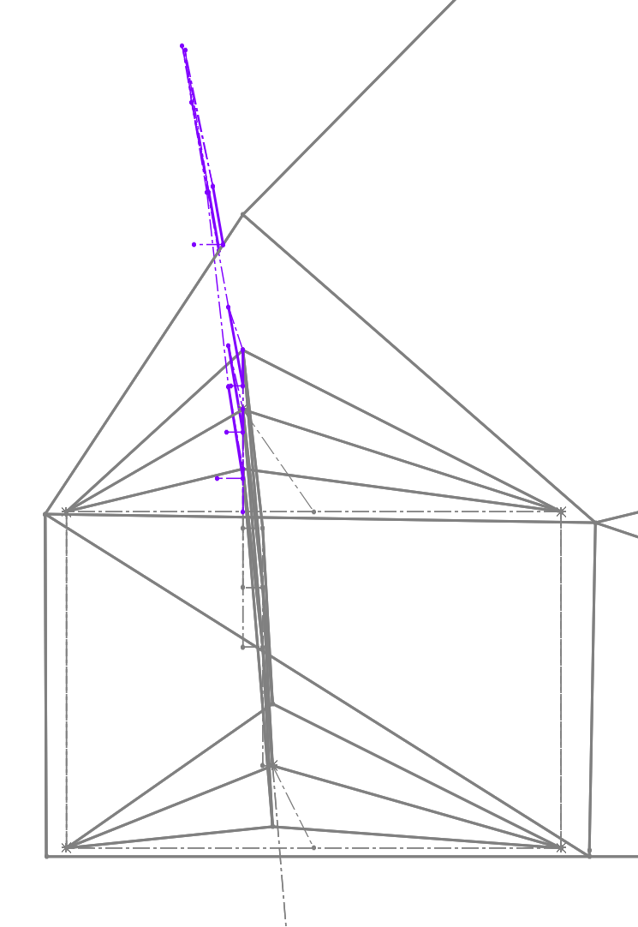
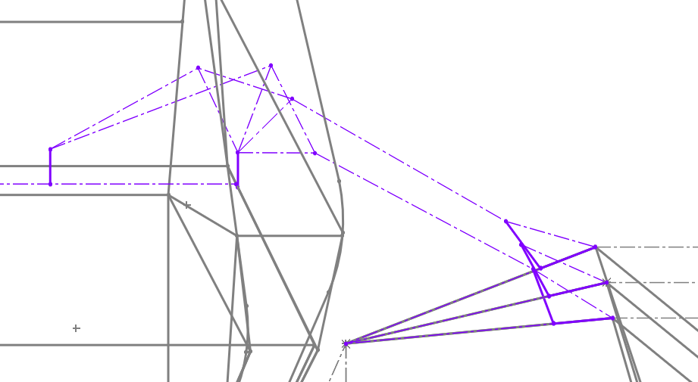
REAR DESIGN - OUT OF PLANE
Bellcrank damper tube moved 10mm and angled at 80 degrees (both backward)
Pros
Lower CG
Cons
Current design has <10 degrees of difference in the wrong direction
Attempts to fix this have resulted in large bellcranks
Need to investigate more

Slide 11
OTHER ITERATIONS
In and out of plane front for wider chassis
Not presented because are going for the new IA and narrow bulkhead
In and out of plane for an older version of the narrow bulkhead
Not presented because the older version was not rules compliant
See CMR 22e → BD22 Iterations for older iterations

Slide 12
MOTION RATIO DATA
Have not had time to do motion ratio because I’ve been sick and stressed with other things >:(
Goal is to get initial motion ratio data by next week to begin optimizing these geometries

Slide 13
MANUFACTURING
I will CNC them in-house (Techspark or ICE)
Send out to be anodized
Waterjet for tabs (Techspark or outsource)
Ask our current welder to weld tabs

Slide 14
ASSEMBLY
Potentially rebuild dampers
Need to email KazTech for cost estimate
Will save money instead of us buying new ones each time
Should be rebuilt after every 35 hours
Press fit two pieces
Put on car
Ask welder to weld tabs

Slide 15
MASS TRACKING
Weigh the individual pieces before press fit
Weigh the bellcranks after press fit
Weigh the pushrod before installing
Weigh the car before and after installing

Slide 16
TIMELINE AND CDR DELIVERABLES
9/30 - Finish motion ratio analysis on all the current geometries to begin optimization
10/5 - Finalize geometry and begin mechanical design and stress analysis
10/12 - Finish mechanical design, start jigging
10/15 - Finalize design, jigging, tabs
10/17 - CDR
10/22 - Design Freeze

Slide 18
NOTES AND CONCERNS
In plane vs out of plane
Depends on what ends up working better with ARBs
ARB placement is more important than visibility in the front
Depends if the out of plane is worth the additional effort
Out of plane is better for tabs
But in plane is easier so if no significant difference, not worth
In the rear, changes to chassis tube need to be told to energetics side bc lowering things eats into their space
Front - bellcranks need to be mounted to the top not the side bc hub motors (ref Fiona)

