Slide 1
Subsystems and Pugh Chart
Group A
Jon Ali, Aurielle Barnett, Gabe Botero, Riley Forster, Jennifer Yang

Slide 2
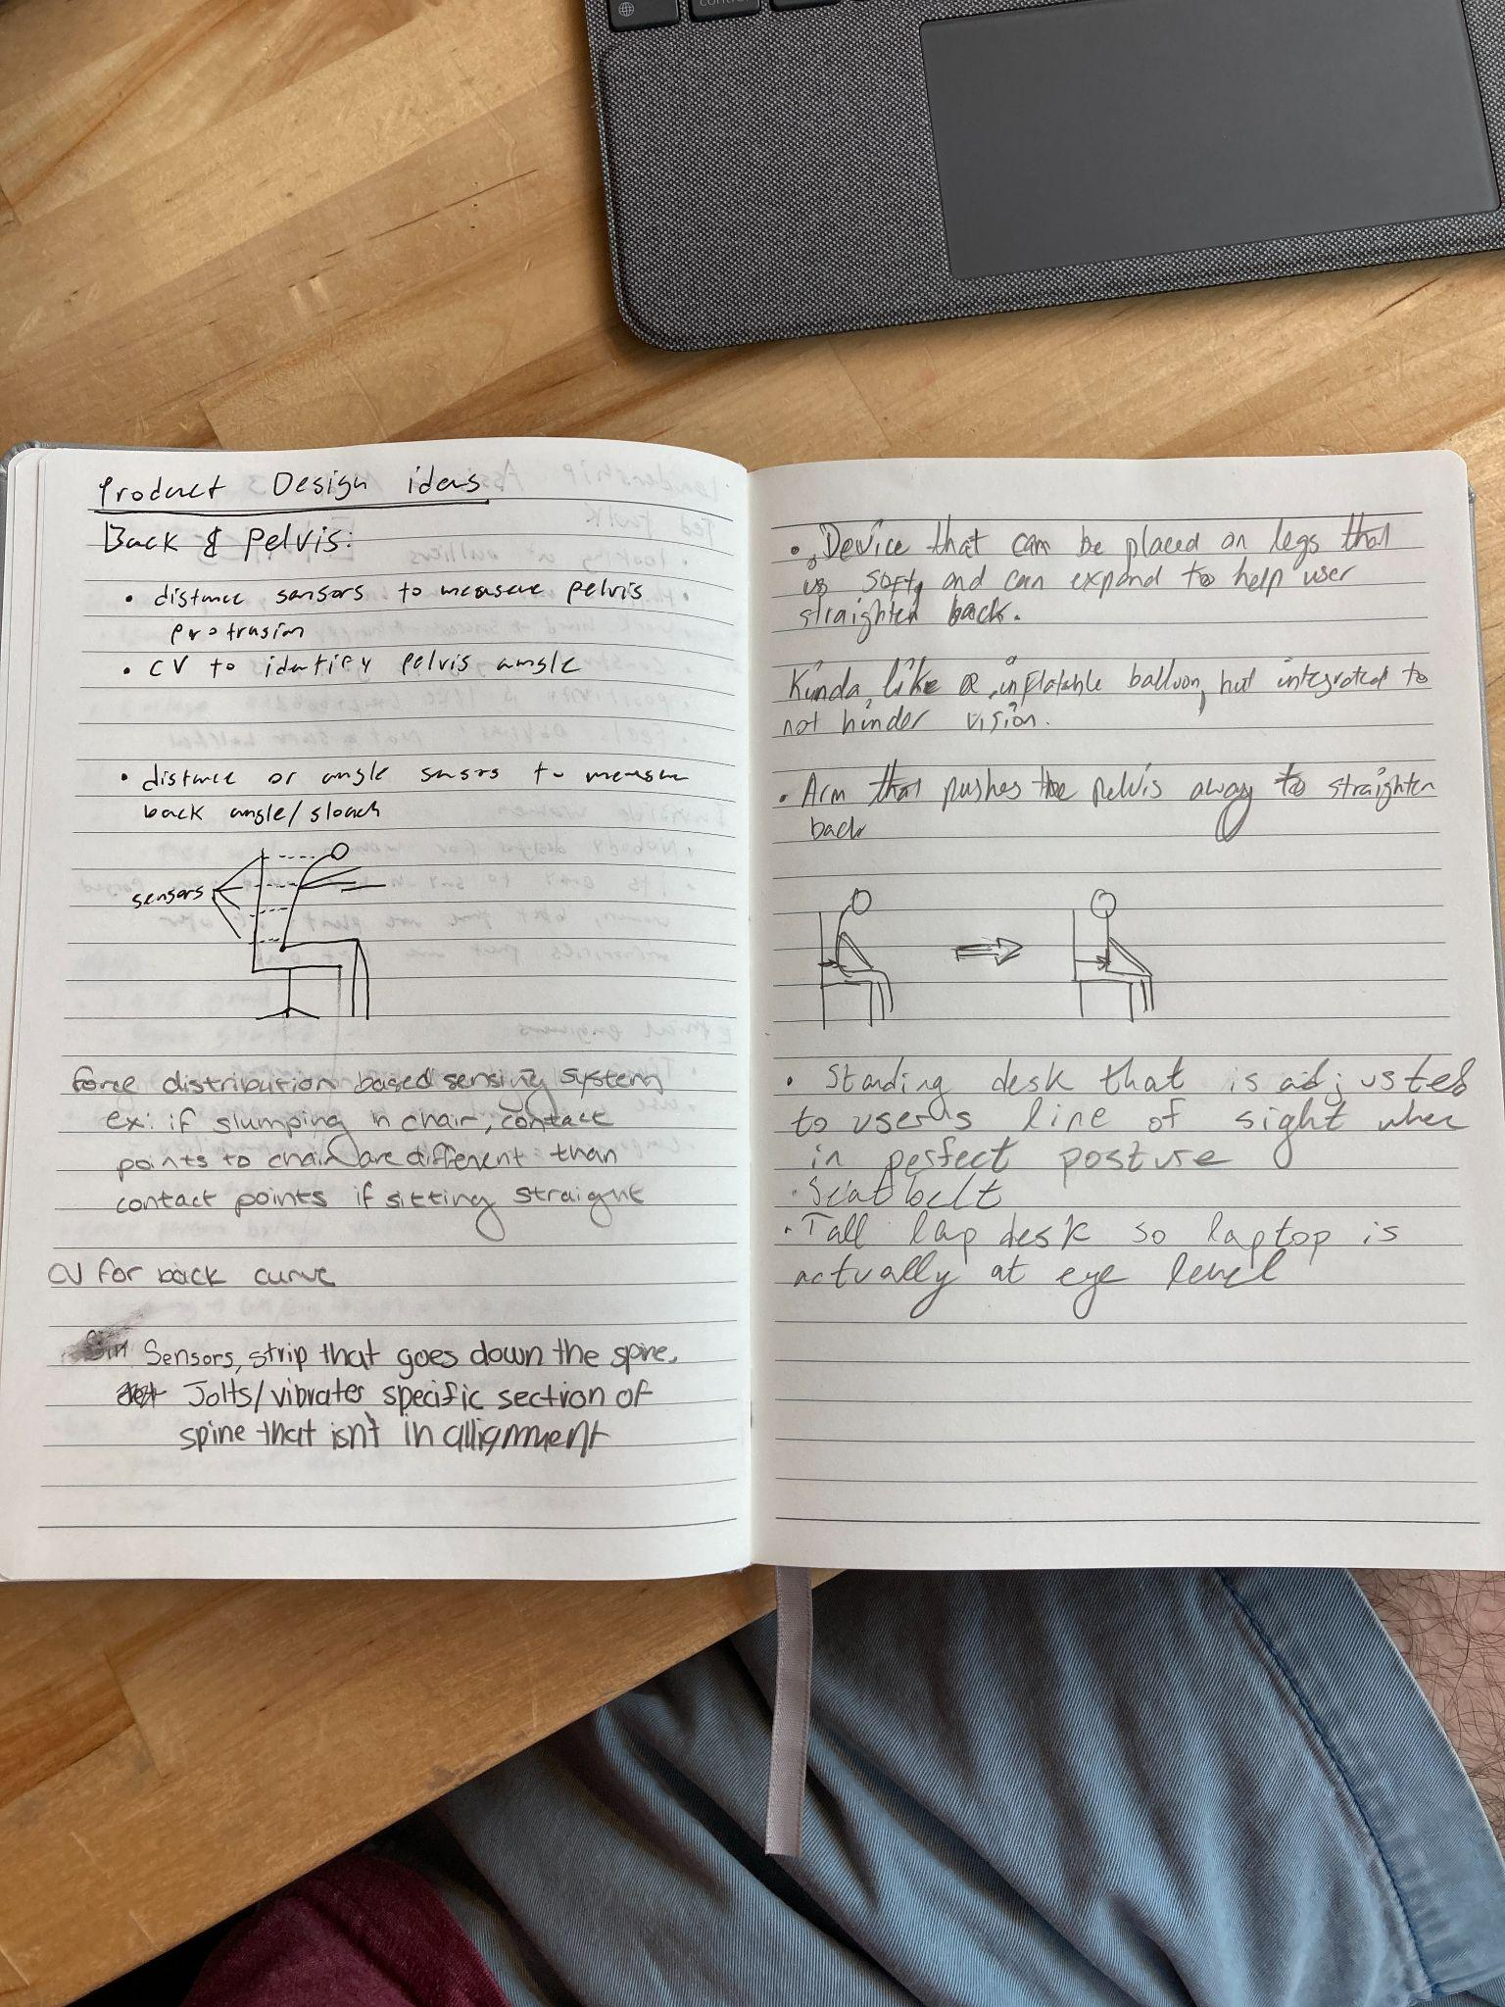
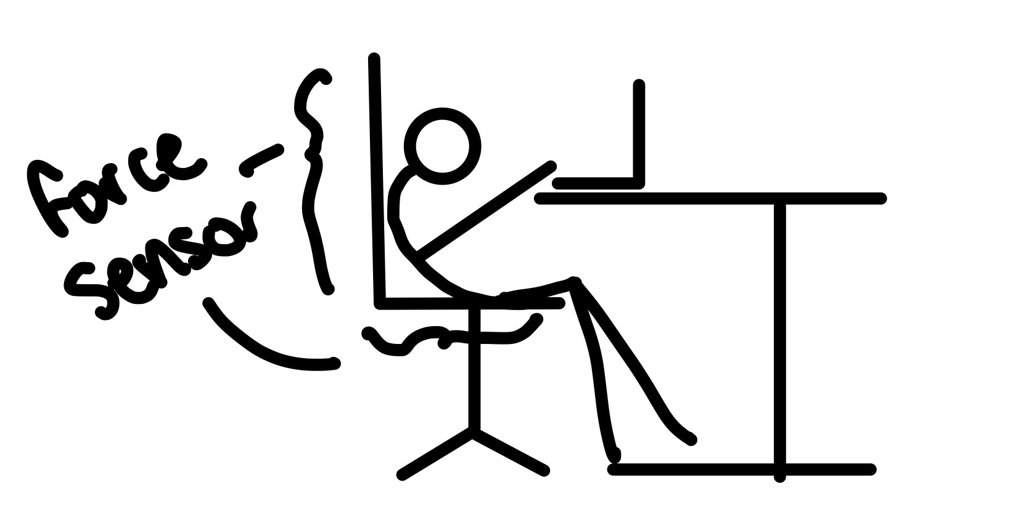
Posture Sensing
Objective
Sense user posture
Position and angle of back, pelvis, shoulders, knees, and feet
Concepts
Use distance sensors to detect slouching
Use force sensors to detect weight distribution
Use touch detection to detect posture changes

Slide 3
User Feedback
Objective
Get posture data back to the user
Non-intrusive and satisfying way
Concepts
Vibrations
Auditory
Gentle tactile contact/physical correction

Slide 4
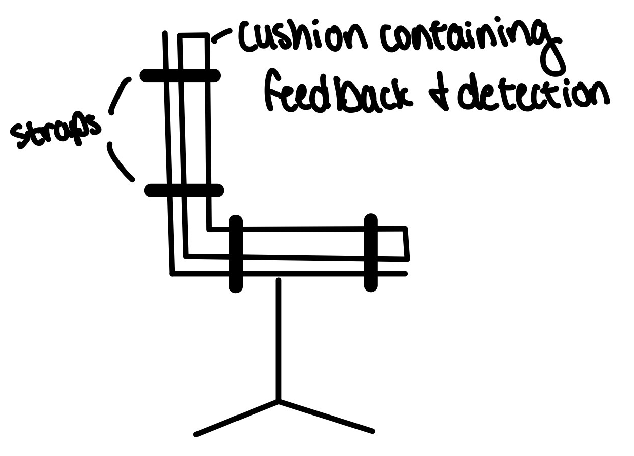
Device Attachment
Objective
Attach to a regular office chair
Concepts
Attached to back
Attached to leg
Attached to arm
Attached with cushion
Unmodified chair
Modified chair

Slide 5
Pugh Chart
 |  | Unmodified Chair w/Posture Sensor and Vibration Feedback | Modified Chair w/Posture Sensor and Audible Feedback | Modified Chair w/Posture Sensor and Tactile Feedback | Upright Pose | Posture Brace | Ergonomic Chair
Criteria | Weight | Design 1 | Design 2 | Design 3
Low Cost | 2 | 0 | 0 | 0 | 0 | 1 | 0
Non Intrusive | 1 | 0 | 1 | -1 | 0 | -1 | 1
Has Sensing Ability | 3 | 1 | 1 | 1 | 1 | 0 | 0
Universality | 1 | 1 | 0 | 0 | 1 | -1 | 0
Low Risk of Injury | 3 | 1 | 1 | -1 | 1 | 0 | 1
Comfortable | 2 | 1 | 0 | 0 | 0 | 0 | 1
 | Total | 9 | 7 | -1 | 7 | 0 | 6
Notes:
This year - the stage that we are at got pushed forward - keep going with this in terms of conceptualization
Final concept will be presented at presentations and report
This is an okay stage to be at
Do we have the customer research to justify these criteria? For example, low cost? Do we have the customer research to verify that
If you haven’t already, talk to physical therapist
Prof esp interested in distance vs touch points - what do physical therapists look at?
Are there indicators that are general across the market? Keep in mind different body shapes and sizes
Use case for working or studying at at desk - think about customer needs in terms of how distracting / not distracting the feedback is
Consider something that just sends a signal to a computer - some sort of notification
Think broadly about how the feedback can be provided to the user
Can have a prototype 0 be a basic description or prototype of the thing - get some customer feedback
We didn’t have a benchmark all 0s
For revised thing - make sure that scales are consistent
Vibration feedback is probably lower cost - cost vs feedback type
Modified vs unmodified chair - how much are you modifying chair - are you selling a chair
Specify the designs more in pugh chart
For feedback - possibility for physical correction - what are we thinking?
Ex; small pushing things
Consult on this and do research - make sure that we do what physical therapists recommend - talk to find out what people recommend
Our questions
What do you think we should focus on?
Generality
ANything for body is only as useful as the person’s needs
Try and accommodate as much as possible but bell curve your design specifications in terms of how much you can narrow down
Think about that now
Are there metrics that are able to accomodate the generality
Can evaluate different sensing mechanisms based on different things
Cool concept - maybe consider chair modification in long list of concepts - keep in mind wearables too - if it is more effective don’t rule it out just yet
Talk with whoever we can get a hold of if possible

