Slide 1
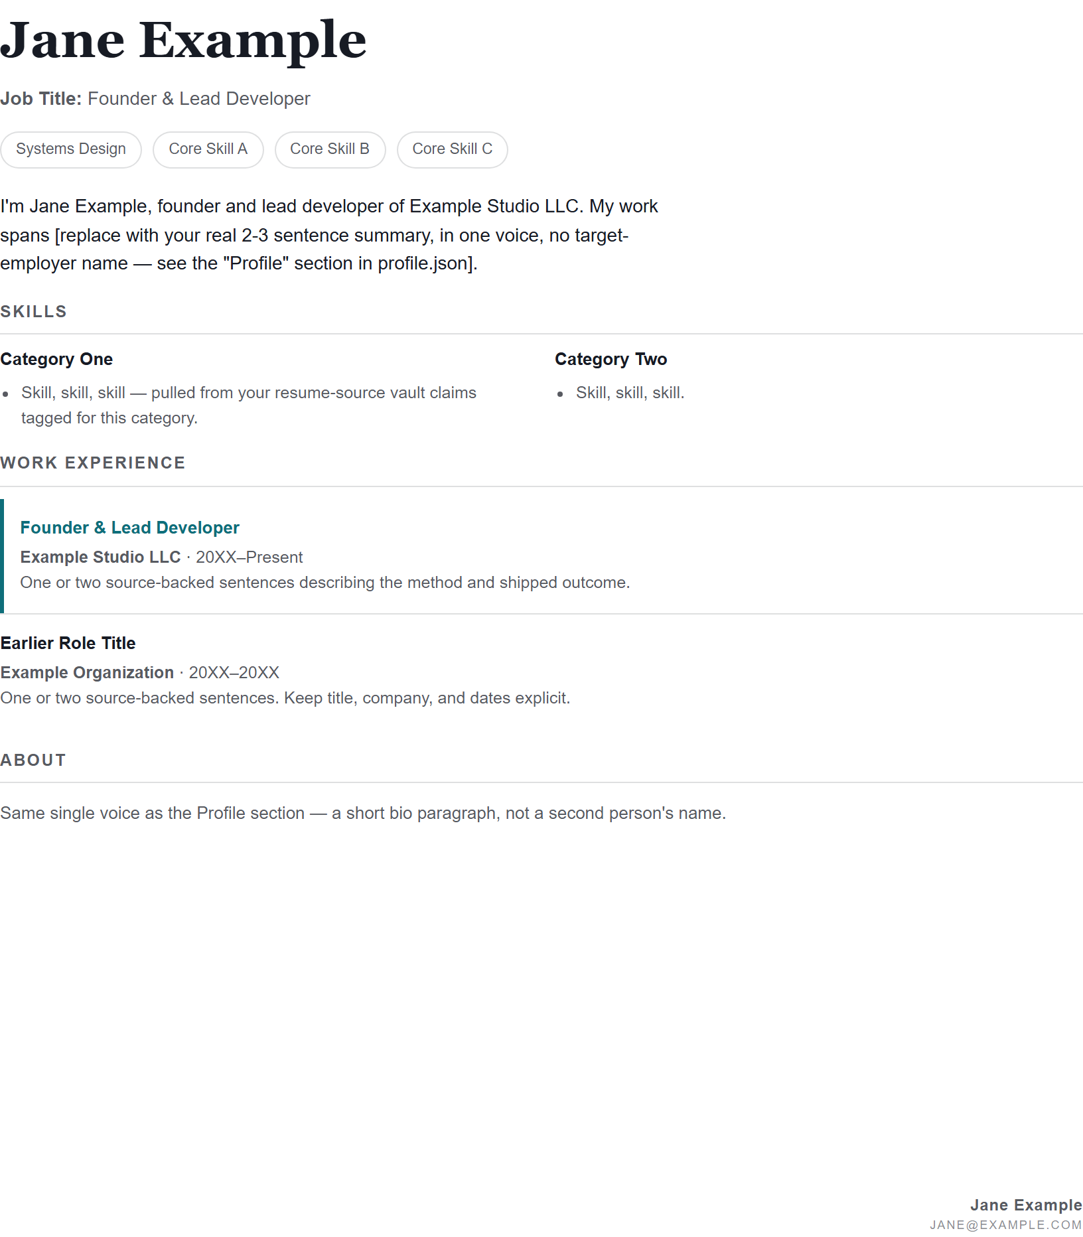
PDF DESIGNER
Your résumé should
print exactly as
you designed it.
A local-first PDF studio for source-backed, ATS-honest applications — with a branded version for human eyes.
HTML → PDF · light + dark · private vaults · rendered QA
Notes:
[Sources]
Product claims and terminology: docs/PRODUCT.md; public sample: examples/profiles/default-resume/default-resume.html.

Slide 2
THE JOB-MARKET PROBLEM
PDF DESIGNER / 02
Job applications need a system that respects both truth and presentation.
Most tools force a trade-off: generic templates, fragile ATS output, or a cloud service that owns your history.
Generic output
Unreliable print
Data surrender
A résumé looks like every other template — even when the work behind it is specific.
A document can look polished on screen and still overflow, clip, or shred in an ATS text layer.
Career facts and job history drift into a hosted form instead of remaining a local source of truth.
PDF Designer keeps the application workflow local, source-backed, and verifiable.
Notes:
[Sources]
Problem framing: docs/PRODUCT.md (Why this exists; pain/answer table). No external claims.

Slide 3
ONE ENGINE, TWO AUDIENCES
PDF DESIGNER / 03
Design once. Export the right PDF for the moment.
The same HTML keeps pagination stable while each export serves a different reader.
A
Light PDF for boards
H
Dark PDF for humans
ONE HTML SOURCE
System-font print styling plus a text-layer check keeps applications parseable for Jobright, Indeed, and LinkedIn.
EXPORT
The branded version carries the same content and pagination — tailored for a person reviewing your work.
Same source. Same page geometry. Different context.
Notes:
[Sources]
Dual-mode and ATS claims: AGENTS.md (Dual mode; Board upload); docs/JOB-ASSESSMENT.md; docs/PRODUCT.md.

Slide 4
THE STUDIO LOOP
PDF DESIGNER / 04
A small workflow that makes good output repeatable.
01
02
03
04
Start
Shape
Export
Verify
Open a public example or your own local workspace.
Write in HTML, select a palette, and keep claims source-backed.
Create synchronized light and dark PDFs.
Run the rendered QA gate; use the light file for boards.
The Design Hub makes the loop visible locally: browse, swap palettes, export, and refresh without restarting.
Notes:
[Sources]
Workflow: README.md; docs/GETTING-STARTED.md; AGENTS.md (QA gate and Design Hub).

Slide 5
PRIVACY IS A PRODUCT FEATURE
PDF DESIGNER / 05
One checkout. Your data stays yours.
Privacy is not a second app or an environment file. It is a clear local workspace with real files kept out of Git.
users/
vaults/
profiles/
resumes/
_job-apps/
collages/
brands/
✓
Tracked examples teach the shape
✓
Real local data is gitignored
✓
No .env or cloud vault required
Notes:
[Sources]
Workspace and privacy model: docs/GETTING-STARTED.md; docs/WORKSPACE-LAYOUT.md; docs/PUBLIC-LOCAL-SPLIT.md.

Slide 6
RELEASE-READY, NOT PUBLISHED
PDF DESIGNER / 06
The public path is prepared. The remaining gates are deliberate.
PDF Designer is being prepared as a free GitHub toolkit. A future paid shell adds guidance — never a second renderer or a cloud vault.
Ready now
Human launch gates
✓
Public example + smoke proof
✓
History scrub and public push
✓
README + product documentation
✓
Patreon / blog publication
✓
Design Hub, themes, layouts, QA
✓
Gumroad only when the installer exists
Build your résumé. Keep your story. Verify the PDF.
Local Design Hub: http://127.0.0.1:8787/
Notes:
[Sources]
Current release state and human gates: product-design/docs/PDF-DESIGNER.md; Plans/_Active/2026-08-13-launch-ready-workspace.md; docs/PRODUCT.md.

