Slide 1

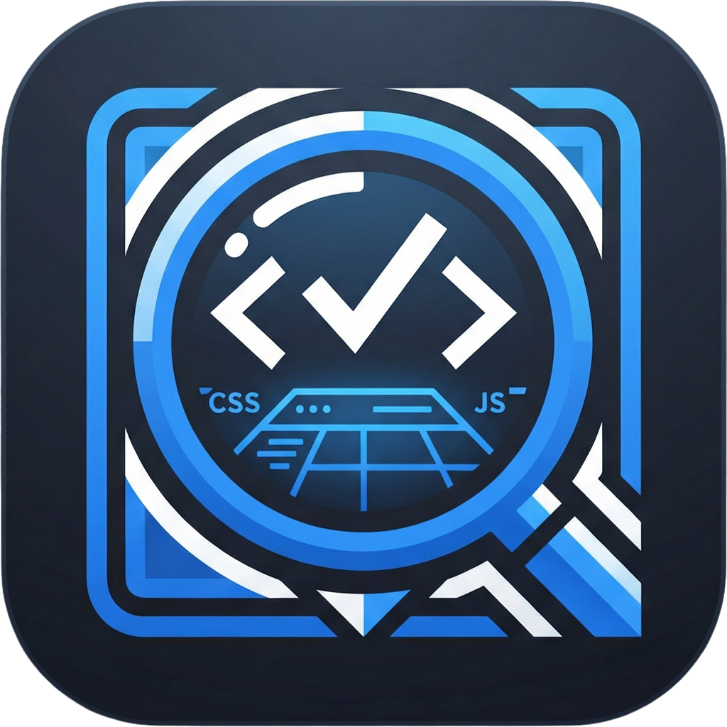
Site Auditor Pro
The First Dual-Mode Website Auditing Tool
Making the web accessible, one audit at a time. Analyze light & dark modes simultaneously.
Production Ready • Live on Vercel

Slide 2







The Problem
With dark mode becoming standard (82% user preference), current auditing tools are leaving critical accessibility gaps.
Light Mode Only
Vague Advice
Blind Implementation
Most tools completely ignore dark mode, missing 50% of potential accessibility violations and contrast issues.
Generic "improve contrast" warnings without specific hex codes or actionable solutions force developers to guess.
No way to preview fixes before committing code. Developers have to implement, deploy, and re-audit in a slow loop.
Leaves users in the dark
Wastes developer time
Slow iteration cycles

Slide 3

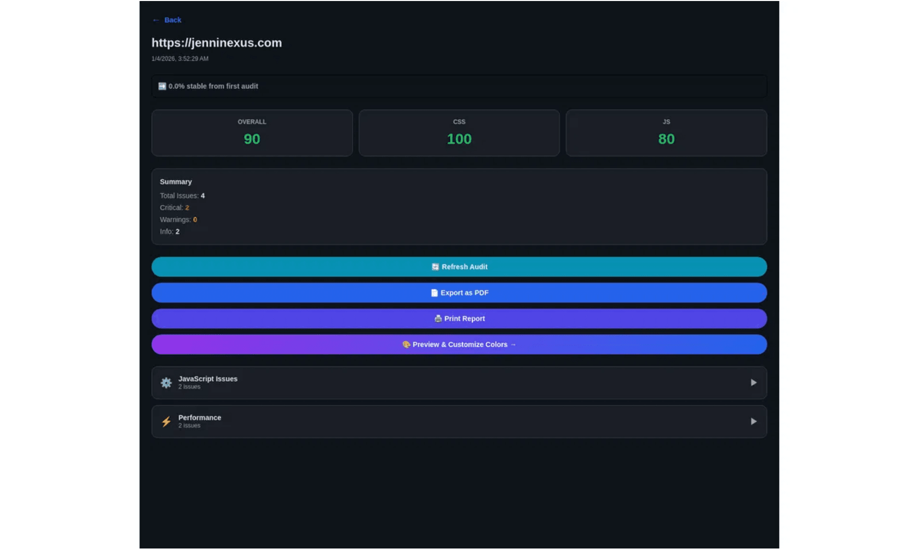


Our Solution
The first comprehensive auditing tool designed for the modern web ecosystem.
Dual-Mode Analysis
Analyzes both light and dark modes simultaneously to catch issues other tools miss.
Unique Feature
Specific Color Fixes
Provides 3 specific WCAG-compliant color alternatives with exact hex codes.
Live Preview
Test fixes in real-time with a live website preview before committing any code.

Slide 4




Competitive Advantages
Why Site Auditor Pro is superior to existing free tools.
Dual-Mode Analysis
Live Preview
Framework Aware
Others
Others
Others
Only check light mode. Miss 50% of issues.
Static reports. Implement fixes blind.
Generic parsing. Breaks on modern stacks.
Site Auditor Pro
Site Auditor Pro
Site Auditor Pro
Analyzes Light + Dark modes simultaneously.
Real-time preview & variable editing.
Native Bootstrap & Tailwind support.
2x
-5h
100%
More Issues Caught
Saved Per Project
Modern Stack Ready

Slide 5





Target Market
Empowering the creators of the modern web ecosystem.
Web Developers
TAM
Fix accessibility issues before they become problems.
28M
Web Developers Worldwide
Designers
Test color schemes for WCAG compliance early.
SOM
SAM
8M
500K
Accessibility-Critical
Agencies
Agencies & Freelancers
Audit client sites and provide professional reports.
Product Teams
Ensure consistent quality across web properties.

Slide 6









Business Model
Transitioning from community growth to a sustainable SaaS revenue model.
Current
Free
Pro
Team
API / Ent
$0
$19
/mo
$49
/mo
Custom
Unlimited Audits
5 User Seats
Basic Audits
All Export Formats
Shared Reports
High-volume API
HTML Exports
Priority Support
White-labeling
CI/CD Integration
Community Support
API Access (Basic)
Team Management
SSO & Security
Limited History
SLA Guarantee

Slide 7





Business Value
Delivering measurable ROI across the entire web development lifecycle.
Freelancers & Agencies
Product Teams
Clients expect WCAG compliance, but manual auditing is slow. Automate the process and generate professional reports instantly.
Accessibility issues found late are expensive. Audit staging sites before launch to catch issues early.
Impact
Impact
Save 5-10 Hours / Project
80% Reduction in Post-Launch Fixes
Designers
Developers
Test color palettes against WCAG standards in both light and dark modes before handing off to developers.
Stop guessing with vague advice. Get exact hex codes and copy-paste CSS fixes.
Impact
Impact
Eliminate Back-and-Forth
Fix in Minutes vs Hours

Slide 8
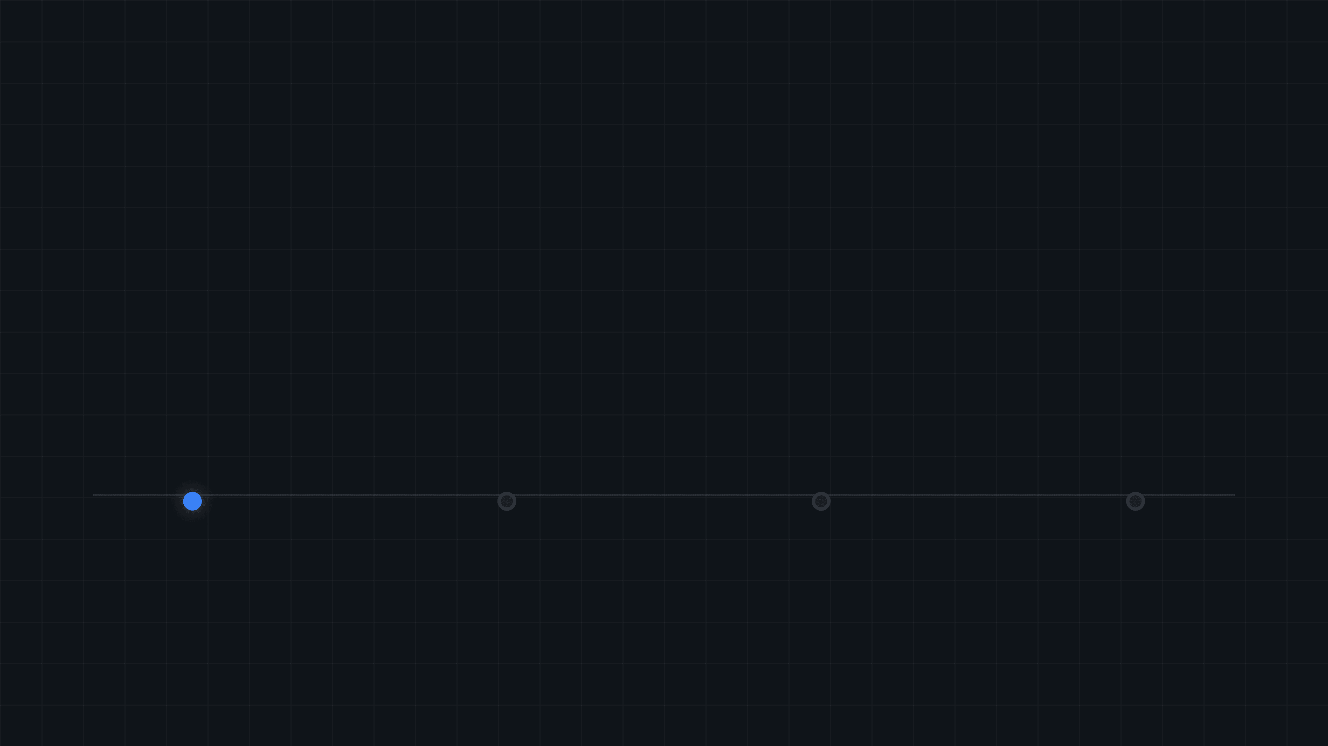



Traction & Roadmap
From launch to enterprise scale in 12 months.
Live Production
10K
10K
500+
10/10 Features Functional
Audits (3 Mo)
MAU (12 Mo)
Pro Users
Product Roadmap
Q1 2026 (Current)
Q2 2026
Q3 2026
Q4 2026
Launch
Extensions
Integration
Scale
Core Auditing
Chrome Extension
CI/CD Actions
Mobile App
Dual-Mode Analysis
VS Code Plugin
API Access (Beta)
Enterprise SSO
Live Preview
Team Collaboration
White-label Reports
On-premise Deploy
Product Hunt Launch
Automated Monitoring
Pro Tier Launch
Partner Program

Slide 9





Why Now?
Market forces are converging to create immediate demand for better accessibility tools.
+300%
82%
Dominant
67%
ADA Lawsuits
Dark Mode
Frameworks
Need Tools
Accessibility litigation has tripled since 2018. Compliance is no longer optional.
Users prefer dark mode, but most sites are only tested for light mode accessibility.
Bootstrap & Tailwind rule the web. Tools must understand these modern stacks.
Developers cite lack of proper tooling as the #1 barrier to accessibility.

Slide 10










The Ask
Join us in building the standard for accessible web development.
Immediate Focus
Future Growth (6-12 Mo)
User Feedback
Seed Funding
Beta testing with agencies and freelance developers to refine the workflow.
$250K - $500K
To accelerate product development and go-to-market.
Community Growth
Key Hires
Engagement on GitHub and Product Hunt to build initial traction.
Marketing Lead and Accessibility Expert to drive adoption.
Partnerships
Strategic Partners
Integrations with existing dev tools and accessibility platforms.
Enterprise pilot programs with large product teams.
site-auditor-pro-nine.vercel.app
github.com/jenninexus/site-auditor-pro

