Slide 1
Module 7: Business Process Solutioning IT Requirements
IS210 – Business Process Analysis and Solution
BPAS Teaching Team

Slide 2
Learning Objectives
Understand the methodology to discover
The Functional Requirements for the IT Solution
Discover the IT functional requirements from the TO-BE process
Develop Use Case Model
Develop Function Model
Notes:
Call IT team to ask them about implementation
It is the job of the BPE team to convert To-Be model to IT language.

Slide 3
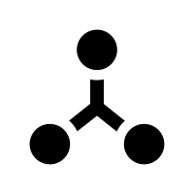



The Learning Journey
Process Selected
Process Modelled
Process Analysed
Process Deployed
Process Managed
WEEK 1 - 3 Business
Process
Modelling
WEEK 3 – 5 Business
Process
Analysis
WEEK 6 – 9
Business
Process
Solutioning
WEEK 10 – 12
Business
Process
Innovation

Slide 4
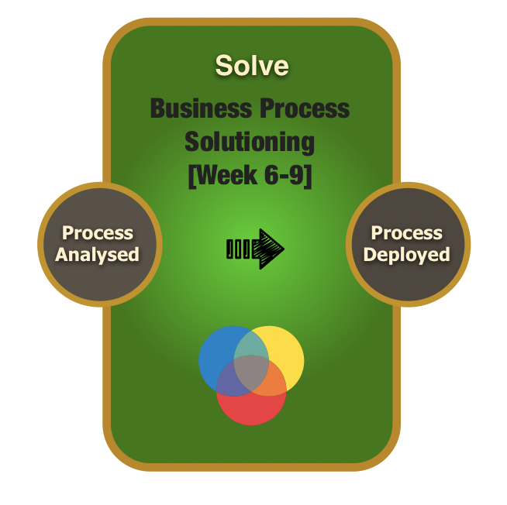
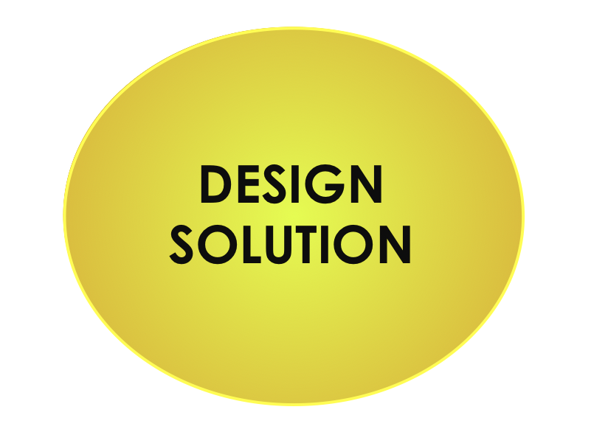
Model and Analyse
Notes:
The To-Be diagram that has been selected is our input, and we start preparations to convert this diagram into IT requirements.

Slide 5
Process Solutioning Big Picture
IT Functional Requirements
Concept Solution Blueprint
Solution Overview Modeling
Modeling use cases
Modeling functional requirements
Application Modeling
Risk Modeling
Cost Modeling
Packaging use cases
Use Case Model
Use Case Packages
Function Model
Solution Overview Model
Application Model
Risk Model
Cost Model
Notes:
The first part is the “Use Case Model” row.

Slide 6
IT Functional Requirements

Slide 7
IT Solution Requirements
Developing the Functional requirements is the focus.
IT Functional Requirements
Modeling use cases
Packaging Use cases
Modeling functional requirements

Slide 8
IT Solution Requirements
IT Functional Requirements
Modeling use cases
Packaging Use cases
Modeling functional requirements
Use Case Model
Use Case Packages
Function Model

Slide 9
Functional Requirements
Functional Requirements
Modeling use cases
Packaging Use cases
Modeling functional requirements

Slide 10
Functional Requirements for Business Processes
“In software engineering and systems engineering, a functional requirement defines a function of a system or its component, where a function is described as a specification of behavior between outputs and inputs” - Wikipedia
Notes:
A business user gives an input, your system must be able to come up with an output.
E.g. Use Cases in a Discussion forum could be “Pin Thread”, “New Thread” and other dropdown options.
- They can be grouped together as managing threads.

Slide 11
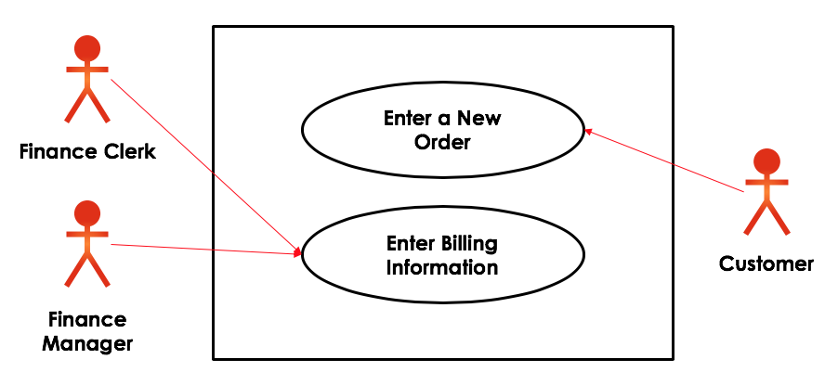

Functional Requirements Methodology
1. Study the chosen To-Be workflow model
2. Modeling use cases
Identify actors
Identify use cases and relationships
Depict use cases in graphical model
Use Case Model
3. Packaging use cases
Identify related use cases
Group related use cases
Provide function name to package
Use Case Packages
4. Modeling Functions
Define the type of use cases
Define system ownership
Define any technical aspects
Function Model

Slide 12
Background

Slide 13
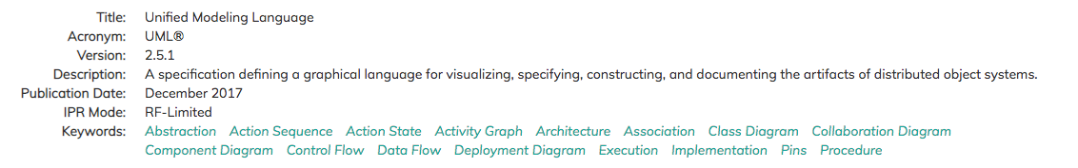
Unified Modeling Language
“The Unified Modeling Language (UML) is a general-purpose, developmental, modeling language in the field of software engineering, that is intended to provide a standard way to visualize the design of a system.” – Wikipedia

Slide 14
UML – Use Case Diagram
Use case diagram is a representation of a user's interaction with the system that shows the relationship between the user and the different use cases in which the user is involved.
Notes:
Tells us how the system is working with the user (relationship between user and system’s performance)
E.g. Swapna can manage the threads with the dropdown menu. (She is the user, and the dropdown menu is the part of the system she is using

Slide 15
Use case Models
Use case diagrams/models describe what a system does from the standpoint of an external observer. The emphasis is on what a system does.
Illustrates the activities that are performed by the users of the system
Use case diagrams are closely connected to scenarios. A scenario is an example of what happens when someone interacts with the system.

Slide 16
Scenario Example -1
Here is as-is scenario for a Jurong medical clinic for medical appointment booking process.
“Mac calls the clinic to make an appointment for a yearly health-checkup. The receptionist finds the nearest empty time slot in the appointment book and the staff book. Doctor records his/her availability in the staff book. She schedules the appointment for that time slot with an available doctor. "
Notes:
- No technology is used; they are using physical books

Slide 17
Scenario Example -2
Here is to-be scenario for a Jurong medical clinic for medical appointment booking process.
Mac submits the appointment request online to make an appointment for a yearly health-checkup. Doctor records his/her availability in the staff module. The receptionist finds the nearest empty time slot in the appointment module and available doctor from the staff module. She schedules the appointment for the time slot with an available doctor and saves.

Slide 18
Use Case Model Components
Use case model consists of three components.
The actor(s) who perform the activity.
The use case that represents a feature needed in a software system.
The relationship line to link the actor to the use case.
Actor
Use case
Relationship

Slide 19
Actor
An Actor interacts with an IT system.
It can be a:
Human
Peripheral device (hardware)
External system or subsystem
Labelled using a noun
Represented by a stick figure
Actor
Actor
Use case
Relationship
Notes:
- External or subsystem refers to the system that asks for info from the IT system, hence interacting with it.

Slide 20
Finding Actors
Who is interested in the scenario/system?
Who will benefit from the use of the scenario/system?
Who will supply the scenario/system with the information, use the information, and remove the information?
Give a generic name or label to the Actors.
Notes:
Who are the users using the system?
Who is going to give input to the system?
An actor is always SINGULAR.

Slide 21
Actor for Medical Booking System
Mac submits the appointment request online to make an appointment for a yearly health-checkup. Doctor records his/her availability in the staff module. The receptionist finds the nearest empty time slot in the appointment module and available doctor from the staff module. She schedules the appointment for the time slot with an available doctor and saves.
Mac is a patient.
Patient

Slide 22
Use Cases
The use case is a summary of scenarios for a single task or goal.
It is a list of actions or interactions with the system
Labelled using a descriptive verb-noun phrase
Represented by an oval
Use case
Book Ticket
Actor
Use case
Relationship

Slide 23
Finding Use cases
The tasks that each Actor requires the system to perform. This may influence both the description of the Actor and the Use Case.
Whether each Actor needs to create, read, update, and/or delete any data to/from the system which is commonly referred to as “CRUD”; Create, Read, Update, and Delete.
If any of the Actors informs the system of any changes.
If any Actor requires notification of any system occurrences.
Notes:
Looks for verbs, they should do something with the system (aka CRUD)
-

Slide 24
Use Case for Medical Booking System
“Mac submits the appointment request online to make an appointment for a yearly health-checkup. Doctor records his/her availability in the staff module. The receptionist finds the nearest empty time slot in the appointment module and available doctor from the staff module. She schedules the appointment for the time slot with an available doctor and saves.
”
The Use Case is Request Appointment.
Request Appointment

Slide 25
Relationship
Represents communication between actor and use case
Depicted by line or double-headed arrow line
Also called association relationship
Request Appointment
Patient
Actor
Use case
Relationship

Slide 26
Summary of use case model
Actors are stick figures. Use cases are ovals. Relationships are lines that link actors to use cases.
relationship
Request Appointment
actor
Patient
use case

Slide 27
7.1 Use case model activity
Class teams
10
Medical Booking System Scenario
“Mac submits the appointment request online to make an appointment for a yearly health-checkup. Doctor records his/her availability in the staff module. The receptionist finds the nearest empty time slot in the appointment module and available doctor from the staff module. She schedules the appointment for the time slot with an available doctor and saves.
Draw the use case model
Notes:
- For receptionist, you can combine “finding time slot” and “finding available doctor” in ONE use case.

Slide 28
Use Case - Summary
Use case is a task, performed by an Actor that has some useful outcome
An Actor can be a human user or an IT system
Enter a New Order
Finance Clerk
Enter Billing Information
Customer
Finance Manager

Slide 29
Use Case Model
2. Modeling use cases
Identify actors
Identify use cases and relationships
Depict use cases in graphical model
Use Case Model

Slide 30
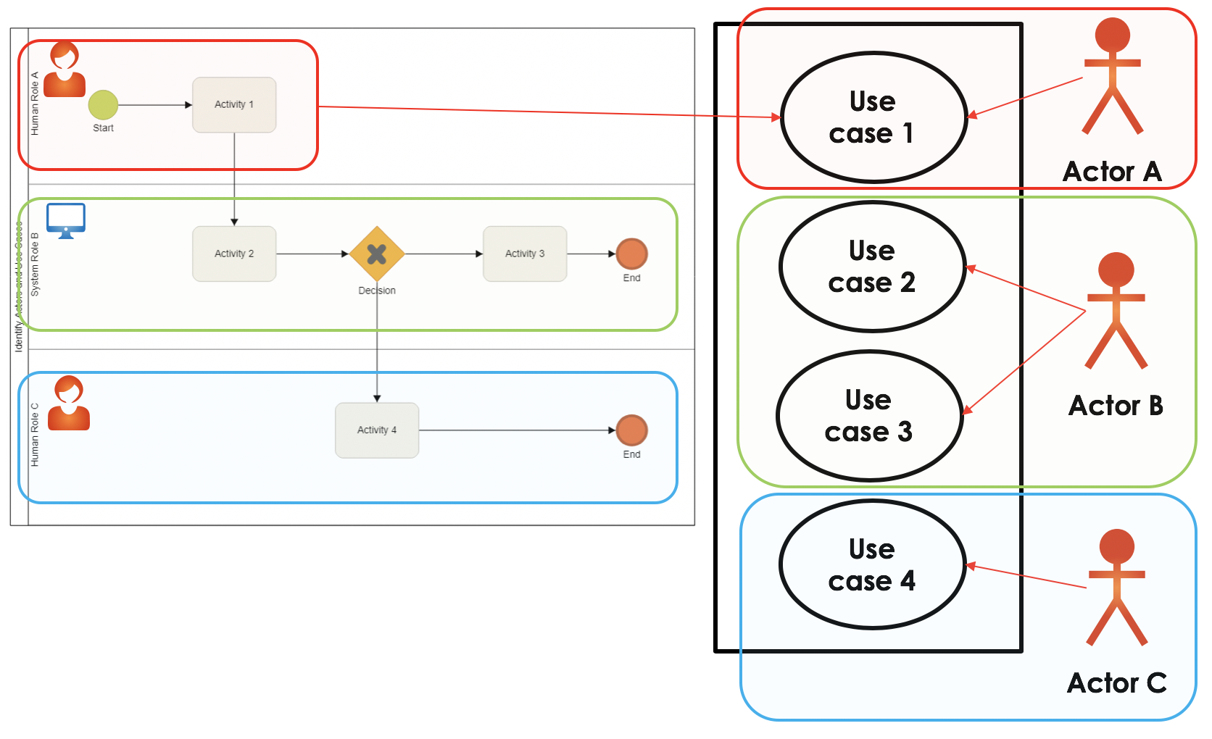
Identifying Actors from Workflow
Actors – All humans and systems in the swim lanes are actors. The systems with which the humans or systems interact are also actors
Actor
Use case
Relationship

Slide 31
Identifying Use Cases from Workflow
An automated or interactive activity in the Workflow Model is a potential candidate for a Use Case
What about manual activities?
Activity
Activity 1
Activity 2
Activity
Use case
Use case
Use case 1
Use case 2
Actor
Use case
Relationship
Notes:
You can combine 2 activities into one use case, or SPLIT one activity into 2 use cases
Not advised to have 2 activities to one use case.

Slide 32
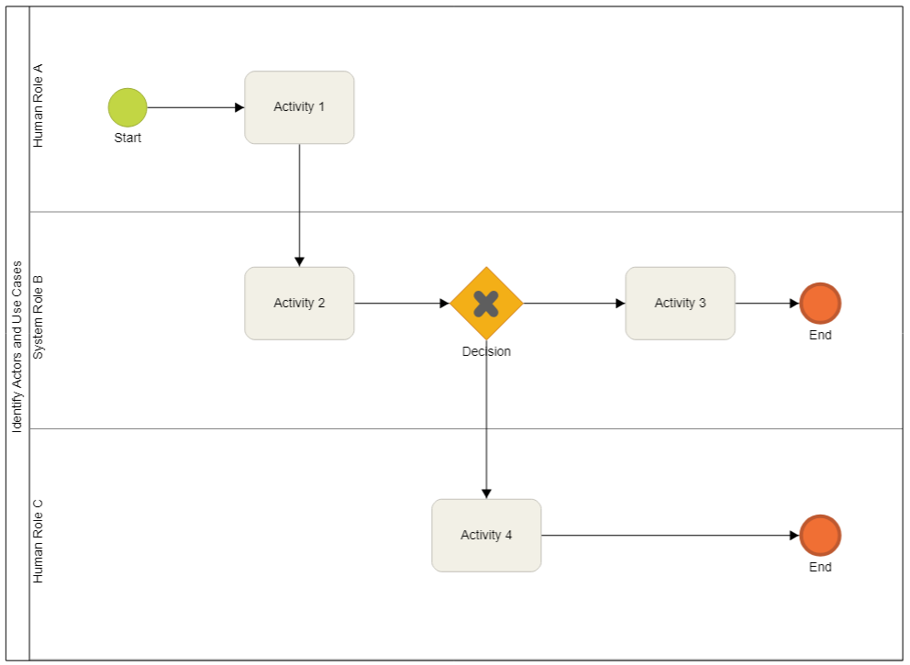

Example - Identifying Actors and Use Cases
Use case 1
Actor A
Use case 2
Use case 3
Actor B
Use case 4
Humans and Systems are actors
Actor C
Notes:
If activity is not manual, make that activity into a use case.

Slide 33
Example Solution- Use Case Model
Use case 1
Use case 5
Actor A
Use case 2
Use case 3
Two extra use cases not from the to-be workflow
Actor B
Use case 4
Actor C
Use case 6
It is possible that one may need to add Use Cases that are not in the Workflow Model

Slide 34
Possible use cases out of workflow
Logging in functions
Search functions
Security functions
Personalization functions

Slide 35
Rules to create use cases from workflow
Manual activities will not be converted into use cases
Interactive activities
Use cases are in relationship with the human actor
Automated activities
If two systems are involved in an activity, we depict two use cases for integration.
System actor (sending machine) will have the use case as client
Receiving machine will have the use case as server
Though sounds logical, please don’t combine automated use cases.
Notes:
If a machine performing an activity by itself, only one use case
If machine performs activity with another machine together, that activity should be SPLIT into two use cases. (sender interacts with use case SENDING, receiver interacts with use case RECEIVING)
Sending a request is sending code and receiving code.
Receiving machine, will also be an actor.
System Integration Use Case → When the systems communicate with each other.

Slide 36
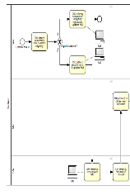
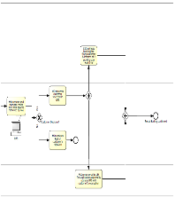
7.2 – StarMall use case model
Class Teams
20
Use the StarMall To-Be Workflow Model provide
Develop use case model for StarMall To-Be Workflow Model

Slide 37
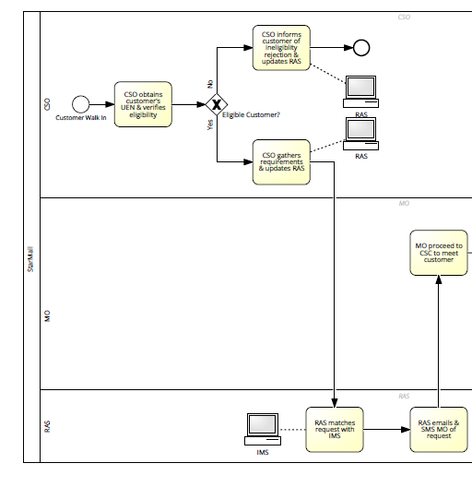
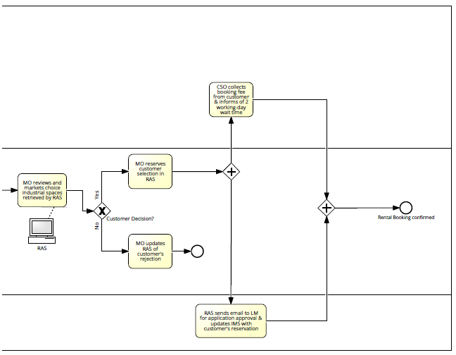

StarMall To-be Workflow Model
UEN Website
RAS

Slide 38
Discuss 7.2a - Use case Model
Interactive activities | Actor
Verifying Eligiblity of UEN | CSO
Updates RAS with ineligibility rejection status | CSO
Updates RAS with requirements | CSO
Retrieve industrial space choice | MO
Reserve Customer selection | MO
Update RAS with customer rejection | MO
Automated activities | System Actor (Send) | System/s (Receiving/Sending)
Send Request | RAS | IMS
Send Match | IMS | RAS
Send Customer Request Email to MO | RAS
Send Customer request SMS to MO | RAS
RAS sends approval email to LM | RAS
Send Customer Selection to IMS for updating. | RAS | IMS

Slide 39
Use Case packages
3. Packaging use cases
Identify related use cases
Group related use cases
Provide function name to package
Use Case Packages

Slide 40
Use case Packages
A use-case package is a collection of use cases, actors, and relationships
It is used to structure the use-case model by dividing it into smaller parts
Each package will be given a unique function name that supports the overall functionality of the use cases in the package
Identify related use cases
Group related use cases
Provide function name to package
Notes:
The dropdown menu for thread can be considered as “Thread Package”. (All use cases inside the dropdown menu are thread)

Slide 41
Rules for packaging
Related use-cases in the same system will be grouped
Use-cases that belong to different systems should not be grouped together
You can add extra use cases as deemed necessary
Use cases that interact with other systems should be grouped together (Rule 2 is still applicable) – Integration use cases
Integration use cases should be separated for each system (Rule 4 is still applicable)
For existing use cases of System A in as-is model, when re-created in a new system, we refer them as new use cases.
Notes:
As long as use cases are in the single machine, you can group them together.
E.g. Use cases within eLearn system can be put as same package “eLearn Package”
But if I have a use case in “Student Mgmt”, and a similar one in eLearn, NEVER Combine them.
Based on Rule 4, all integration use cases within a system should be grouped together by default
If you decommission a system in To-Be model, you call it as a new system, as the code might be existing, but since you are creating a new system based on that code, it is considered NEW.

Slide 42
Use case model to Use Case Package
Use case 1
Function A
Use case 1
Use case 5
Function B
Actor A
Use case 5
Use case 3
Use case 2
Use case 4
Use case 3
Actor B
Function C
Use case 6
Use case 4
Use case 2
Actor C
Use case 6
Use case model
Use case packages

Slide 43
Function Model
4. Modeling Functions
Define the type of use cases
Define system ownership
Define any technical aspects
Function Model

Slide 44
Function Model
Function model is the definition of the technical details of all use-case packages.
Technical details include
Type of the use cases (new, existing with modification and existing without modification).
System ownership of the use cases – for code implementation
Any relevant technical comments about the use case such as its as-is information
If there are many use cases or actors, you can use function model to further structure the use-case model in terms of technical aspects.
Define the type of use cases
Define system ownership
Define other technical aspects
Notes:
-E.g. Use case about SMS. IF you want to add another feature (SMS with additional notifications or timed notifications) you are modifying the SMS feature / use case.
- Existing E.g. Connecting to Database, the use case that does this SHOULD NOT be changed.

Slide 45
Function Model Template
Technical Details
Function | Use Case | New / Existing / To be modified | System/Comments
Function A | Use Case 1 | New | System A- This is currently done manually
 | Use Case 5 | To be modified | System A – use case is partially supported by System A but will require modifications
Function B | Use Case 4 | Existing | System B - Fully supported by System B
 | Use Case 3 | New | System B - This is an existing use case in System C and moved now to System B
 | Use Case 6 | To be modified | System B -Will require modifications
Function C | Use Case 2 | New | System B – new use case
Notes:
Existing – no need modify
- There are 3 systems, but System C has had a feature removed (System may still be existing if there are other features).

Slide 46
7.3 – StarMall Function Model
Class Teams
30
Use the To-Be Workflow Model and the Use Case Model
For StarMall rental application process:
7.3.a: Develop the use case package
7.3.b: Develop the function model

Slide 47
Discuss – Package Use Cases (5 mins)
What are the main features of the StarMall to-be business process?

Slide 48
Activity 7.3a – Use Case Package (10 mins)
Verification Module
Rental-Request Mgmt
Reservation Module
Communication Mgmt
Integration Module RAS
Integration Module IMS

Slide 49
Activity 7.3b– Function Model (10 mins)
Function | Use Case | New / Existing / To be modified | System/Comments
Rental Request Management | Enter customer requirements in RAS | New | RAS – Currently done manually
 | Update rental application rejection in RAS | New | RAS – Currently done manually
 | View rental requirements in RAS | New | RAS – Currently done manually
Reservation Module | View industrial spaces in RAS | New
 | Reserve customer selection in RAS | New | RAS – Was done using IMS
 | Update RAS of customer rejection | New | RAS – Currently done manually
Communications Management | Send customer request SMS to MO | New
 | Send customer request email to MO | New
 | Send customer application approval request email to LM | New | RAS – Currently done manually
Integration Module RAS | Send match request to IMS | New
 | Send customer selection to IMS | New | RAS – System Integration
Verification Module | Verify customer's UEN in Gov website | Existing | External Website from Government
Integration Module IMS | Update customer selection sent by RAS | Tobe modified | IMS – Currently interactive use case. System integration
 | Send match results to RAS | New | IMS – System integration

Slide 50
Need for Function Model
You can use use-case packages to reflect order, configuration, or delivery units in the finished system.
Allocation of resources and the competence of different development teams may require that the project be divided among different groups
In some applications, certain information should be accessible to only a few people. Use-case packages let you preserve secrecy in areas where it is needed.
Use-case packages ensure that changes from a particular user type will affect only the parts of the system that correspond to that user type.

Slide 51
BPAS Teaching Case Part 3 - Review

Slide 52
Class Reflection
Individual
5
Module 7: Business Process Solutioning
– IT Requirements
Reflect about the class
Answer the questions at the Google Form https://smu.sg/IS210Reflect

