Slide 1
Module 7: Business Process Solutioning IT Requirements
IS210 – Business Process Analysis and Solution
BPAS Teaching Team

Slide 2
7.1 Use case model activity
Class teams
10
Medical Booking System Scenario
“Mac submits the appointment request online to make an appointment for a yearly health-checkup. Doctor records his/her availability in the staff module. The receptionist finds the nearest empty time slot in the appointment module and available doctor from the staff module. She schedules the appointment for the time slot with an available doctor and saves.
Draw the use case model

Slide 3
Solution 7.1 – Use Case Model
Request Appointment
Find schedule
Receptionist
Find available staff
Patient
Book Appointment
Answers may vary with assumptions
Submit availability
Doctor

Slide 4
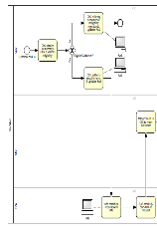
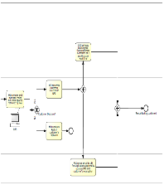
7.2 – StarMall use case model
Class Teams
20
Use the StarMall To-Be Workflow Model provide
Develop use case model for StarMall To-Be Workflow Model

Slide 5
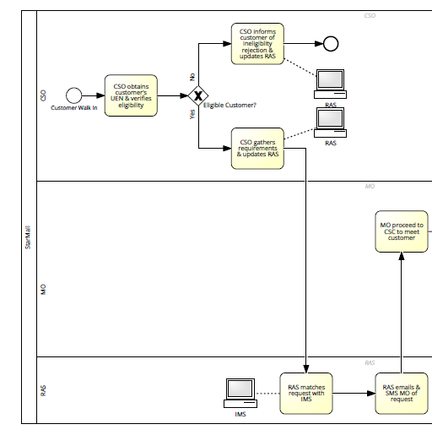
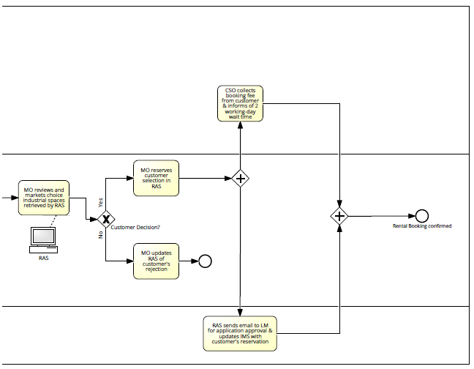

StarMall To-be Workflow Model
UEN Website
RAS
Notes:
-> What do we do with decision boxes? Are there use cases?
- No

Slide 6
Solution 7.2a - Use case Model
Interactive activities | Actor
Enter customer requirements in RAS | Customer Service Officer
Verify customer's UEN in Gov website | Customer Service Officer
Update rental application rejection in RAS | Customer Service Officer
View rental requirements in RAS | Marketing Officer, CSO
View industrial spaces in RAS | Marketing Officer
Reserve customer selection in RAS | Marketing Officer
Update RAS of customer rejection | Marketing Officer
Automated activities | System Actor (Send) | System/s (Receiving) if any
Send customer request email to MO | RAS
Send customer request SMS to MO | RAS
Send customer application approval request email to LM | RAS
Send match request to IMS | RAS | IMS
Send match results to RAS | IMS | RAS
Send customer selection to IMS | RAS | IMS
Update customer selection sent by RAS | IMS | RAS (Optional)
Notes:
All activities (except manual) should be converted to use cases. As long as a human uses machine, we call it as interactive activity.

Slide 7
Solution 7.2a - Use case Model
Interactive activities | Actor
Enter customer requirements in RAS (1) | Customer Service Officer
Verify customer's UEN in Gov website (2) | Customer Service Officer
Update rental application rejection in RAS (3) | Customer Service Officer
View rental requirements in RAS (4) | Marketing Officer, CSO
View industrial spaces in RAS (5) | Marketing Officer
Reserve customer selection in RAS (6) | Marketing Officer
Update RAS of customer rejection (7) | Marketing Officer
Extra Use case like CRUD
Automated activities | System Actor (Send) | System/s (Receiving) if any
Send customer request email to MO (8) | RAS
Send customer request SMS to MO (9) | RAS
Send customer application approval request email to LM (10) | RAS
Send match request to IMS (11) | RAS | IMS
Send match results to RAS (12) | IMS | RAS
Send customer selection to IMS (13) | RAS | IMS
Update customer selection sent by RAS (14) | IMS | RAS (Optional)
Two use cases for “RAS match request with IMS”
Two use cases for “RAS updates IMS with customer reservation”
Notes:
All activities (except manual) should be converted to use cases. As long as a human uses machine, we call it as interactive activity.

Slide 8
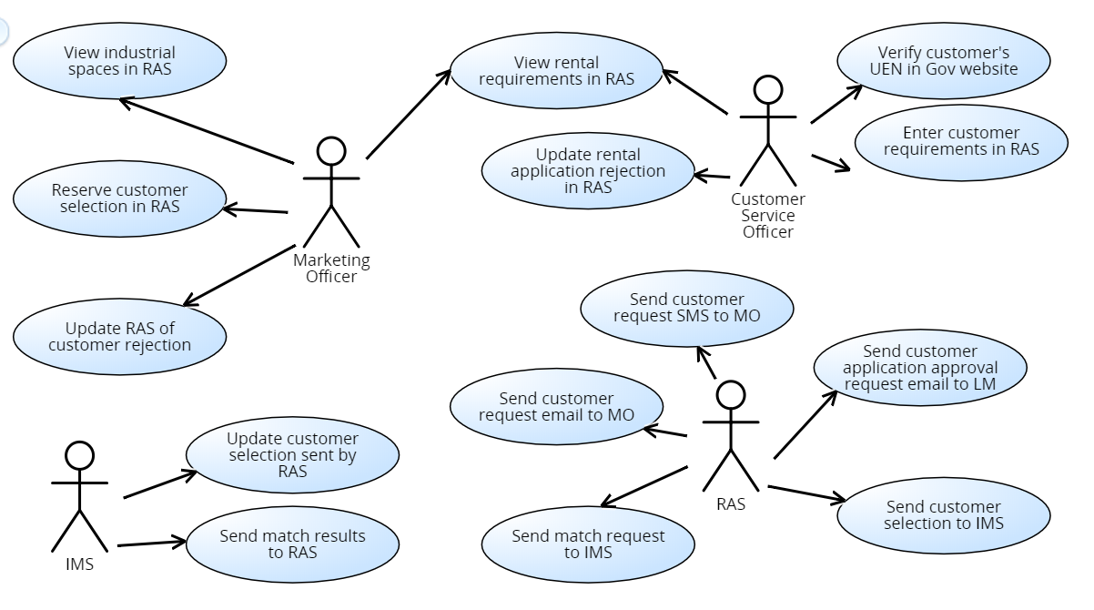
Solution 7.2b – StarMall Use Case Model

Slide 9
Solution 7.2b – StarMall Use Case Model
Use cases for system integration

Slide 10
7.3 – StarMall Function Model
Class Teams
30
Use the To-Be Workflow Model and the Use Case Model
For StarMall rental application process:
7.3.a: Develop the use case package
7.3.b: Develop the function model

Slide 11
Discuss Solution – Package Use Cases
What are the main features of the business process?
Rental requests
Rental reservations
Verifications
Notifications
Integrations
These features help us to name the packages

Slide 12
Solution 7.3a - Use Case Package
Enter customer requirements in RAS
View industrial space in RAS
Verify customer’s UEN in Gov Website
View rental requirements in RAS
Reserve customer selection in RAS
Verification Module
Update rental application rejection in RAS
Update RAS of customer rejection
Send customer request SMS to MO
Rental-Request Mgmt
Reservation Module
Send customer request email to MO
Send customer selection to IMS
Update customer selection sent by RAS
Send customer application approval request email to LM
Send match request to IMS
Send match results to RAS
Communication Mgmt
Integration Module RAS
Integration Module IMS

Slide 13
Solution 7.3b – Function Model
Function | Use Case | New / Existing / To be modified | System/Comments
Rental Request Management | Enter customer requirements in RAS | New | RAS – Currently done manually
 | Update rental application rejection in RAS | New | RAS – Currently done manually
 | View rental requirements in RAS | New | RAS – Currently done manually
Reservation Module | View industrial spaces in RAS | New | RAS – Was done using IMS
 | Reserve customer selection in RAS | New | RAS – Was done using IMS
 | Update RAS of customer rejection | New | RAS – Currently done manually
Communications Management | Send customer request SMS to MO | New | RAS – Currently done manually
 | Send customer request email to MO | New | RAS – Currently done manually
 | Send customer application approval request email to LM | New | RAS – Currently done manually
Integration Module RAS | Send match request to IMS | New | RAS – System Integration
 | Send customer selection to IMS | New | RAS – System Integration
Verification Module | Verify customer's UEN in Gov website | Existing | UEN – Fully supported
Integration Module IMS | Update customer selection sent by RAS | To be modified | IMS – Currently interactive use case. System integration
 | Send match results to RAS | New | IMS – System integration

