Slide 1
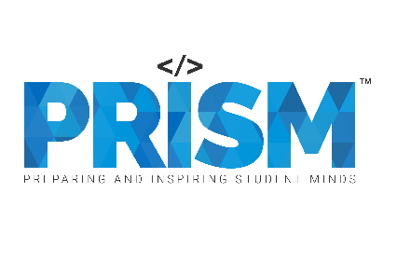

| Tech Management, SRI-B
CLAWS
CLASH OF THE
MSRIT_CrimsonLobster
LifeOS: A privacy-first workspace that simplifies your daily reality into one clear perspective.
Arpitha C Jennifer Monteiro

Slide 2
Idea
Problem Statement
Why this theme (On-device/Productivity): We chose this to prove that Generative AI can be a "silent partner" in productivity—automating the boring parts (like logging expenses) while keeping data strictly private and on-device.
The Problem: Digital Fragmentation. Most people use 3-4 different apps just to manage a single day (one for money, one for tasks, one for notes). This causes "context-switch fatigue."
The Persona: The "Focused Student/Professional." Someone who is overwhelmed by complex features and just wants a clean slate to manage their top-of-mind priorities.
Why it's important: Mental clarity is the ultimate productivity hack. By reducing the UI to a single command line, we help users get things out of their head and into a safe system in seconds.

Slide 3
Idea
Current Solution & Gaps
Existing solutions (if any): Standard apps like Todoist (for tasks), Notion (for notes), and Splitwise/Monefy (for expenses).
What’s missing/broken? These solutions are silos. They don't talk to each other. They require constant manual data entry and often sell user behavior data. They are designed for "power users," which leaves normal people feeling overwhelmed by "feature bloat."
Opportunity: The opportunity is in "Zero-Friction Logging." With the power of Llama 3.3 via Groq, we can turn a casual sentence into a structured memory. This is the transition from a "Database" to a "Living Memory" — a tool that feels more like a teammate and less like a chore.

Slide 4
Idea
Your Solutions
What we built: LifeOS — an AI-powered Android productivity app featuring a smart assistant, task manager, voice input, and smart reminders.
Core Ideas Explanation:
Assistant-First Entry: No forms. Just type/speak "I spent ₹200 on books" and it's filed.
Local-First Privacy: Data is treated as "Memory" rather than "Data," ensuring the user feels safe.
Adaptive Context: The app changes its "vibe" and focus based on whether you are in Academic or Personal mode.
Key Features:
Smart Neural Assistant: Instantly parses natural language into tasks and reminders via Llama 3.3 (Groq)
Memory Diary: Add, edit, delete tasks by category — Pending or Done
Voice Input & TTS: Speak tasks hands-free, app reads responses aloud
Smart Reminders: Set alarms via chat or time picker, fires as push notification

Slide 5
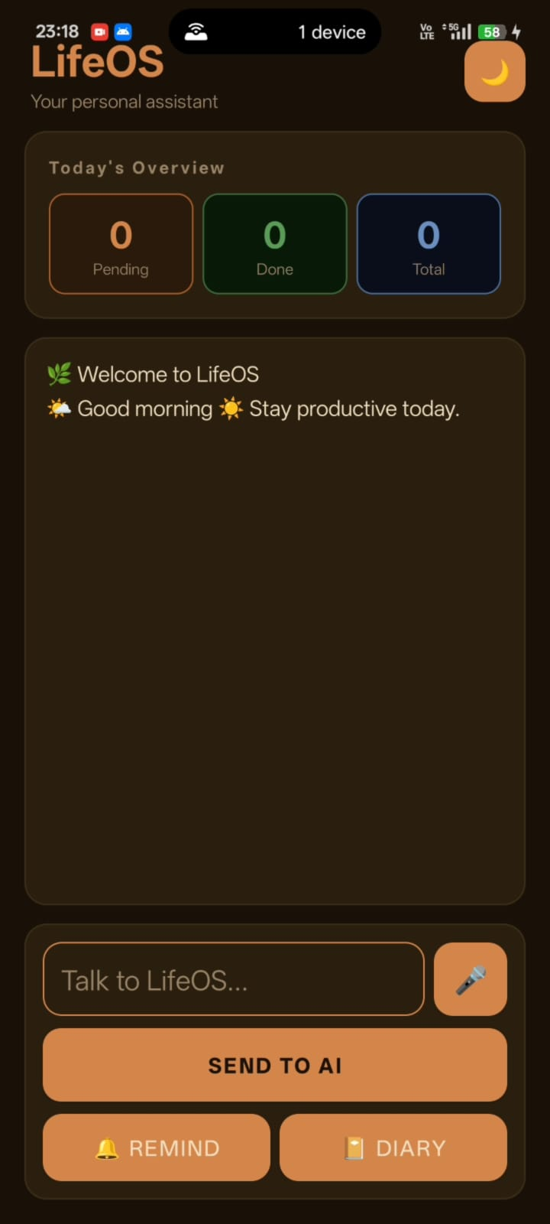
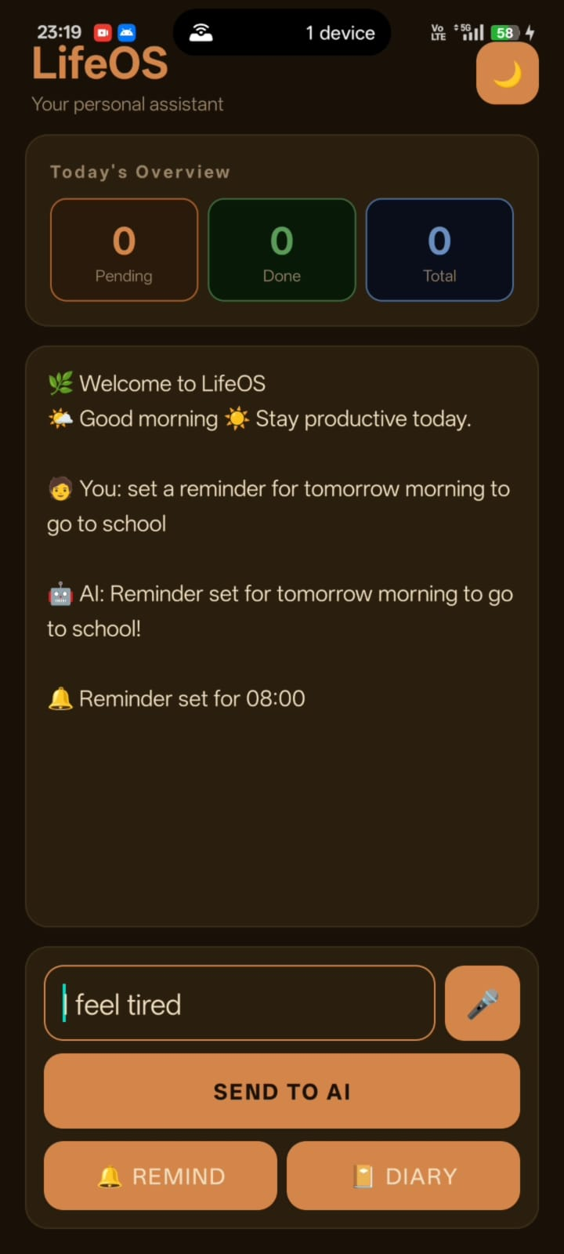
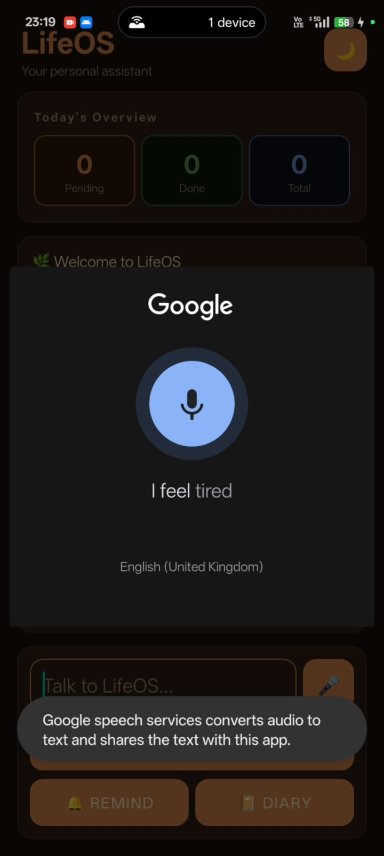
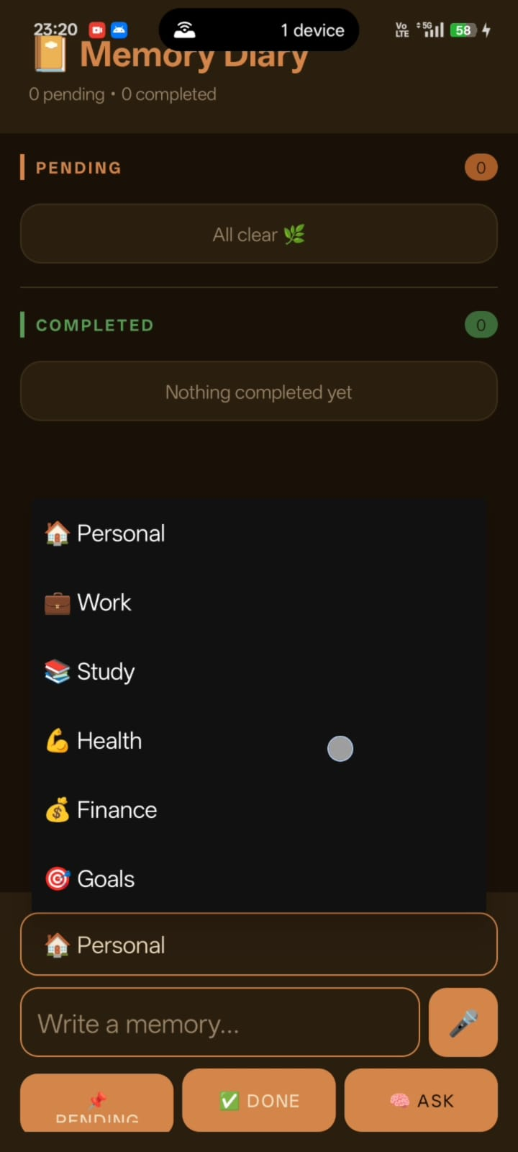
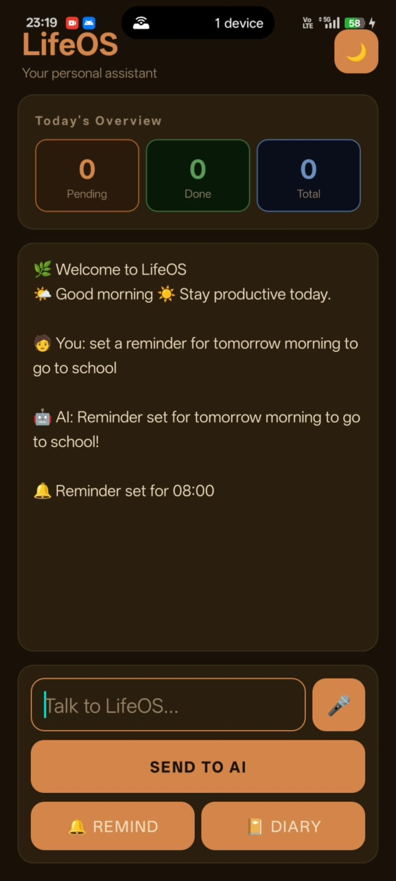
Idea
Demo/Product Walkthrough

Slide 6
Idea
Demo/Product Walkthrough
Screen/Flow | How User Interacts | Key Moments
Home Screen | Opens app, sees dashboard with Pending, Done, Total counts | Morning briefing: "Welcome to LifeOS ☀️ Stay productive today"
AI Chat — Reminder | Types "I feel tired", then types "Set a reminder for tomorrow morning to go to school" → taps Send to AI | AI parses intent and auto-sets reminder at 08:00
Voice Input | Taps mic button → Google Speech activates → speaks naturally | Speech converts to text and fills the input field
Memory Diary | Taps Diary → sees Pending and Completed sections with categories | Categories: Personal, Work, Study, Health, Finance, Goals. Tap to edit, long press to delete
Full Flow | Types message → taps Send to AI, Remind, or Diary | All actions accessible from one screen — no app switching

Slide 7
Idea
Tech & Architecture
Tech Stack
Frontend: Android (Kotlin), XML Layouts
Backend: Node.js (manages AI intent API)
Language: Kotlin (Android), JavaScript (server)
Database: SQLite (local, on-device)
AI Usage
Model: Llama 3.3 70B via Groq API
APIs: groq-sdk (Official Node.js SDK)
Implementation: A custom prompt-engineered Intent Extraction Layer that transforms unstructured user speech/text (e.g., "Remind me at 6pm" or "Save a task to buy groceries") into structured JSON objects for the database.
System Flow (Simple)
Capture: User types or speaks into the Assistant input field
Process: Input is sent to the Groq AI Engine, which identifies intent — task, reminder, or chat
Commit: Structured data is saved to SQLite on-device via DatabaseHelper
Reflect: Android UI updates the dashboard instantly showing new task counts and entries

Slide 8
Idea
Impact & Use cases
🎓 Student:
Rushing to class, remembers a deadline — says "Remind me to submit assignment at 9pm" — done in 2 seconds, no app switching
💼 Working Professional:
In a meeting, thinks of a task — types it quickly into LifeOS — saved, categorized, reminder set — all from one screen
🏠 Daily User:
Wants to track personal errands — speaks tasks hands-free while cooking — app saves and reads them back via TTS
😓 Overwhelmed Person:
Using 4 different apps daily — switches to LifeOS — one app replaces all of them
Scale Potential
Works fully offline — no internet needed for tasks and reminders
No account, no sign-up — instant setup on any Android device
SQLite scales to thousands of entries with zero lag
AI backend can be swapped to any LLM without changing the Android app

Slide 9
Idea
Impact & Use cases
Scale Potential
Works fully offline — no internet needed for tasks and reminders
No account, no sign-up — instant setup on any Android device
SQLite scales to thousands of entries with zero lag
AI backend can be swapped to any LLM without changing the Android app

Slide 10
Idea
Differentiation
MOAT 1 — Privacy by Architecture
Every competing app (Todoist, Notion, Google Tasks) stores your data on their servers. LifeOS stores everything in SQLite on your device. No account, no cloud, no data selling. This is not a feature — it's a structural decision that competitors cannot easily copy without rebuilding their entire backend.
MOAT 2 — Zero-Friction Natural Language as the Only UI
Most productivity apps still require forms, dropdowns, and menus. LifeOS replaces all of that with one input line — type or speak naturally, AI handles the rest. The lower the friction, the higher the habit retention. Users who don't need to "learn" an app will always come back to it.

Slide 11
Idea
Demo Link
https://github.com/jenniyoo17/LifeOS

