Slide 1
SEIR Model Simulation
Jennefer Maldonado

Slide 2



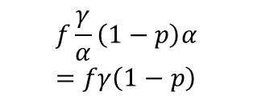


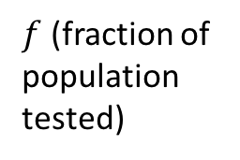








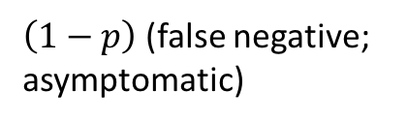

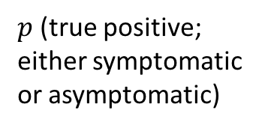

Infection Diagram for Community Transmission
Infected,
not tested
Infected, tested
$$μ_{i}$$
$p$ (true positive; either symptomatic or asymptomatic)
$f$ (fraction of population tested)
I+
$$\frac{αγ}{α−γ}$$
$$f\frac{γ}{α}pα=fγp$$
S
I₀
$$\left(1−f\right)\left(1−\frac{γ}{α}\right)\frac{α^{2}γ\left(1−f\right)+αγ^{2}f}{α^{2}\left(1−f\right)+γ^{2}f}=\left(1−f\right)\left(α−γ\right)γ\frac{α\left(1−f\right)+γf}{α^{2}\left(1−f\right)+γ^{2}f}$$
R
$$β\left(I_{0}+I_{−}\right)$$
$$μ_{n}$$
$$μ_{n}$$
$$μ_{n}$$
$$f\frac{γ}{α}\left(1−p\right)α=fγ\left(1−p\right)$$
I-
$$\frac{αγ}{α−γ}$$
$\left(1−p\right)$ (false negative; asymptomatic)
$$μ_{n}$$
$$1−f$$
0
time
time taken to get tested: $a=\frac{1}{α}$
Infection period: $c=\frac{1}{γ}$

Slide 3



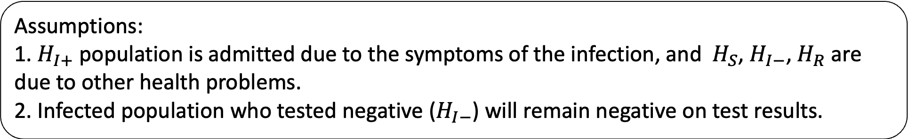
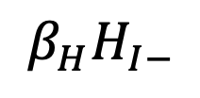

Infection diagram in hospital
H_{S}
H_{I-}
H_{I+}
H_{R}
x
x
$$β_{H}H_{I−}$$
$$μ_{hn}$$
$$μ_{hn}$$
$$μ_{hi}$$
$$μ_{hn}$$
Assumptions:
1. $H_{I+}$ population is admitted due to the symptoms of the infection, and $H_{S}$, $H_{I−}$, $H_{R}$ are due to other health problems.
2. Infected population who tested negative ($H_{I−}$) will remain negative on test results.
x
no flow

Slide 4

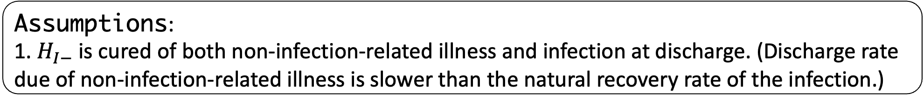










Diagram of interactions between community and hospital
admission when rooms are available
within community/hospital transitions
I+
S
I₀
R
I-
$$p h_{n}$$
$$h_{n}$$
$$d_{n}$$
$$h_{n}\left(1−p\right)$$
$$h_{i}$$
$$h_{n}p$$
$$h_{n}$$
$$d_{n}$$
$$\left(1−p\right)h_{n}$$
$$d_{i}$$
$$d_{n}$$
H_{S}
H_{I-}
H_{I+}
H_{R}
Assumptions:
1. $H_{I−}$ is cured of both non-infection-related illness and infection at discharge. (Discharge rate due of non-infection-related illness is slower than the natural recovery rate of the infection.)

Slide 5
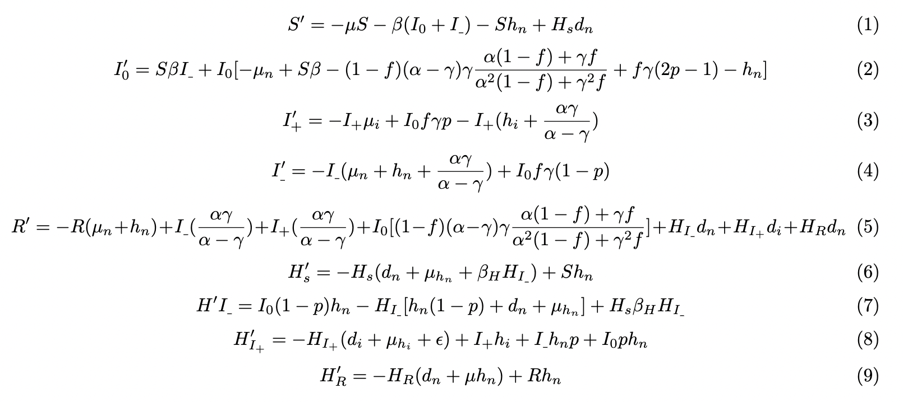
The Model

Slide 6
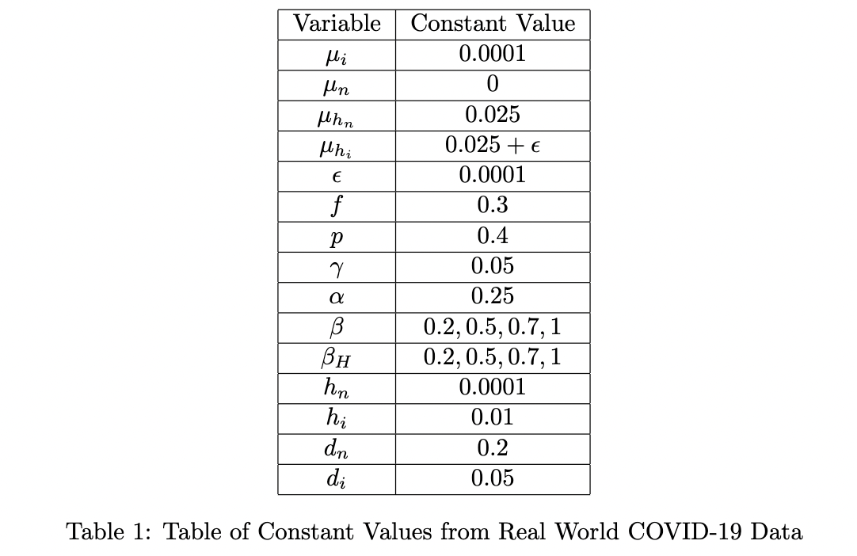
Define the Constant Values

Slide 7


Euler’s Method
Can a simple numerical method like Euler’s method solve a complex system of equations?

Slide 8
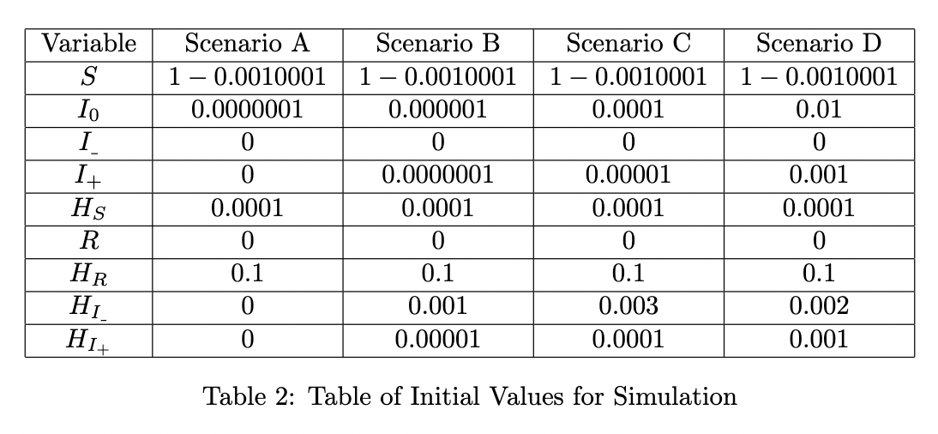
Initial Conditions

Slide 9
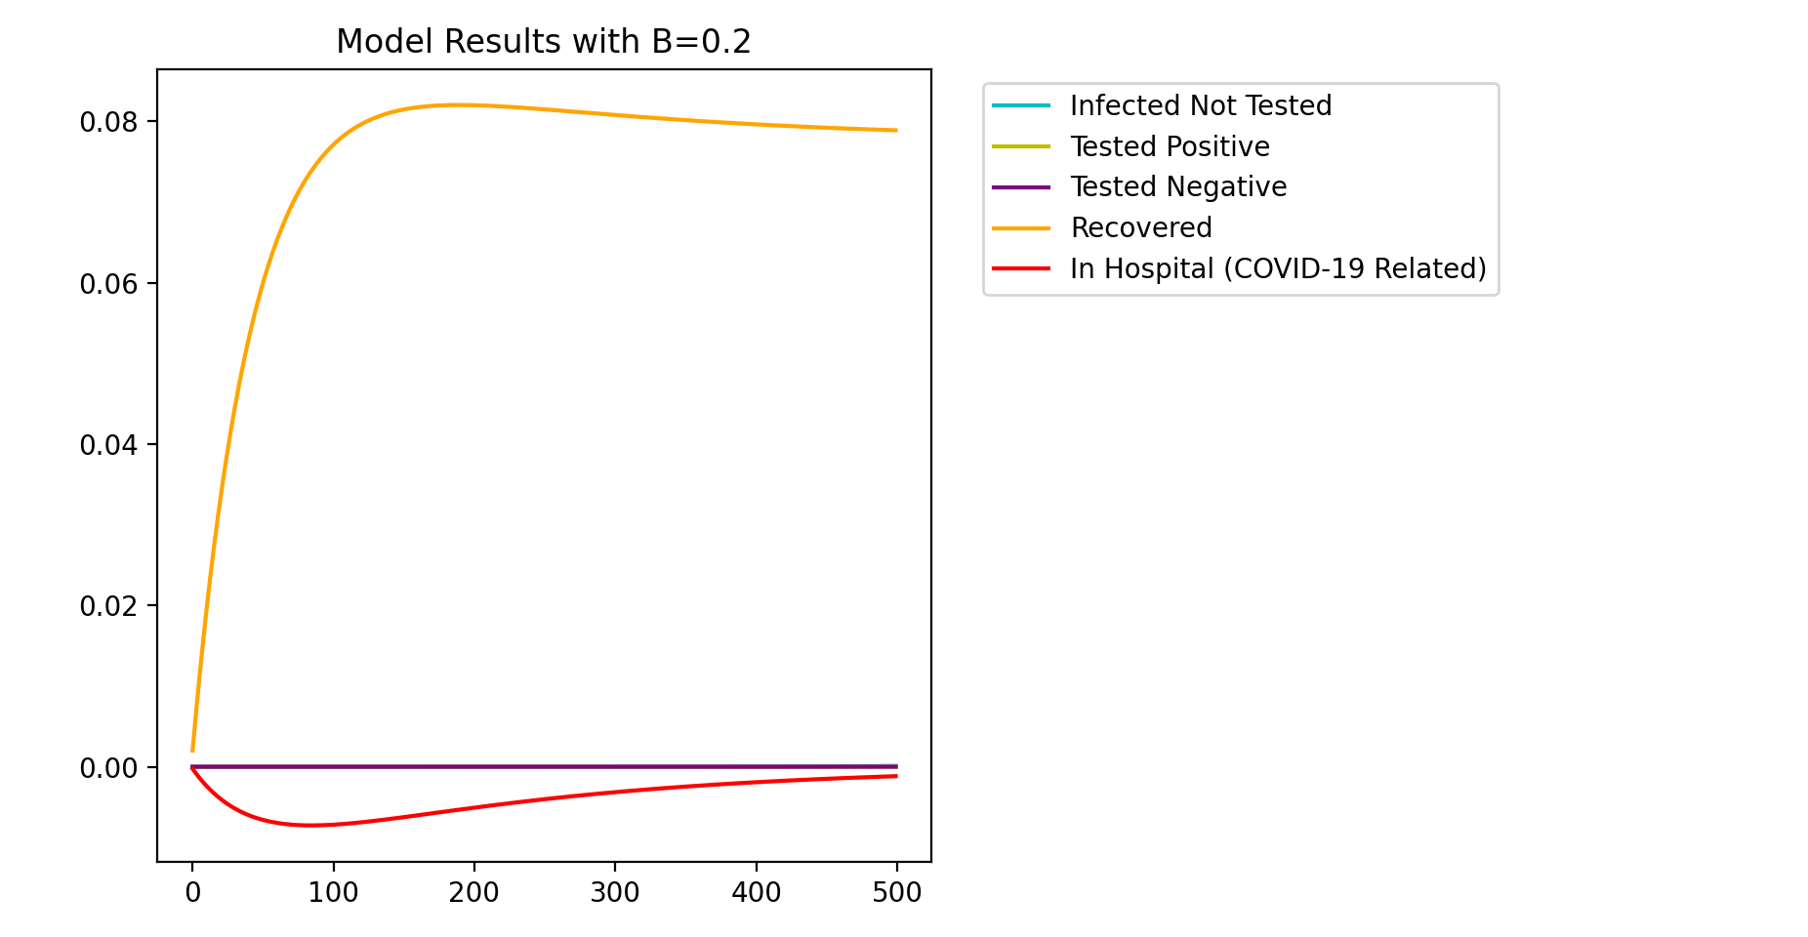

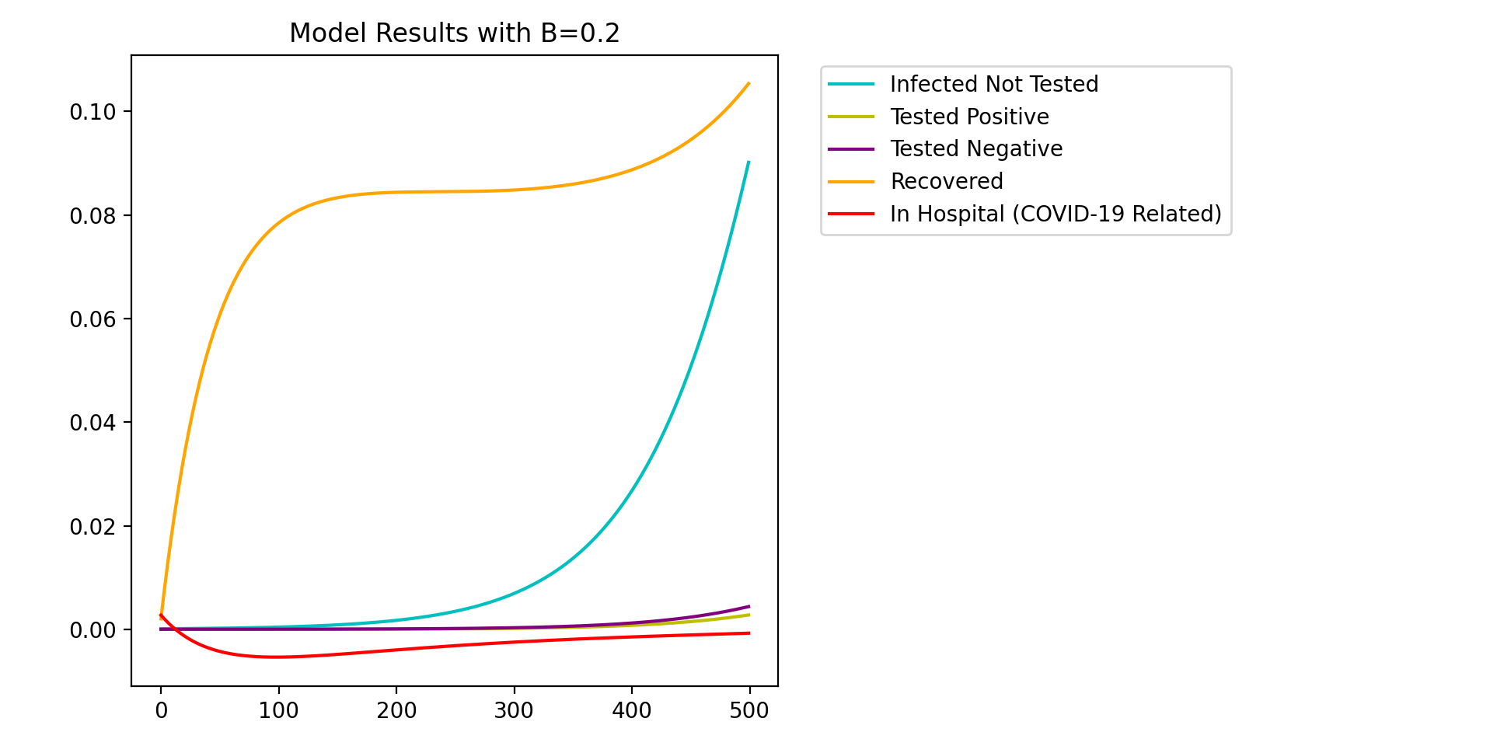
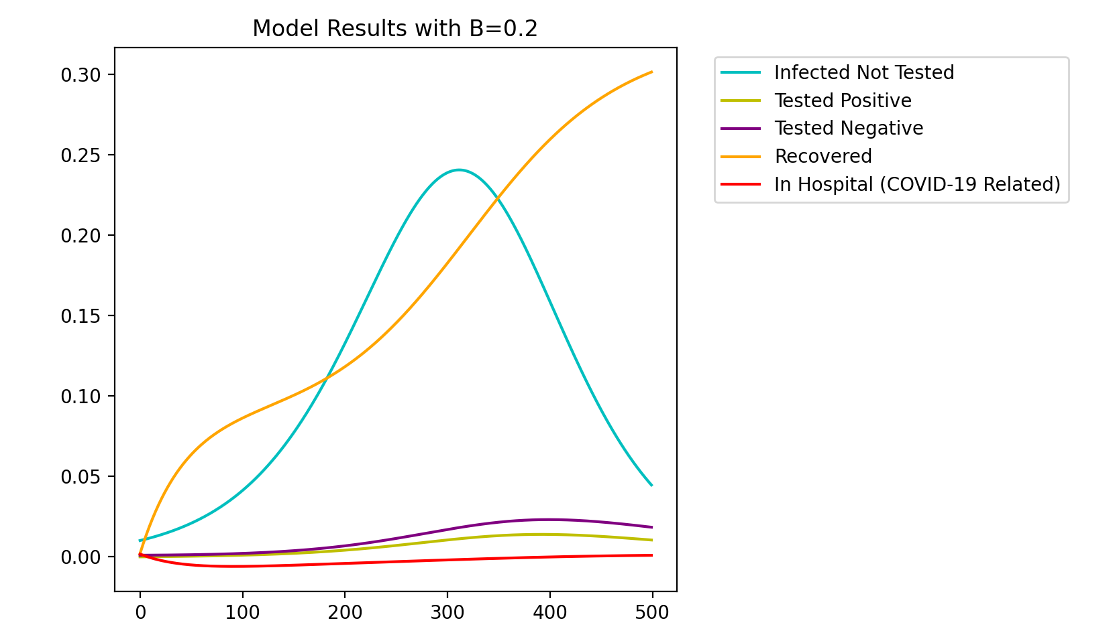
Notes:
Scenario A

Slide 10
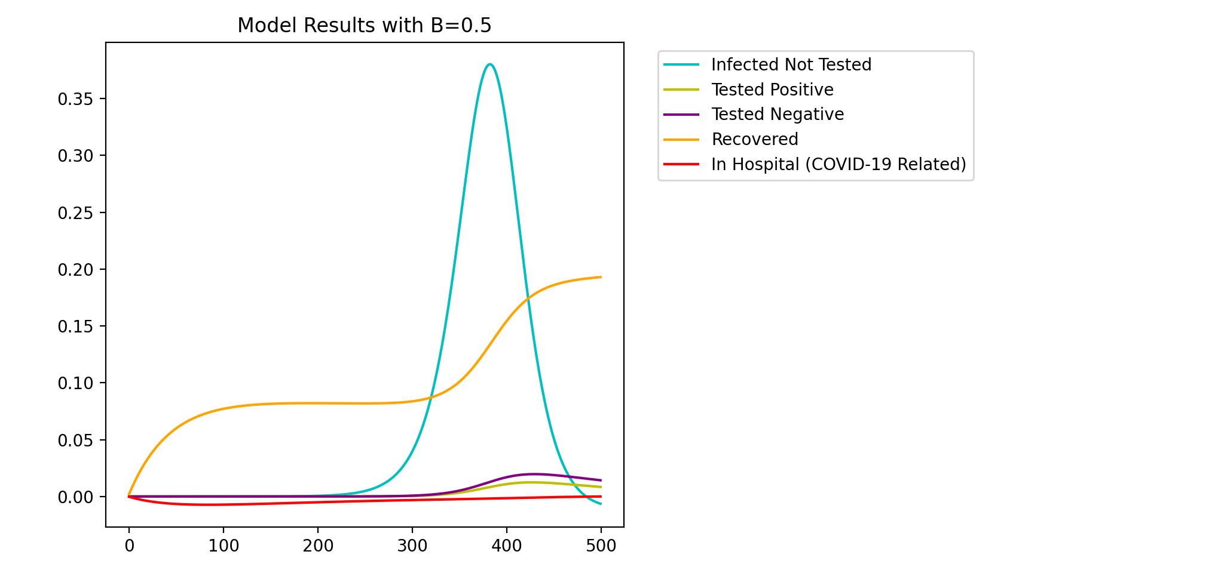
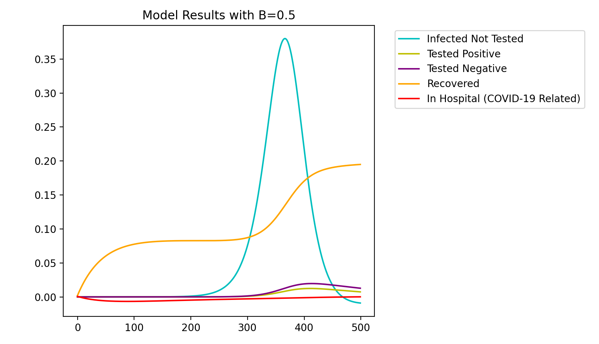
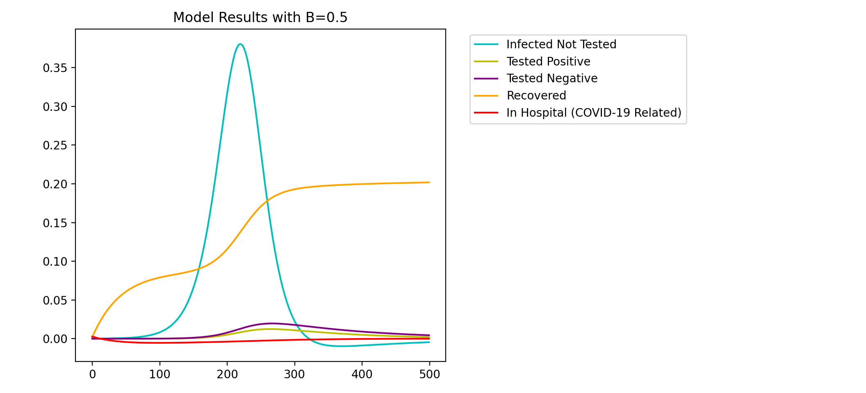
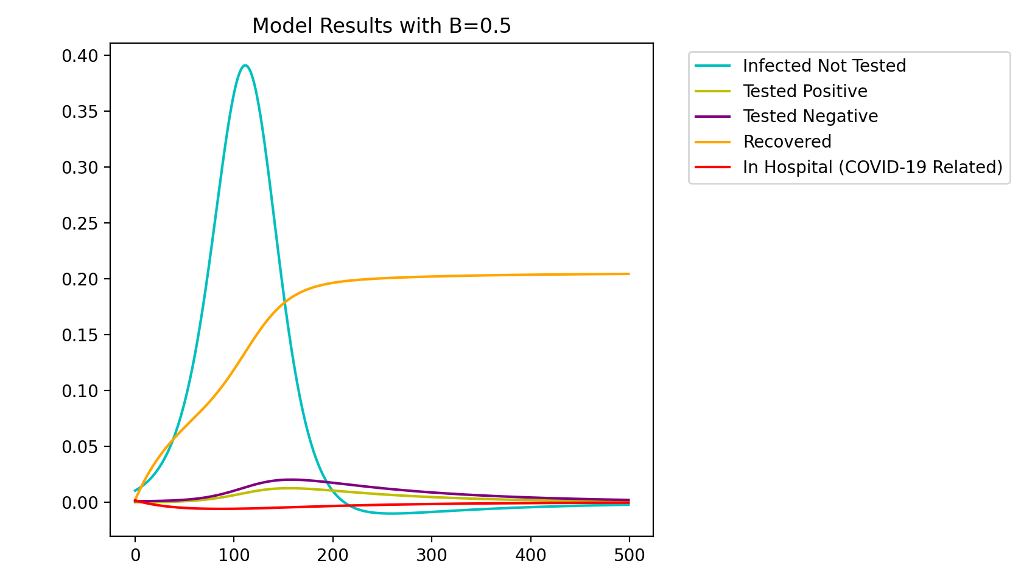
Notes:
Scenario B

Slide 11
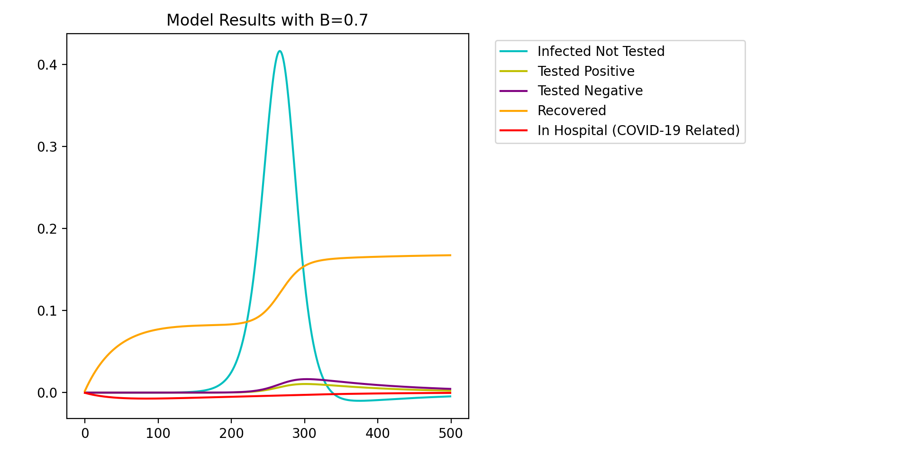
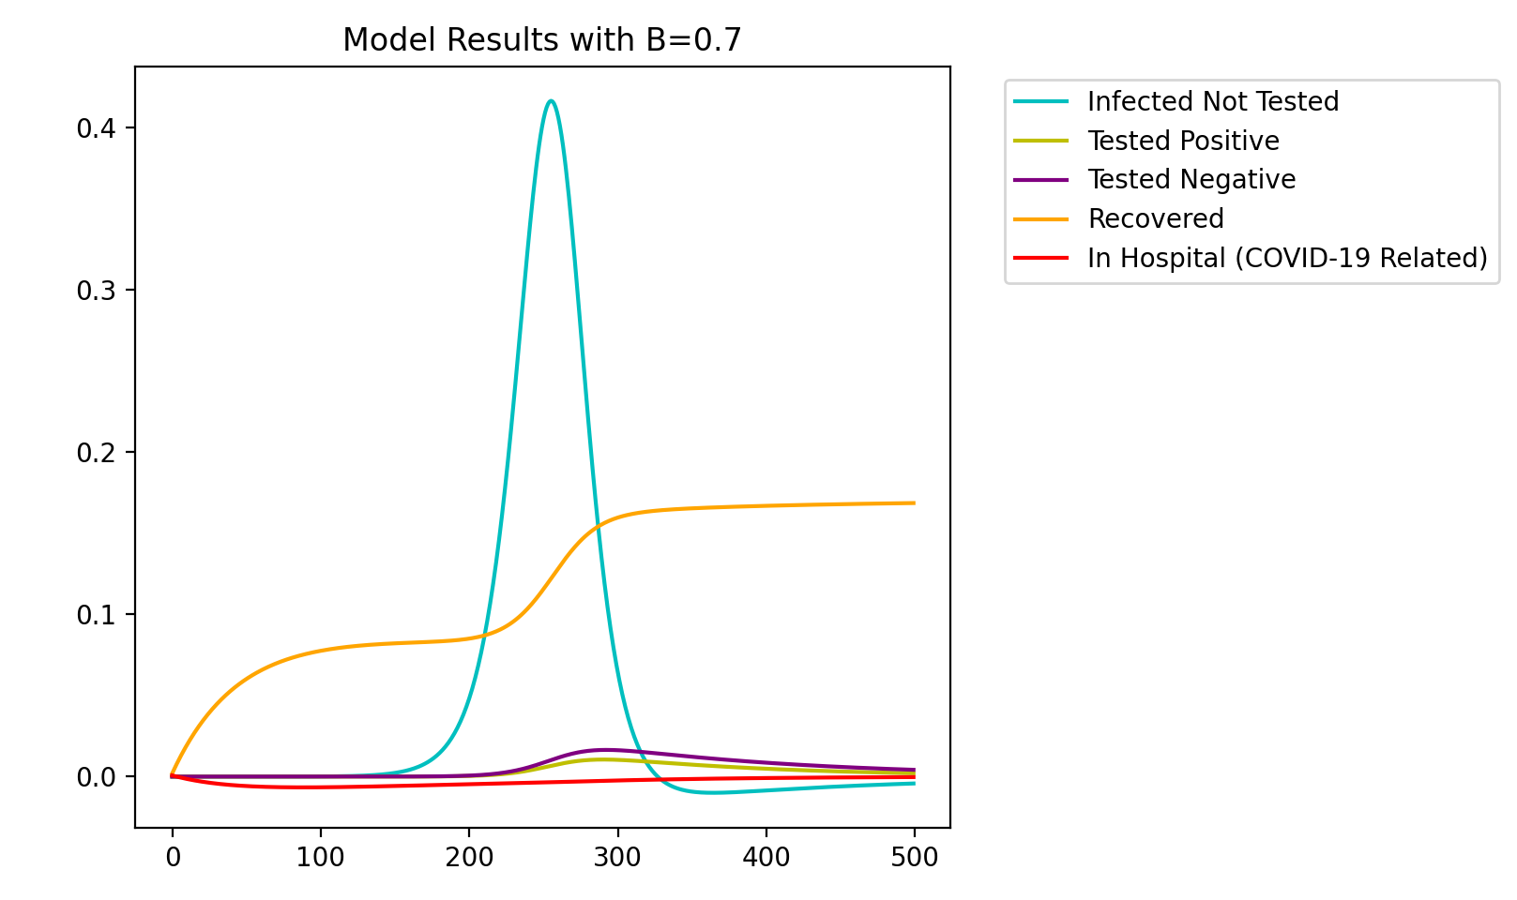
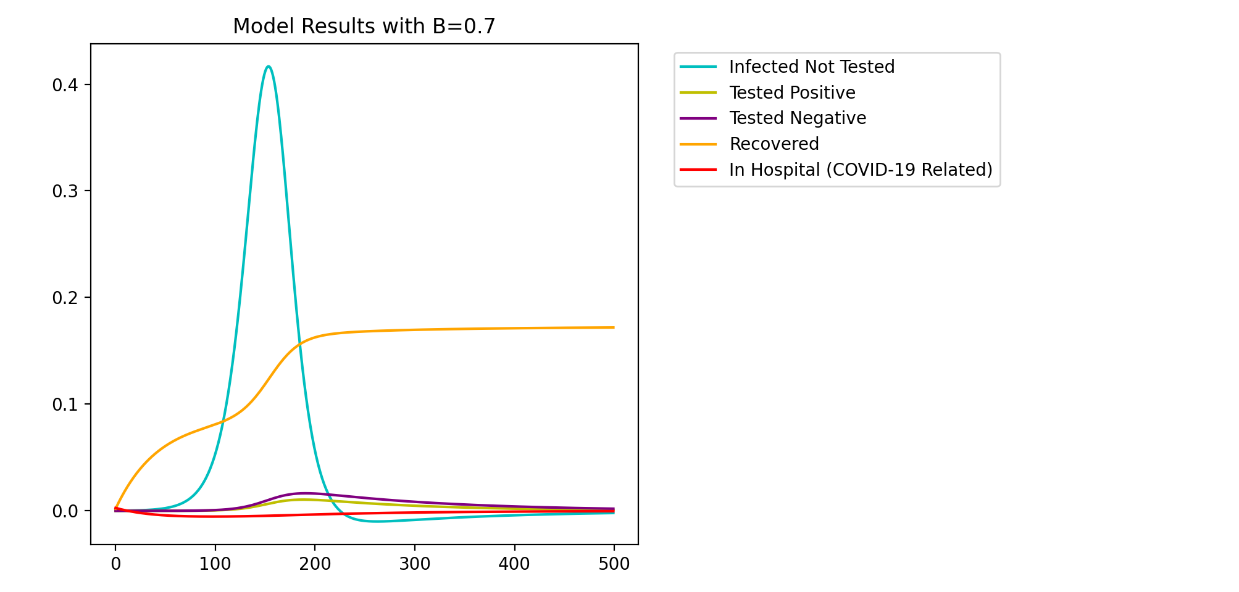
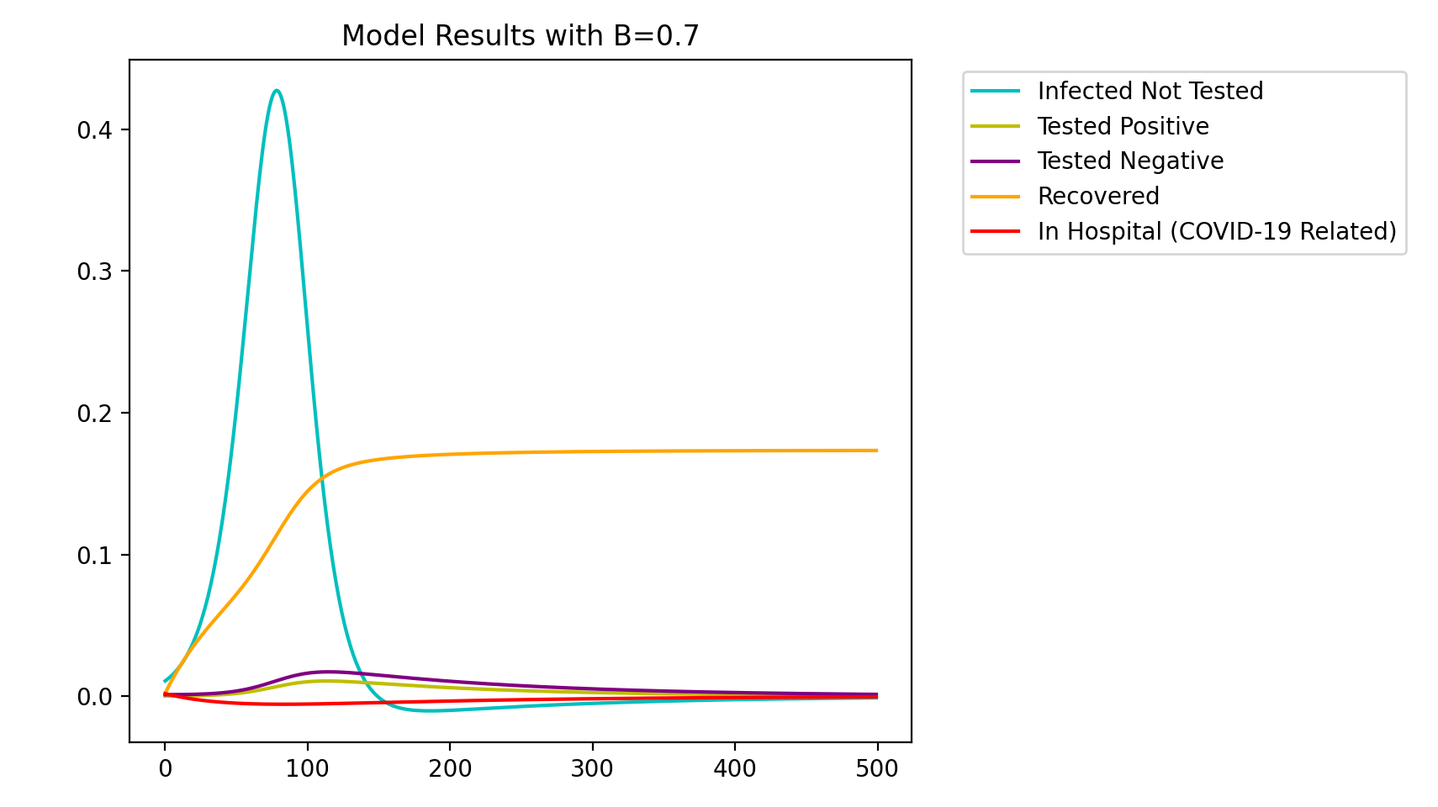
Notes:
Scenario C

Slide 12
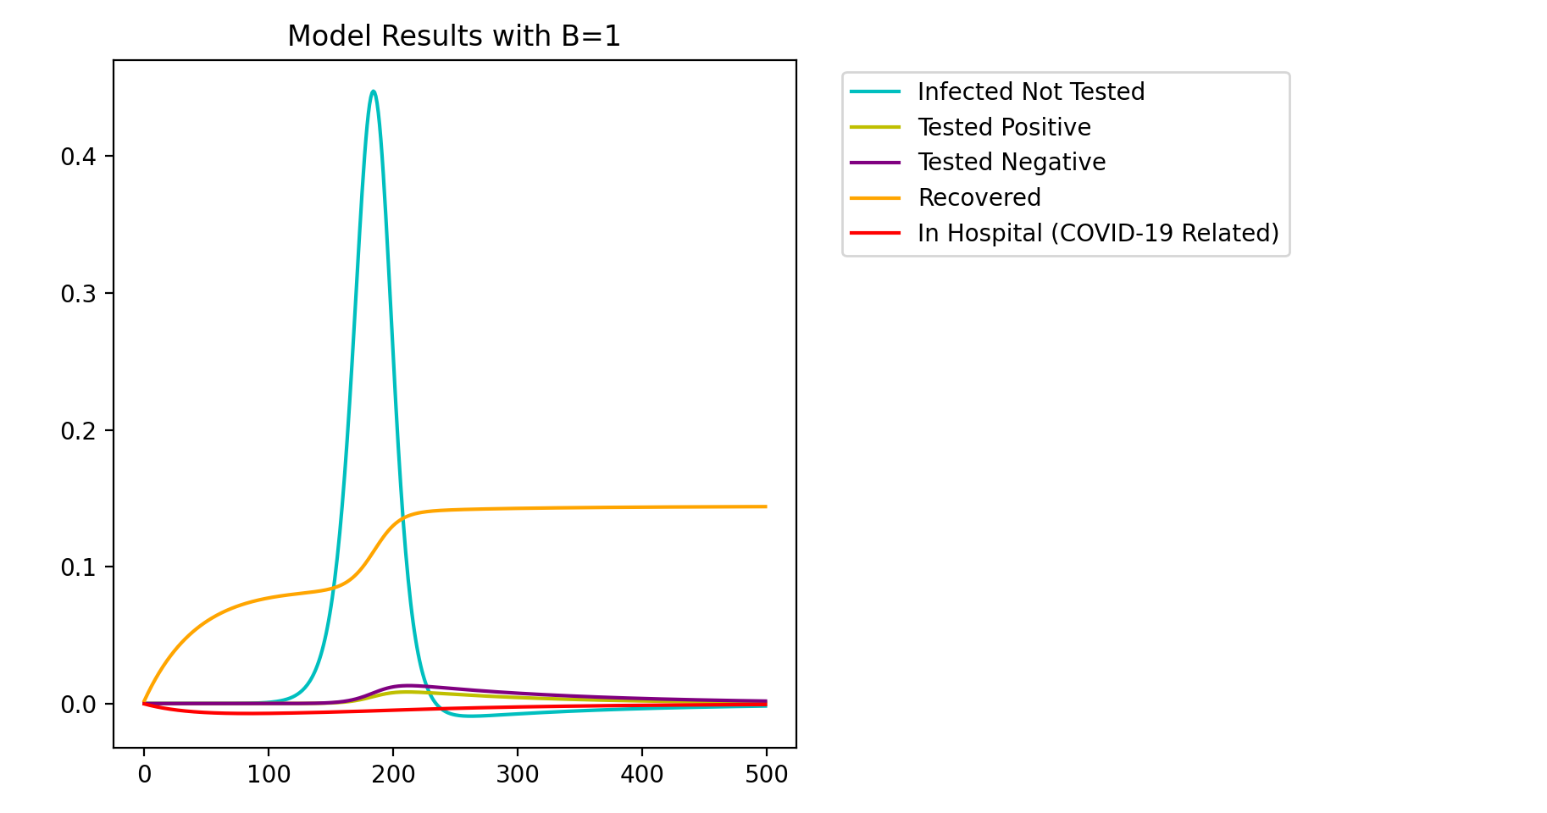

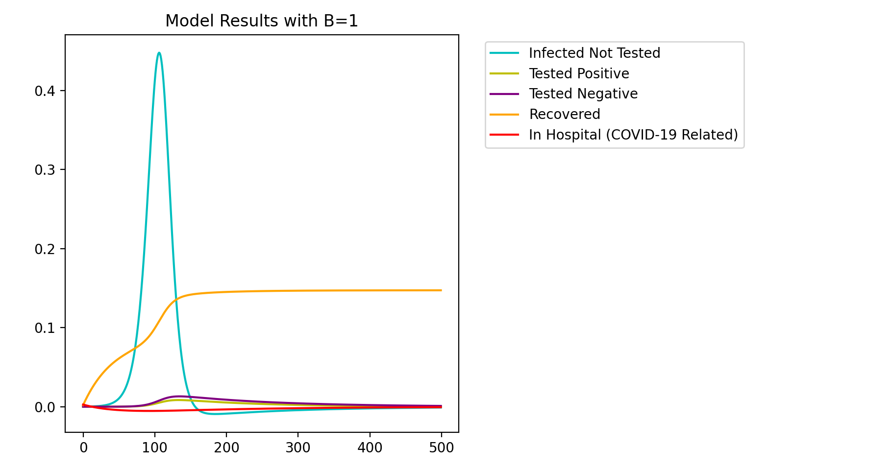
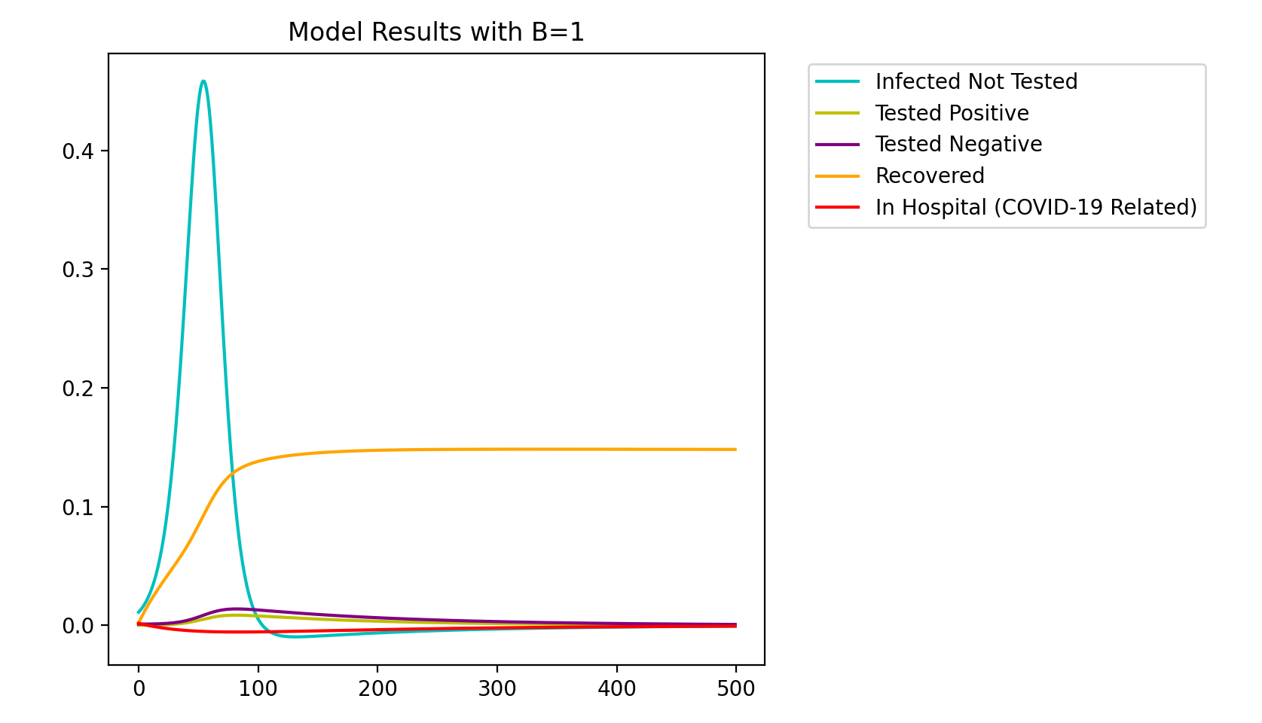
Notes:
Scenario C

Slide 13
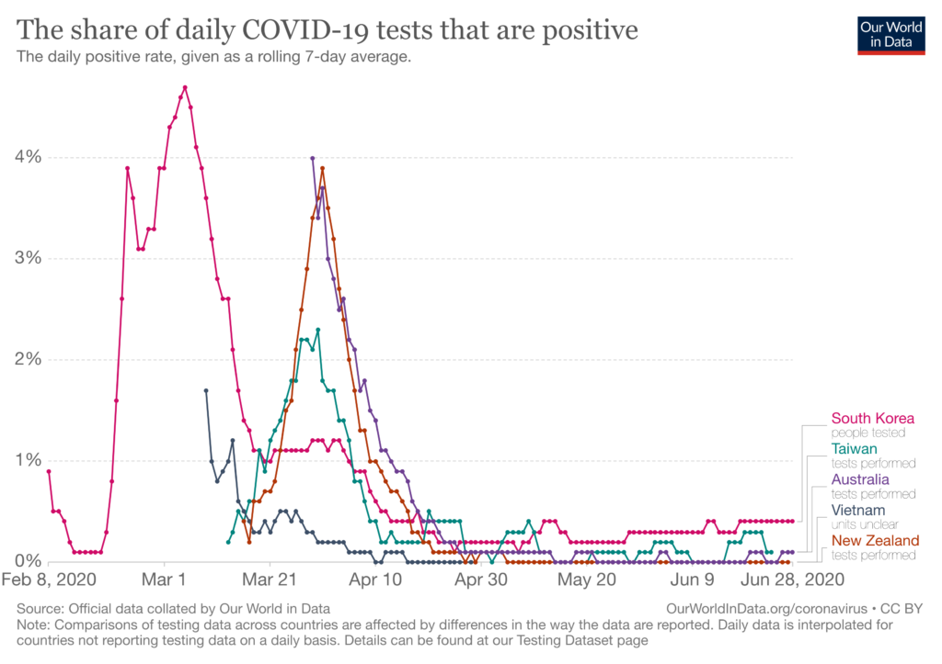
https://globalhealth.harvard.edu/evidence-roundup-why-positive-test-rates-need-to-fall-below-3/

Slide 14
Analysis
When the recovery rate has a slight decrease, the total infected population is at its peak
Hospital population stays steady
Are individuals being admitted as fast as released?
The rate of positive and negative tests increases when the infected population is at its peak
Do we need more people to be tested?
Recovery hits a steady state
Should this increase or decrease at all?

Slide 15
Questions?

