Slide 1
Proyecto ETL
Jenifer Ramos Rios

Slide 2
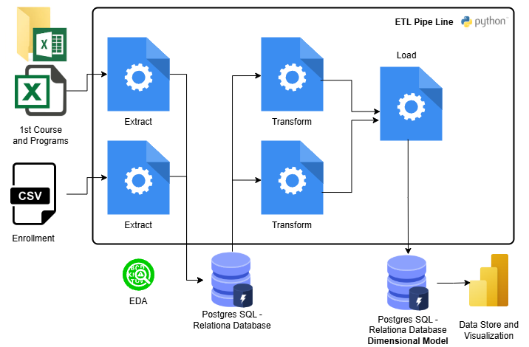
Problem and Project Description
Higher education enrollment trends are crucial for understanding the evolution of academic programs and making informed decisions. However, raw data provided by the Ministerio Nacional de Educación is not readily structured for direct analysis. The figures on first-semester enrollments and total enrollment are published annually, but they require extraction, transformation, and consolidation to enable meaningful comparisons over time.

Slide 3
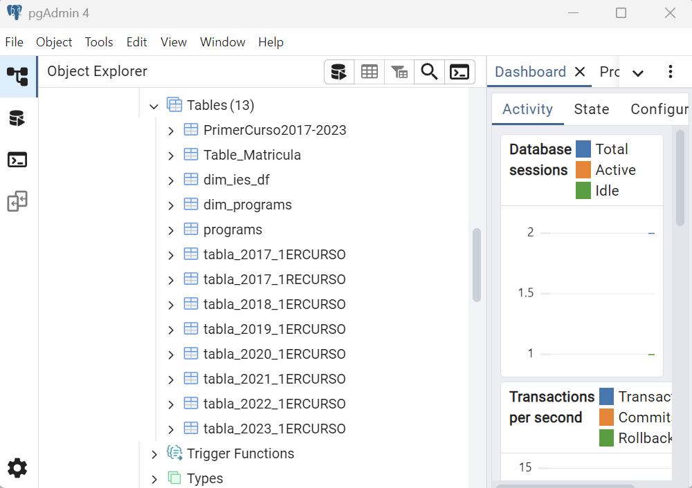
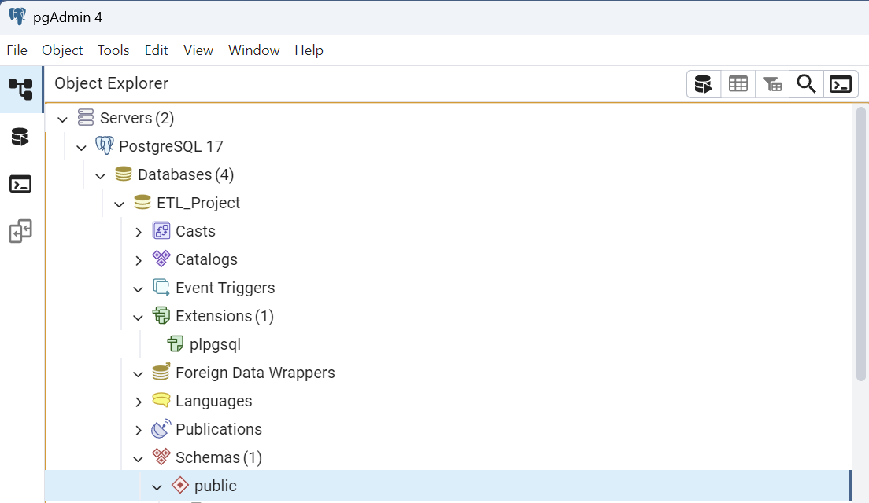
Data Warehouse

Slide 4
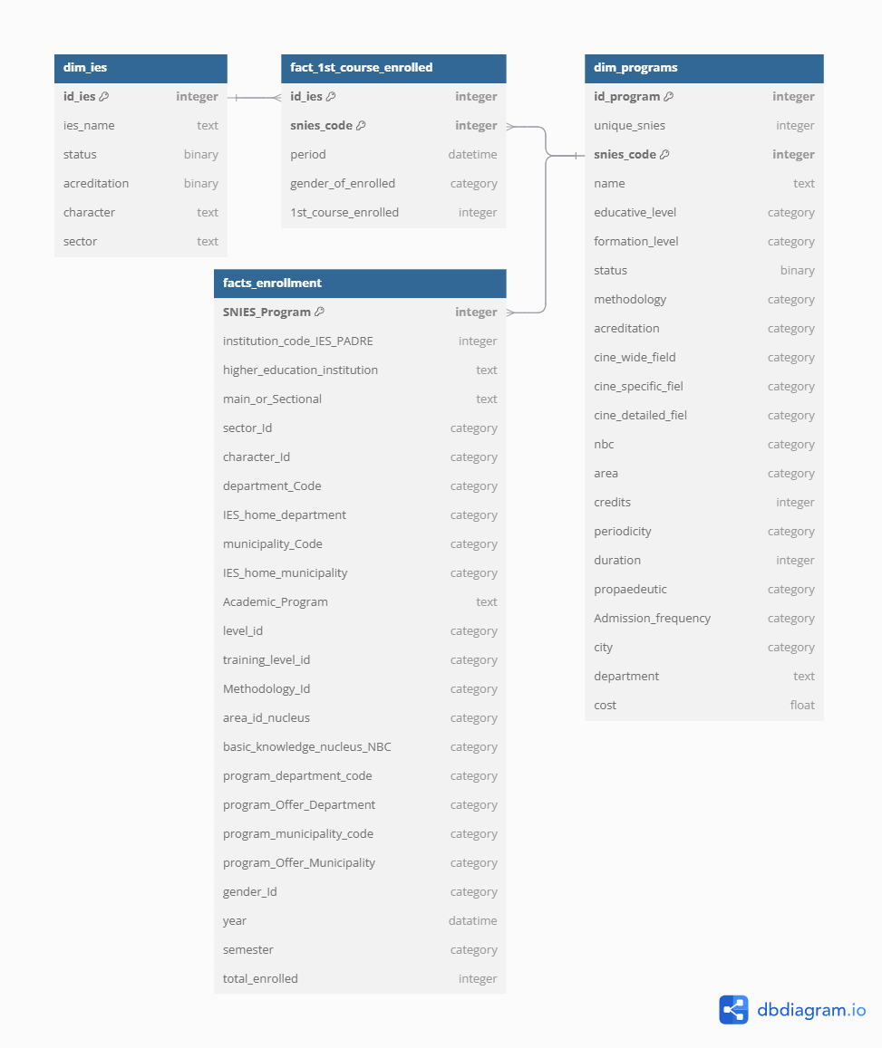
Dimensional Model
Transformation of First Curse Files:
A table called "Inscritos2017-2023" was created, combining all the tables of students enrolled in the first course for each year from 2017 to 2023.
a "SEXO" column was created to classify gender based on an ID SEXO column.
318.451 records.
Transformations in Programs.xlsx file
Unnecessary columns were dropped.
The MODALIDAD column was reviewed and standardized by replacing certain values to ensure consistency. Specifically, "Presencial-Virtual" was renamed to "Híbrida (Presencial-Virtual)", "Dual" to "Presencial-Dual", and "A distancia" to "Presencial-A distancia".

Slide 5
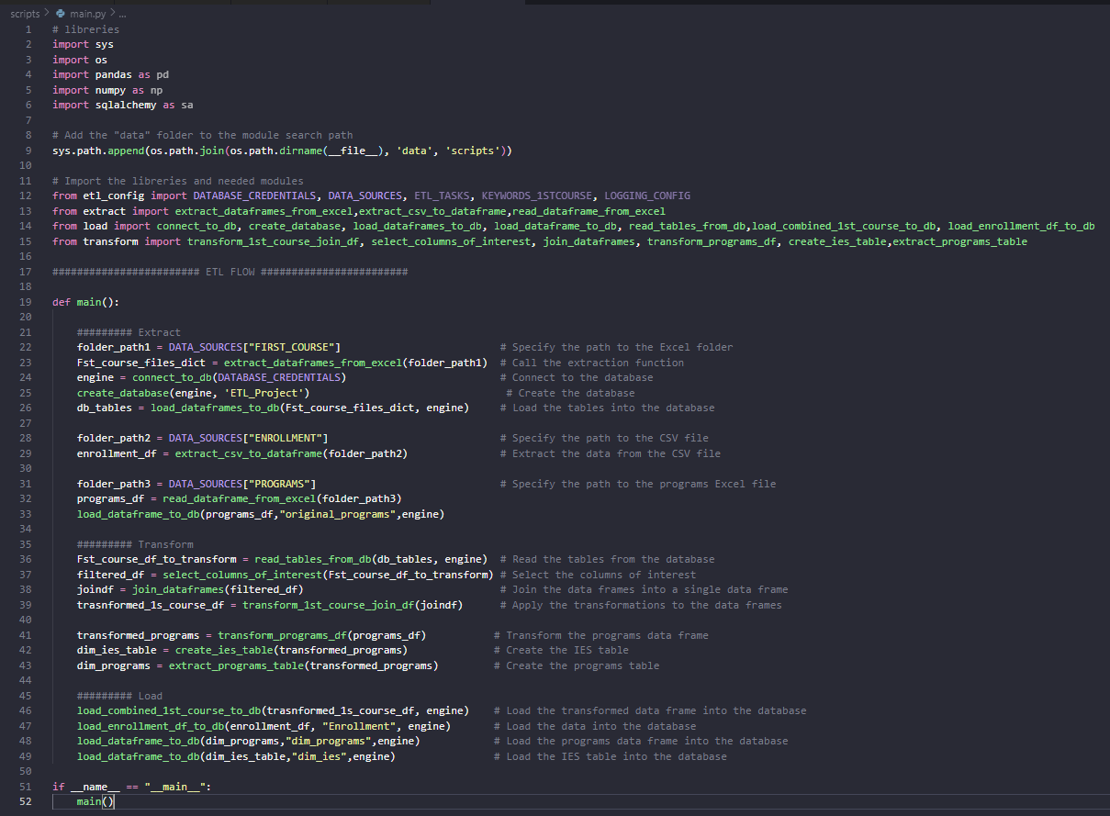
ETL Pipeline Python
Notes:
Desafíos: formatos de entrada y salida de una tarea a otra, no logré trabajarlo con jupyter notebooks.

