Slide 1

Meet Osmos: A New Way to Approach Data Engineering in Fabric
Fabric Data Engineering Agent • Project Osmos
Dallas–Fort Worth Fabric and Power BI User Group
A practical, honest tour with reproducible demos
Notes:
Opening: “What if the unit of data engineering work were no longer a code suggestion, but a persistent task with a plan, checkpoints, evidence, and a human decision at every consequential boundary?”
Set expectations: this is a technical session, the feature is preview, and the demos emphasize reproducibility over magic.
[Sources]
- https://learn.microsoft.com/en-us/fabric/data-engineering/data-engineering-agent-overview
- https://learn.microsoft.com/en-us/fabric/data-engineering/data-engineering-agent-get-started?tabs=github-copilot-cli
- Visual on this slide was generated with Microsoft Copilot.

Slide 2
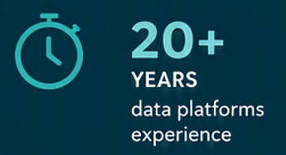
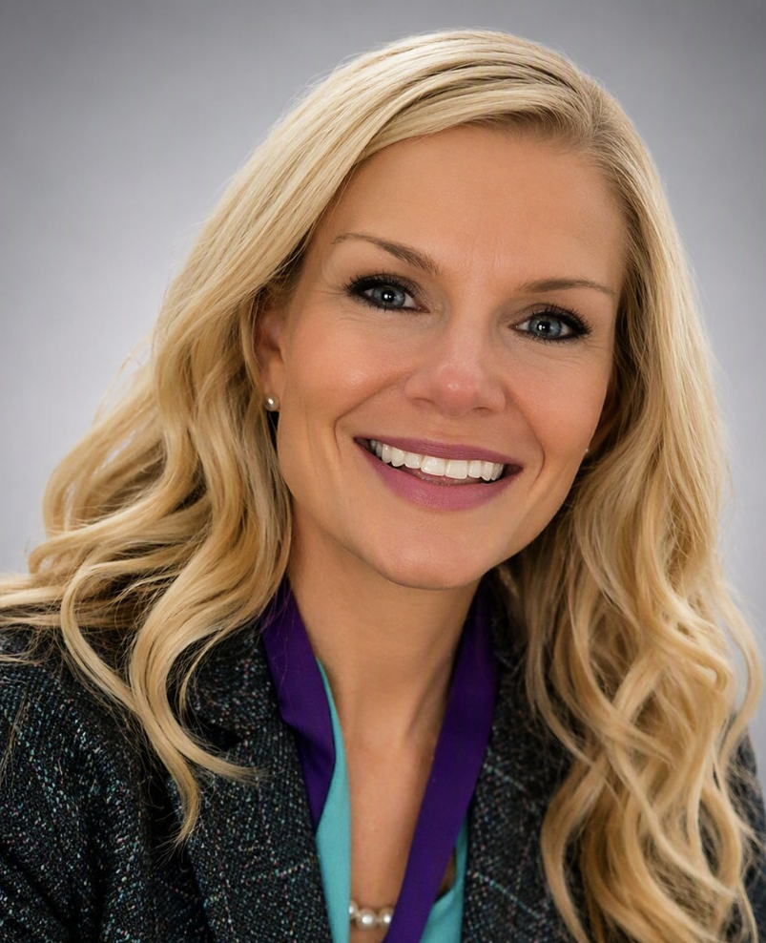
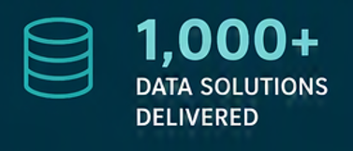




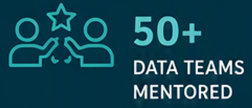


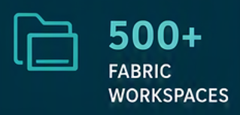





PROVEN RESULTS
REAL IMPACT
Meet the Instructor
ENABLE PEOPLE
Eliminate bottlenecks
JENNIFER
RATTEN
GOVERN WITH GUARDRAILS
Not gates
VP, APPLICATION ENGINEERING
DATA, AI AND PLATFORM TRANSFORMATION LEADER
AI-FIRST MINDSET
Learn. Build. Scale.
MICROSOFT
DATA PLATFORMS
SUPER USER x 6
/in/jenniferratten
TEAMWORK
Right people. Big impact.
Architecting governed, scalable solutions and platform that empower people, accelerate insights and drive real business outcomes.
SCALE WITHOUT CHAOS
Strategy. Standards. Simplicity.
LEADER

Slide 3
What you will leave with
MENTAL MODEL
STACK FIT
BOUNDARIES
What Osmos is — and how it differs from inline Copilot assistance.
Where the developer surface, agent, Fabric artifacts, and OneLake meet.
What it can do today, what still needs a human, and what is preview.
LIVE PATTERNS
ECONOMICS
OPERATING MODEL
Three reproducible use cases with prompts, validation, recovery, and fallback.
How Fabric capacity consumption differs from licensing and token-style pricing.
Prompting, governance, monitoring, cost control, and adoption guardrails.
PROJECT OSMOS • DFW FABRIC & POWER BI USER GROUP
03
Notes:
Invite the audience to select one lens to pay special attention to: engineering productivity, platform architecture, governance, or cost.
[Sources]
- https://learn.microsoft.com/en-us/fabric/data-engineering/data-engineering-agent-overview
- https://learn.microsoft.com/en-us/fabric/data-engineering/data-engineering-agent-get-started?tabs=github-copilot-cli
- https://learn.microsoft.com/en-us/fabric/data-engineering/data-engineering-agent-best-practices
- https://learn.microsoft.com/en-us/fabric/data-engineering/data-engineering-agent-consumption
- https://github.com/microsoft/project-osmos

Slide 4
Osmos: The promise — and the discipline
Osmos changes the unit of assistance from a snippet to an engineering task.
PROMPT
PLAN
EXECUTE
PROVE
HAND OFF
Natural language defines the outcome and guardrails
A persistent task decomposes and coordinates work
Fabric artifacts and compute do the engineering
Validation evidence keeps the human in control
The essential boundary
Agentic does not mean total accountability. Review plans, inspect generated artifacts, validate data, and promote through your normal engineering lifecycle.
PROJECT OSMOS • DFW FABRIC & POWER BI USER GROUP
02
Notes:
Emphasize that persistent execution is the differentiator, but normal engineering accountability remains. This framing avoids presenting preview software as an autonomous production operator.
[Sources]
- https://learn.microsoft.com/en-us/fabric/data-engineering/data-engineering-agent-overview
- https://learn.microsoft.com/en-us/fabric/data-engineering/data-engineering-agent-get-started?tabs=github-copilot-cli
- https://learn.microsoft.com/en-us/fabric/data-engineering/data-engineering-agent-best-practices

Slide 5

PART 1
Meet the agent
Definition, interaction model, and why it matters.
PROJECT OSMOS • DFW FABRIC & POWER BI USER GROUP
04
Notes:
Use this as a transition. Pause and reset the audience’s mental model before moving into the next section.
[Sources]
- Visual on this slide was generated with Microsoft Copilot.

Slide 6
What is Project Osmos?
A Fabric data engineering agent designed for persistent, outcome-oriented engineering work.
OUTCOME FIRST
Describe the intended data product (end-to-end), constraints, sources, quality rules, and acceptance criteria.
PERSISTENT TASK
The agent plans multi-step work and can continue across longer-running activity instead of ending with one reply. Keeps running without needing to be monitored.
FABRIC NATIVE
It works with Fabric context, artifacts, and capacity rather than acting as a detached code generator.
HUMAN-GOVERNED, SHARED VISIBILITY
You review the plan, permissions, generated assets, evidence, and readiness for promotion.
PROJECT OSMOS • DFW FABRIC & POWER BI USER GROUP
05
Notes:
Do not equate Osmos with a Fabric Data Agent used for conversational analytics. The subject here is the data engineering agent: it helps build and modify engineering solutions. Mention the current preview status explicitly.
[Sources]
- https://learn.microsoft.com/en-us/fabric/data-engineering/data-engineering-agent-overview
- https://learn.microsoft.com/en-us/fabric/data-engineering/data-engineering-agent-get-started?tabs=github-copilot-cli
- Visual on this slide was generated with Microsoft Copilot.

Slide 7
Why consider it?
The value is not typing code faster; it is compressing coordination across an engineering task.
1
2
3
4
5
LESS TOIL
MORE CONTEXT
REPEATABLE EVIDENCE
PARALLEL FOCUS
CAPACITY NOT CREDITS
Delegates repetitive discovery, scaffolding, transformation, and validation work.
Keeps requirements, plans, artifacts, and outcomes connected across the task.
Can produce notebooks, checks, and task artifacts that can be reviewed and retained.
Persistent work lets the engineer focus on architecture, stakeholder decisions, and exceptions.
Osmos uses the Fabric capacity instead of AI credit consumption.
Best fit: meaningful work with a clear outcome, available context, testable acceptance criteria, and enough scope to justify planning.
PROJECT OSMOS • DFW FABRIC & POWER BI USER GROUP
06
Notes:
Position this as a productivity and coordination tool, not a replacement for engineering judgment. The strongest candidates are bounded projects whose correctness can be evaluated.
[Sources]
- https://learn.microsoft.com/en-us/fabric/data-engineering/data-engineering-agent-overview
- https://learn.microsoft.com/en-us/fabric/data-engineering/data-engineering-agent-get-started?tabs=github-copilot-cli
- https://learn.microsoft.com/en-us/fabric/data-engineering/data-engineering-agent-best-practices

Slide 8
Standard Agent vs. Osmos
INLINE ASSISTANCE
PROJECT OSMOS TASK
Think: “help me with this step”
Think: “deliver this bounded outcome”
• Generate or explain code
• Refactor a selected section
• Answer in the current interaction
• Developer coordinates the larger workflow
• Excellent for tight feedback loops
• Discover and plan across multiple steps
• Work through a persistent task
• Create or update Fabric engineering artifacts
• Check progress and preserve task context
• Engineer reviews, steers, validates, and promotes
PROJECT OSMOS • DFW FABRIC & POWER BI USER GROUP
07
Notes:
Both patterns remain useful. Osmos is not “better Copilot” for every prompt; use the smallest interaction model that fits the work.
[Sources]
- https://learn.microsoft.com/en-us/fabric/data-engineering/data-engineering-agent-overview
- https://learn.microsoft.com/en-us/fabric/data-engineering/data-engineering-agent-get-started?tabs=github-copilot-cli

Slide 9
Interaction model: contract → plan → checkpoints → evidence
1
2
3
4
5
CONTRACT
PLAN
EXECUTION
CHECKPOINTS
EVIDENCE
Outcome, scope, constraints, target workspace, acceptance criteria
Proposed steps, dependencies, read/write boundaries, expected artifacts
Fabric tools and compute perform approved engineering work
Progress, decisions, failures, and resumable task state
Artifacts, validation results, exceptions, and handoff notes
The prompt is a project brief. Acceptance criteria are the test harness.
PROJECT OSMOS • DFW FABRIC & POWER BI USER GROUP
08
Notes:
The audience should see the prompt as an engineering contract. A strong task includes the target, data grain, expected tables, quality rules, observability, and explicit stop points.
[Sources]
- https://learn.microsoft.com/en-us/fabric/data-engineering/data-engineering-agent-overview
- https://learn.microsoft.com/en-us/fabric/data-engineering/data-engineering-agent-get-started?tabs=github-copilot-cli
- https://learn.microsoft.com/en-us/fabric/data-engineering/data-engineering-agent-best-practices

Slide 10
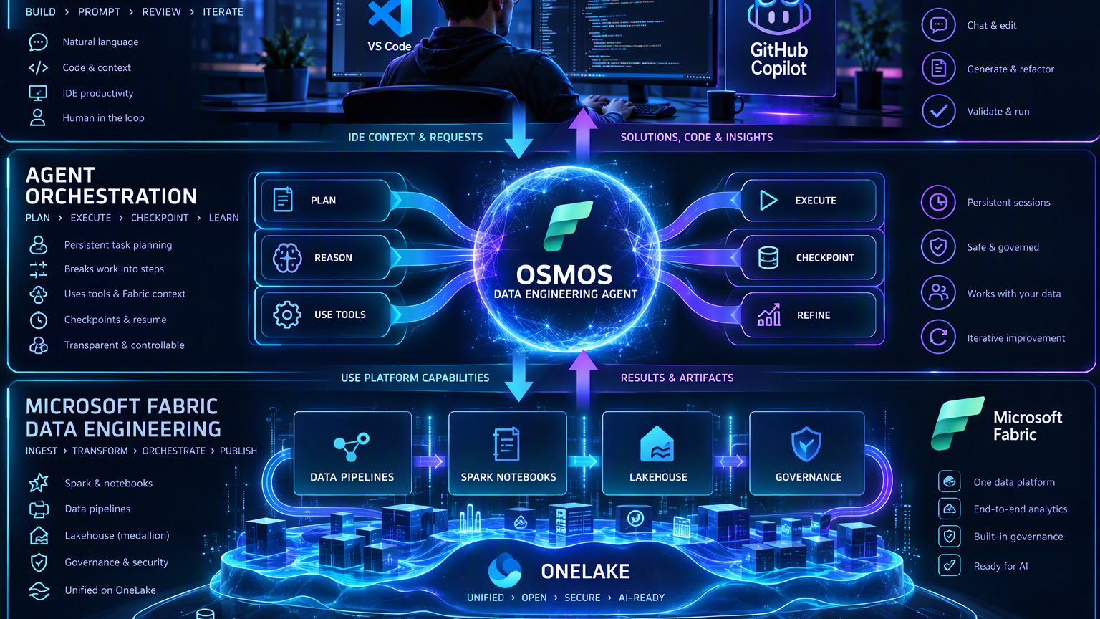
PART 2
Where it fits
Developer surface above; governed Fabric engineering below.
PROJECT OSMOS • DFW FABRIC & POWER BI USER GROUP
09
Notes:
Use this as a transition. Pause and reset the audience’s mental model before moving into the next section.
[Sources]
- Visual on this slide was generated with Microsoft Copilot.

Slide 11
Osmos in the Fabric stack
Developer experience
Build › Prompt › Review › Iterate
VS Code
GitHub Copilot
Natural-language requests
Code & context
IDE context & requests
Solutions, code & insights
Agent orchestration
Plan › Execute › Checkpoint › Learn
OSMOS
Data engineering agent
Plan
Reason
Use tools
Execute
Checkpoint
Refine
Use platform capabilities
Results & artifacts
Microsoft Fabric
Data engineering platform
Data pipelines
Spark notebooks
Lakehouse
Governance
OneLake
PROJECT OSMOS • DFW FABRIC & POWER BI USER GROUP
10
Notes:
Walk top to bottom: the developer starts in the supported GitHub Copilot CLI/VS Code-oriented workflow; Osmos coordinates the task; Fabric engineering artifacts and compute execute; OneLake stores the data. The generated image is conceptual—use the official docs for exact supported behavior.
[Sources]
- https://learn.microsoft.com/en-us/fabric/data-engineering/data-engineering-agent-overview
- https://learn.microsoft.com/en-us/fabric/data-engineering/data-engineering-agent-get-started?tabs=github-copilot-cli
- Visual on this slide was generated with Microsoft Copilot.

Slide 12
What Osmos does — today
DISCOVER
PLAN
BUILD
TRANSFORM
Inspect available context and understand the target engineering problem.
Break a bounded outcome into steps and expose the approach for review.
Create or update supported data-engineering artifacts and code.
Implement ingestion, cleansing, shaping, and medallion-style processing.
VALIDATE
TROUBLESHOOT
PERSIST
DOCUMENT
Add checks and evaluate outputs against stated acceptance criteria.
Investigate failures, schemas, dependencies, and generated assets.
Maintain task context for longer-running work and resume.
Produce artifacts that explain what was changed and why.
PROJECT OSMOS • DFW FABRIC & POWER BI USER GROUP
11
Notes:
Frame capabilities at a category level; exact supported operations can change during preview. Demonstrate against the current tenant and current documentation before presenting.
[Sources]
- https://learn.microsoft.com/en-us/fabric/data-engineering/data-engineering-agent-overview
- https://learn.microsoft.com/en-us/fabric/data-engineering/data-engineering-agent-get-started?tabs=github-copilot-cli
- https://learn.microsoft.com/en-us/fabric/data-engineering/data-engineering-agent-best-practices

Slide 13
What it does not remove
The agent can perform work; it does not absorb organizational accountability.
NOT A BUSINESS OWNER
NOT A SECURITY EXCEPTION
NOT A PRODUCTION APPROVER
It cannot decide whether the requirement or metric is correct.
It works within identity, permissions, tenant settings, and workspace access.
Promotion, change control, release evidence, and support ownership remain human processes.
NOT A QUALITY GUARANTEE
NOT A UNIVERSAL ORCHESTRATOR
NOT A FIX FOR POOR INPUT
Generated code and data can be plausible and wrong; validation is mandatory.
Do not assume every Fabric workload, external system, or deployment path is supported.
Ambiguous requirements, unrestricted scope, and production-sized dev data still create risk.
PROJECT OSMOS • DFW FABRIC & POWER BI USER GROUP
12
Notes:
This is the honesty slide. Separate documented product boundaries from practitioner safeguards. Because the service is preview, treat undocumented behavior as unsupported until verified.
[Sources]
- https://learn.microsoft.com/en-us/fabric/data-engineering/data-engineering-agent-overview
- https://learn.microsoft.com/en-us/fabric/data-engineering/data-engineering-agent-get-started?tabs=github-copilot-cli
- https://learn.microsoft.com/en-us/fabric/data-engineering/data-engineering-agent-best-practices

Slide 14
Use cases supported by Osmos
DATA PREPARATION
TABLE INTEGRATION
LAKEHOUSE MODERNIZATION
MEDALLION ARCHITECTURE
Clean sales files, standardize types, remove invalid rows, and write a validated Delta table.
Join orders, customers, and product data, then create a curated table for downstream analytics.
Convert an existing transformation into Spark, produce a tested notebook, and validate the new output.
Build bronze, silver, and gold transformations from source files as one complete task.
DATA QUALITY REMEDIATION
PERFORMANCE IMPROVEMENT
MIGRATION ASSISTANCE
NOT INTENDED FOR
Profile a table, identify quality issues, apply approved fixes, and report before-and-after metrics.
Review Delta tables, recommend partitioning or layout changes, implement approved changes, and measure results.
Transform legacy extracts into a Fabric-ready model while preserving business rules and validating totals.
A quick query, a Power BI report change, or other non-data engineering tasks.
PROJECT OSMOS • DFW FABRIC & POWER BI USER GROUP
13

Slide 15
How Osmos differs from GitHub Copilot alone
Same request, different workflow: Osmos inspects, compares, executes, and refines instead of stopping at plausible code.
GITHUB COPILOT WITHOUT OSMOS
WITH PROJECT OSMOS
Produces a plausible notebook or code outline
You identify the tables, relationships, and schemas
You run the code and return errors or results
No live lakehouse inspection or SparkCore run
Inspects the live lakehouse
Compares implementation options
Runs the code in Fabric SparkCore
Keeps refining based on actual results
COMPLEX OUTCOMES FROM THE MICROSOFT LEARN QUICKSTART
Source: Microsoft Learn, Project Osmos quickstart
DYNAMICS 365 CUSTOMER LIFECYCLE
SAP ORDER-TO-CASH
NETSUITE FINANCIAL RECONCILIATION
SALESFORCE PIPELINE & FORECAST
Build a trusted customer lifecycle model from Dynamics 365 data in the lakehouse.
COPILOT ALONE
You identify the Dataverse tables, relationships, and option-set values.
WITH OSMOS
Starts from the outcome, investigates the lakehouse, and refines from measured results.
Build an order-to-cash model from the SAP data in the lakehouse.
COPILOT ALONE
You locate tables, explain SAP relationships, supply schemas, and relay each error.
WITH OSMOS
Discovers and executes autonomously in one persistent SparkCore task.
Reconcile NetSuite financials from supplied business rules.
COPILOT ALONE
Can't reliably infer how postings, books, eliminations, and exchange rates are extracted.
WITH OSMOS
Iterates execution and validation until the result reconciles.
Build pipeline, conversion, and forecast metrics with stage history and currency.
COPILOT ALONE
Spark that looks right, but isn't tested against your actual extraction and history.
WITH OSMOS
Compares current-state, history, and snapshot designs by running them in SparkCore.
PROJECT OSMOS • DFW FABRIC & POWER BI USER GROUP
14

Slide 16
Prerequisites and readiness gate
Project Osmos/data engineering agent available to your tenant, region, and account
Fabric workspace on supported capacity with a Lakehouse (for the spark session)
Contributor or higher access to the target workspace
Tenant/workspace AI setting enabled as required
GitHub Copilot and GitHub Copilot CLI, Claude Code or Codex
Azure sign-in that can reach the intended Fabric workspace
DO NOT START WITH THE PROMPT
First confirm the exact Fabric URL, workspace, Lakehouse, identity, and whether the task is read-only or write-capable.
USE A CLEAN TOOL CONTEXT OR PROFILE
Keep the Osmos/Fabric skills visible and minimize unrelated agents, plugins, and MCP servers.
KEEP APPROVALS INTERACTIVE
Do not begin with broad auto-approval. Learn the plan and boundaries first.
VERIFY WITH A SMALL TASK
Run a read-only inspection or tiny test before attempting the full scenario.
PROJECT OSMOS • DFW FABRIC & POWER BI USER GROUP
15
Notes:
Use the supplied setup guide as practitioner context: a clean VS Code profile, authenticated Azure CLI, GitHub Copilot CLI, Project Osmos and Fabric skills, and visible interactive approvals improved repeatability in prior testing. Official prerequisites must take precedence if they change.
[Sources]
- https://learn.microsoft.com/en-us/fabric/data-engineering/data-engineering-agent-overview
- https://learn.microsoft.com/en-us/fabric/data-engineering/data-engineering-agent-get-started?tabs=github-copilot-cli
- Internal practitioner reference: project_osmos_fabric_skills_setup.html

Slide 17
Install the Fabric skills in GitHub Copilot CLI
Sign in, install, restart, update if needed, then confirm Project Osmos is available.
SIGN IN TO AZURE
1
Use an identity that can access the target workspace and lakehouse. With multiple Microsoft Entra tenants, sign in to the tenant that contains your Fabric workspace.
az login
INSTALL THE FABRIC SKILLS
2
Start GitHub Copilot CLI, then run these inside it to add the Skills for Fabric marketplace and install the Fabric collection.
copilot
/plugin marketplace add microsoft/skills-for-fabric
/plugin install fabric-skills@fabric-collection
3
RESTART THE CLI
Restart GitHub Copilot CLI so the new skills load.
/quit
4
UPDATE SKILLS IF NEEDED
If the skills are out of date, update them, then restart again so the changes load.
5
CONFIRM WHAT IS ACCESSIBLE
Start GitHub Copilot CLI again and list the skills. Confirm Project Osmos, shown as project-osmos, is available.
/skills
PROJECT OSMOS • DFW FABRIC & POWER BI USER GROUP
16

Slide 18
A controlled first prompt
Copy/paste this before any demo task.
Use Project Osmos for this Microsoft Fabric data engineering task.
Before running anything:
1. Confirm the target workspace and Lakehouse from the full Fabric browser URL.
2. Identify whether the task is read-only or write-capable.
3. Show the planned steps, artifacts, and validation approach.
4. Use Fabric-specific skills and conventions.
5. Ask before running commands or changing Fabric artifacts.
6. If an existing task exists in .dataprojects, resume it instead of creating a duplicate.
Do not use unrelated plugins, MCP servers, or custom agents.
WHY IT WORKS
It forces identity, scope, plan, tooling, approval, and resume behavior into the contract.
LIVE MOMENT
Pause after the plan. Ask the room: “Would you approve this?”
RED FLAG
If the target or write boundary is unclear, stop and repair the prompt.
PROJECT OSMOS • DFW FABRIC & POWER BI USER GROUP
17
Notes:
This prompt comes from your practitioner setup material. Tailor the wording to the current UI and skill names. Never paste workspace identifiers or secrets into a public deck.
[Sources]
- https://learn.microsoft.com/en-us/fabric/data-engineering/data-engineering-agent-overview
- https://learn.microsoft.com/en-us/fabric/data-engineering/data-engineering-agent-get-started?tabs=github-copilot-cli
- Internal practitioner reference: project_osmos_fabric_skills_setup.html

Slide 19
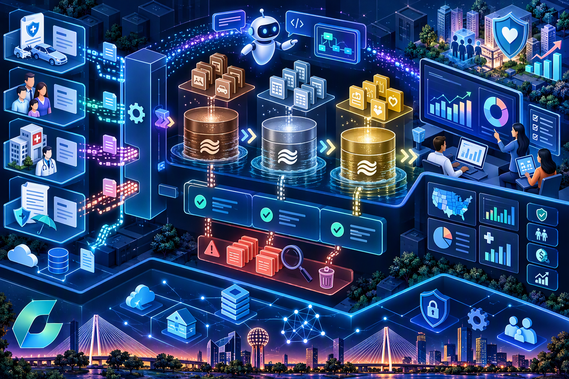
PART 3
Demos…(the reproducible kind!)
Three scenarios: insurance medallion build, schema drift, and quality recovery.
PROJECT OSMOS • DFW FABRIC & POWER BI USER GROUP
18
Notes:
Use this as a transition. Pause and reset the audience’s mental model before moving into the next section.
[Sources]
- Visual on this slide was generated with Microsoft Copilot.

Slide 20
Demo portfolio
Use one live, one abbreviated, and keep one as a discussion backup.
A • SYNTHETIC CLAIMS MEDALLION
B • SCHEMA DRIFT & QUARANTINE
C • INCREMENTAL SALES PIPELINE
Insurance
Build Bronze, Silver, and Gold outputs from synthetic claims, member, provider, and policy files. Add quality checks and exceptions.
Best for: end-to-end value.
Broadly applicable
Detect a changed input schema, preserve good rows, quarantine invalid records, and document the remediation.
Best for: troubleshooting.
Broadly applicable
Create an idempotent incremental load with a watermark, merge logic, reconciliation, and rerun proof.
Best for: production habits.
PROJECT OSMOS • DFW FABRIC & POWER BI USER GROUP
19
Notes:
Recommended live sequence: run Demo B live because it is bounded and visible; show Demo A as the richer end-to-end scenario; keep Demo C as a prepared backup or extended lab.
[Sources]
- https://learn.microsoft.com/en-us/fabric/data-engineering/data-engineering-agent-overview
- https://learn.microsoft.com/en-us/fabric/data-engineering/data-engineering-agent-get-started?tabs=github-copilot-cli
- https://learn.microsoft.com/en-us/fabric/data-engineering/data-engineering-agent-best-practices

Slide 21
Demo portfolio
Use one live, one abbreviated, and keep one as a discussion backup.
A • SYNTHETIC CLAIMS MEDALLION
B • SCHEMA DRIFT & QUARANTINE
C • INCREMENTAL SALES PIPELINE
Insurance
Build Bronze, Silver, and Gold outputs from synthetic claims, member, provider, and policy files. Add quality checks and exceptions.
Best for: end-to-end value.
Broadly applicable
Detect a changed input schema, preserve good rows, quarantine invalid records, and document the remediation.
Best for: troubleshooting.
Broadly applicable
Create an idempotent incremental load with a watermark, merge logic, reconciliation, and rerun proof.
Best for: production habits.
PROJECT OSMOS • DFW FABRIC & POWER BI USER GROUP
19
Notes:
Recommended live sequence: run Demo B live because it is bounded and visible; show Demo A as the richer end-to-end scenario; keep Demo C as a prepared backup or extended lab.
[Sources]
- https://learn.microsoft.com/en-us/fabric/data-engineering/data-engineering-agent-overview
- https://learn.microsoft.com/en-us/fabric/data-engineering/data-engineering-agent-get-started?tabs=github-copilot-cli
- https://learn.microsoft.com/en-us/fabric/data-engineering/data-engineering-agent-best-practices

Slide 22
Demo A: synthetic claims medallion
Business problem: build a trusted claims data product without using regulated or personal data.
PREREQUISITES
Fabric workspace + Lakehouse; Osmos access; clean VS Code/Copilot CLI context; Contributor permissions.
SAMPLE INPUTS
Four small synthetic CSVs: claims, members, providers, policies. Include duplicates, missing provider IDs, and invalid dates.
TARGET OUTPUT
Bronze raw tables; Silver conformed claims; Gold monthly claim summary; exception table; validation notebook.
SUCCESS CRITERIA
Idempotent rerun; duplicate rules; referential checks; reconciled counts/amounts; no raw PII; documented assumptions.
PROJECT OSMOS • DFW FABRIC & POWER BI USER GROUP
20
Notes:
Pre-stage the four CSVs in a local demo folder or Lakehouse Files area. Keep each file small enough to complete quickly. Use synthetic identifiers only. The generated visual is conceptual and should not be treated as a product screenshot.
[Sources]
- https://learn.microsoft.com/en-us/fabric/data-engineering/data-engineering-agent-overview
- https://learn.microsoft.com/en-us/fabric/data-engineering/data-engineering-agent-get-started?tabs=github-copilot-cli
- https://learn.microsoft.com/en-us/fabric/data-engineering/data-engineering-agent-best-practices
- Visual on this slide was generated with Microsoft Copilot.

Slide 23
Demo A: exact task prompt
Create a Microsoft Fabric medallion data engineering solution in the target workspace and Lakehouse using the four synthetic files: claims.csv, members.csv, providers.csv, and policies.csv.
Requirements:
• Preserve raw inputs in Bronze with ingestion metadata.
• Create Silver conformed tables with explicit data types and deterministic business keys.
• Remove exact duplicates but retain rejected rows in an exception table with reason codes.
• Validate claim dates, paid amounts, policy relationships, provider relationships, and member relationships.
• Create a Gold monthly claim summary by policy, provider specialty, and service month.
• Add reconciliation checks from source to Silver and Silver to Gold.
• Make the process idempotent and safe to rerun.
• Generate a validation notebook and a concise README describing artifacts, assumptions, and unresolved issues.
Before writing anything, show the plan and ask for approval.
PROJECT OSMOS • DFW FABRIC & POWER BI USER GROUP
21
Notes:
Presenter: read only the first sentence and the success criteria. Let the audience scan the details. Approve the plan only after confirming it names the expected artifacts and validation steps.
[Sources]
- https://learn.microsoft.com/en-us/fabric/data-engineering/data-engineering-agent-overview
- https://learn.microsoft.com/en-us/fabric/data-engineering/data-engineering-agent-get-started?tabs=github-copilot-cli
- https://learn.microsoft.com/en-us/fabric/data-engineering/data-engineering-agent-best-practices

Slide 24
Demo A: expected outcome and validation
EXPECTED
VALIDATE
FAILURE MODES
RECOVER
Task plan
Bronze/Silver/Gold artifacts
Exception table
Validation notebook
README + assumptions
Row-count reconciliation
Duplicate behavior
Broken-key exceptions
Amount totals
Rerun without duplication
Wrong target workspace
Type inference surprises
Large-file capacity pressure
Unclear business key
Task/poller stalls
Stop writes
Inspect checkpoint and artifacts
Repair the requirement
Resume existing task
Fall back to staged results
PROJECT OSMOS • DFW FABRIC & POWER BI USER GROUP
22
Notes:
Presenter checkpoint sequence: (1) show the plan, (2) show the task folder/checkpoint, (3) inspect one generated notebook, (4) run validation, (5) show the exception rows, and (6) rerun to demonstrate idempotency. If execution stalls, switch to the prepared artifacts and narrate the checkpoint/resume model.
[Sources]
- https://learn.microsoft.com/en-us/fabric/data-engineering/data-engineering-agent-overview
- https://learn.microsoft.com/en-us/fabric/data-engineering/data-engineering-agent-get-started?tabs=github-copilot-cli
- https://learn.microsoft.com/en-us/fabric/data-engineering/data-engineering-agent-best-practices

Slide 25

Demo B: schema drift and quarantine
Business problem: yesterday’s file worked; today’s file added, renamed, and corrupted fields.
SETUP
A working sales ingestion notebook plus a “day 2” file: renamed amount field, new currency column, malformed timestamp, and null key.
LIVE ASK
Diagnose the failure, propose a compatibility strategy, update the notebook, and preserve invalid rows in quarantine.
EXPECTED
Schema comparison, explicit mapping, safe casts, quarantine reason codes, and regression checks.
WHY IT DEMOS WELL
Fast, visible, and honest: the audience sees investigation, a proposed plan, code changes, and proof.
PROJECT OSMOS • DFW FABRIC & POWER BI USER GROUP
23
Notes:
This is the preferred live demo. Pre-run the original notebook successfully. Then introduce only the changed file. A visible failure gives the agent a concrete diagnostic target.
[Sources]
- https://learn.microsoft.com/en-us/fabric/data-engineering/data-engineering-agent-overview
- https://learn.microsoft.com/en-us/fabric/data-engineering/data-engineering-agent-get-started?tabs=github-copilot-cli
- https://learn.microsoft.com/en-us/fabric/data-engineering/data-engineering-agent-best-practices
- Visual on this slide was generated with Microsoft Copilot.

Slide 26
Demo B: prompt, proof, and reset
COPY/PASTE PROMPT
PROOF
The existing ingestion notebook succeeded on the original files and fails on the new file. Diagnose the schema drift before making changes. Compare the expected and actual schemas, explain the root cause, and propose a backward-compatible plan. After approval, update the notebook to: preserve the new currency field; map the renamed amount field; safely parse timestamps; quarantine rows with null business keys or unparseable timestamps; and add tests that prove both the old and new files work. Do not overwrite the original notebook; create a versioned copy.
Run old + new files; compare accepted/quarantined counts; inspect one reason code.
LIKELY FAILURE
Agent guesses a mapping, edits the original, or “fixes” by dropping bad rows.
RESET
Restore the prepared notebook; remove day-2 outputs; resume or restart from the approved plan.
PRESENTER LINE
“The useful output is not the code. It is the diagnosis plus evidence that both contracts still work.”
PROJECT OSMOS • DFW FABRIC & POWER BI USER GROUP
24
Notes:
Stop after diagnosis and ask the room whether the proposed compatibility rule is a business decision or an engineering decision. The correct answer is often “both,” which reinforces the human role.
[Sources]
- https://learn.microsoft.com/en-us/fabric/data-engineering/data-engineering-agent-overview
- https://learn.microsoft.com/en-us/fabric/data-engineering/data-engineering-agent-get-started?tabs=github-copilot-cli
- https://learn.microsoft.com/en-us/fabric/data-engineering/data-engineering-agent-best-practices

Slide 27
Demo C: Idempotent incremental sales load
PREREQS
TASK
PROOF
OBSERVE
RECOVER
Lakehouse tables
orders_day1.csv
orders_day2.csv
watermark table
Build incremental ingestion
MERGE by order_id
Handle updates/deletes
Persist batch metadata
Run day 1
Run day 2
Rerun day 2
Counts and totals unchanged
Batch ID
Inserted/updated counts
Rejected records
Duration and capacity
Reset target tables
Restore watermark
Resume task
Use staged notebook
PROJECT OSMOS • DFW FABRIC & POWER BI USER GROUP
25
Notes:
Sample prompt: “Create an idempotent incremental load for orders_day1.csv and orders_day2.csv. Use order_id as the key, updated_at as the watermark, deterministic MERGE behavior, batch audit fields, duplicate handling, and reconciliation tests. Show the plan and table contracts before writing.”
[Sources]
- https://learn.microsoft.com/en-us/fabric/data-engineering/data-engineering-agent-overview
- https://learn.microsoft.com/en-us/fabric/data-engineering/data-engineering-agent-get-started?tabs=github-copilot-cli
- https://learn.microsoft.com/en-us/fabric/data-engineering/data-engineering-agent-best-practices

Slide 28
PART 4
Economics and operations
Capacity consumption, cost interpretation, and production-minded guardrails.
PROJECT OSMOS • DFW FABRIC & POWER BI USER GROUP
27
Notes:
Use this as a transition. Pause and reset the audience’s mental model before moving into the next section.
[Sources]
- Visual on this slide was generated with Microsoft Copilot.

Slide 29
How cost works
Think Fabric capacity consumption rather than a standalone “Osmos price per project.”
1 • FABRIC CAPACITY
2 • SEPARATE ENTITLEMENTS
3 • OBSERVE, THEN PRICE
The engineering activity is reflected through Fabric capacity consumption. Work competes with other activity on the capacity.
GitHub Copilot/CLI access, tenant enablement, and any other prerequisites are separate from Fabric compute.
Measure the task in the Capacity Metrics app and apply your organization’s actual capacity economics. Preview behavior and documentation can change.
No authoritative public flat-rate Osmos pricing table was identified in the supplied materials. Do not invent a per-task dollar figure.
PROJECT OSMOS • DFW FABRIC & POWER BI USER GROUP
28
Notes:
Explain that “how much does it cost?” has two layers: required licenses/enablement and Fabric capacity consumption. The consumption documentation is the authoritative source for what appears in capacity reporting. Your October 2026 Microsoft correspondence also stated that an Osmos pricing table was not yet published; verify again before delivery.
[Sources]
- https://learn.microsoft.com/en-us/fabric/data-engineering/data-engineering-agent-consumption
- Internal context: email from AJ Seidman, October 16, 2026

Slide 30
Practical cost measurement workflow
BASELINE
TAG
RUN
Record capacity utilization before the task.
Use a dedicated workspace/task and note the start time.
Execute with representative development-sized data.
OBSERVE
COMPARE
DECIDE
Review Capacity Metrics and attributable operations.
Measure duration, CU impact, outputs, and rerun behavior.
Scale, schedule, optimize, or reject the use case.
Cost-control pattern: small data in Dev → validated code → larger capacity in Prod
PROJECT OSMOS • DFW FABRIC & POWER BI USER GROUP
29
Notes:
A prior internal test encountered capacity-limit errors when production-scale enrollment/demographic volumes were used on development capacity. Present that as practitioner experience, not universal product behavior. The transferable lesson is to size test data to the environment and observe capacity while the task runs.
[Sources]
- https://learn.microsoft.com/en-us/fabric/data-engineering/data-engineering-agent-consumption
- Internal practitioner experience: Teams discussion, October 16, 2026

Slide 31
Best practices that materially improve outcomes
USE A MINIMAL PROFILE
WRITE A CONTRACT
START READ-ONLY
Use a profile with minimal MCPs and extensions to prevent unexpected AI credit usage and tool confusion.
Outcome, scope, target, grain, constraints, artifacts, and measurable acceptance criteria.
Inspect context and propose a plan before granting write-capable actions.
KEEP DATA SMALL
MAKE QUALITY EXECUTABLE
VERSION EVERYTHING
Use representative subsets in Dev; promote code, not a giant demo data.
Turn business rules into tests, reconciliation, and exception outputs.
Prompt, task brief, notebooks, schemas, tests, README, and decisions.
RESUME, DON’T DUPLICATE
OBSERVE CAPACITY
REVIEW THE HANDOFF
Use persistent task state and existing .dataprojects context when available.
Watch utilization and attributable operations during long tasks.
Require an artifact inventory, evidence, assumptions, and unresolved risks.
PROJECT OSMOS • DFW FABRIC & POWER BI USER GROUP
30
Notes:
Distinguish Microsoft-published best practices from practitioner guidance. The contract/validation/versioning pattern is deliberately conservative and aligns the preview agent with a normal SDLC.
[Sources]
- https://learn.microsoft.com/en-us/fabric/data-engineering/data-engineering-agent-best-practices
- https://learn.microsoft.com/en-us/fabric/data-engineering/data-engineering-agent-consumption

Slide 32
Prompt anatomy for engineering work
ROLE + TARGET
Use Project Osmos. Confirm this Fabric workspace and Lakehouse.
OUTCOME
Build the named data product—not “an ETL.”
CONTRACTS
Define source grain, keys, schemas, layers, naming, and ownership.
QUALITY
State duplicate, null, referential, range, freshness, and reconciliation rules.
OPERATIONS
Require idempotency, audit columns, logging, and safe reruns.
BOUNDARIES
Specify what must not be changed and when approval is required.
EVIDENCE
Name the tests, artifact inventory, README, and unresolved-issues report.
PROJECT OSMOS • DFW FABRIC & POWER BI USER GROUP
31
Notes:
The main technique is specificity without prescribing every implementation detail. Define the engineering contracts and evidence, then allow the agent to propose the mechanics.
[Sources]
- https://learn.microsoft.com/en-us/fabric/data-engineering/data-engineering-agent-best-practices

Slide 33
Security and governance checklist
Osmos does not create a new security bypass. The target Fabric identity and permissions still matter.
Use the least-privileged, human identity and workspace role
Confirm the exact target from the full Fabric URL
Keep secrets and sensitive values out of prompts and demo files
Use synthetic data for public demos
Require plan approval before write-capable steps
Preserve generated artifacts in version control
Use normal Dev / Test / Prod promotion and separation of duties
Log task IDs, prompts, artifacts, validation, duration, and capacity
Define rollback and support ownership before production
Revalidate all assumptions while the service remains in preview
PROJECT OSMOS • DFW FABRIC & POWER BI USER GROUP
32
Notes:
Osmos does not create a new security bypass. The target Fabric identity and permissions still matter. For public demos, use synthetic data and remove tenant/workspace identifiers from slides and screenshots.
[Sources]
- https://learn.microsoft.com/en-us/fabric/data-engineering/data-engineering-agent-overview
- https://learn.microsoft.com/en-us/fabric/data-engineering/data-engineering-agent-get-started?tabs=github-copilot-cli
- https://learn.microsoft.com/en-us/fabric/data-engineering/data-engineering-agent-best-practices

Slide 34
Adoption path: pilot without creating chaos
1
2
3
4
5
6
SELECT
SANDBOX
PROVE
STANDARDIZE
EXPAND
OPERATE
Bounded, repeatable, measurable task
Synthetic or representative data; dedicated workspace
Quality, idempotency, observability, and capacity evidence
Reusable task brief, prompt, checks, and review checklist
More users and scenarios only after evidence
Ownership, monitoring, support, and lifecycle
PROJECT OSMOS • DFW FABRIC & POWER BI USER GROUP
33
Notes:
A Strategic Coach-style framing: identify who owns the outcome, review, security, capacity, and support before asking how to scale the technology.
[Sources]
- https://learn.microsoft.com/en-us/fabric/data-engineering/data-engineering-agent-overview
- https://learn.microsoft.com/en-us/fabric/data-engineering/data-engineering-agent-get-started?tabs=github-copilot-cli
- https://learn.microsoft.com/en-us/fabric/data-engineering/data-engineering-agent-best-practices
- https://learn.microsoft.com/en-us/fabric/data-engineering/data-engineering-agent-consumption

Slide 35
Key takeaways
1
Osmos is a persistent data engineering agent—not merely inline code completion.
2
The prompt should be an engineering contract with executable acceptance criteria.
3
It sits between the developer experience and governed Fabric artifacts/compute.
4
Human review, security, validation, promotion, and support remain essential.
5
Cost is understood through Fabric capacity consumption plus separate prerequisites.
6
The safest path is small data, visible plans, versioned artifacts, and measurable proof.
PROJECT OSMOS • DFW FABRIC & POWER BI USER GROUP
34
Notes:
Close by asking the audience to remember three verbs: contract, prove, govern. Those remain useful even as preview details change.
[Sources]
- https://learn.microsoft.com/en-us/fabric/data-engineering/data-engineering-agent-overview
- https://learn.microsoft.com/en-us/fabric/data-engineering/data-engineering-agent-get-started?tabs=github-copilot-cli
- https://learn.microsoft.com/en-us/fabric/data-engineering/data-engineering-agent-best-practices
- https://learn.microsoft.com/en-us/fabric/data-engineering/data-engineering-agent-consumption
- https://github.com/microsoft/project-osmos

Slide 36
Questions?
Contract the outcome. Prove the result. Govern the handoff.
Jennifer Ratten • Dallas–Fort Worth Fabric and Power BI User Group
Project Osmos is in preview. Recheck current documentation often.
Notes:
Use Q&A to distinguish the data engineering agent from Fabric Data Agents used for conversational analytics. If asked about price, return to capacity consumption and current documentation rather than giving an invented per-task dollar estimate.
[Sources]
- https://learn.microsoft.com/en-us/fabric/data-engineering/data-engineering-agent-overview
- https://learn.microsoft.com/en-us/fabric/data-engineering/data-engineering-agent-get-started?tabs=github-copilot-cli
- https://learn.microsoft.com/en-us/fabric/data-engineering/data-engineering-agent-best-practices
- https://learn.microsoft.com/en-us/fabric/data-engineering/data-engineering-agent-consumption
- https://github.com/microsoft/project-osmos
- Visual on this slide was generated with Microsoft Copilot.

