Slide 1
Network Flows
Sébastien Lahaie
Microsoft Research, NYC
Data Science Summer School
July 10, 2015

Slide 2
Outline
Flow Networks
Maximum Flow
Augmenting path algorithm
Max-flow/Min-cut theorem
Bipartite matching
Flows with Demands
Reduction to max flow
Conformal decomposition
Min-Cost Flow
Cycle cancellation algorithm
Ad allocation

Slide 3
Example Flow Network
u
20
10
s
30
t
10
20
v

Slide 4
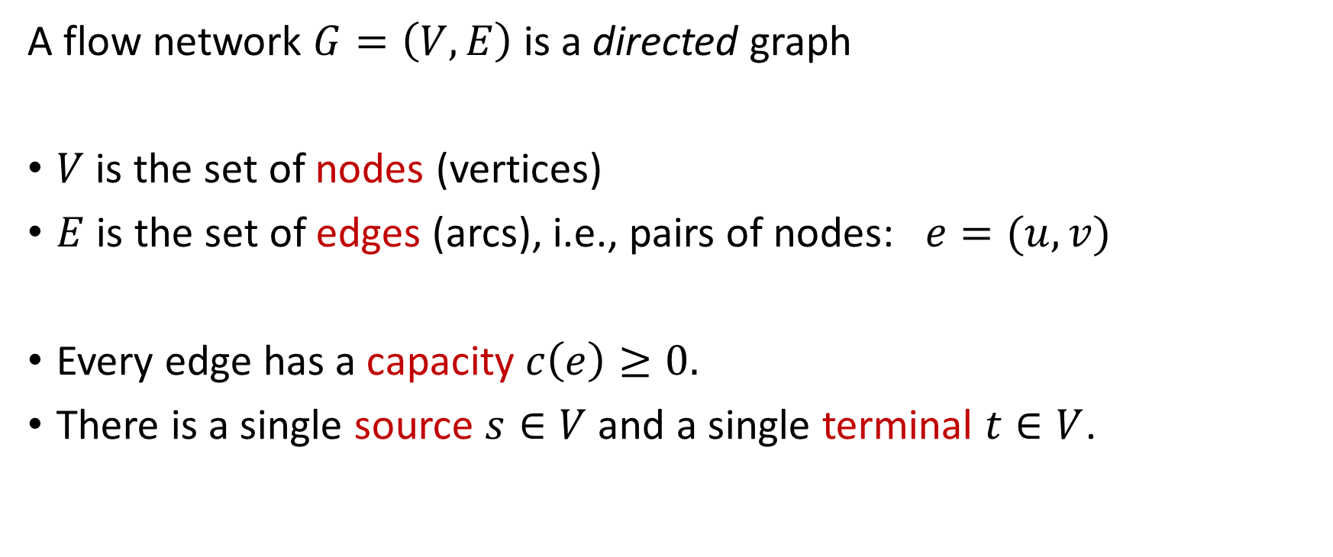
Flow Network
A flow network $G=\left(V,E\right)$ is a directed graph
$V$ is the set of nodes (vertices)
$E$ is the set of edges (arcs), i.e., pairs of nodes: $e=(u,v)$
Every edge has a capacity $c\left(e\right)≥0.$
There is a single source $s∈V$ and a single terminal $t∈V$.

Slide 5
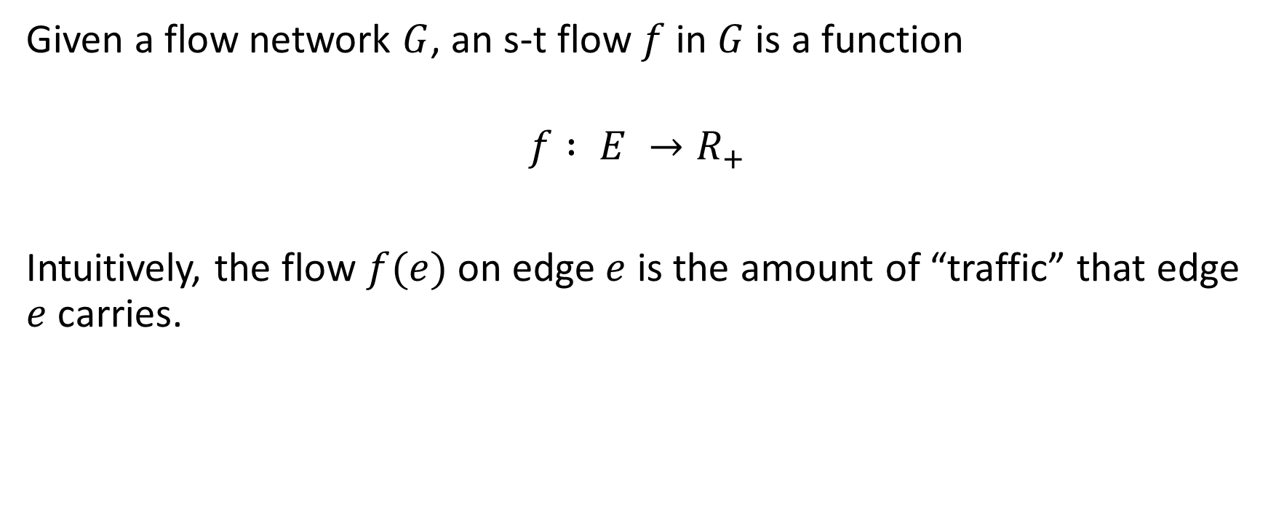
Flows
Given a flow network $G$, an s-t flow $f$in $G$is a function
$$f : E →R_{+}$$
Intuitively, the flow $f(e)$on edge $e$ is the amount of “traffic” that edge $e$ carries.

Slide 6
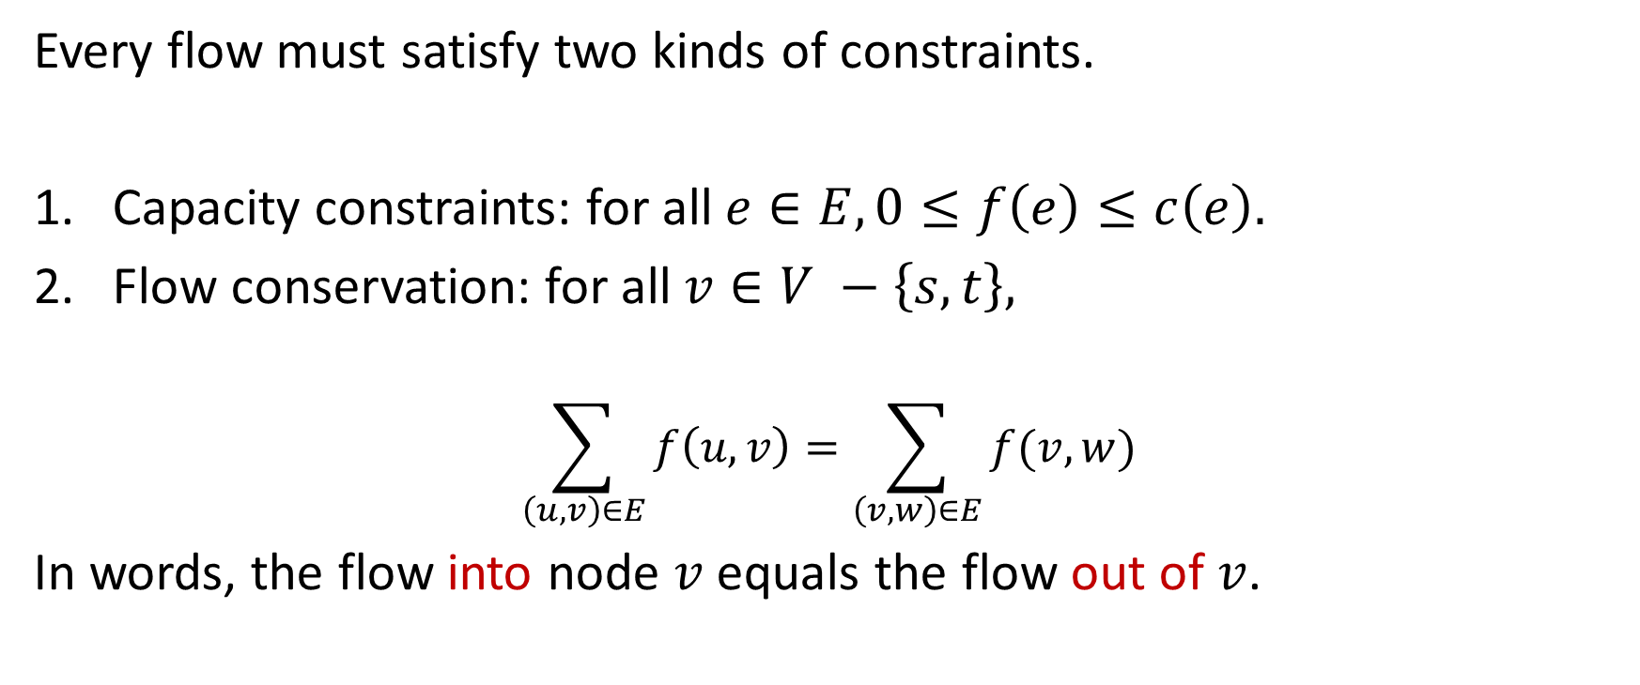
Flow Constraints
Every flow must satisfy two kinds of constraints.
Capacity constraints: for all $e∈E, 0≤f\left(e\right)≤c\left(e\right).$
Flow conservation: for all $v∈V −\left\{s,t\right\},$
$$\sum_{\left(u,v\right)∈E}{f\left(u,v\right)}=\sum_{\left(v,w\right)∈E}{f(v,w)}$$
In words, the flow into node $v$ equals the flow out of $v$.

Slide 7
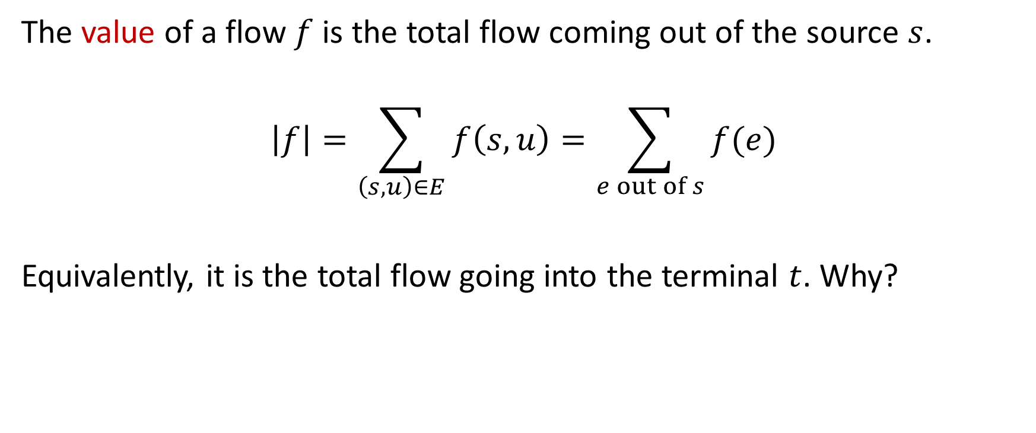
Value of a Flow
The value of a flow $f$ is the total flow coming out of the source $s$.
$$\left|f\right|=\sum_{\left(s,u\right)∈E}{f\left(s,u\right)=\sum_{e out of s}{f(e)}}$$
Equivalently, it is the total flow going into the terminal $t$. Why?

Slide 8
Example Flow of Value 20
u
20/20
0/10
s
20/30
t
0/10
20/20
v

Slide 9
Modeling Applications
Application | Nodes | Edges | Flow
Communication systems | telephone exchanges, computers, satellites | cables, fiber optic links, microwave relay links | voice messages, data, video transmission
Transportation systems | intersections, airports, stations | highways, railways, airline routes | passengers, cargo
Integrated circuits | registers, processors | wires | electrical current
Hydraulic systems | pumping stations, reservoirs | pipelines | water, gas, oil

Slide 10
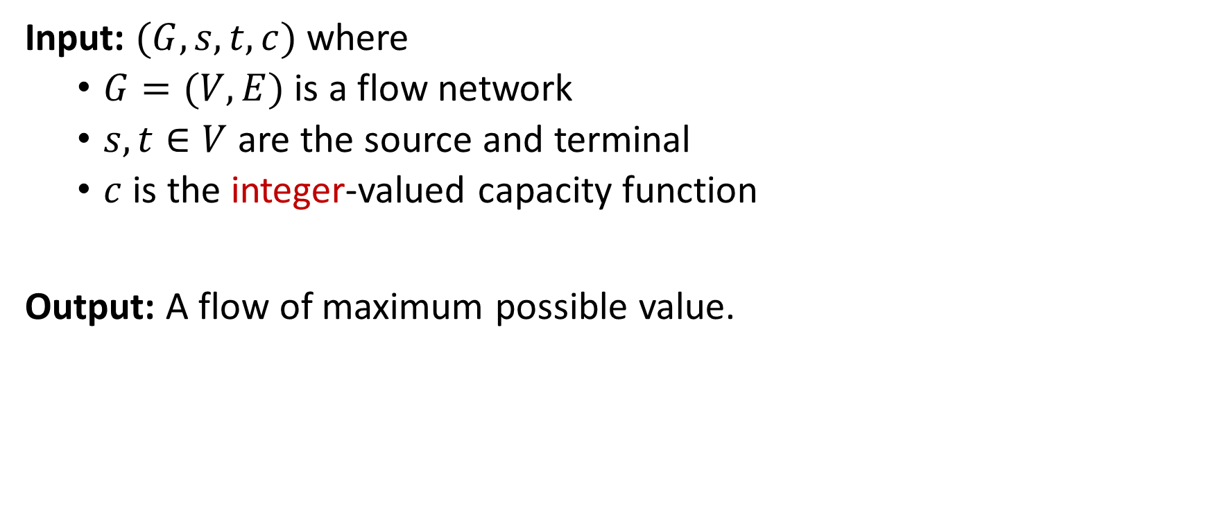
Max Flow Problem
Input: $(G, s, t, c)$ where
$G=(V,E)$ is a flow network
$s,t∈V$ are the source and terminal
$c$ is the integer-valued capacity function
Output: A flow of maximum possible value.

Slide 11
Example Flow of Value 20
u
20/20
0/10
Is this optimal? How can we find a way to push more flow through the network?
s
20/30
t
0/10
20/20
v

Slide 12
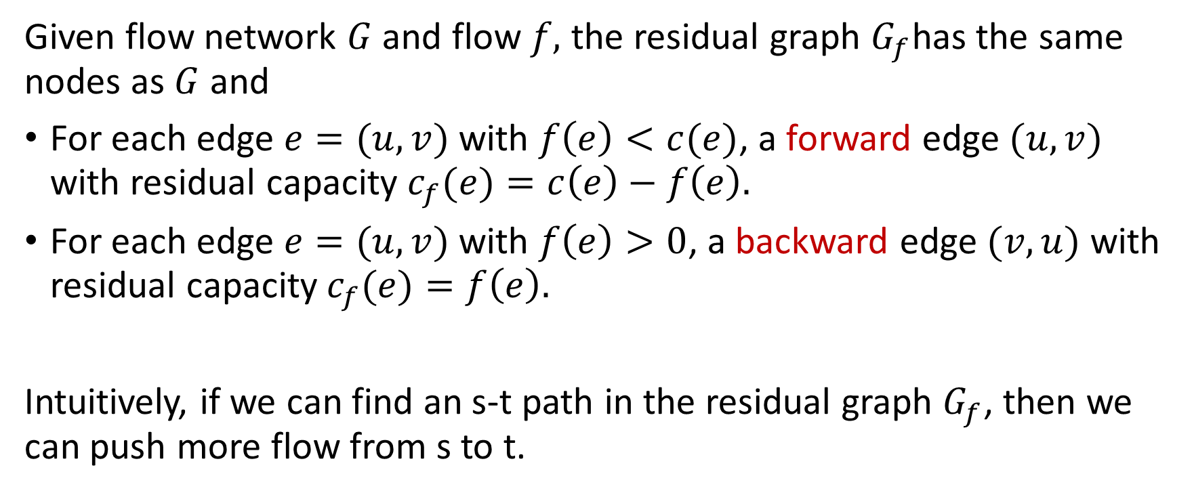
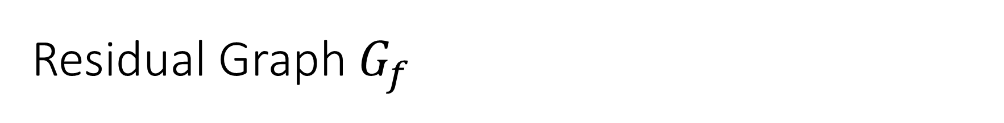
Residual Graph $G_{f}$
Given flow network $G$ and flow $f,$ the residual graph $G_{f}$has the same nodes as $G$ and
For each edge $e=(u,v)$ with $f\left(e\right)<c(e)$, a forward edge $(u,v)$ with residual capacity $c_{f}(e)=c\left(e\right)−f\left(e\right).$
For each edge $e=(u,v)$ with $f\left(e\right)>0$, a backward edge $(v,u)$ with residual capacity $c_{f}(e)=f\left(e\right).$
Intuitively, if we can find an s-t path in the residual graph $G_{f}$, then we can push more flow from s to t.

Slide 13
Example Residual Graph
u
u
20/20
0/10
20
10
s
20/30
t
s
20
10
t
0/10
20/20
10
20
v
v
We can push a flow of 10 along the augmenting path $s →v →u →t.$

Slide 14
Flow of Value 30
u
20/20
10/10
s
10/30
t
10/10
20/20
v

Slide 15
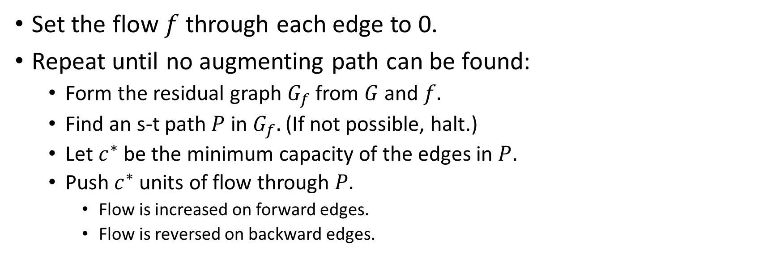
Ford-Fulkerson Algorithm
Set the flow $f$through each edge to 0.
Repeat until no augmenting path can be found:
Form the residual graph $G_{f}$ from $G$and $f.$
Find an s-t path $P$ in $G_{f}.$ (If not possible, halt.)
Let $c^{∗}$ be the minimum capacity of the edges in $P.$
Push $c^{∗}$units of flow through $P.$
Flow is increased on forward edges.
Flow is reversed on backward edges.
Need to prove optimality and scalability.

Slide 16
Flow of Value 30
u
20/20
10/10
Is this optimal?
How can we tell?
s
10/30
t
10/10
20/20
v

Slide 17

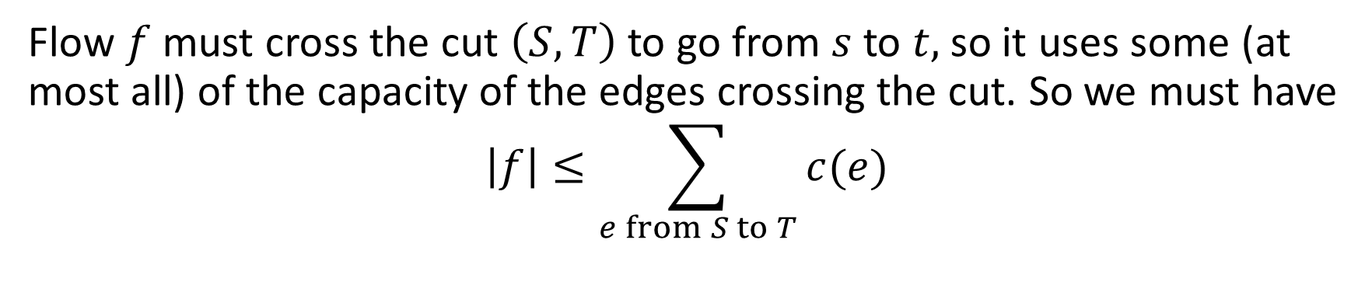

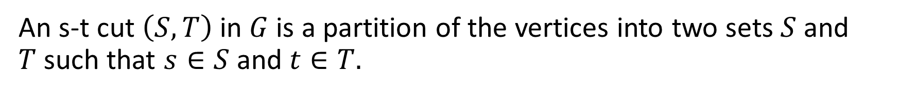



Cuts in Flow Networks
An s-t cut $\left(S, T\right)$ in $G$is a partition of the vertices into two sets $S$and $T$such that $s∈S$and $t∈T.$
$$S$$
$$c\left(e_{1}\right)$$
$$T$$
$$c\left(e_{2}\right)$$
s
$$c\left(e_{3}\right)$$
t
Flow $f$must cross the cut $\left(S, T\right)$ to go from $s$to $t,$so it uses some (at most all) of the capacity of the edges crossing the cut. So we must have
$$\left|f\right|≤\sum_{e from S to T}{c(e)}$$

Slide 18
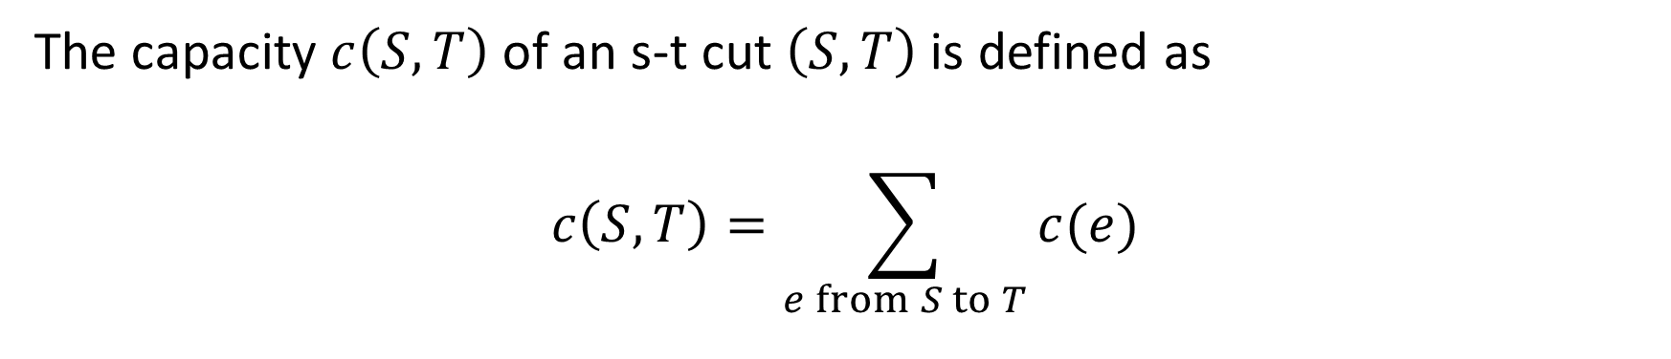
Max Flow-Min Cut
The capacity $c\left(S,T\right)$ of an s-t cut $\left(S,T\right)$ is defined as
$$c\left(S,T\right)=\sum_{e from S to T}{c(e)}$$
Theorem: In every flow network, the maximum value of an s-t flow equals the minimum capacity of an s-t cut.

Slide 19
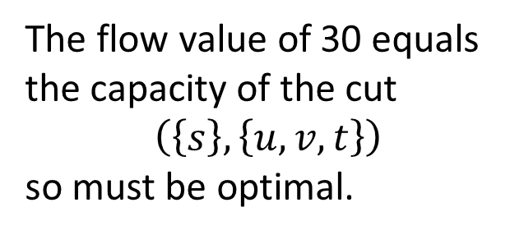
Flow of Value 30
u
20/20
10/10
Is this optimal?
How can we tell?
s
10/30
t
The flow value of 30 equals the capacity of the cut
$\left(\left\{s\right\}, \left\{u,v,t\right\}\right)$
so must be optimal.
10/10
20/20
v

Slide 20

Properties of Ford-Fulkerson
Outputs an optimal (maximum) flow from $s$to $t.$
The optimal flow is integer-valued.
Also finds a minimum s-t cut. How?
The algorithm is scalable in the number of nodes and edges.

Slide 21
Application: Bipartite Matching
Can we find a subset of edges such that each node on the left is linked to just one node on the right, and vice-versa?

Slide 22
Application: Bipartite Matching
Can we find a subset of edges such that each node on the left is linked to just one node on the right, and vice-versa?

Slide 23
Application: Bipartite Matching
Reduce (i.e., transform) the problem into a max-flow problem.
Add a source linked to all nodes on the left.
Add a terminal linked to all nodes on the right.
Add capacities of 1 to all edges.
If the maximum flow value is 4, there is a bipartite matching.
s
t

Slide 24
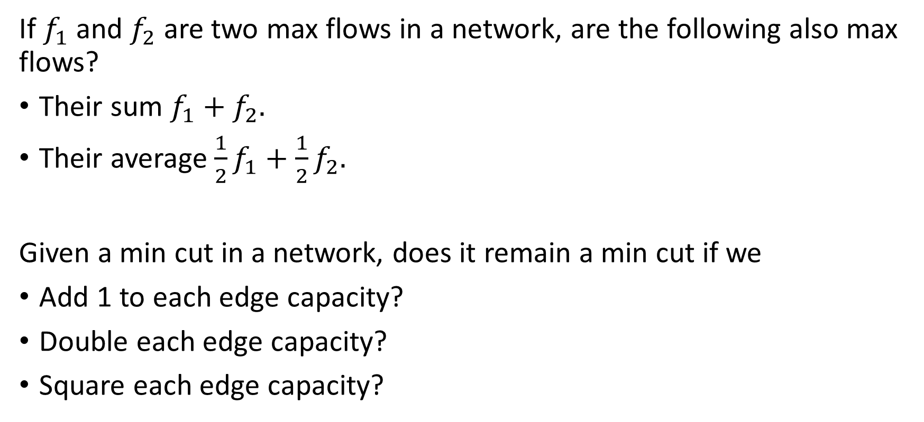
Exercises
If $f_{1}$ and $f_{2}$ are two max flows in a network, are the following also max flows?
Their sum $f_{1}+f_{2}.$
Their average $\frac{1}{2}f_{1}+\frac{1}{2}f_{2}.$
Given a min cut in a network, does it remain a min cut if we
Add 1 to each edge capacity?
Double each edge capacity?
Square each edge capacity?

Slide 25
Outline
Flow Networks
Maximum Flow
Augmenting path algorithm
Max-flow/Min-cut theorem
Bipartite matching
Flows with Demands
Reduction to max flow
Conformal decomposition
Min-Cost Flow
Cycle cancellation algorithm
Ad allocation

Slide 26
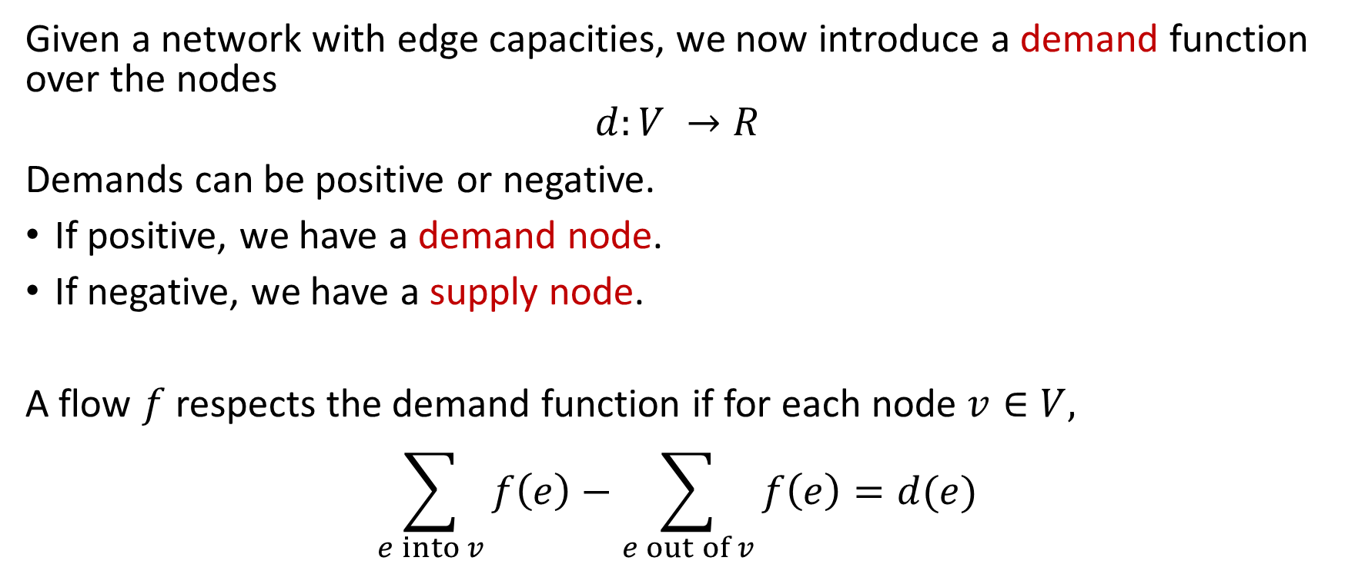
Flow Networks with Demands
Given a network with edge capacities, we now introduce a demand function over the nodes
$$d:V →R$$
Demands can be positive or negative.
If positive, we have a demand node.
If negative, we have a supply node.
A flow $f$respects the demand function if for each node $v∈V,$
$$\sum_{e into v}{f\left(e\right)}−\sum_{e out of v}{f\left(e\right)}=d(e)$$

Slide 27
Example Network with Demands
5
u
20
10
-25
s
30
t
20
10
20
v
0

Slide 28
Flow Respecting the Demands
5
u
15/20
0/10
-25
s
10/30
t
20
10/10
20/20
v
0

Slide 29
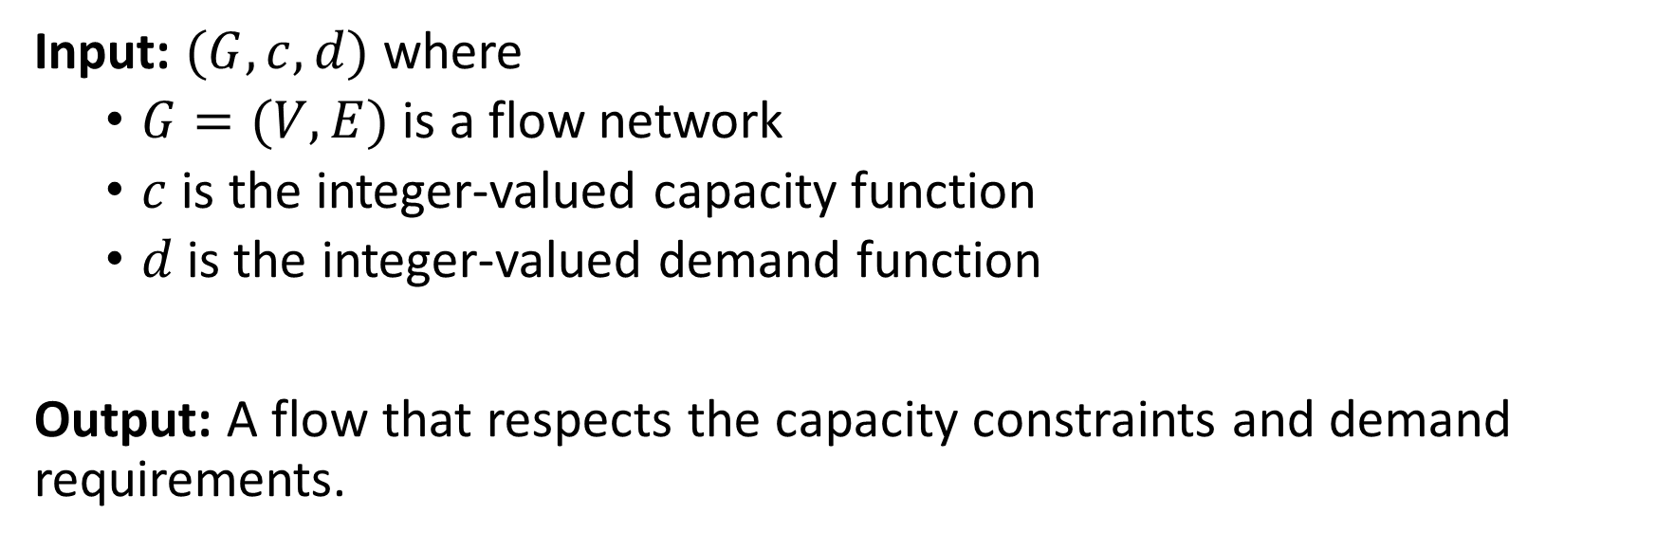
Flow with Demands Problem
Input: $(G, c, d)$ where
$G=(V,E)$ is a flow network
$c$ is the integer-valued capacity function
$d$is the integer-valued demand function
Output: A flow that respects the capacity constraints and demand requirements.
This is a feasibility problem, rather than an optimization problem.

Slide 30
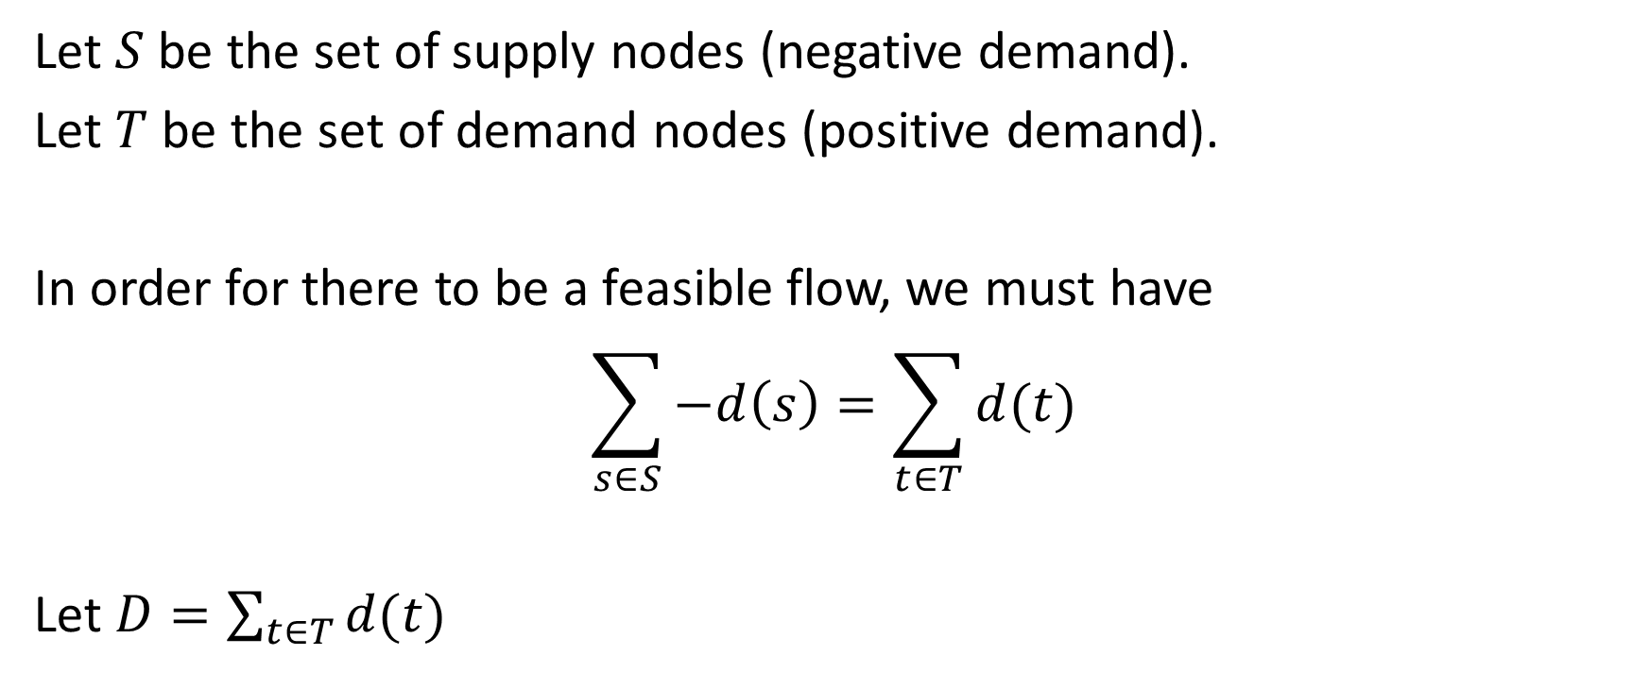
Necessary Condition
Let $S$be the set of supply nodes (negative demand).
Let $T$be the set of demand nodes (positive demand).
In order for there to be a feasible flow, we must have
$$\sum_{s∈S}{−d\left(s\right)=\sum_{t∈T}{d(t)}}$$
Let $D=\sum_{t∈T}{d(t)}$

Slide 31
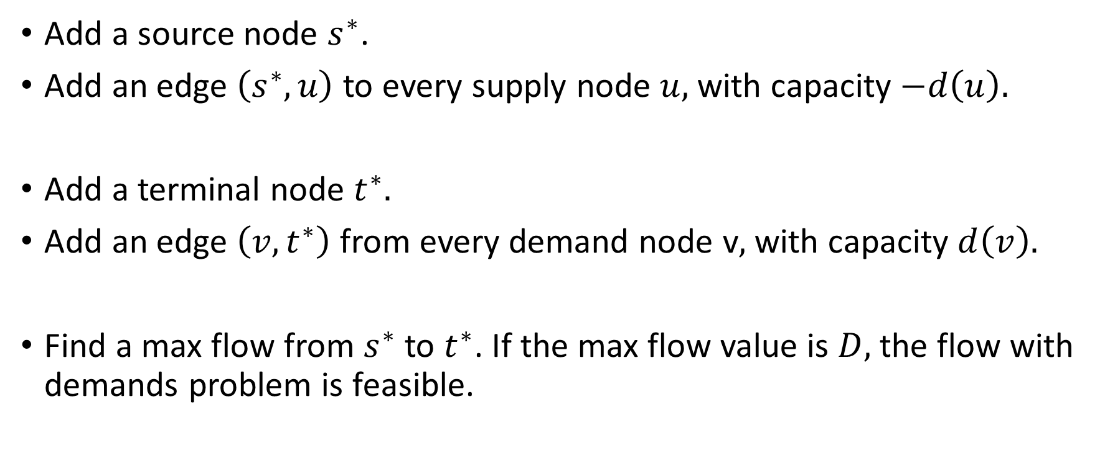
Reduction to Max Flow
Add a source node $s^{∗}$.
Add an edge $\left(s^{∗}, u\right)$to every supply node $u,$with capacity $−d\left(u\right).$
Add a terminal node $t^{∗}.$
Add an edge $\left(v, t^{∗}\right)$from every demand node v$,$with capacity $d\left(v\right).$
Find a max flow from $s^{∗}$ to $t^{∗}$. If the max flow value is $D,$the flow with demands problem is feasible.

Slide 32
Example Network with Demands
5
u
20
10
-25
s
30
t
20
10
20
v
0

Slide 33


Reduction to Max Flow
u
20
10
5
$s^{∗}$
s
30
t
$$t^{∗}$$
25
20
10
20
v

Slide 34
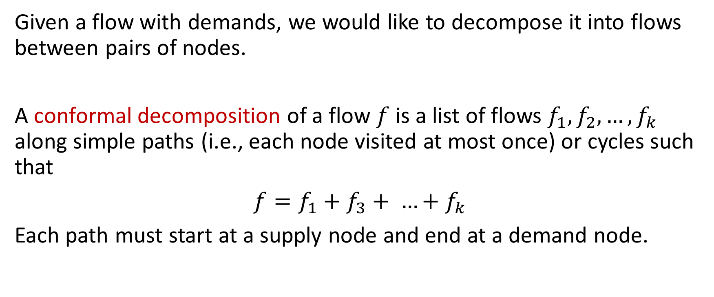
Conformal Decomposition
Given a flow with demands, we would like to decompose it into flows between pairs of nodes.
A conformal decomposition of a flow $f$is a list of flows $f_{1},f_{2},…, f_{k}$ along simple paths (i.e., each node visited at most once) or cycles such that
$f=f_{1}+f_{3}+ …+f_{k}$
Each path must start at a supply node and end at a demand node.

Slide 35
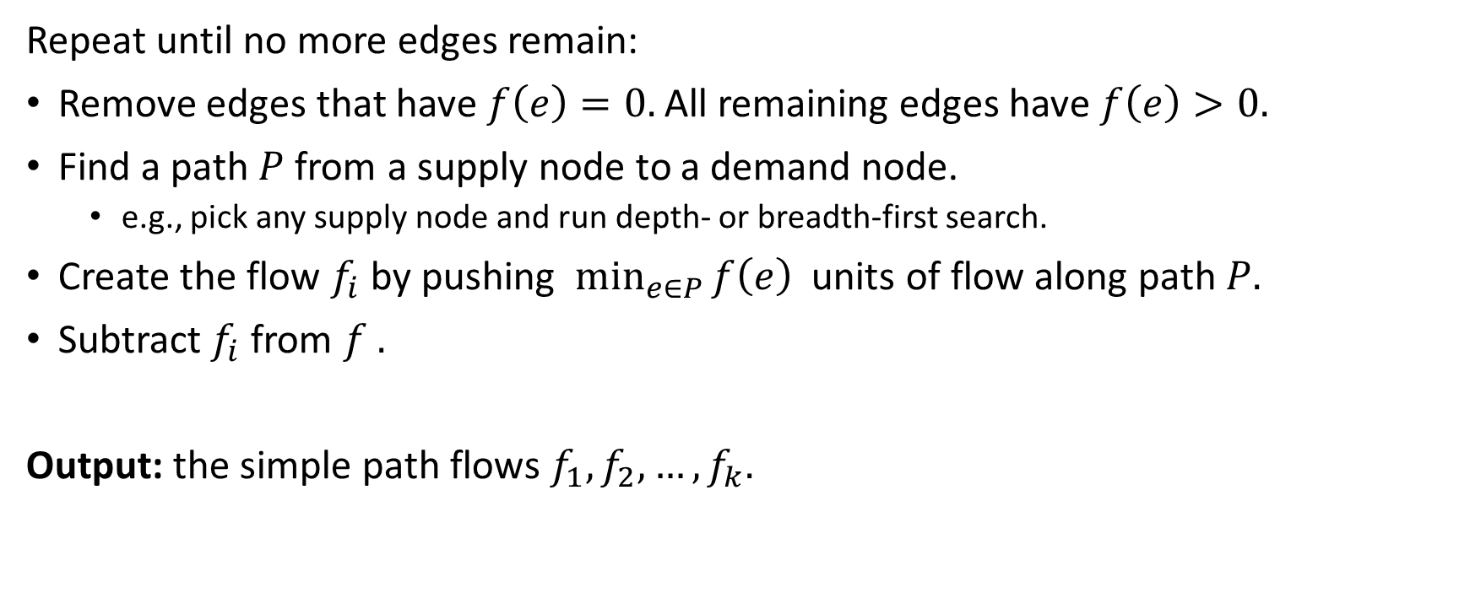
Algorithm for Conformal Decomposition
Repeat until no more edges remain:
Remove edges that have $f\left(e\right)=0.$All remaining edges have $f\left(e\right)>0.$
Find a path $P$from a supply node to a demand node.
e.g., pick any supply node and run depth- or breadth-first search.
Create the flow $f_{i}$by pushing $\min_{e∈P}{f\left(e\right) }$ units of flow along path $P.$
Subtract $f_{i}$from $f .$
Output: the simple path flows $f_{1},f_{2},…, f_{k}.$

Slide 36
Example Conformal Decomposition
5
5
u
u
10
t
20
10
15
0
-25
s
10
v
-25
s
10
t
20
0
10
20
v
0

Slide 37
Example Conformal Decomposition
5
5
u
u
10
t
20
10
5
-25
s
10
v
-25
s
0
t
20
0
-25
s
t
20
10
10
10
10
v
0
v
0

Slide 38
Example Conformal Decomposition
5
5
u
u
10
t
20
10
5
-25
s
10
v
-25
s
t
20
0
-25
s
t
20
0
0
10
v
10
0
v
-25
s
u
5
0
5

Slide 39
Example Conformal Decomposition
5
5
u
u
10
t
20
10
0
-25
s
10
v
-25
s
t
20
0
-25
s
t
20
10
v
10
0
v
-25
s
u
5
0
5

Slide 40
Example Conformal Decomposition
5
5
u
u
10
t
20
15
0
10
-25
s
10
v
-25
s
10
t
20
0
-25
s
t
20
10
20
10
v
10
v
0
0
-25
s
u
5
5

Slide 41
Outline
Flow Networks
Maximum Flow
Augmenting path algorithm
Max-flow/Min-cut theorem
Bipartite matching
Flows with Demands
Reduction to max flow
Conformal decomposition
Min-Cost Flow
Cycle cancellation algorithm
Ad allocation

Slide 42
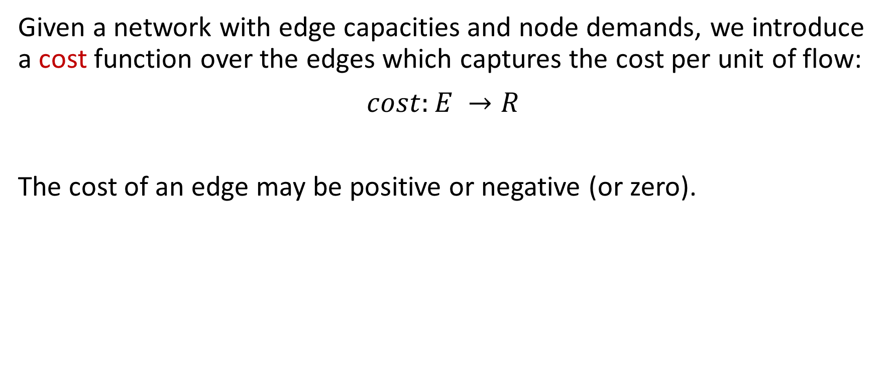
Flow Networks with Demands and Costs
Given a network with edge capacities and node demands, we introduce a cost function over the edges which captures the cost per unit of flow:
$$cost:E →R$$
The cost of an edge may be positive or negative (or zero).

Slide 43
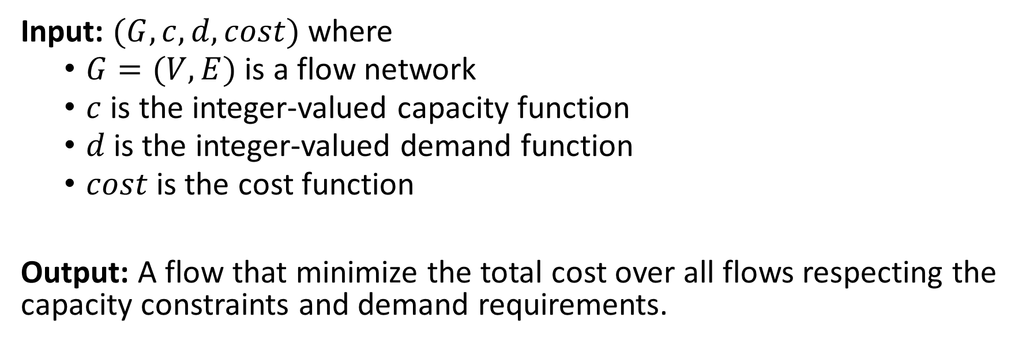
Min-Cost Flow Problem
Input: $(G, c, d, cost)$ where
$G=(V,E)$ is a flow network
$c$ is the integer-valued capacity function
$d$is the integer-valued demand function
$cost$is the cost function
Output: A flow that minimize the total cost over all flows respecting the capacity constraints and demand requirements.

Slide 44
Improving a Feasible Flow
5
u
u
$1
$1
$1
$1
15/20
0/10
5
10
15
$1
-$1
$1
10
20
s
10/30
t
20
s
t
-25
-$1
$2
-$2
10
10/10
$1
20/20
-$1
20
v
v
Adding a negative cost cycle from the residual graph improves total cost, continues to satisfy constraints.
0

Slide 45
Improving a Feasible Flow
5
u
u
$1
$1
$1
-$1
15/20
10/10
5
10
15
$1
-$1
$1
30
t
-25
s
0/30
t
20
s
$2
$2
10
-$2
10
10/10
$1
10/20
-$1
10
v
v
When there is no negative cycle in the residual graph, we are done.
0

Slide 46
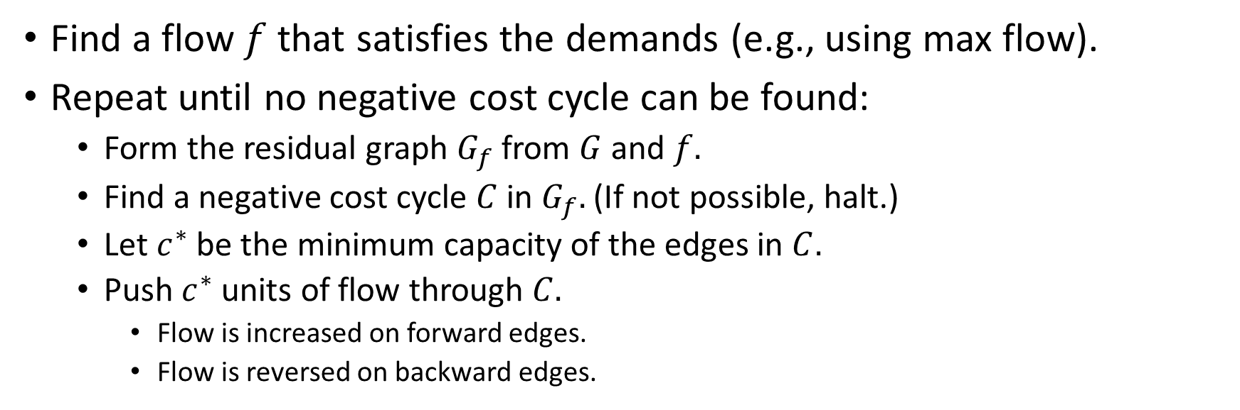
Klein’s Cycle Canceling Algorithm
Find a flow $f$that satisfies the demands (e.g., using max flow).
Repeat until no negative cost cycle can be found:
Form the residual graph $G_{f}$ from $G$and $f.$
Find a negative cost cycle $C$in $G_{f}.$ (If not possible, halt.)
Let $c^{∗}$ be the minimum capacity of the edges in $C.$
Push $c^{∗}$units of flow through $C.$
Flow is increased on forward edges.
Flow is reversed on backward edges.

Slide 47
Properties of Cycle Canceling Algorithm
Outputs an optimal (min-cost) flow from satisfying node demands.
The optimal flow is integer-valued.
The algorithm is scalable in the number of nodes and edges.
In analogy to max-flow/min-cut, there is also a “dual” problem of finding node prices to optimize storage costs of materials at nodes.

Slide 48


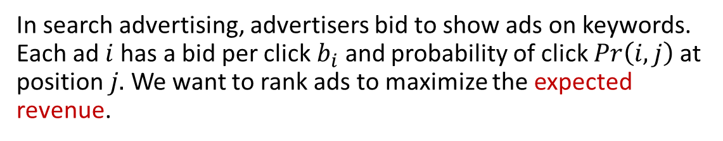


Application: Ad Allocation
In search advertising, advertisers bid to show ads on keywords. Each ad $i$has a bid per click $b_{i}$ and probability of click $Pr\left(i,j\right)$at position $j.$We want to rank ads to maximize the expected revenue.
Ads $i$
Positions $j$
-1
1
-1
1
$$cost\left(i, j\right)={−b}_{i}×Pr(i,j)$$
-1
1
-1
1

Slide 49
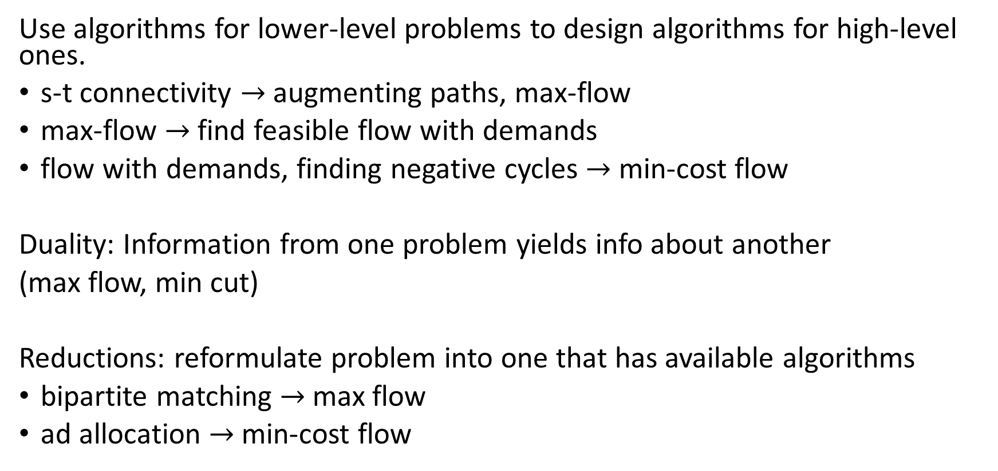
General Principles
Use algorithms for lower-level problems to design algorithms for high-level ones.
s-t connectivity $→$augmenting paths, max-flow
max-flow $→$find feasible flow with demands
flow with demands, finding negative cycles $→$ min-cost flow
Duality: Information from one problem yields info about another
(max flow, min cut)
Reductions: reformulate problem into one that has available algorithms
bipartite matching $→$max flow
ad allocation $→$min-cost flow

