Slide 1
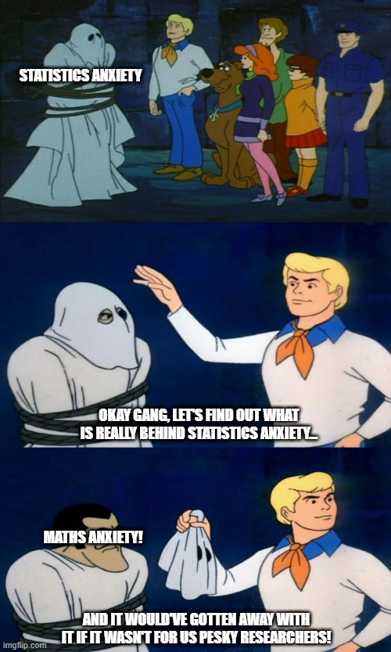

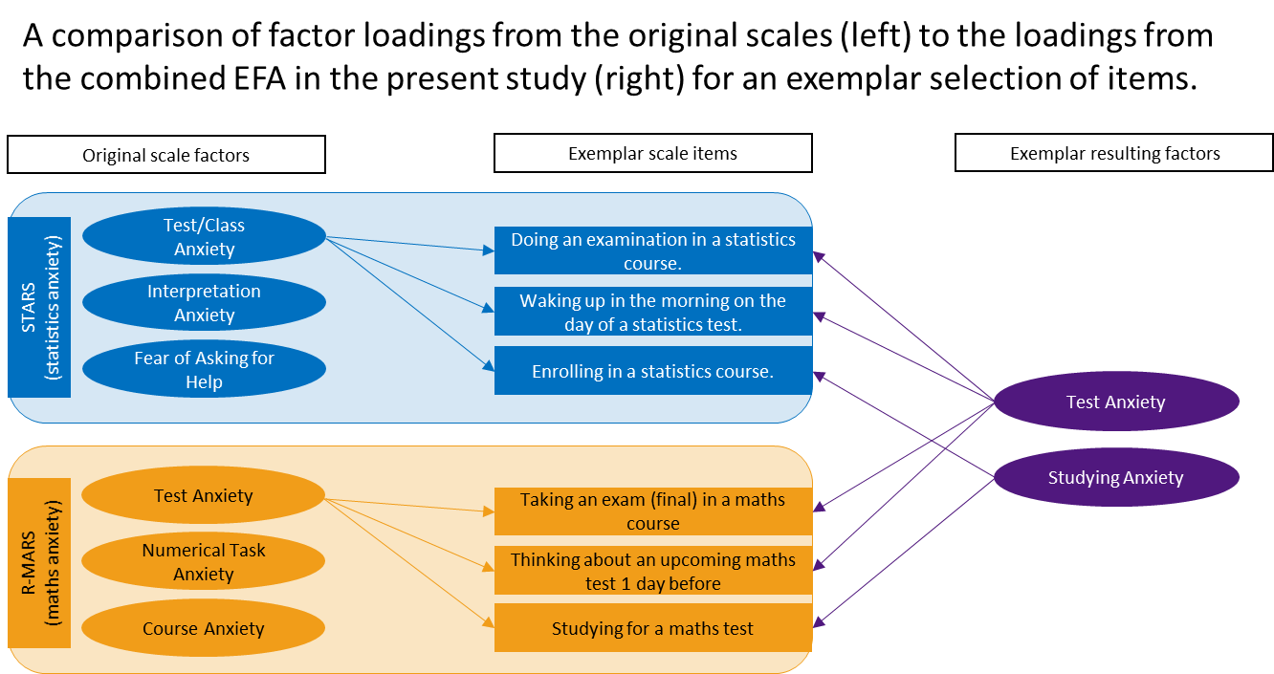
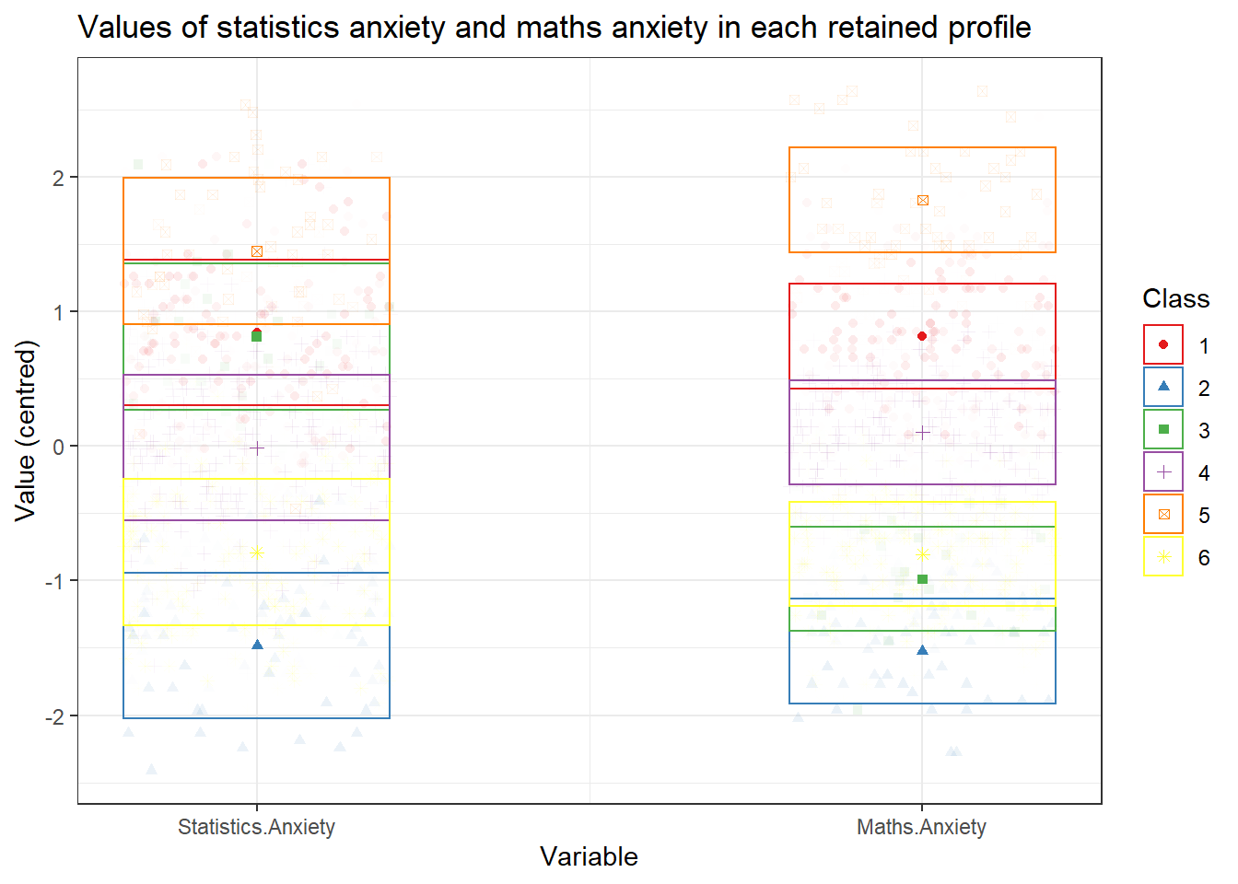
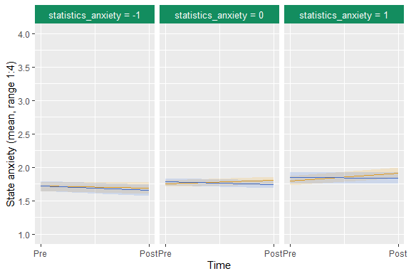
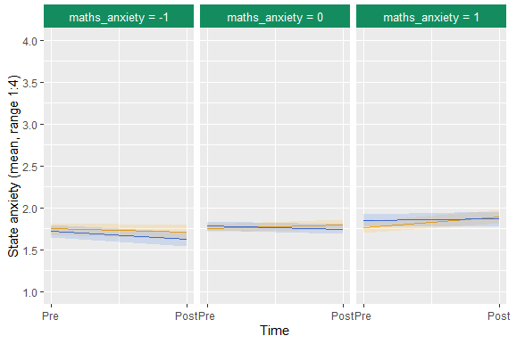








ZOINKS! STATISTICS ANXIETY AND MATHS ANXIETY WERE THE SAME ALL ALONG!
Mystery Inc.: Jenny Terry & Andy P. Field
Background/Aim: Previous research indicates that the construct of statistics anxiety is distinct from maths anxiety (e.g. Paechter et al., 2017) but reported differences are based only on correlations and may have been due to methodological limitations and temporal measurement non- invariance. We re-evaluated the constructs’ uniqueness in three novel ways. No directional hypotheses were made.
Design: Online study with self-report questionnaires (statistics anxiety, maths anxiety, trait anxiety, pre-manipulation state anxiety) followed by a between-subjects experimental manipulation (MCQ test: statistics or maths) and a post-manipulation state anxiety questionnaire.
Participants: N = 465 undergraduate psychology students (age: M = 20.5, SD = 2.8; 78.7% female).
Analysis: Three primary analyses were pre-registered and conducted.
1) Exploratory factor analysis of the statistics anxiety and maths anxiety scales combined. If items from both scales load onto shared factors it suggests they are indicators of a construct common to both measures.
2) Latent profile analysis to test whether any individuals report high levels of statistics anxiety but low maths anxiety and vice-versa. If such profiles do not exist, it suggests statistics anxiety and maths anxiety may not be independent.
3) Multi-level three-way interaction models to test specificity in the constructs’ predictive validity. That is, whether state anxiety rose for statistics- anxious students that took the statistics test but not the maths test, and vice-versa for maths-anxious students (adjusting for trait anxiety).
Results/Conclusion: Findings are summarised below. They converge in agreement that statistics anxiety and maths anxiety are not separate constructs and, therefore, that statistics anxiety and maths anxiety have fallen prey to the ‘jangle fallacy’ (Kelley, 1927).
Predicted mean values of state anxiety change at -1 SD, M, & +1 SD of statistics anxiety for each MCQ condition.
Predicted mean values of state anxiety change at -1 SD, M, & +1 SD of maths anxiety for each MCQ condition.
Profile
Figure 3
Figure 4
Figure 1
Figure 2
Exploratory factor analysis resulted in factors driven by a shared underlying construct. For example, Figure 1 shows how some items from the test anxiety subscales of both the statistics anxiety and maths anxiety measures loaded onto a single test anxiety factor. This pattern was repeated for other items and subscales, revealing additional factors seemingly driven by anxiety about academic activities (e.g. tests, studying, feedback) and not the subject being studied (i.e. stats or maths).
Latent profile analysis indicated 96.6% of participants had similar ratings on both the maths anxiety and statistics anxiety scales (Figure 2). Only profile 3 deviated (in green in Figure 2), whereby individuals had higher statistics anxiety than maths anxiety. No profiles emerged containing individuals higher in maths anxiety. This pattern means it is very unusual for an individual to report having statistics anxiety independently of maths anxiety or vice-versa, again supporting the likelihood of a shared underlying construct.
The two multi-level models showed state anxiety changes did not vary by MCQ type for either statistics-anxious, γ = -0.04, p = 0.29, 95% CI
[-0.11, 0.034], or maths-anxious individuals,
γ = -0.02, p = 0.51, 95% CI [-0.10, 0.05]. Furthermore, state anxiety change was similar for statistics-anxious and maths-anxious individuals in each MCQ condition (see Figures 3 & 4). Therefore, the constructs showed no specificity in their predictive validity.
Scan for pre-registration, data, R code, a copy of this poster, references, & more!
jlt26@sussex.ac.uk
jennyterry.co.uk
@jennyterry
jenny-terry/stats_maths_anx

