Slide 1
SMCIPMITool

Slide 2
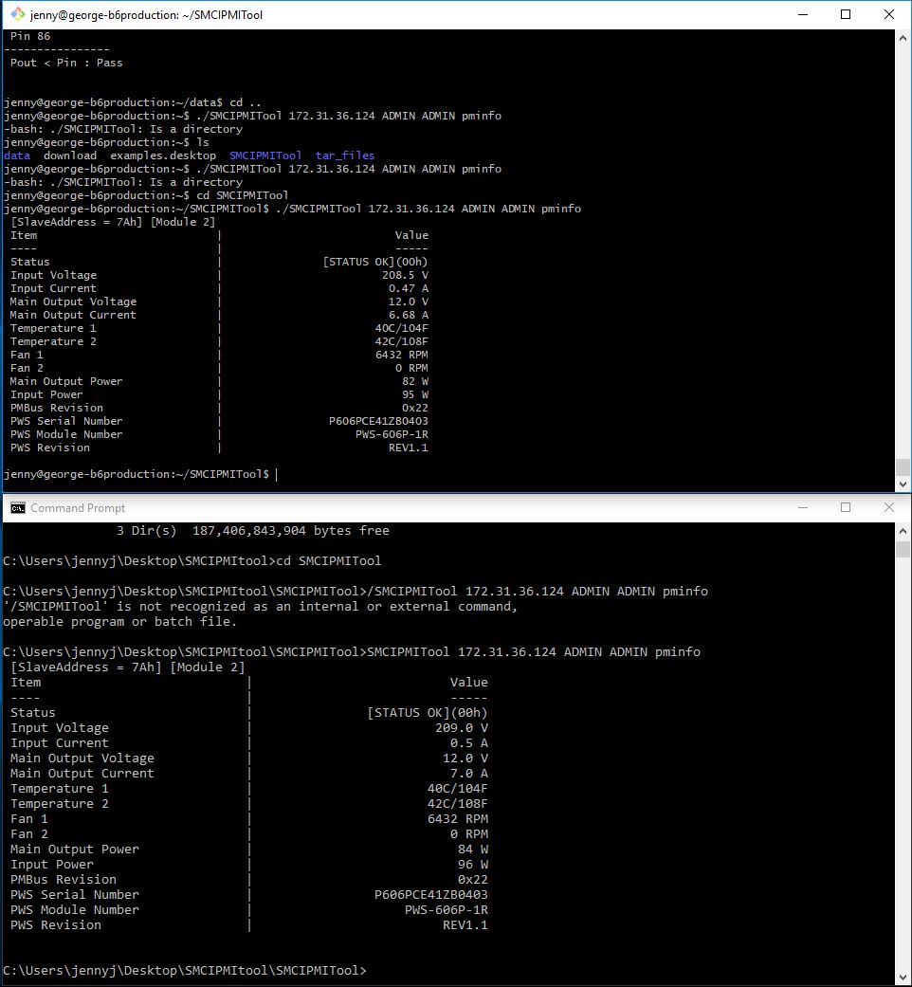
Install & Execute
Linux
Windows
Unzip
tar zxvf [filename].tar.gz
Execute command
./SMCIPMITool [IP] [User] [Password] [Command]
Unzip
Execute command
SMCIPMITool [IP] [User] [Password] [Command]

Slide 3
Python
Automatic program execute SMCIPMITool and save the data in the file
Run program on Linux

Slide 4
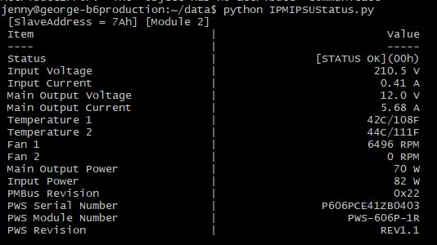
Step 1
Run and print pminfo, with repeat 10 time per 10 seconds

Slide 5
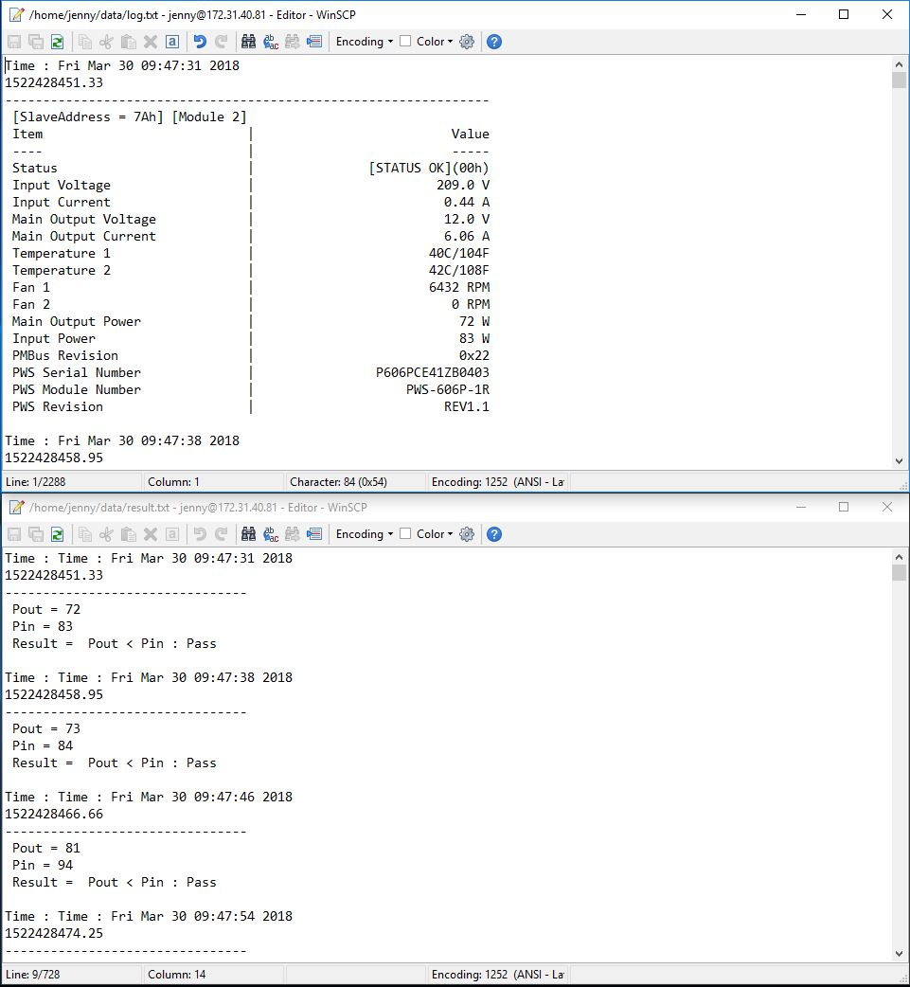
Step 2
Save the data to the file(log.txt)

Slide 6
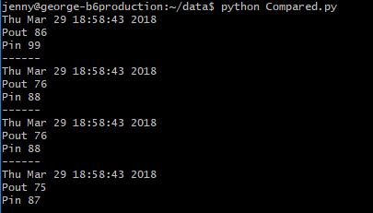
Step 3
Catch the value of Pout and Pin

Slide 7
Step 4
Compared Pin and Pout
Pout < Pin → Pass
Pout > Pin → Error
Save the result to the file
(result.txt)

Slide 8
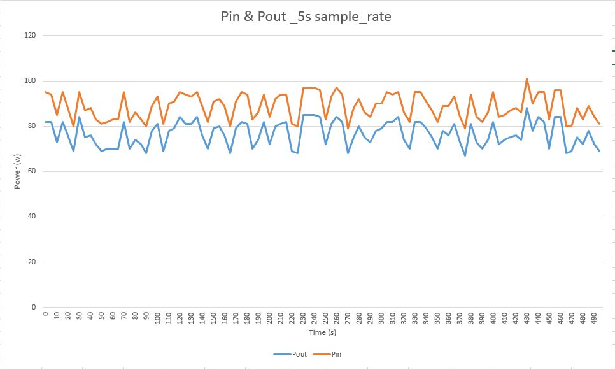
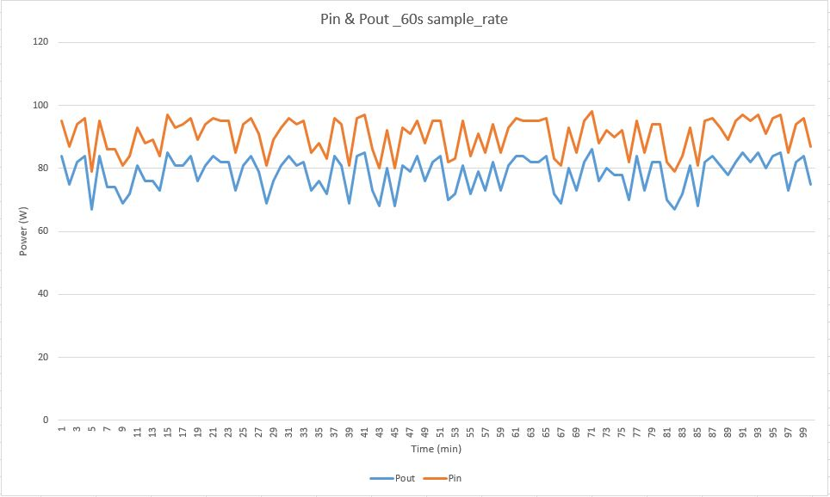
Step 5
Make data to chart (result.csv)

Slide 9
Improved Version

Slide 10
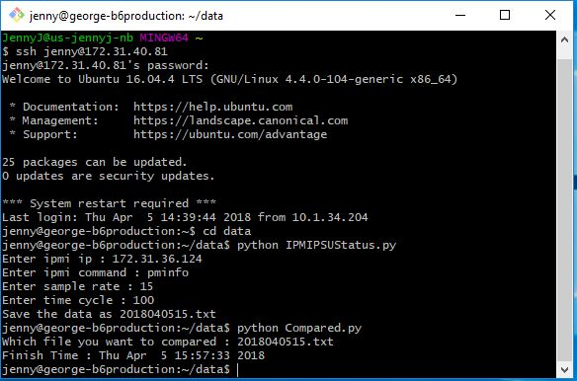
Flowchat
Execute IPMIPSUStatus.py
Change parameter by user
ipmi ip
ipmi command
sample rate
time cycle
data file name
Execute Compared.py
Input the file you want to compared.
The function we have is compared
the value between Pin and Pout.

Slide 11
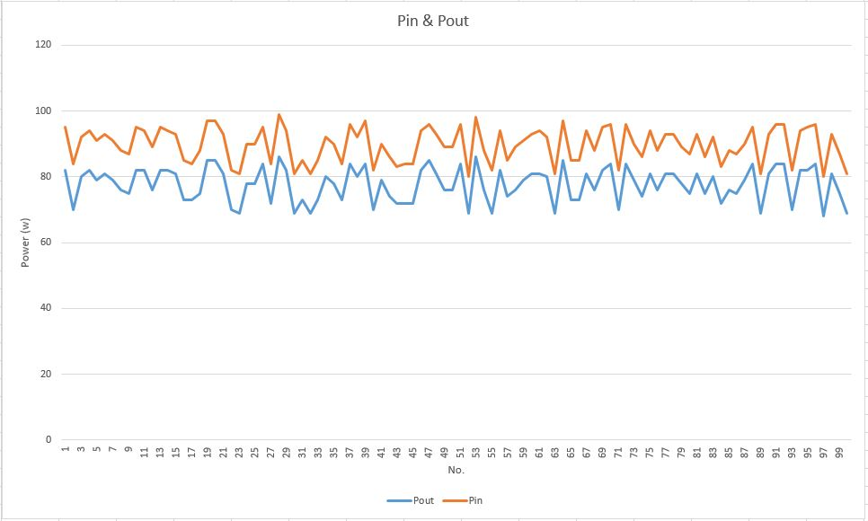
Data
Create by IPMIPSUStatus.py
raw data
Create by Compared.py
.csv data (Timestamp, Pin, Pout)
result data (Time, Pin, Pout, result)
Create by Excel
Line chart

Slide 12
Auto Run

Slide 13
Write a Script to auto run the program

