Slide 1
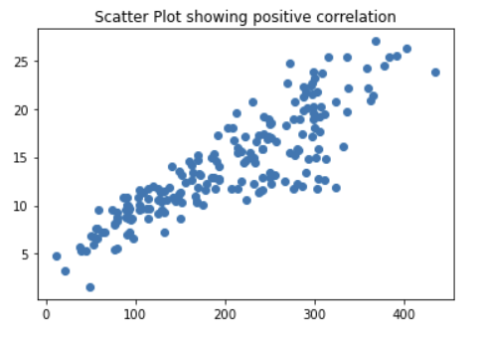
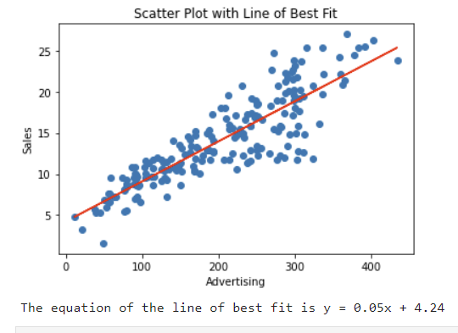
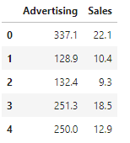
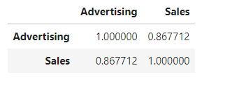

Slide 2
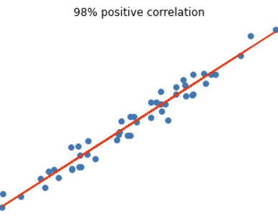
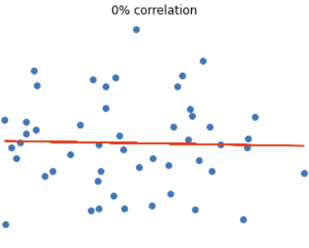
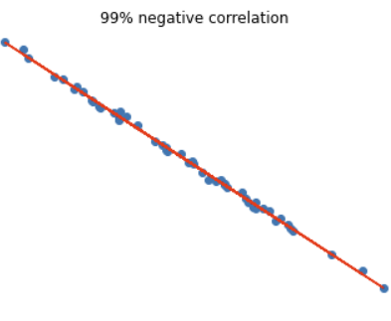

Slide 3
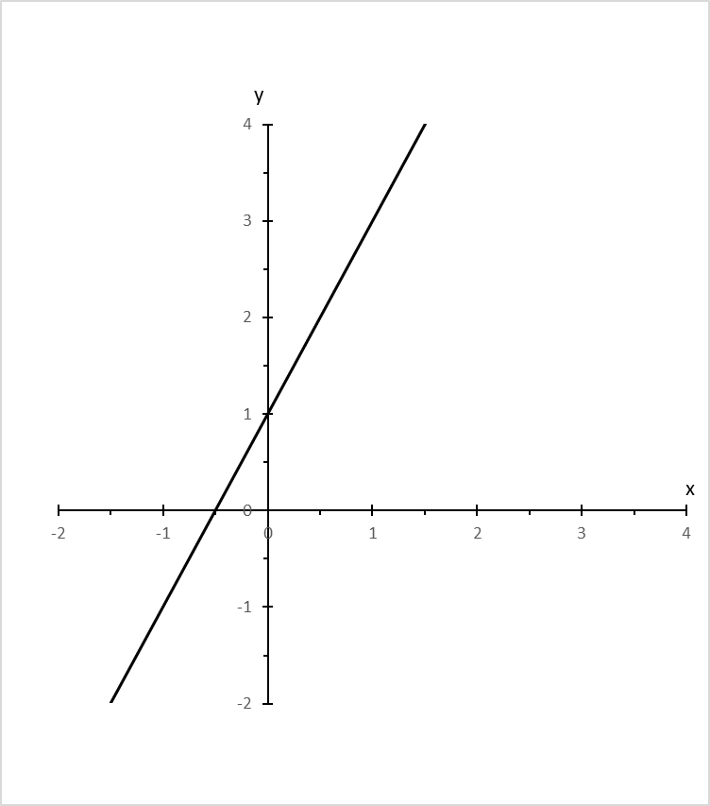
Equation of a line
y = 2x + 1
m
c
y = mx + c
m slope
c intercept on the y-axis

Slide 4
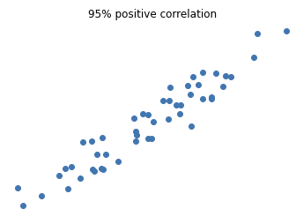
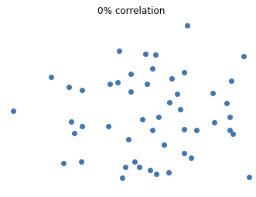
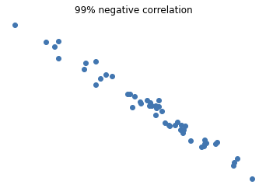

Slide 5
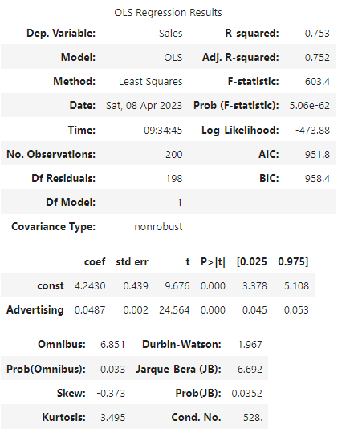

Slide 6
Data Set
Training Set
Test Set
Predictive Model

Slide 7
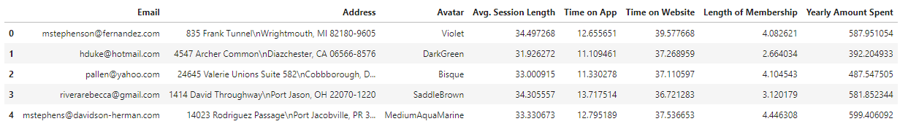
Multiple linear regression

Slide 8
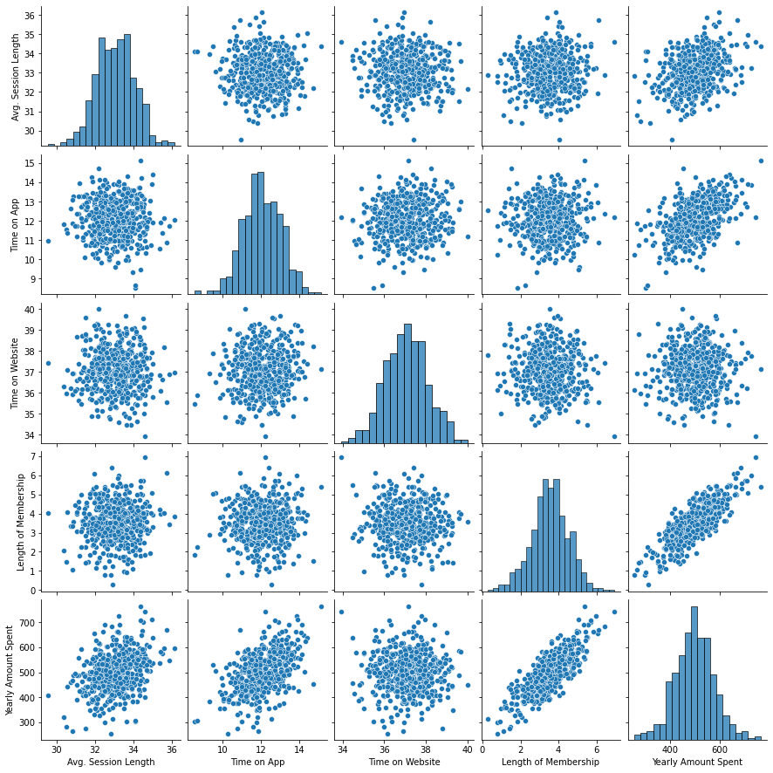

Slide 9
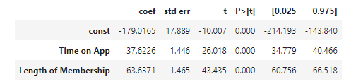

Slide 10
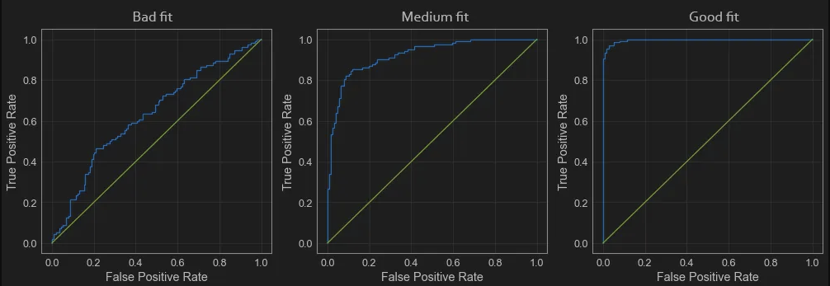

Slide 11
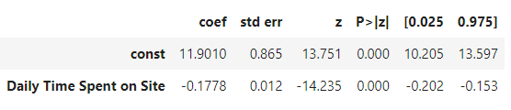

Slide 12
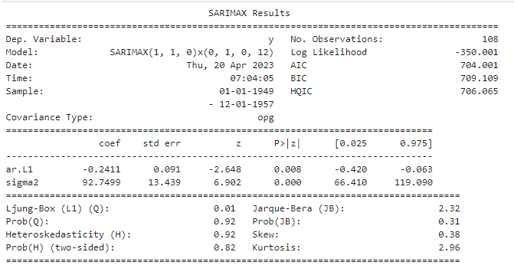
Install and import libraries
Load and prepare data
Plot data
Split data into train and test set
Prepare the model
Test stationarity
ARIMA – train model
ARIMA – test model
Linear Model

Slide 13



Slide 14
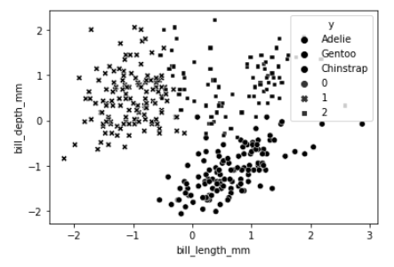
Import libraries
Load and prepare data
Run k-means
k-means: Visualise the clusters
Optimise via silhouette scores
Visualise the best model
Plot of scores
k-means: Train the model

Slide 15
Explore
Predict
Communicate
Propose
Build
Interpret

Slide 16
Predicted Values
False
True
TN
FP
Actual Values
False
True
FN
TP

Slide 17
02
Storage
03
Use
01
Generation
Data Lifecycle
04
Sharing
06
Deletion
05
Archiving

Slide 18

Business Understanding
Data Understanding
Data Preparation
Data Modeling
Model Evaluation
Model Deployment
Results Interpretation & Communication
Data Analytics Lifecycle

Slide 19
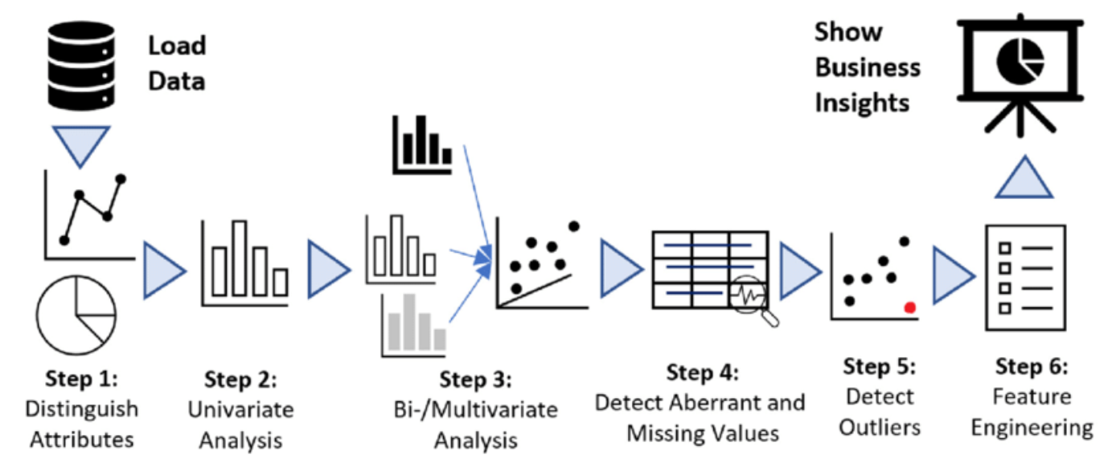
Understanding the attributes
Univariate Analysis
- Exploring each variable separately
Bivariate Analysis
- Exploring the relationships between the data
Detect Aberrant and Missing values
Detect Outliers
Feature Engineering
Using the most relevant variables

Slide 20
Data
Categorical (qualitative)
Nominal
(unordered, mutually exclusive)
Ordinal
(ordered, mutually exclusive)
Numerical (quantitative)
Discrete
(whole numerical value, typically counts)
Continuous
(can take any value within a range)
Types of Data

