Slide 1
CS4101 Introduction to Embedded Systems Lab 1: General Purpose IO
Prof. Chung-Ta King
Department of Computer Science
National Tsing Hua University, Taiwan

Slide 2
Introduction
In this lab, we will learn the basic GPIO of MSP430 LaunchPad
LaunchPad development environment
Configure the I/O port of LaunchPad for input and output
Run the debugger for basic debugging

Slide 3
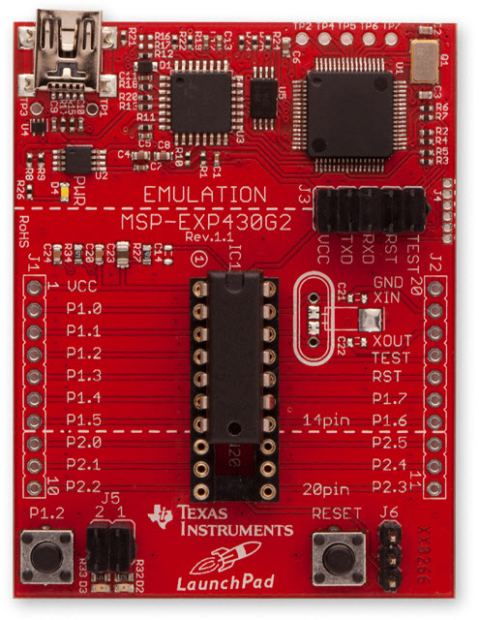
Hardware Setup
Please check the version of the MSP430 microcontroller and use the right settings in the IDE
MSP430G2553

Slide 4
Code Composer Studio (CCS)
An Integrated Development Environment (IDE) based on Eclipse
Integrated “Debugger” and “Editor” – IDE
Edit and Debug have own “perspectives” (menus, windows)
Contains all development tools: compiler, assembler, linker, loader, debugger, …
Other development tools also available:
Energia
CCS Cloud
(https://dev.ti.com)

Slide 5
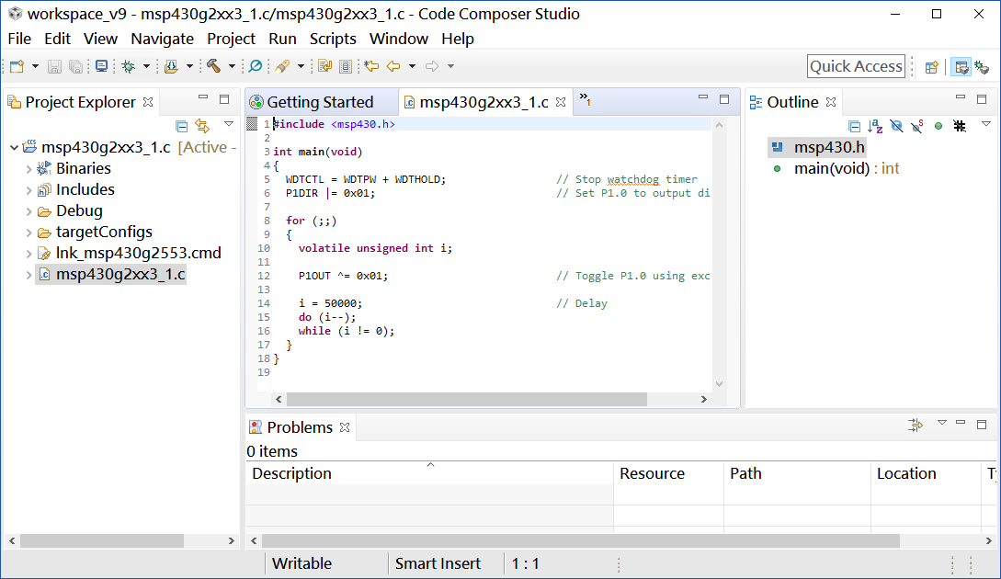
CCS GUI – EDIT Perspective
Menus & Buttons
Specific actions related to EDIT’ing
Perspectives
EDIT and DEBUG
Project Explorer
Project(s)
Source Files
Source EDIT’ing
Tabbed windows
Color-coded text
Outline View
Declarations and functions

Slide 6
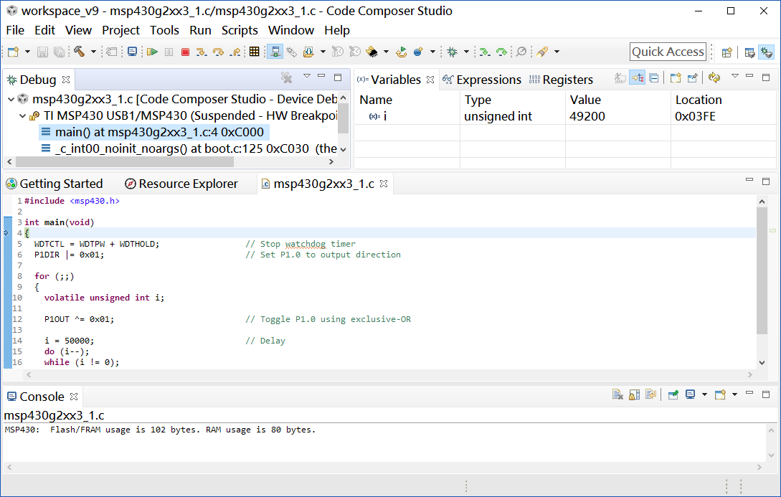
CCS GUI – DEBUG Perspective
Menus & Buttons
Related to DEBUG’ing
Play, pause, terminate
Connection Type
Specified in Target Cfg file
What options do users have when connecting to a target?
This window also provides a “call” stack
DEBUG Windows
Watch variables
Memory browser
PC execution point
Console window

Slide 7
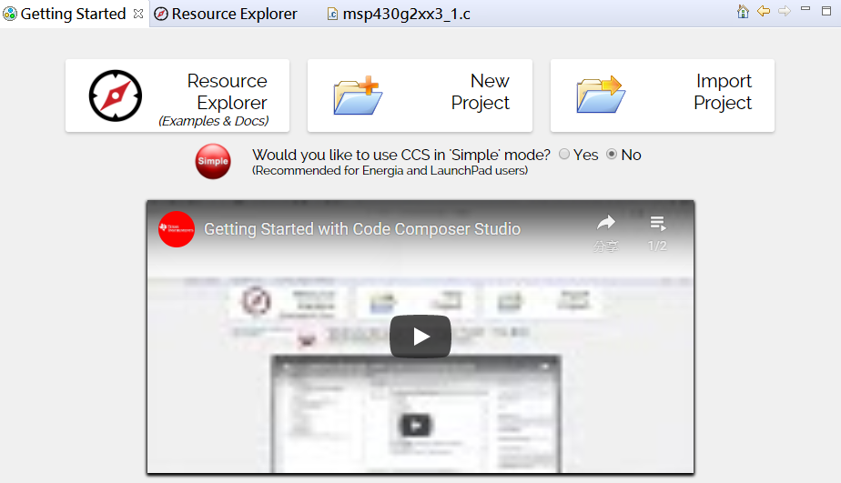
Create a New CCS Project
1

Slide 8
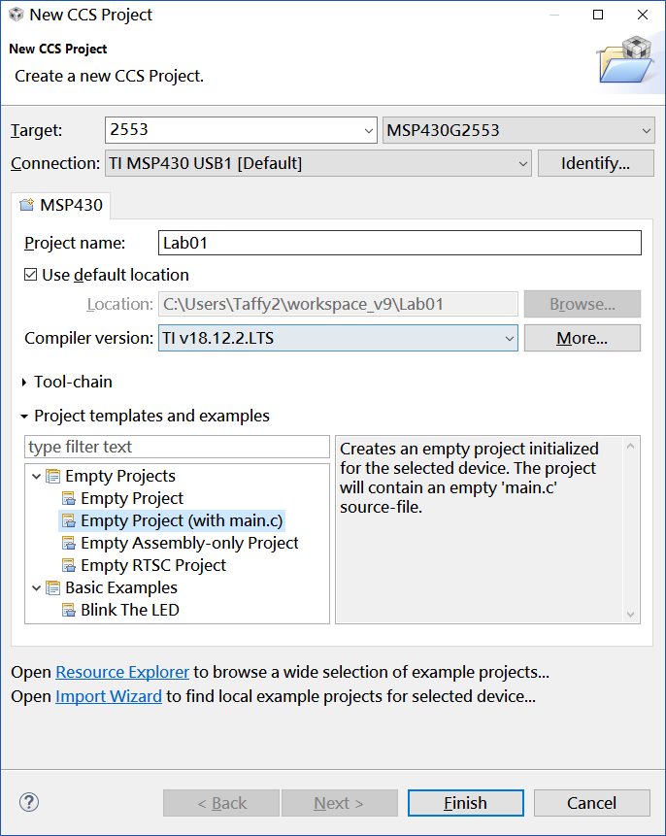
Create a New CCS Project
Type 2553 to find MSP430G2553
2
3
Type the project name
4
5

Slide 9
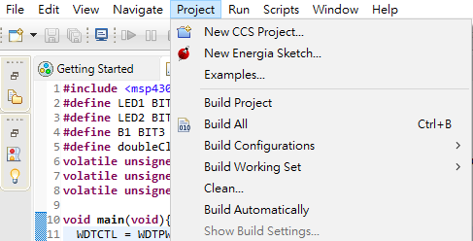
Build and Load the Project
Click Project
Click the “Build All” and watch the tools run in the Console window. Check for any errors in the Problems window.
Click the “Build Project” and CSS will automatically add the file included in your project.
Notes:
不需要手動去把每個檔案include到你的project之中，CCS會幫你做這件事。
在build你的project後，include files會出現在project view之中

Slide 10
Build and Load the Project
CCS can automatically save modified source files, build the program, open the debug perspective view for debugging, download the program to the target, and run the program at the beginning of the main() function
Click on the “Debug” button (green bug) or
Click Run → Debug or press F11

Slide 11
Debug Environment
The basic buttons that control the debug environment are located in the top of CCS:
At this point you should still be at the beginning of main(). Click the Run button to run the code.
RUN

Slide 12
End Debug Session and Close Project
The Terminate button will terminate the active debug session, close the debugger and return CCS to the “C/C++ Perspective” view
Click Run → Terminate or use the Terminate button
Next, close the project by right-clicking on project-name in the C/C++ Projects window and select Close Project.

Slide 13
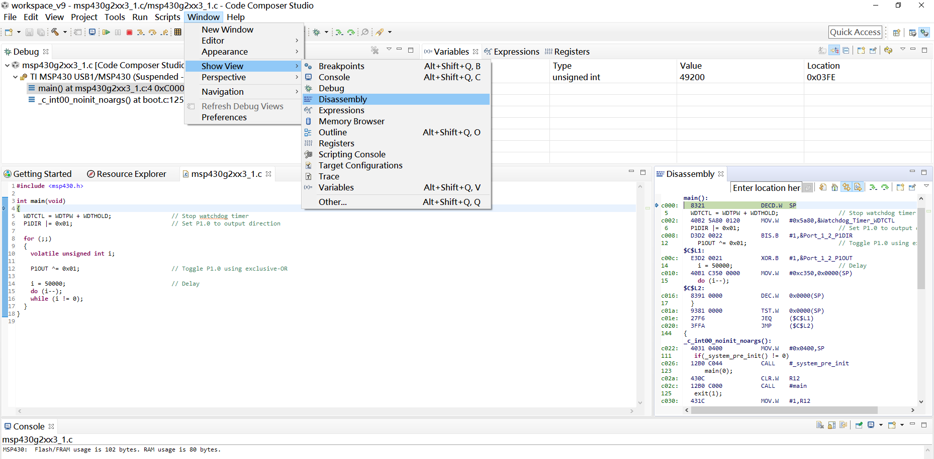
Use Disassembly Window in Debug Mode

Slide 14
Cloud-based IDE: CCS Cloud
It is a light version of the desktop CCS that provides a space to store your program in the cloud
For more advanced features, such as disassembly, memory view, and profiling, please use CCS Desktop
To use CCS Cloud, you have to register first (https://dev.ti.com/)

Slide 15
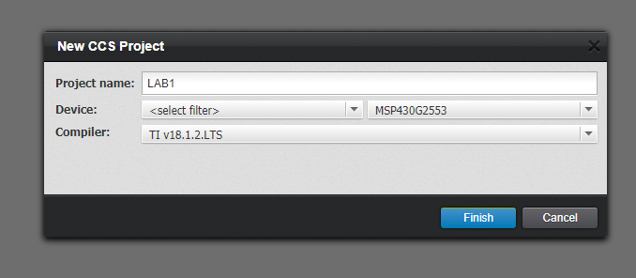
CCS Cloud
Select the corresponding device: MSP430G2553
Install a browse extension if you use CCS Cloud for the first time on this computer

Slide 16
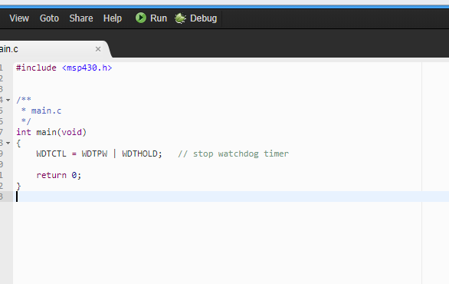
CCS Cloud
User interface is intuitive and very similar to that of desktop CCS
Enjoy coding and click run!

Slide 17
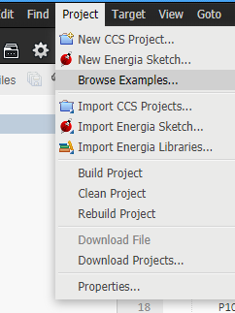
CCS Cloud
Retrieve your project later: Project > download project

Slide 18
Sample Code for Output: Blinking Red LED
#include <msp430.h> int main(void) { WDTCTL = WDTPW | WDTHOLD; // Stop watchdog timer P1DIR |= 0x01; // Set P1.0 as output for(;;) { volatile unsigned int i; // prevent optimization P1OUT ^= 0x01; // Toggle P1.0 using XOR i = 20000; // SW Delay do i--; while(i != 0); } return 0; }

Slide 19
Sample Code for Input: Pushing Button
#include <msp430.h> //Button up/down → LED on/off #define LED1 BIT0 //P1.0 to red LED #define B1 BIT3 //P1.3 to button void main(void){ WDTCTL = WDTPW + WDTHOLD; //Stop watchdog timer P1DIR |= LED1; //Set P1.0 for output P1OUT |= LED1; //Turn on red LED P1REN |= B1; //Set P1.3 to use internal resistor P1OUT |= B1; //Set P1.3 to use pull-up resistor for(;;){ //Loop forever if((P1IN & B1) ==0){ //Is button down? P1OUT &= ~LED1;} // Yes, turn red LED off else{ P1OUT |= LED1; } // No, turn red LED on } }
Notes:
Whenever button is down, turn LED off. Whenever button is up, turn LED on.
P1OUT is not initialized and must be written before configuring the pin for output.
Assume button is active low (0 → pressed; 1 → depressed)

Slide 20
Sample Code for Debugger
#include <msp430.h> // Button up/down → LED on/off #define LED1 BIT6 // P1.0 to red LED #define B1 BIT3 // P1.3 to button volatile unsigned int i, j; void main(void){ WDTCTL = WDTPW + WDTHOLD; // Stop watchdog timer P1OUT |= LED1 + B1; P1DIR |= LED1; // Set pin with LED1 to output P1REN |= B1; // Set pin to use pull-up resistor for(;;){ while((P1IN & B1) != 0){ // Loop on button up i = P1IN; j = P1OUT; } P1OUT &= ~LED1; // Turn LED1 off while((P1IN & B1) == 0){ // Loop on button down i = P1IN; j = P1OUT; } P1OUT |= LED1; // Turn LED1 on } }
Notes:
On button down, turn LED off. On button up, turn LED on.

Slide 21
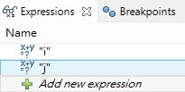

How to Debug?
In the code line containing:
i = P1IN; j = P1OUT;
Click the “Expressions” tag and choose “Add new expression”
Right-click on the appropriate line of code and set the Breakpoint
When the code runs, it will hit the breakpoint and stop
Observe the values of the variables

Slide 22
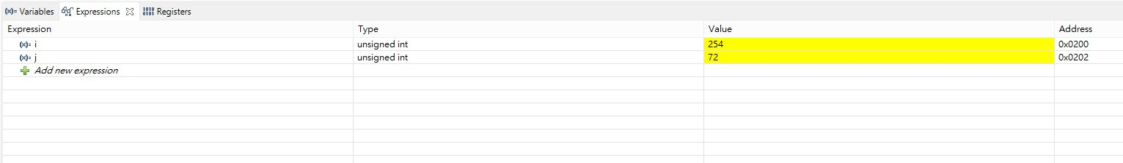
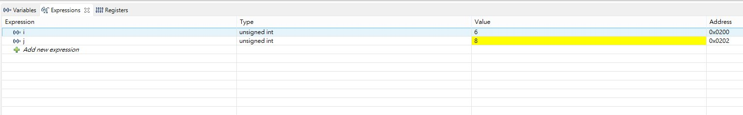
Debugger Output
1111 1110
01001000
00000110
00001000
No need to care about other bits!

Slide 23
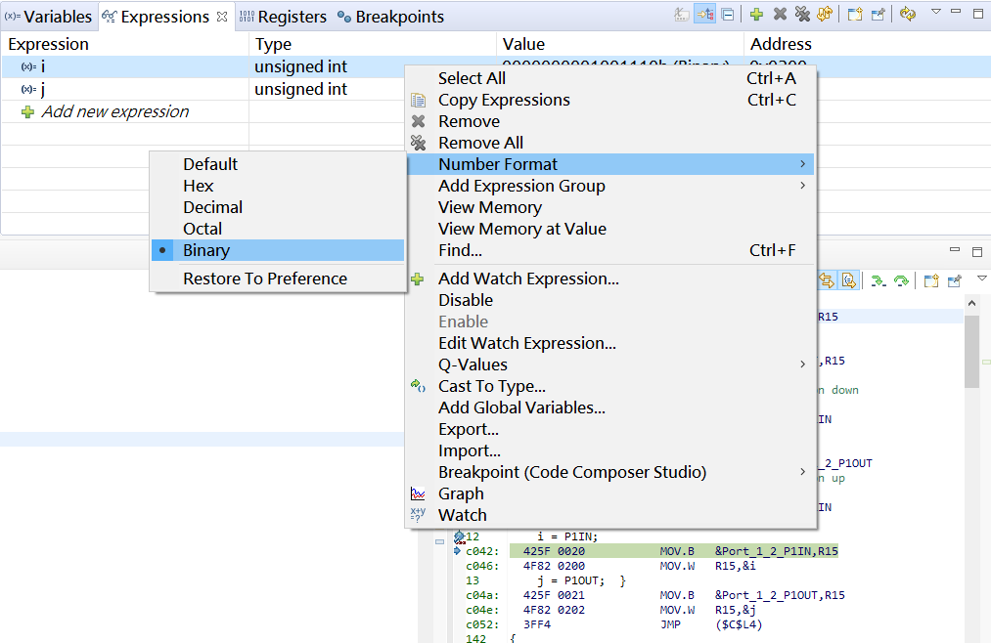
Debugger Output
You can also right click on the row and change Number Format to Binary

Slide 24
Lab 1
Basic 1: (30%)
Modify “sample code for output” to make red LED blink two times and then green LED one time repeatedly.
The red LED should blink twice as fast as the green LED, i.e., the on-time of the green LED should be two times longer than the on-time of the red LED.
The program should start with two consecutive red LED blinks.
Observations and explanations:
Change the count of i from 20,000 to 200,000. Observe how quickly your LEDs can blink. Can you explain the reasons?

Slide 25
Lab 1
Basic 2: (30%)
Modify “sample code for output” to remove volatile keyword and observe how the LaunchPad behaves.
To explain the behavior of LaunchPad, let us study the assembly code of the programs.
Use the disassembly window to obtain the assembly code of the original sample code and the modified sample code.
Observe the differences of these two assembly programs and explain the behavior of LaunchPad.

Slide 26
Assembly for Not Using volatile
WDTCTL = WDTPW | WDTHOLD; main(): c078: 40B2 5A80 0120 MOV.W #0x5a80,&Watchdog_Timer_WDTCTL P1DIR |= 0x01; c07e: D3D2 0022 BIS.B #1,&Port_1_2_P1DIR 31 P1OUT ^= 0x01; $C$L1: c082: E3D2 0021 XOR.B #1,&Port_1_2_P1OUT 34 do i--; c086: 3FFD JMP ($C$L1) 65 func_epilog_7: POP r4 __mspabi_func_epilog(), __mspabi_func_epilog_7(): c088: 4134 POP.W R4 66 func_epilog_6: POP r5 __mspabi_func_epilog_6(): c08a: 4135 POP.W R5

Slide 27
Assembly for Using volatile
23 int main(void) { main(): c05e: 8321 DECD.W SP WDTCTL = WDTPW | WDTHOLD; c060: 40B2 5A80 0120 MOV.W #0x5a80,&Watchdog_Timer_WDTCTL P1DIR |= 0x01; c066: D3D2 0022 BIS.B #1,&Port_1_2_P1DIR 31 P1OUT ^= 0x01; $C$L1: c06a: E3D2 0021 XOR.B #1,&Port_1_2_P1OUT i = 20000; c06e: 40B1 4E20 0000 MOV.W #0x4e20,0x0000(SP) 34 do i--; $C$L2: c074: 8391 0000 DEC.W 0x0000(SP) 36 } c078: 9381 0000 TST.W 0x0000(SP) c07c: 27F6 JEQ ($C$L1) c07e: 3FFA JMP ($C$L2)

Slide 28
Assembly for Using volatile
179 { _c_int00(), _c_int00_noexit(): c080: 4031 0400 MOV.W #0x0400,SP 182 if(_system_pre_init() != 0) _auto_init(); c084: 12B0 C0B0 CALL #_system_pre_init c088: 930C TST.W R12 c08a: 2402 JEQ ($C$L2) c08c: 12B0 C000 CALL #_auto_init 183 main(0); $C$L2: c090: 430C CLR.W R12 c092: 12B0 C05E CALL #main 184 abort(); c096: 12B0 C0B4 CALL #abort 65 func_epilog_7: POP r4 __mspabi_func_epilog(), __mspabi_func_epilog_7(): c09a: 4134 POP.W R4 66 func_epilog_6: POP r5 __mspabi_func_epilog_6():

Slide 29
Lab 1
Basic 3: (40%)
Modify the code in Basic 1 so that when the button is pressed, blink green and red LEDs simultaneously, with same frequency as red LED in Basic 1. When the button is released, go back to the initial state of Basic 1.
Bonus: (15%)
Accomplish Basic 3 without any busy-waiting loop
Busy-waiting loop example:
int j = 20000; do j--; while (j != 0);
for (int i = 0; i < 20000; i++);
That is, only one loop is allowed in your program

Slide 30
Grading Policies
DEMO in the lab --------------------------------------100%
DEMO within a week ----------------------------------80%
DEMO after a week ------------------------------------60%
After two weeks ----------------------------------------- 0%

