Slide 1
CS4101 Introduction to Embedded Systems Lab 2: Timer and Clock
Prof. Chung-Ta King
Department of Computer Science
National Tsing Hua University, Taiwan

Slide 2
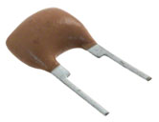
Introduction
In our previous lab, it is difficult to precisely set the timings of the events, e.g. flash frequency of the LEDs, duration of button-down, etc.
In this lab, we will learn how to control the timings of events using the timer and clock systems of MSP430
Set time to control when events should happen, e.g. flash frequency of LEDs
Measure intervals of events, e.g. duration of button-down
Clock
Timer

Slide 3
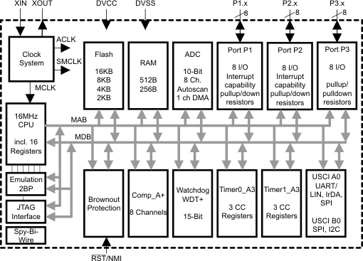
Interior of MSP430G2553
Lab 1
Clock system
IO
X
Not available on 20-pin device
Timer system

Slide 4
Sample Code for Output: Blinking Red LED
#include <msp430.h> int main(void) { WDTCTL = WDTPW | WDTHOLD; // Stop watchdog timer P1DIR |= 0x01; // Set P1.0 as output for(;;) { volatile unsigned int i; // prevent optimization P1OUT ^= 0x01; // Toggle P1.0 using XOR i = 20000; // SW Delay do i--; while(i != 0); } return 0; }

Slide 5
Lab 2
Basic 1: from Basic 1 of Lab 1 (30%)
Modify “sample code for output” to make red LED blink two times and then green LED one time repeatedly.
The red LED is on for 0.5 sec and off for 0.5 sec. The green LED is on for 0.9 sec and off for 0.5 sec.
Control the time by Timer0_A3 driven by ACLK sourced from VLO running at 12KHz.
Check timer up by checking the TAIFG bit.
Not allowed to use a smaller timer, e.g. 0.1 sec, to count time.
Be care of TA0R overflow.
Start with two consecutive red LED blinks.

Slide 6
Lab 2
Basic 2: from Basic 3 of Lab 1 (30%)
Modify the code in Basic 1 so that when the button is pressed, blink green and red LEDs simultaneously, with same frequency as the red LED in Basic 1. When the button is released, go back to the initial state of Basic 1.
Show the FSM of your code.
Try to identify states, events, actions in the problem, e.g.
Figure out what event occurred at what state will cause what actions and enter what next state, and draw the FSM
Turn FSM into code
Timer0_A3 not up
Timer0_A3 up
1st Red on
1st Red off
Button_down
Both on
Both off

Slide 7
Pseudo Code of Basic 2
for(;;) switch(state) case 1st_red_on: switch(event) case Timer0_A3_up: ... state = 1st_red_off; break; case Button_down: ... case green_on: ... case both_on: ... case both_off: ...

Slide 8
Lab 2
Basic 3: measuring time (40%)
Modify Basic 2 so that both LEDs blink simultaneously only when the button is pressed for more than 2 seconds.
Measure the duration of button-down by Timer1_A3 driven by SMCLK sourced from DCO.

Slide 9
Grading Policies
DEMO in the lab --------------------------------------100%
DEMO within a week ----------------------------------80%
DEMO after a week ------------------------------------60%
After two weeks ----------------------------------------- 0%

