Slide 1
CS4101 Introduction to Embedded Systems Lab 3: Interrupt
Prof. Chung-Ta King
Department of Computer Science
National Tsing Hua University, Taiwan

Slide 2
Introduction
In lab 2, we have learned how to precisely set the time of a system, e.g. flash frequency of the LEDs, duration of button down, etc.
However, CPU still wastes time polling registers in I/O modules to detect events, e.g. Timer0_A3 time up, button down, etc.
In this lab, we will learn how to let I/O modules notify CPU when events occur through interrupts, so that CPU is free to do other things until events occur.

Slide 3
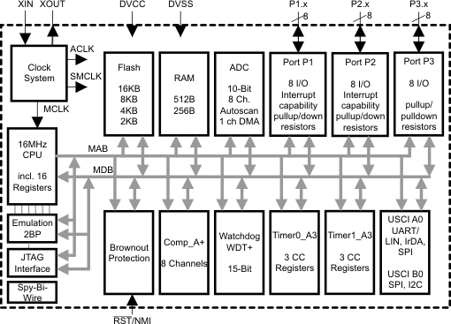
Interior of MSP430G2553
Lab 1
Clock system
GPIO
X
Not available on 20-pin device
Lab 2
Timer system

Slide 4
Lab 3
Basic 1: Use interrupt to handle events (40%)
Use interrupts to implement Basic 2 of Lab 2
On startup, blink red LED two times first and then green LED one time repeatedly, with frequencies as in Basic 1 of Lab 2.
flash pattern 1
On button-press, turn both LEDs on for 0.5 sec first and off for 0.5 sec repeatedly.
flash pattern 2
On button-release, return to flash pattern 1.
Control the time from Timer0_A3 driven by ACLK sourced from VLO running at 12KHz.
When switching patterns, LEDs should start with initial state.
Handle all events by interrupts, so you should not write any code in the loop of main(). Respond to events immediately.

Slide 5
Lab 3
Basic 2: Measure time (60%)
Normal mode: Flash the LEDs using flash pattern 1.
Press mode: On button-down, immediately measure the duration of button down (pressed time) while still running flash pattern 1. As soon as the button is released,
if the pressed time is less than 3 sec, do nothing.
if the pressed time is more than 3 sec, run flash pattern 2 for the same duration as the pressed time, and then return to flash pattern 1.
Measure the duration of button down by Timer1_A3 driven by SMCLK sourced from DCO.
Handle all events by interrupts, so you should not write any code in the loop of main(). Respond to events immediately.
Notes:
預設：紅燈ｘ２ 綠燈ｘ１
按下按鈕：繼續閃燈，開始計時直到放開
放開按紐：
如果按不到3秒 → 不做事
按超過3秒 → 計算按了幾秒 就0.5秒閃一次到幾秒
然後回到預設

Slide 6
Lab 3
Hint:
Set these registers: P1IE, P1IES, P1IFG, GIE
Use while(1); or for(;;); at the end of main()
Should not write any code in the loop of main()
Please handle timer overflow carefully
You need to implement three interrupt function:
#pragma vector=PORT1_VECTOR
__interrupt void Port_1(void) {…}
#pragma vector=TIMER0_A0_VECTOR
__interrupt void TA0_ISR(void) {…}
#pragma vector=TIMER1_A0_VECTOR
__interrupt void TA1_ISR(void) {…}

