Slide 1
CS4101 Introduction to Embedded Systems Lab 4: ADC
Prof. Chung-Ta King
Department of Computer Science
National Tsing Hua University, Taiwan

Slide 2
Introduction
In previous labs, we have learned how to set time for an embedded system and let its CPU respond to events through interrupts.
In this lab, we will learn how to read analog signals and convert the signals into digital information.
Configuration of ADC10 of MSP430
Use of ADC10 to measure the temperature of LaunchPad

Slide 3
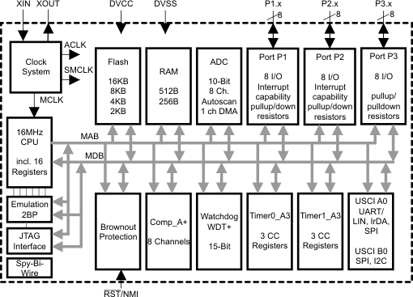
Interior of MSP430G2553
Lab 1
Clock system
GPIO
X
Not available on 20-pin device
Lab 3
Lab 2
Timer system

Slide 4
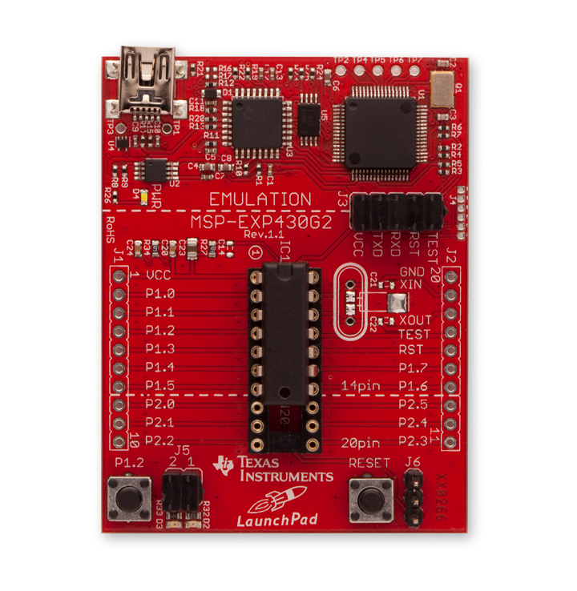

Thermostat in MSP430
The thermostat is encapsulated in MSP430 IC.
If you want to raise the temperature, you can put your finger on the IC.

Slide 5
Recall: Sample Code 1 for ADC10
void main(void) { WDTCTL = WDTPW + WDTHOLD; // Stop WDT // H&S time 16x, interrupt enabled ADC10CTL0 = ADC10SHT_2 + ADC10ON + ADC10IE; ADC10CTL1 = INCH_1; // Input from A1 ADC10AE0 |= 0x02; // Enable pin A1 for analog in P1DIR |= 0x01; // Set P1.0 to output ADC10CTL0 |= ENC + ADC10SC; // Start sampling for (;;) { } } #pragma vector=ADC10_VECTOR __interrupt void ADC10_ISR(void) { if (ADC10MEM < 0x1FF) P1OUT &= ~0x01; else P1OUT |= 0x01; ADC10CTL0 |= ENC + ADC10SC; // enable sampling }
Sampling time = time to convert once
Notes:
4
Why not read ADC10MEM right after setting ADC10CTL0? While wait for interrupt? What is the time to go through one iteration?
Any one of the pins of Port 1 can be set to be an analog input. Thus up to 8 channels are available for separate ADC inputs.
Analog Enable control register ADC10AE0 will be used for enabling the corresponding input channels.
4

Slide 6
Lab 4
Basic 1: Based on Basic 1 of Lab 3 (40%)
Change flash pattern when temperature (T) is above or below 740. You may adjust the value to make the effect of temperature change more obvious.
T < 740: red LED blinks two times first and then green LED one time repeatedly, with frequencies as in Basic 1 of Lab 3 (flash pattern 1)
T > 740: turn both LEDs on for 0.35 sec and then off for 0.65 sec repetitively (flash pattern 2)
Measure temperature every 0.8 sec triggered continuously by Timer0_A3 driven by SMCLK sourced from DCO and by 1.5V voltage reference.

Slide 7
Lab 4
Basic 1: (cont.)
Control the time from Timer1_A3 driven by ACLK sourced from VLO running at 12KHz.
Handle all events by interrupts!
Code in ISR cannot be longer than 15 lines!
Cannot use a counter to sum up the time for interrupts!

Slide 8
Lab 4
Basic 2: Based on Basic 1 (60%)
Normal state: run flash pattern 1 without measuring temperature and detect the press time of the button.
If pressed time > 5 sec, enter the measurement state.
Measurement state:
Exit to normal state immediately when button is released.
Measure the temperature every 0.25 sec.
Use DTC to store every 4 consecutive measurements into an array pointed to by ADC10SA (see sample code for DTC).
Change the flash patterns using the average temperature of the last 4 measurements
If the average temperature is below the threshold, run flash pattern 2; otherwise, run flash pattern 3 (next page).

Slide 9
Lab 4
Basic 2: (cont.)
Flash pattern 3: turn red LED on for 0.2 sec and off for 0.2 sec alternatively. Keep green LED off.
Show the following variables in the debug mode of CCS:
The 4 temperature values in calculating the average
The average in Celsius stored in a variable
Hint:
Voltage = T * 1.5 / 1023 , where T is the value of ADC10MEM
Celsius = (Voltage - 0.986) / 0.00355
Code in ISR can’t longer than 15 lines!
Cannot use counter to sum up the time for interrupt!
Handle all events by interrupts!

Slide 10
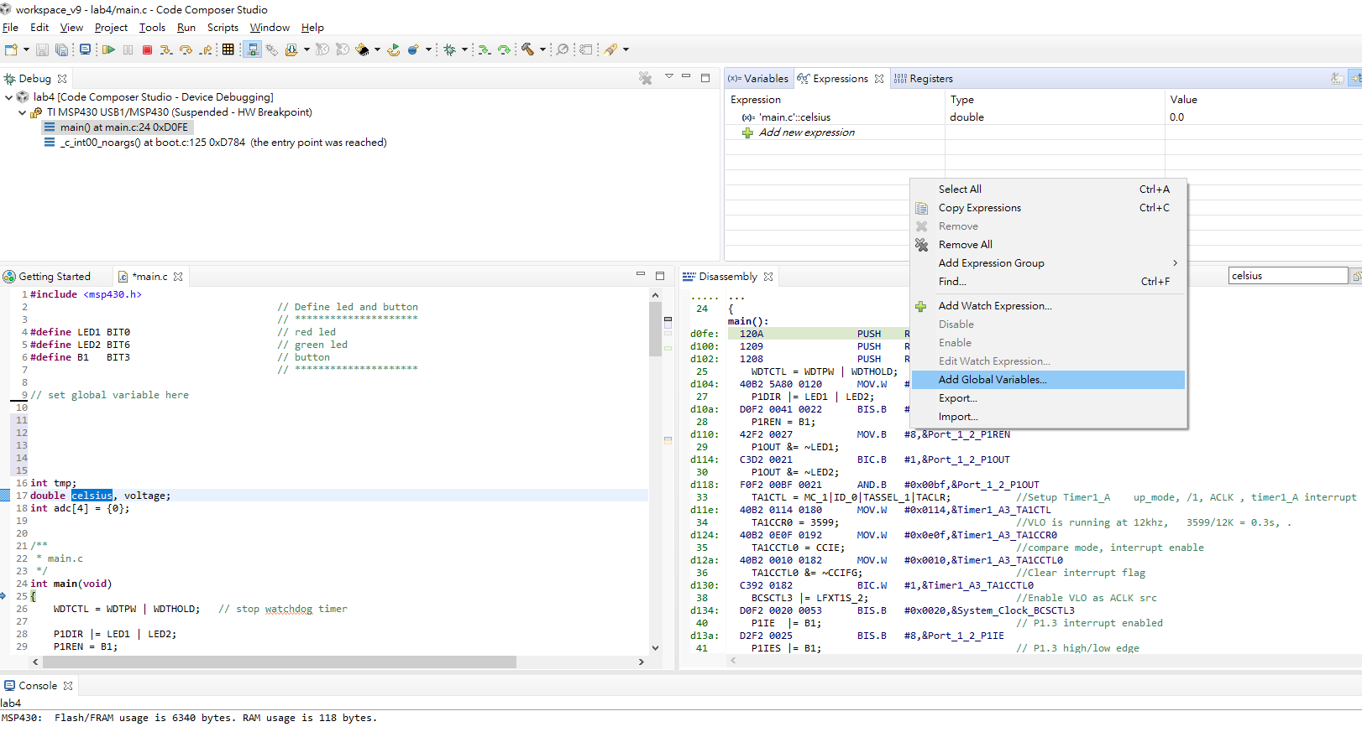
Show Variables in Debug Mode

Slide 11
Sample Code for DTC
#include “msp430.h” int adc[10]; // Buffer to store the ADC values void main(void) { WDTCTL = WDTPW + WDTHOLD; // Stop WDT ADC10CTL1 = SHS_1 + CONSEQ_2 + INCH_10; ADC10CTL0 = SREF_1 + ADC10SHT_2 + REFON + ADC10ON + ADC10IE; ADC10DTC1 = 10; // # of transfers ADC10SA = (int)adc; // Buffer starting address __enable_interrupt(); // Enable interrupts
Notes:
10
SHS_1: S&H triggering source → OUT1
CONSEQ_2: Conversion sequence mode select (Repeat-single-channel)
INCH_10: temperature sensor
SREF_1: Select reference (VR+ = VREF+ and VR- = VSS)
ADC10SHT_2: Sample-and-hold time (6 × ADC10CLKs)
REFON: internal reference generator on
ADC10DTC1: Number of transfers per block (DTC disabled if 0)
The settling time for the internal reference is < 30µs. If DCOCLK is 1 MHz, then 1 cycle takes 6µs and 30 cycles gives long enough delay for the internal reference voltage to settle down.
10

Slide 12
Sample Code for DTC
TA0CCR0 = 2048-1; // Sampling period TA0CCTL1 = OUTMOD_3; // TACCR1 set/reset TA0CCR1 = 2046; // TACCR1 OUT1 on time TA0CTL = TASSEL_1 + MC_1; // ACLK, up mode while(1); } #pragma vector=ADC10_VECTOR __interrupt void ADC10_ISR(void){ // Converted ADC data in adc[10] // Assign starting address for next conversion ADC10SA = (int)adc; }
Notes:
11
11

