Slide 1
CS4101 Introduction to Embedded Systems Lab 5: Low-Power Optimization
Prof. Chung-Ta King
Department of Computer Science
National Tsing Hua University, Taiwan

Slide 2
Lab 5
Basic 1: Based on Basic 1 of Lab 4 (40%)
Normal state: run flash pattern 1 while keeps measuring temperature, entering CPU into LPM3 when idle
Flash pattern 1: red LED blinks twice first and then green LED once repeatedly, with red LED on 0.5 sec and off 0.5 sec and green LED on 0.9 sec and off 0.5 sec, using Timer1_A3 driven by ACLK sourced from VLO running at 12KHz.
Measure temperature every 0.8 sec by single-channel-single-conversion, triggered continuously by Timer0_A3 driven by ACLK sourced from VLO with 1.5V voltage reference.
If the temperature is above 28。C, enter emergency state.
Count the amount of time that CPU is in LPM3. Use debugger to show the accumulated count and the temperature.

Slide 3
Lab 5
Basic 1: (cont.)
Emergency state: run flash pattern 2 while keeps measuring temperature, entering CPU into LPM0 when idle
Flash pattern 2: turn both LEDs on for 0.3 sec first and off for 0.2 sec alternatively by Timer1_A3 driven by ACLK sourced from VLO running at 12KHz.
Measure temperature every 0.4 sec by single-channel-single-conversion but triggered continuously by Timer0_A3 driven by ACLK sourced from VLO and by 1.5V voltage reference.
If the temperature is below 28。C, enter normal state.
Count the amount of time CPU is in LPM0. Use debugger to show the accumulated count and the temperature.
Voltage = T * 1.5 / 1023 (T = value of ADC10MEM)
Celsius = (Voltage - 0.986) / 0.00355

Slide 4
Lab 5
Basic 2: (60%)
Normal state: run flash pattern 1 but do not measure temperature, entering CPU into LPM3 when idle
On double-click of the button, enter the measurement state
A double-click is valid if the duration between two clicks is less than 0.5 sec. Use Timer1_A3, driven by ACLK sourced from VLO to measure the duration between clicks.
Measurement state:
Run flash pattern 2, entering CPU into LPM0 when idle.
Measure temperature every 0.25 sec using DTC triggered by Timer0_A3 driven by ACLK sourced from VLO and by 1.5V voltage reference.
Each time DTC is called, take 4 measurements and calculate the average temperature.
Notes:
Normal: patten1(紅兩次綠一次) 不測溫度 (LPM3 when idle)
按兩下: 開始測溫度(兩次之間小於0.5秒才算，用Timer1測)
Measurement: patten 2 (LPM0) (亮0.3暗0.2)
每0.25秒測一次，DTC 4次
算平均

Slide 5
Lab 5
Basic 2: (cont.)
Measurement state: (cont.)
If the temperature is above 28。C, run only the red LED.
If the temperature is below 28。C, run both LEDs.
On a double-click of the button, return to the normal state.
Count the amount of time CPU is in LPM0. Use debugger to show the accumulated count and the temperature.
Notes:
(亮0.3暗0.2)
>28度 : 只跑紅燈
<28度： 兩個燈都跑
再按兩下: 回到Normal state
計算LPM0時間，debugger看時間和溫度

Slide 6
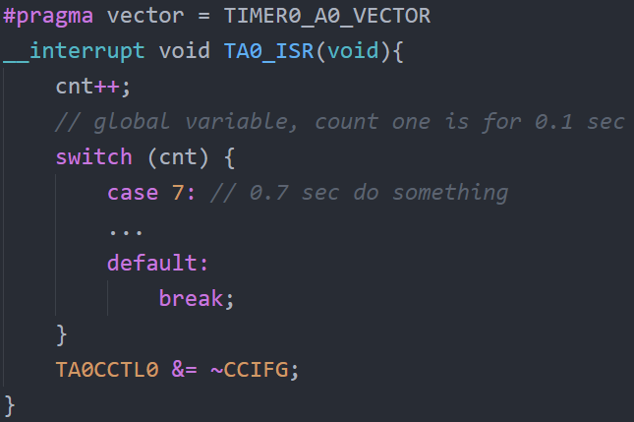
Requirements
Handle all events by interrupts.
Cannot use a counter to sum up time for interrupts.
Keep ISP short.

Slide 7
Grading Policies
DEMO in the lab --------------------------------------100%
DEMO within a week ----------------------------------80%
DEMO after a week ------------------------------------60%
After two weeks ----------------------------------------- 0%

