Slide 1
CS4101 Introduction to Embedded Systems
Lab 6: Serial Communication
Prof. Chung-Ta King
Department of Computer Science
National Tsing Hua University, Taiwan

Slide 2
Introduction
In this lab, we will learn
  To implement a software UART on MSP430 LaunchPad, which serves to summarize all that we have learned so far
  To communicate between MSP430 LaunchPad and PC through RS232 interface

Slide 3
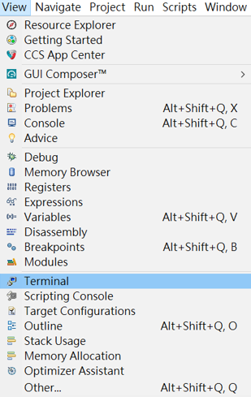
Setting PC for Serial Communication
In the Debug perspective of CCS IDE, click [View] -> [Terminal]

Slide 4
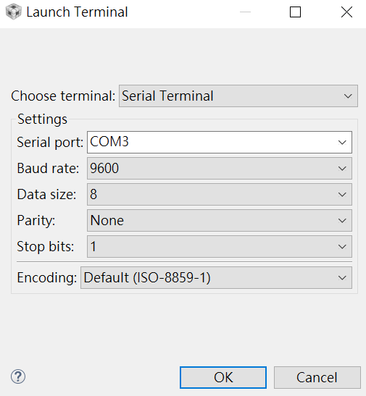
Setting PC for Serial Communication
A Terminal pane will appear on the screen.
Click the [Open a Terminal] button in the Terminal pane and make the selections (set the serial communication setting)

Slide 5
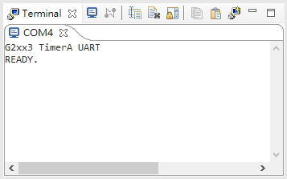
Before Starting Lab 6
Run the sample code in L08-Comm and make sure you can get the following result on the CCS terminal.
If there is nothing on the CCS terminal, replug your USB cable from the computer until you get the result.

Slide 6
Lab 6
Basic 1: communicate with host computer (40%)
  LaunchPad: Whenever the button is clicked once (i.e., pressed and released once), change the mode.
    Start with Normal mode.
    You must handle button events by interrupt.
  Normal mode:
    On PC: You type a string and hit <enter> in CCS, and the string will be sent to the LaunchPad through the RS232 interface.
    On LaunchPad: Count the number of characters received and send that number and the received string back using 8-N-1 (8-bit data, no parity bit, 1 stop bit) to the PC.
    On PC: The received data will be shown on the CCS terminal.
    Hint: Include stdio.h to use sprint() for a string of a number.

Slide 7
Lab 6
Basic 1: (cont.)
  Enhanced mode:
    On LaunchPad: Send the string “HELLO!” to the PC through the RS232 interface using 8-N-1 (8-bit data, no parity bit, 1 stop bit) every 3 seconds.
    On PC: “HELLO!” will be shown on CCS terminal.

Slide 8
Lab 6
Basic 2: device driver (60%)
  Write a function flash(char id, int on, int off) to flash the LEDs by interrupts using Timer1_A3 driven by ACLK sourced from VLO running at 12Khz, where
    id = 0 for red LED; 1 for green LED.
    on/off = time (in ms) for the LED to be on/off.
    Let CPU enter LPM3 at the end of flash function.
    (Hint: this function is for Normal state only.)
  Write a function temp(int interval, int times) to measure the temperature using repeat-single-channel (see sample code) triggered by Timer0_A3, where
    interval: the interval (in ms) between measurements.
    times: the number of times to measure in total.
    Results are stored in a global integer array Temp[64].

Slide 9
Lab 6
Basic 2: (cont.)
  Normal state:
    Use flash() to flash the green LED at 0.9 Hz (0.9 sec on and 0.5 sec off) by interrupts (ACLK sourced from VLO).
    Use temp() to measure the temperature at 1 Hz continuously. (Hint: must reuse Temp[])
    If average temperature of the last 2 seconds is higher than 740, change the state into Emergency state and send the string “Emergency!” to the host computer via the software UART using 8-N-2 (8-bit data, no parity bit, 2 stop bits).

Slide 10
Lab 6
Basic 2: (cont.)
  Emergency state:
    Flash the red LED with 0.2 sec on and 0.3 sec off and send the average temperature to PC every 2 seconds using 8-N-2 (8-bit data, no parity bit, 2 stop bits).
    Whenever PC receives the average temperature, it displays the string and waits for user’s input from its keyboard.
    When user enters a string, PC transmits the string to the LaunchPad using 8-N-2.
    If the string is “Ack!”, then the LaunchPad goes back to the Normal state. Otherwise, it ignores the string and keeps in Emergency state.

Slide 11
Sample Code for Repeat-Single-Channel
#include "msp430.h" void main(void) { WDTCTL = WDTPW + WDTHOLD; // Stop WDT // TA1 trigger sample start ADC10CTL1 = SHS_1 + CONSEQ_2 + INCH_10; ADC10CTL0 = SREF_1 + ADC10SHT_3 + REFON + ADC10ON + ADC10IE; ADC10CTL0 |= ENC; // ADC10 Enable ADC10AE0 |= 0x02; // P1.1 ADC10 option select P1DIR |= 0x01; // Set P1.0 output TA0CCR0 = 2048-1; // Sampling period TA0CCTL1 = OUTMOD_3; // TACCR1 set/reset TA0CCR1 = 2046; // TACCR1 OUT1 on time TA0CTL = TASSEL_1 + MC_1; // ACLK, up mode // Enter LPM3 w/ interrupts __bis_SR_register(LPM3_bits + GIE); }
Notes:
10
10

Slide 12
Sample Code for Repeat-Single-Channel
// ADC10 interrupt service routine #pragma vector=ADC10_VECTOR __interrupt void ADC10_ISR(void){ if (ADC10MEM < 0x1FF) // ADC10MEM = A1 > 0.5V? P1OUT &= ~0x01; // Clear P1.0 LED off else P1OUT |= 0x01; // Set P1.0 LED on }
Notes:
11
11

