Slide 1
PageRank Algorithm
Get to Know How Google Search Engine works
Before Doing
Searching Engine Optimization

Slide 2
Agenda
Background
The Original PageRank
Example and Problems
The Revised PageRank
Matrix Representation and Power Iteration
PageRank on Python
Reference

Slide 3
Background
World Wide Web (www) introduced in 1989
1994 – full text search –WebCrawler
1995 – 1996: AltaVista, Yahoo, AskJeeves
Relevance score: association of page with search query
1997 Google & PageRank
Importance score: irrespective of search query
Notes:
Relevance score -> count how many times the query show in the page

Slide 4
Initiation of Google and PageRank
Larry Page and Sergey Brin developed PageRank at Stanford University in 1996 as part of a research project about a new kind of search engine.
First paper describing PageRank and the initial prototype of the Google search engine published in 1998.
“Google is designed to crawl and index the Web efficiently and produce much more satisfying search results than existing systems.”
PageRank (PR) is an algorithm used by Google Search to rank web pages in their search engine results

Slide 5
The Basic Concept Behind PageRank
PageRank works by counting the number and quality of links to a page to determine how important the webpage is.
Page A
Page C
Page E
Page B
Page D
Page F
Notes:
Importance = score
page ->(webpage), Web graph (pages + links)
Links and arrow
Page A –> page C The direction: hyperlink to the other page
Page C can not go back to Page A

Slide 6
Terminology
Inbound Links: Links pointing into the given page from other pages
Outbound Links: Links from the given page pointing out to other pages
Dangling Links: Links that pointing out to any pages from the given page with no outgoing links
Page A
Page A
Page A

Slide 7
Random Surfer - Basis for calculating PageRank
Surfing the web at random
Two possibilities:
Chose on hyperlink from the current page
Enter a URL from browser
Page A
Page C
Page E
Page B
Page D
Page F
Notes:
For suffer (yellow icon)Page A got 3 chance to click
Page D got 2 chance
Page F
Page E
Page E type url (n chances)
What is a chance that a page is selected any time?

Slide 8

The original equation of PageRank
PR(A) : PageRank of Page A
PR(n) : PageRank of Page n which links to Page A
L(n): the number of outbound links on Page n
d: damping factor in the range 0 and 1, usually set to 0.85
Notes:
We assume page A has pages T1...Tn which point to it (i.e., are citations). The parameter d is a damping factor which can be set between 0 and 1. We usually set d to 0.85. There are more details about d in the next section. Also C(A) is defined as the number of links going out of page A. The PageRank of a page A is given as follows:
PageRank -> Score

Slide 9
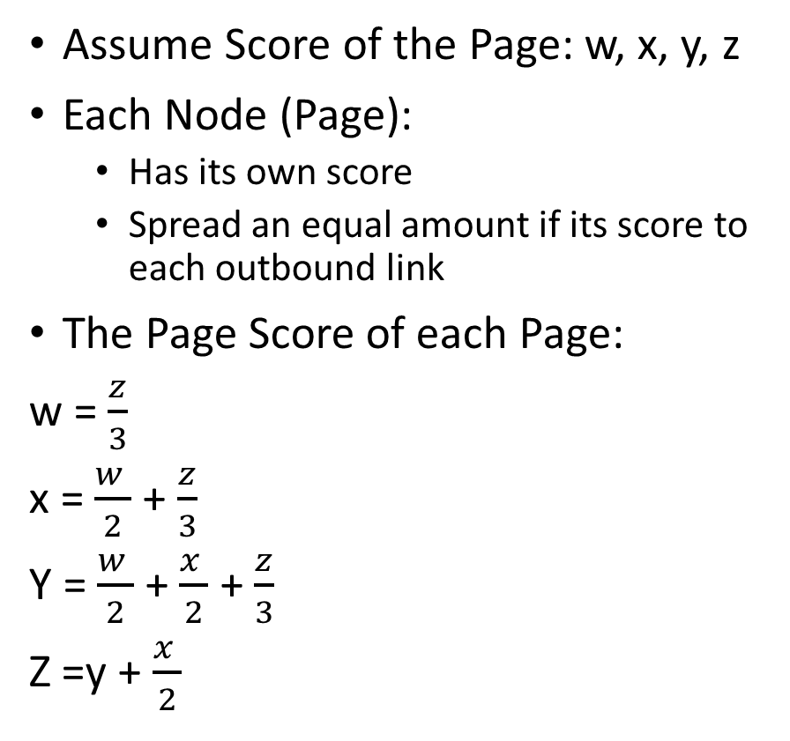
Example
Assume Score of the Page: w, x, y, z
Each Node (Page):
Has its own score
Spread an equal amount if its score to each outbound link
The Page Score of each Page:
w = $\frac{z}{3}$
x = $\frac{w }{2}$ + $\frac{z}{3}$
Y = $\frac{w }{2}$ + $\frac{x }{2}$ + $\frac{z}{3}$
Z =y + $\frac{x }{2}$
W
w/2
X
x/2
w/2
Y
x/2
z/3
z/3
Y
z/3
Z
Notes:
不考慮 damping factor
Ignore Random surfer getting bored and
Random surfer follow the web graph

Slide 10
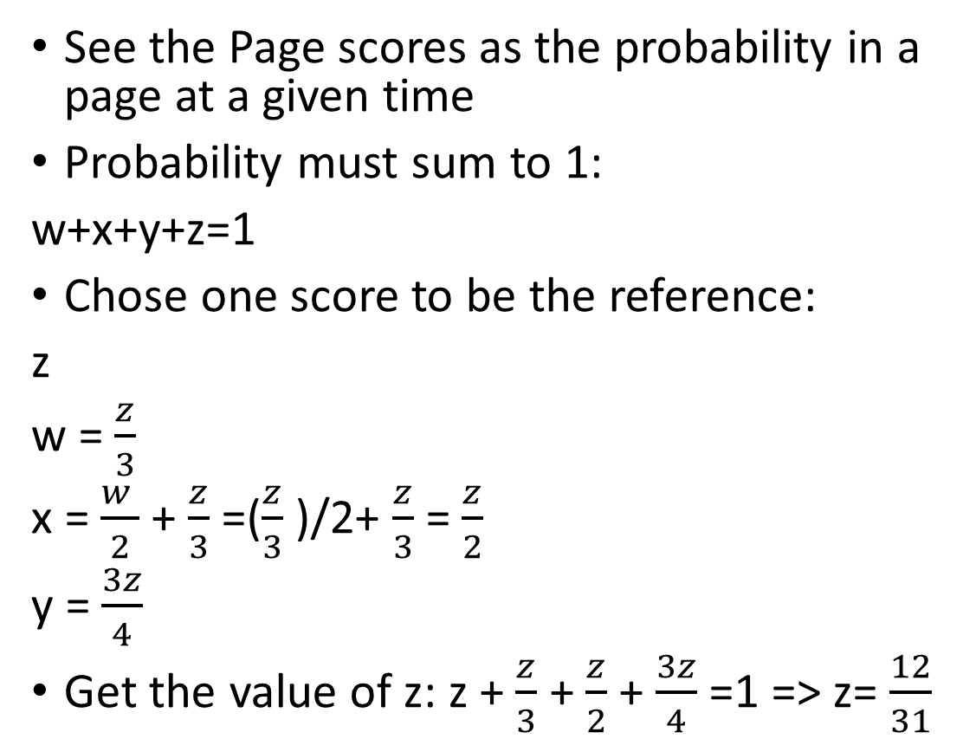

The Calculation
The Page Score :
w = $\frac{z}{3}$
x = $\frac{w }{2}$ + $\frac{z}{3}$
Y = $\frac{w }{2}$ + $\frac{x }{2}$ + $\frac{z}{3}$
Z =y + $\frac{x }{2}$
See the Page scores as the probability in a page at a given time
Probability must sum to 1:
w+x+y+z=1
Chose one score to be the reference:
z
w = $\frac{z}{3}$
x = $\frac{w }{2}$ + $\frac{z}{3}$ =($\frac{z}{3}$ )/2+ $\frac{z}{3}$ = $\frac{z}{2}$
y = $\frac{3z}{4}$
Get the value of z: z + $\frac{z}{3}$ + $\frac{z}{2}$ + $\frac{3z}{4}$=1 => z= $\frac{12}{31}$
W
w/2
X
x/2
w/2
Y
x/2
z/3
z/3
Y
z/3
Z
Notes:
(1)分數越高 越高機率 random surfer
(2) Sum = 1 某個時間點你指會
解方程式 四個變數

Slide 11


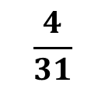


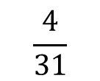
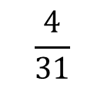
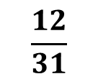
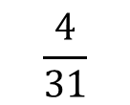



Important Summary
$$\frac{4}{31}$$
$$\frac{6}{31}$$
$$\frac{2}{31}$$
W
X
Y is not most important
Z is most important
The rationale behind:
A page with a link from a page which is known to be of high importance is also important.
Page | PageRank
 | Score | Rank
W | 0.129 | 4th
X | 0.194 | 3th
Y | 0.290 | 2th
Z | 0.387 | 1th
$$\frac{3}{31}$$
$$\frac{2}{31}$$
$$\frac{9}{31}$$
$$\frac{3}{31}$$
Y
$$\frac{4}{31}$$
$$\frac{4}{31}$$
$$\frac{4}{31}$$
$$\frac{9}{31}$$
Z
$$\frac{12}{31}$$
Notes:
The rationale behind:
- More important websites are likely to receive more links from other websites
- a page with a link from a page which is known to be of high importance is also important.

Slide 12

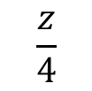
Some problems
W
X
Dangling Nodes
V = $\frac{z}{4}$
Z = 0
Disconnected graph
Y
I
Z
J
$$\frac{z}{4}$$
V

Slide 13
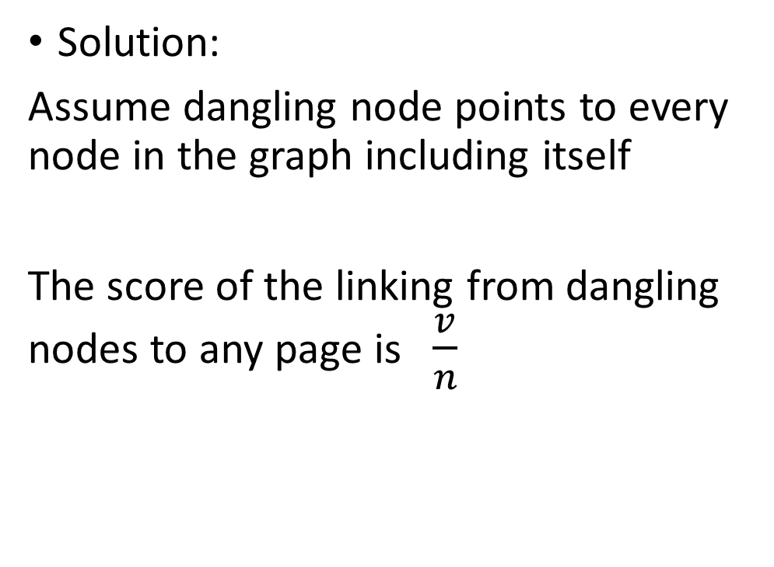
How to handle dangling nodes?
W
X
Solution:
Assume dangling node points to every node in the graph including itself
The score of the linking from dangling nodes to any page is $\frac{v}{n}$
Y
Z
V

Slide 14
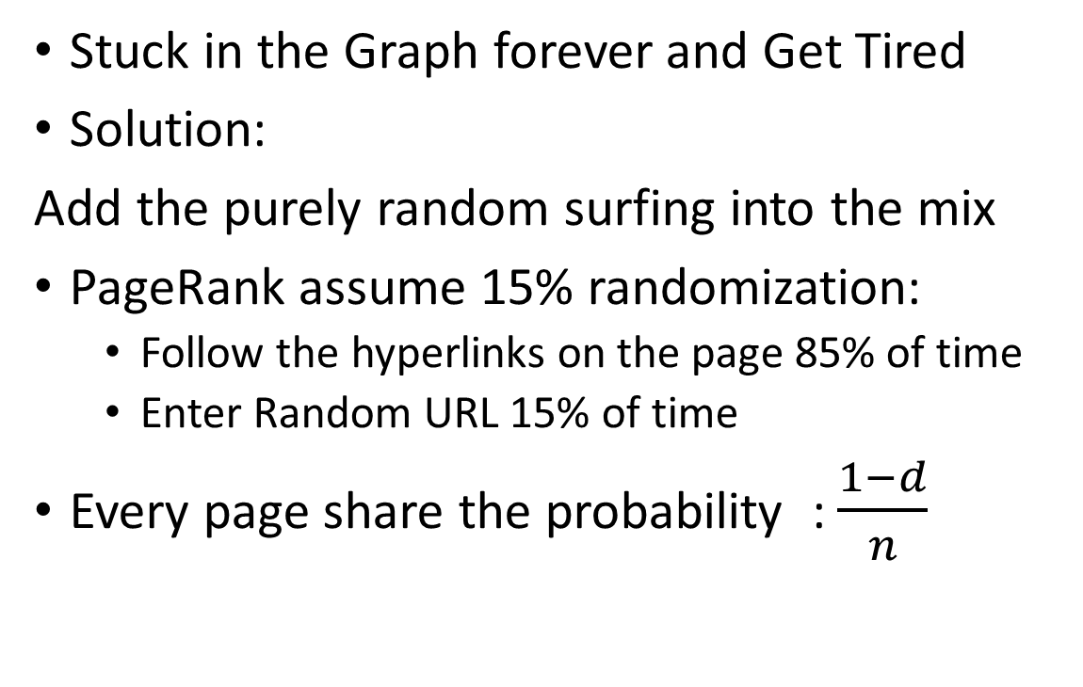
How to deal with Disconnected Graph?
Stuck in the Graph forever and Get Tired
Solution:
Add the purely random surfing into the mix
PageRank assume 15% randomization:
Follow the hyperlinks on the page 85% of time
Enter Random URL 15% of time
Every page share the probability : $\frac{1−d}{n}$
W
X
I
Y
J
Z
Notes:
Stuck in sub graph

Slide 15
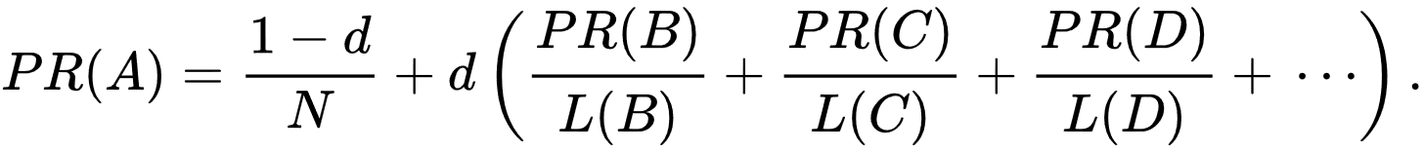
Revised Formula of PageRank
PR(A) : PageRank of Page A
PR(n) : PageRank of Page n which links to Page A
L(n): the number of outbound links on Page n
d: damping factor in the range 0 and 1, usually set to 0.85

Slide 16
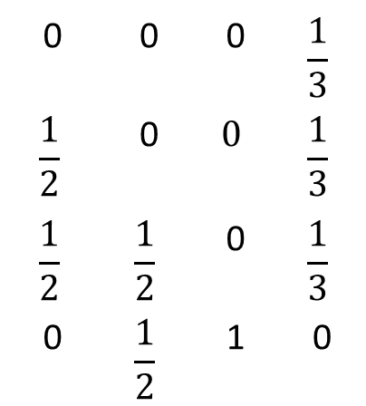

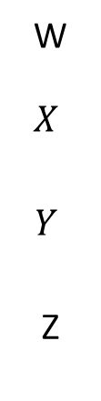
Matrix Representation
W
w/2
X
W | X | Y | $$Z$$
W
$$X$$
$$Y$$
Z
0 | 0 | 0 | $$\frac{1}{3}$$
$$\frac{1}{2}$$ | 0 | $$0$$ | $$\frac{1}{3}$$
$$\frac{1}{2}$$ | $$\frac{1}{2}$$ | 0 | $$\frac{1}{3}$$
0 | $$\frac{1}{2}$$ | 1 | 0
x/2
w/2
Y
x/2
z/3
z/3
Y
z/3
Z
Notes:
Store every page and the connections between pages

Slide 17
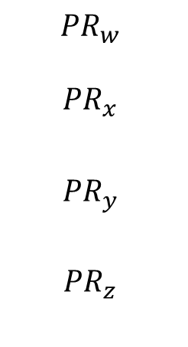
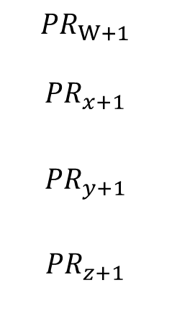
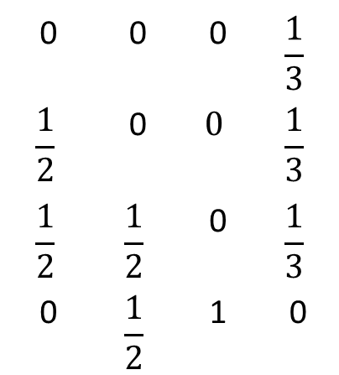
Power Iteration
${PR}_{t+1}$= M ${PR}_{t}$
$${PR}_{W+1}$$
$${PR}_{x+1}$$
$${PR}_{y+1}$$
$${PR}_{z+1}$$
0 | 0 | 0 | $$\frac{1}{3}$$
$$\frac{1}{2}$$ | 0 | $$0$$ | $$\frac{1}{3}$$
$$\frac{1}{2}$$ | $$\frac{1}{2}$$ | 0 | $$\frac{1}{3}$$
0 | $$\frac{1}{2}$$ | 1 | 0
$${PR}_{w}$$
$${PR}_{x}$$
$${PR}_{y}$$
$${PR}_{z}$$

Slide 18
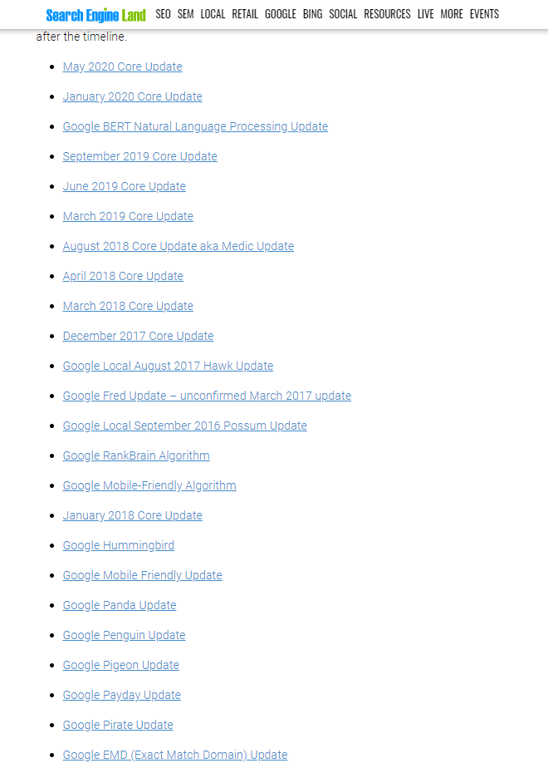
Next Week Topic : SEO practice
The search engine results page (SERP) is the actual result returned by a search engine in response to a keyword query.
The SERP rank of a web page is a function not only of its PageRank, but of a relatively large and continuously adjusted set of factors (over 200).
Google Algorithm Updates
SEO is aimed at influencing the SERP rank for a website or a set of web page

Slide 19
Reference
Paper
"The Anatomy of a Large-Scale Hypertextual Web Search Engine“
Lecture
Networks Illustrated: Principles without Calculus
“Notes on PageRank Algorithm”
Wiki
https://en.wikipedia.org/wiki/PageRank
Video
https://www.youtube.com/playlist?list=PLH7W8KdUX6P2n4XwDiKsEU6sBhQj5cAqa

