Slide 1
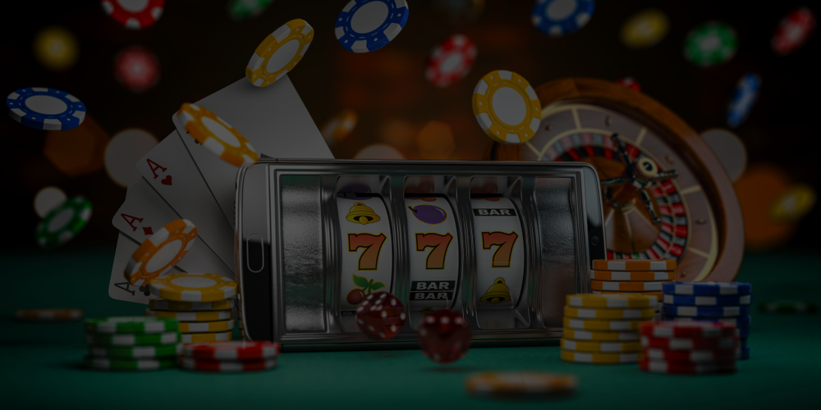
Can You Win at
Gambling?
Roulette
F74065050 邱凱琳 資訊110
F74066080 游淳如 資訊110
F74062078 丁筠馨 資訊110
F64054049 黃姿涵 資訊110

Slide 2
Background and Motivation
As the Chinese New Year approaches, friends and family get together and spend quality time together. Along with chinese new years comes the thing many people look forward to, Red Envelopes(紅包).
The near-miss effect is one of the main incentives for gambling, causing individuals to mistakenly believe that the result of losing money is bring them closer to winning rather than losing money.
Over time, this seemingly similar outcome of winning money will fuel further misunderstandings that they do not often lose money, but is actually winning money, therefore increasing their motivation to continue gambling.
We wanted to know the largest amount we can earn in a few bets, then we can celebrate the new year with fatter wallets. ｡◕‿◕｡

Slide 3
Problem Definition
We wanted to find out whether risking your money in a few rounds of roulette would be worth the payout, or would you actually just end up losing.
In our project we chose to calculate and compare which tactic is the most optimal choice to win money from (or which you would lose the least from).

Slide 4
Methodology
We used the markov chain method to calculate our problem. We assume that the probability of each round in a game do not affect each other and that we would stop once we reach our desired goal or when we have no more money left.
We did this by organizing our transition matrix with the possibility of each state(the amount of money we have at the end of each round). As well as calculating the expected value of each tactic.

Slide 5
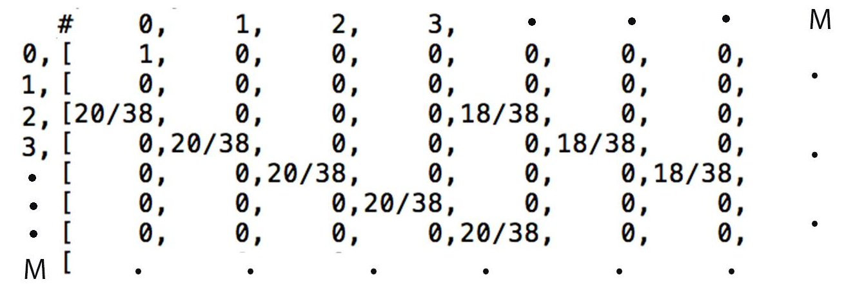
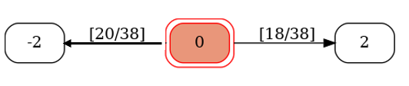
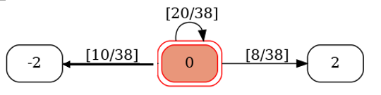
Methodology
For every tactic, we start off with $10, we decide to play 20 rounds, for every round we bet $2. We decide to stop playing after 20 rounds or when we reach $0 where we cannot bid anymore or $20/$30.

Slide 6
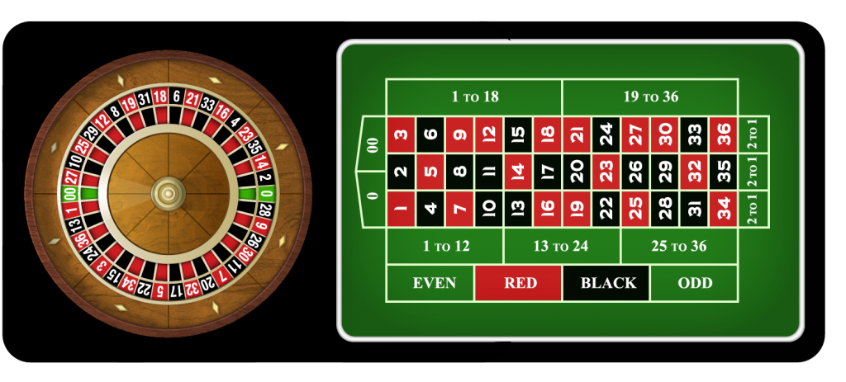
Roulette

Slide 7
Data Collection
Roulette Bet | Payout | Probability
Even/Odd | 1:1 | 18/38
Red/Black | 1:1 | 18/38
Low/High | 1:1 | 18/38
Even&Red / Odd&Black | 1:1 | 8/38, 20/38
Odd&Red / Even&Black | 1:1 | 10/38, 16/38
Even/Odd & Low/High | 1:1 | 9/38, 18/38
Red/Black & Low/High | 1:1 | 9/38, 18/38
Column / Dozen | 1:2 | 12/38
https://www.roulettesites.org/rules/odds/

Slide 8
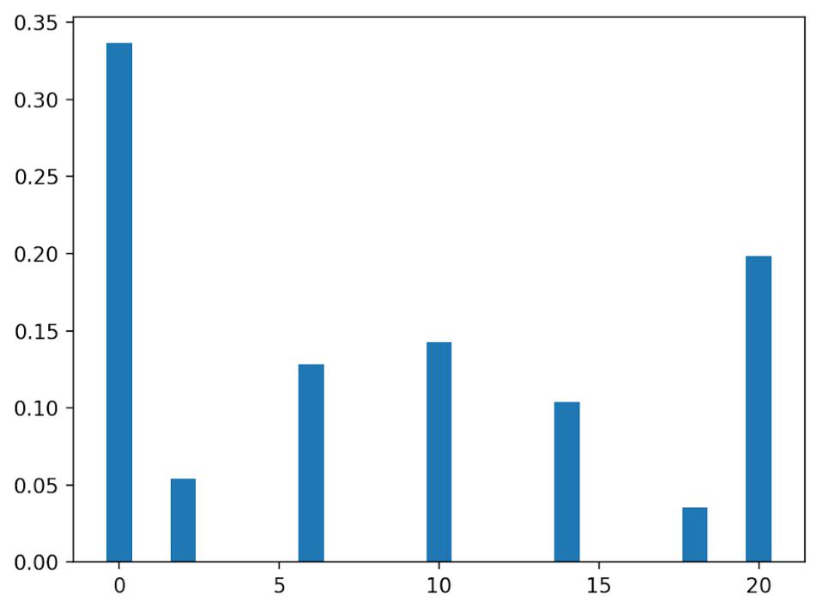
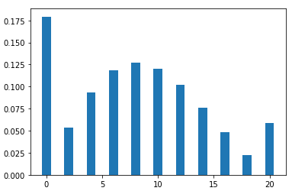
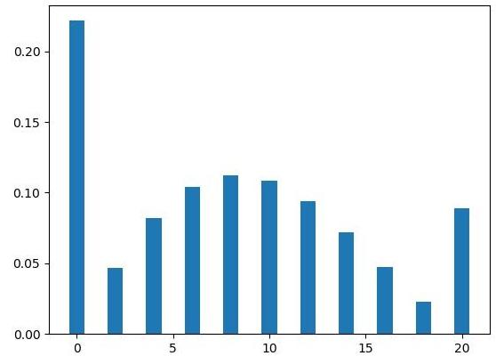
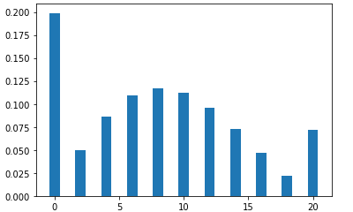
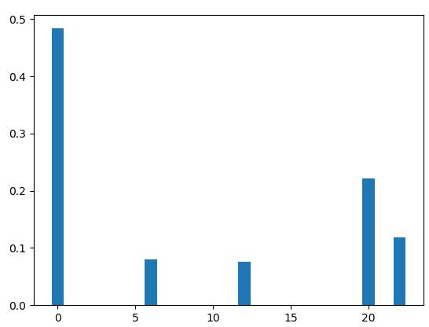
Analysis Result - 上限20元 probability figure
1.Even/Odd & Red/Black & Low/High 2.Even&Red / Odd&Black 3.Odd&Red / Even&Black
4.Even/Odd & Low/High + Red/Black & Low/High 5.Column / Dozen

Slide 9
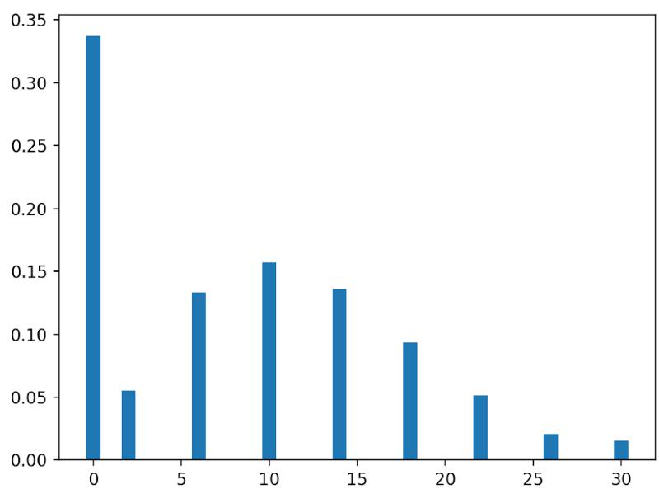
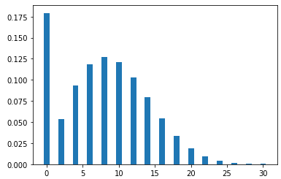
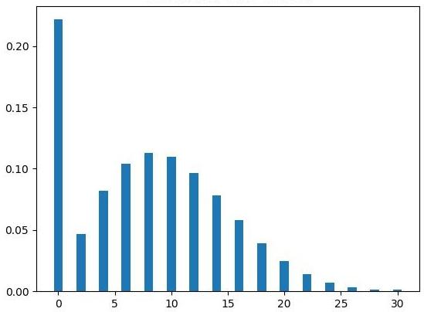
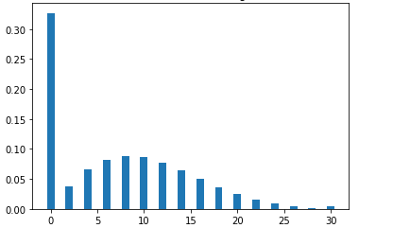
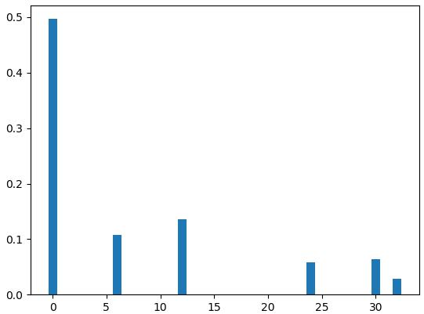
Analysis Result - 上限30元 probability figure
1.Even/Odd & Red/Black & Low/High 2.Even&Red / Odd&Black 3.Odd&Red / Even&Black
4.Even/Odd & Low/High + Red/Black & Low/High 5.Column / Dozen

Slide 10
Analysis Result
Roulette Bet | Expected Value-上限20塊 | Expected Value-上限30塊
Even/Odd Red/Black Low/High | 8.374713949056163 | 8.201945676458728
Even&Red / Odd&Black | 8.043314862253071 | 8.006714767767914
Odd&Red / Even&Black | 8.108338823285955 | 8.047390997183085
Even/Odd & Low/High Red/Black & Low/High | 7.90899672654373 | 7.018601283400339
Column / Dozen | 8.79763243368719 | 8.464260496761755

Slide 11
Conclusion
Betting on only one type earned us a higher payout compared to betting on two types at the same time(a good example of the near miss effect).
Stopping once reaching $20 would be more beneficial.
In conclusion, the more rounds you bet and gamble the higher your chance of accumulating loss and end up losing money.
Best to just not gamble, Save your money instead and have a Happy New Year ｡◕‿◕｡

