Slide 1


Presentation to the University of Waterloo
Stud
ify

Slide 2
Agenda
Stud
ify
Social Learning
What is it?
Why Waterloo?
Product Demonstration
User Implementation & Retention
Risk Factors
Questions

Slide 3


Social Learning: What is it?
Stud
ify
“Learning as a group also made students more resilient and more likely to persevere when learning difficult concepts, compared to learning alone²”
“Students working in groups achieved higher grades in STEM courses than students working alone¹”
<
Collaborative learning is when two or more people come together to tackle a problem and learn something new1
Sources:
1. Springer, Leonard, et al. “Effects of Small-Group Learning on Undergraduates in Science, Mathematics, Engineering, and Technology: A Meta-Analysis.” Review of Educational Research, vol. 69, no. 1, Mar. 1999, pp. 21–51
2. Gouvea, Julia. “Learning in a Group, as a Group, and between Groups.” CBE-Life Sciences Education, 31 May 2019
3. Dillenbourg, P. (1999). Collaborative Learning: Cognitive and Computational Approaches. Advances in Learning and Instruction Series. New York, NY: Elsevier Science, Inc.

Slide 4





Social Learning: What is it?
Stud
ify
Benefits
Higher Engagement
2 + 2 = 5
Develops Better Communication Skills¹
Exposure to Different Methods of Thought¹
Learning as a group is better than learning individually
Sources:
1. Baker, T., & Clark, J. (2010). Cooperative learning – a double-edged sword: A cooperative learning model for use with diverse student groups. Intercultural Education, 21(3), 257–268.

Slide 5
Social Learning: Why Waterloo?
Stud
ify
Quality of Interactions
Social Support
Waterloo ranked near the bottom for student surveys focused around social environment¹
Sources:
1. Maclean’s National Survey of Student Engagement for Canadian Universities

Slide 6




Social Learning: Why Waterloo?
Stud
ify
Antisocial Behavior
Supporting Students
STEM Focused
Several of Waterloo’s defining traits make it a prime target for Studify’s platform
Sources:
1. Maclean’s National Survey of Student Engagement for Canadian Universities

Slide 7
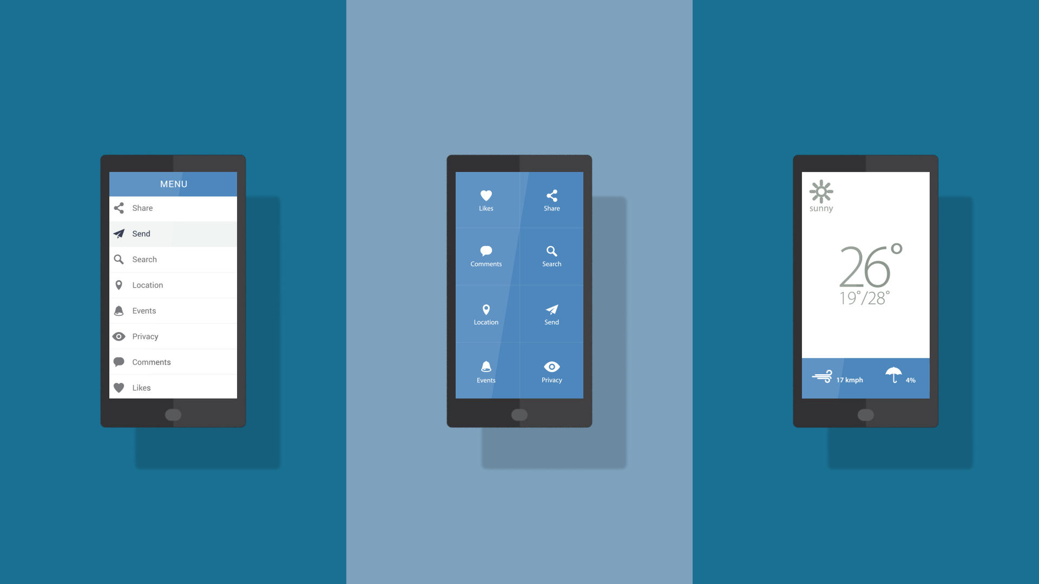
Use this for headers
Product Demonstration

Slide 8
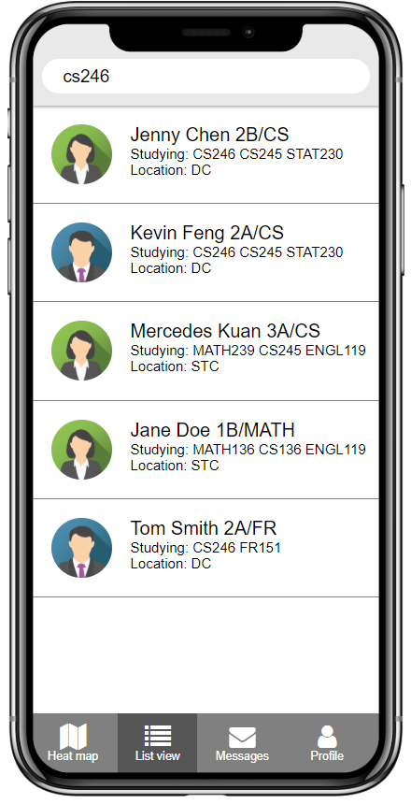
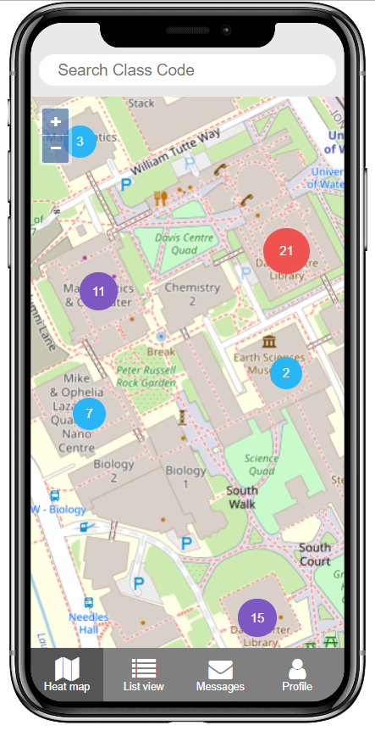
Design Choices
Stud
ify
Global Search Bar
Icons for Faster Information Display
Tabs for Quick Switching
Heat Map for Finding Study Partners
Messaging Feature for Coordinating Projects

Slide 9



User Engagement
Stud
ify
Teaching as an Incentive
UWaterloo Integration
Higher Academic Results
Sources:
1. Anghelcev, George, and John Eighmey. “The Impact of Extrinsic Incentives on Students’ Willingness to Volunteer as Peer Mentors: Implications for Advertising Education.” Journal of Advertising Education, vol. 17, no. 2, ser. 2013, 1 Nov. 2013, pp. 5–16. 2013,
2. Tamuliene, Vilma, and Ingrida Gabryteb. “Factors Influencing Customer Retention: Case Study of Lithuanian Mobile Operators .” 19th International Scientific Conference; Economics and Management, 25 Apr. 2014. Vilnius Universit,y Kaunas Faculty of Humanities, Lithuania ,

Slide 10



User Retention
Stud
ify
Constant Feedback Cycle from User’s and Faculty
Bi-Weekly App Updates
In-App Point System
Sources:
1. Anghelcev, George, and John Eighmey. “The Impact of Extrinsic Incentives on Students’ Willingness to Volunteer as Peer Mentors: Implications for Advertising Education.” Journal of Advertising Education, vol. 17, no. 2, ser. 2013, 1 Nov. 2013, pp. 5–16. 2013,
2. Tamuliene, Vilma, and Ingrida Gabryteb. “Factors Influencing Customer Retention: Case Study of Lithuanian Mobile Operators .” 19th International Scientific Conference; Economics and Management, 25 Apr. 2014. Vilnius Universit,y Kaunas Faculty of Humanities, Lithuania ,

Slide 11





Risk Factors
Stud
ify
Risk Factor
Malicious Users
Plagiarism
Mitigation
User Reporting and Banning System
Data Collection and Verification
Accounts Tied to University ID
Sources:
1. Shea, James Herbert. “Problems with Collaborative Learning.” Journal of Geological Education, vol. 43, no. 4, 1995, pp. 306–308., doi:10.5408/0022-1368-43.4.306.

Slide 12

Questions
Stud
ify

