Slide 2
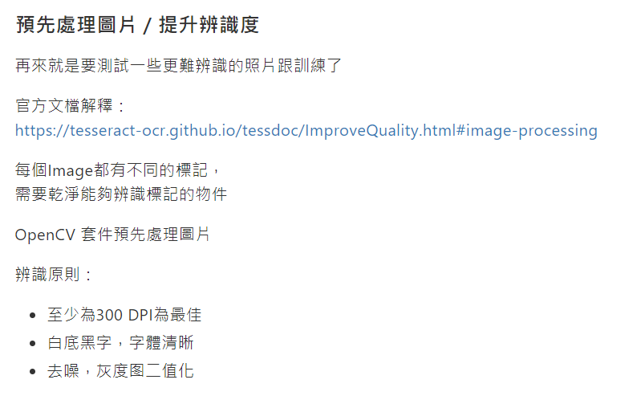

Slide 3
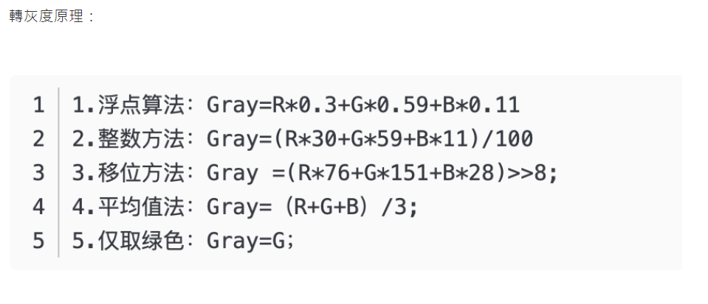

Slide 4
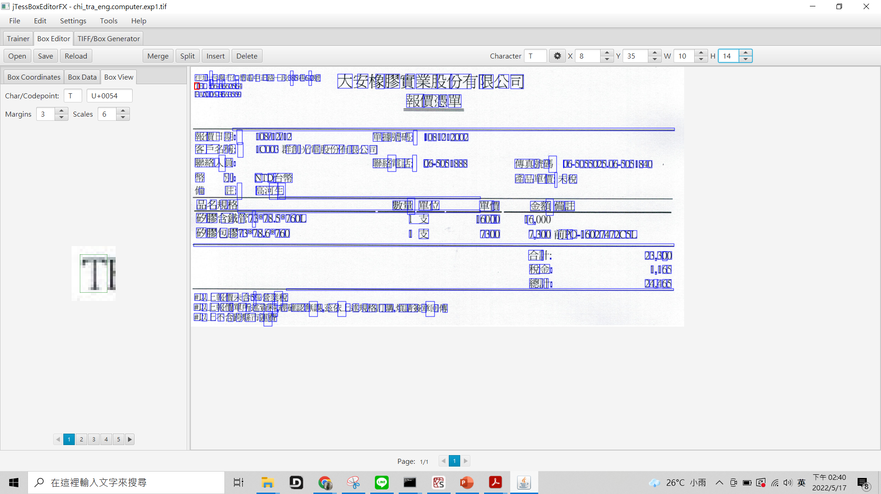

Slide 5
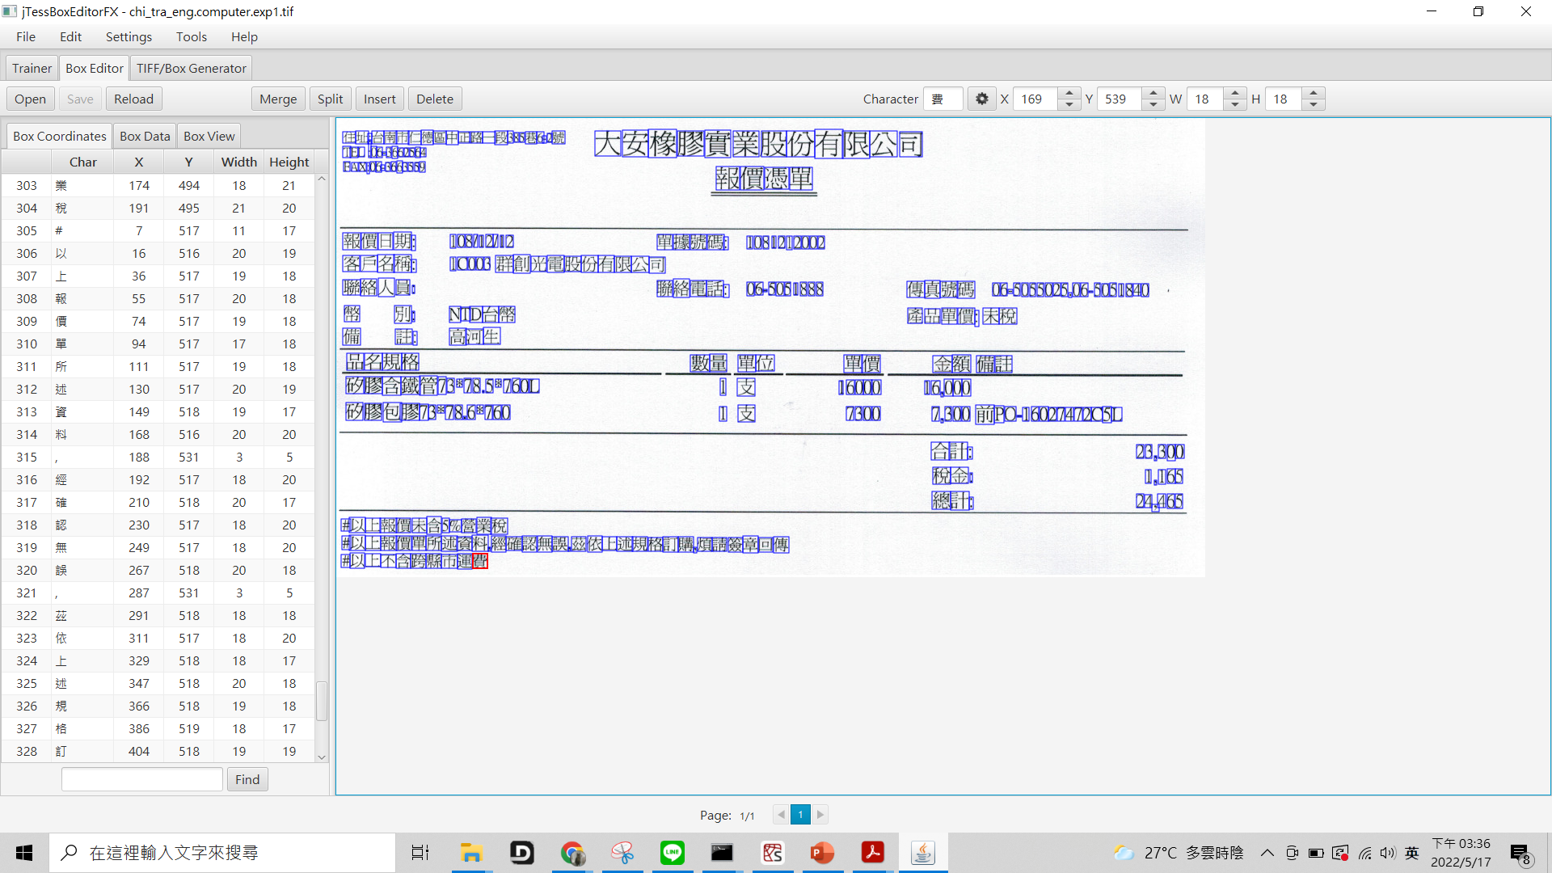

Slide 6
歷史安裝檔
https://digi.bib.uni-mannheim.de/tesseract/
PDF辨識
https://github.com/ocrmypdf/OCRmyPDF
去噪:
https://blog.csdn.net/u012067766/article/details/80013611
Magik 指令
file:///C:/Program%20Files/ImageMagick-7.1.0-Q16-HDRI/www/convert.html
https://www.796t.com/post/MjhwYzg=.html
Tesseract 5 官方訓練章程
https://tesseract-ocr.github.io/tessdoc/tess5/TrainingTesseract-5.html#building-the-training-tools
預處理網址:
https://hackmd.io/@DCT/Tesseract-OCR-%E6%96%87%E5%AD%97%E8%BE%A8%E8%AD%98
https://tesseract-ocr.github.io/tessdoc/ImproveQuality.html#image-processing
訓練網址:
https://www.honglimin.cn/OCR/tesseract_train.html
https://www.jianshu.com/p/5f847d8089ce
https://www.codeprj.com/zh/blog/a914241.html
https://blog.51cto.com/shanyou/3280754
https://www.796t.com/content/1548144562.html
驗證碼:
https://medium.com/mr-wang/%E6%96%87%E5%AD%97%E8%BE%A8%E8%AD%98%E5%AF%A6%E4%BD%9C%E5%8F%8A%E9%80%86%E5%90%91%E8%A7%A3%E6%9E%90-e42078f50916
圖片位置:
https://www.youtube.com/watch?v=6DjFscX4I_c&t=502s

Slide 7
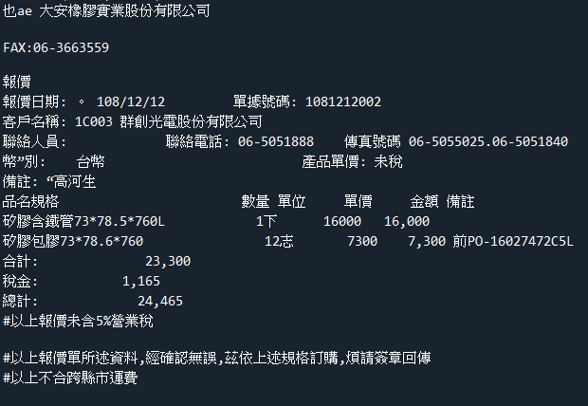
一開始

Slide 8
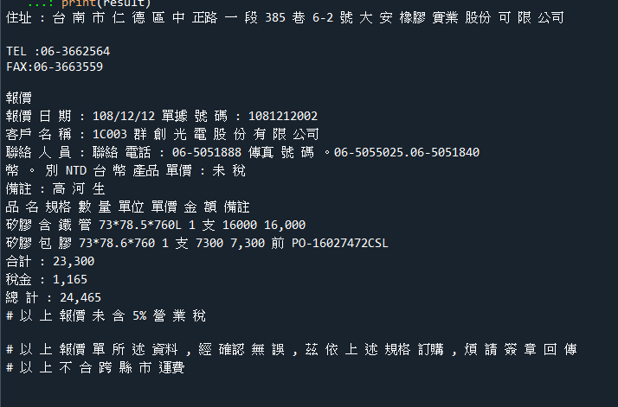
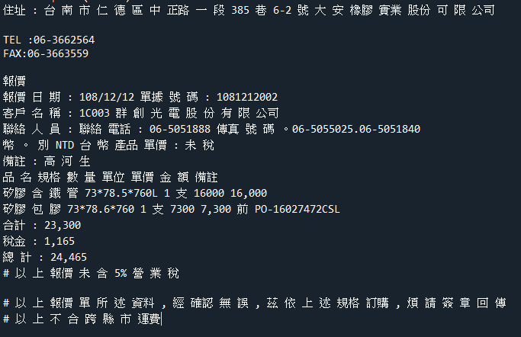
跌代800times、10000times

Slide 9
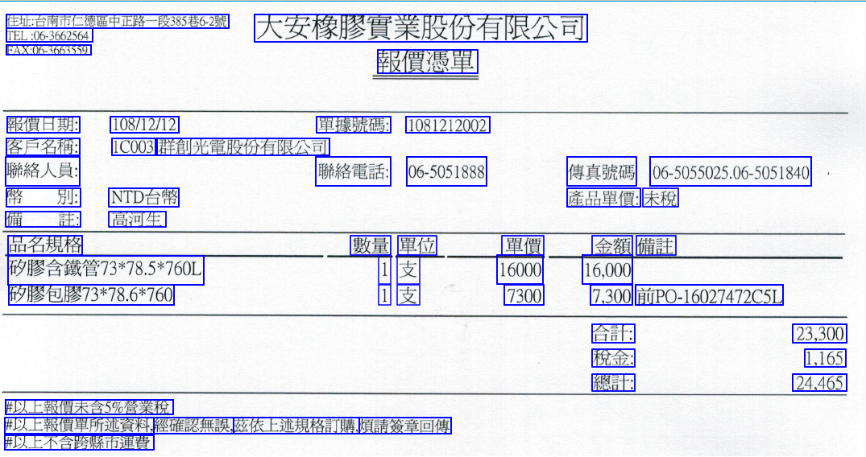
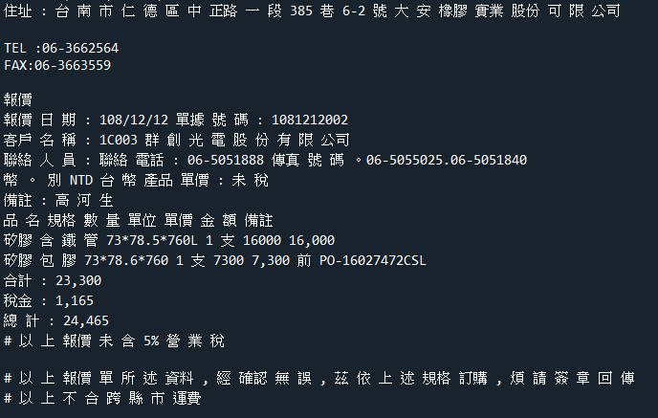
By word

