Slide 1
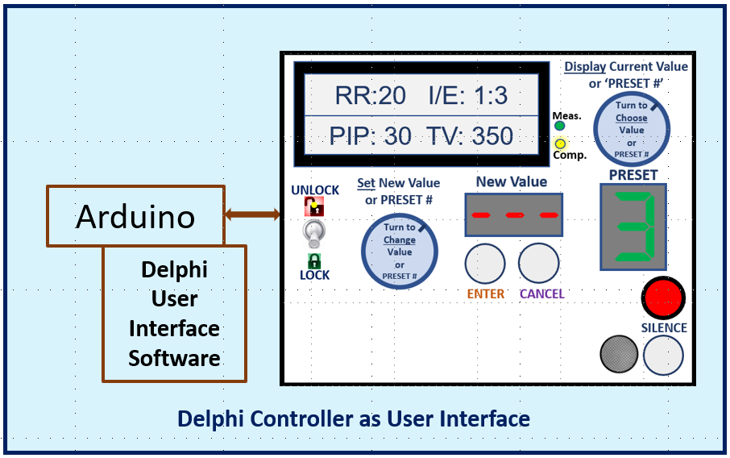
Emergency Medical Ventilator Using the Delphi User Interface
System Block Diagram
Wall or
Outside Air
Air / O₂
Mixing Valve
IP
IFlow
Input
Filter
Air
Handling
Heating / Humidification
X
X
Patient
Motor
Drive
Pressure
Relief Valve
O₂
Wall or Bottle
ExP
Gear Motor,
Stepper Motor,
or Synchro Motor
Control
Portions of patient ventilator circuit (e.g., one-way valves and vent kit) not shown
ExFlow
CO₂
X
PEEP Valve
PWM Outputs
Current Inputs
Sensors:
IP
IFlow
ExP
ExFlow
CO2
Ventilator
Emergency Ventilator
Control Board
Output Filter /
UV Sterilization
AC
Power
SPI Interface
DC Power Supply
Battery

