Slide 1

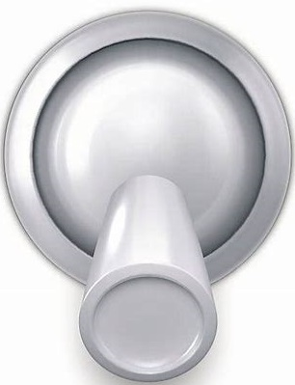


EMVCS Main Display (version of 4/7/20 1:30 PM MDT)
(updated presets based upon ICU doc input)
Display Current Value
or ‘PRESET #’
RR:20 I/E: 1:3
Meas.
Turn to
Choose
Value or PRESET #
PIP: 30 TV: 350
Comp.
Set New Value
or PRESET #
New Value
PRESET
UNLOCK
---
3
Turn to
Change
Value or PRESET #
LOCK
ENTER
CANCEL
SILENCE

