Slide 1

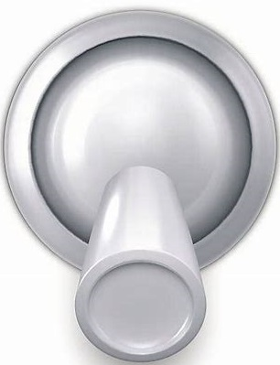



EMVCS Main Display (version of 4/7/20 1:30 PM MDT)
(updated presets based upon ICU doc input)
Display Current Value
or ‘PRESET #’
Write Externally Controlled Settings Here
RR:20 I/E: 1:3
PEEP
FiO2
IP MAX
Meas.
Turn to
Choose
Value or PRESET #
PIP: 30 TV: 350
20
80%
40
Comp.
Set New Value
or PRESET #
New Value
PRESET
Presets
UNLOCK
---
3
 | RR | I/E | PEEP | FIO2 | PIP
1 | 15 bpm | 1:4 | 10 cm | 50% | 20 cm
2 | 18 bpm | 1:3 | 14 cm | 60% | 25 cm
3 | 20 bpm | 1:3 | 16 cm | 80% | 30 cm
4 | 20 bpm | 1:3 | 18 cm | 100% | 35 cm
5 | 20 bpm | 2:1 | 20 cm | 100% | 40 cm
Turn to
Change
Value or PRESET #
LOCK
ENTER
CANCEL
To Adjust Settings:
1. UNLOCK
2. Display desired parameter.
3. Set New Value. Press ENTER or CANCEL to undo.
4. Repeat steps 2-3 as desired.
5. LOCK to update all modified settings.
SILENCE

