Slide 1

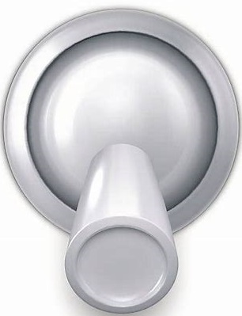

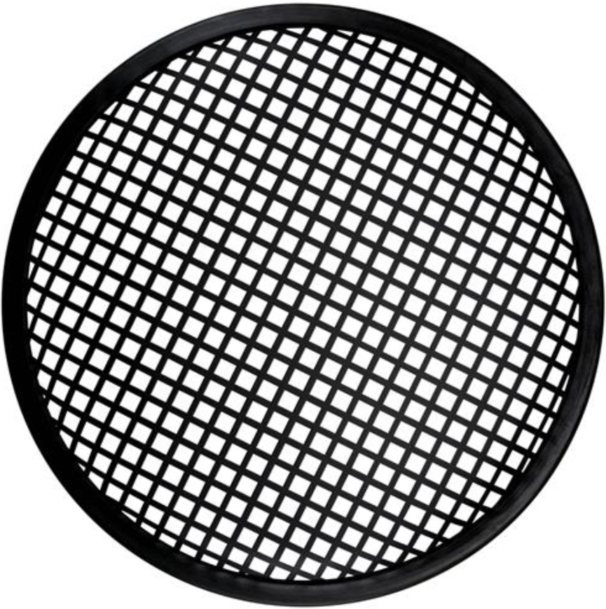

EMVCS Main Display (version of 4/7/20 1:30 PM MDT)
(updated presets based upon ICU doc input)
These three areas are a place to record the ordered settings of the manual PEEP valve, FiO2 valve, and IP pressure relief valve. These valves are not under EMVCS ventilator control.
Display Current Value
or ‘PRESET #’
Write Externally Controlled Settings Here
RR:20 I/E: 1:3
PEEP
FiO2
IP MAX
Meas.
Turn to
Choose
Value or PRESET #
PIP: 30 TV: 350
20
80%
40
Comp.
Set New Value
or PRESET #
New Value
PRESET
Presets
UNLOCK
---
3
 | RR | I/E | PEEP | FIO2 | PIP
1 | 15 bpm | 1:4 | 10 cm | 50% | 20 cm
2 | 18 bpm | 1:3 | 14 cm | 60% | 25 cm
3 | 20 bpm | 1:3 | 16 cm | 80% | 30 cm
4 | 20 bpm | 1:3 | 18 cm | 100% | 35 cm
5 | 20 bpm | 2:1 | 20 cm | 100% | 40 cm
Turn to
Change
Value or PRESET #
LOCK
ENTER
CANCEL
To Adjust Settings:
1. UNLOCK
2. Display desired parameter.
3. Set New Value. Press ENTER or CANCEL to undo.
4. Repeat steps 2-3 as desired.
5. LOCK to update all modified settings.
SILENCE

