Slide 1
Mobile Safety
Android
April 6th,2017

Slide 2
I. Matching Algorithm
 | Matched | Total
“Everyone” | 3096 | 28974
Total | 3826 | 36927
iOS “12+”, “17+”: 280
iOS “9+”: 160
iOS “4+”: 2656

Slide 3
II. Similarity Algorithm – number of suspicious app under different threshold
Threshold | Freq + Control | Occur + Control | Tfidf + Control | Freq + All | Occur + All | Tfidf + All
9 | 16 | 21 | 25 | 57 | 36 | 58
8 | 69 | 51 | 80 | 165 | 111 | 159
7 | 182 | 116 | 190 | 323 | 270 | 321
6 | 370 | 243 | 392 | 576 | 497 | 594
5 | 701 | 484 | 751 | 992 | 861 | 1028
0.5
0.3

Slide 4
III. Ensemble 3 Algorithms
Matching (a)
Similarity (b)
Strong Vocabulary (c)
Suspicious
Probability
%
Match with 3,4 : 0.5
Match with 2 : 0.3
9-7 : 0.5
6-5 : 0.3
16-8: 0.8
7-5 : 0.5
4-1 : 0.3
a+(1-a)*b+{1-[a+(1-a)*b]}*c = Suspicious Probability (%)
Impact of a
Impact of b
Impact of c
100%
a+(1-a)*b
{1-[a+(1-a)*b]}*c
a
(1-a)*b
For example:
a= 0.5
b=0.2
c=0.8
0.5
(1-0.5)*0.2= 0.1
(1-0.6)*0.8= 0.32
92%

Slide 5
Compared with an Average approach
1. (a+b+c)/3
2. (a+b+c)/(number of non-zeros)
 | a | b | c
1) | 0.9 | 0 | 0
2) | 0.3 | 0.3 | 0.3
 | a | b | c
1) | 0.9 | 0.1 | 0
2) | 0.5 | 0 | 0
0.3
0.5
0.3
0.5
Will not show the strong suspicious probability

Slide 6
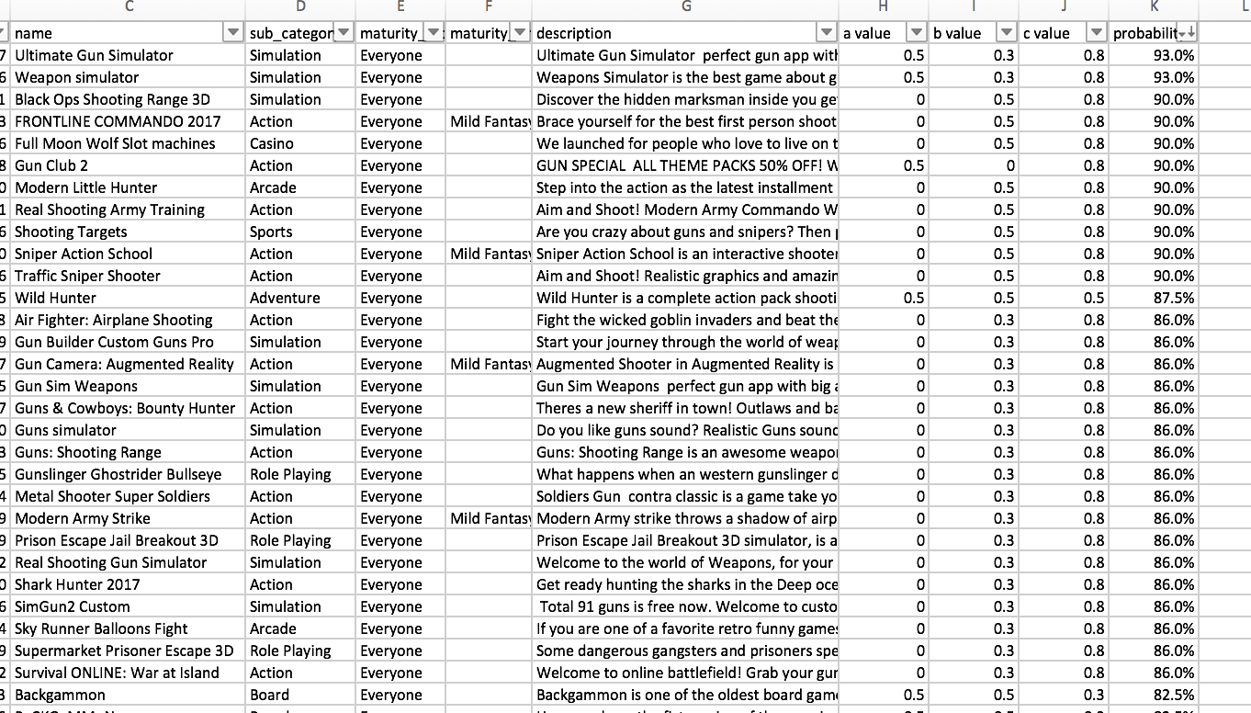
Suspicious Apps

Slide 7
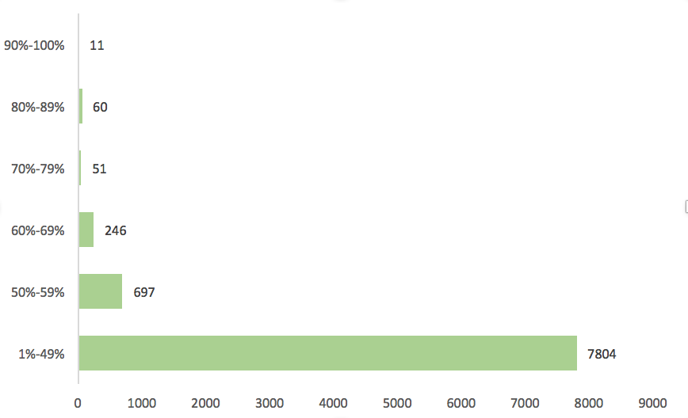
Suspicious Probability
0% | 1%-49% | 50%-59% | 60%-69% | 70%-79% | 80%-89% | 90%-100% | total
20105 | 7804 | 697 | 246 | 51 | 60 | 11 | 28974

Slide 8
1. CACM magazine (3000 words)
-download papers
2. data list (each algorithm 200) ensemble: voting, avg, my ensemble
3. MTurk

