Slide 1

Rapid Assessment of national planning documents using machine-based text analysis -United Nation & Fordham
Zeyang (Jenny) Gong, Yanzhe (Maxwell) Li
Yongdong Zhang, Di Zhu, Jinchen Hou

Slide 2
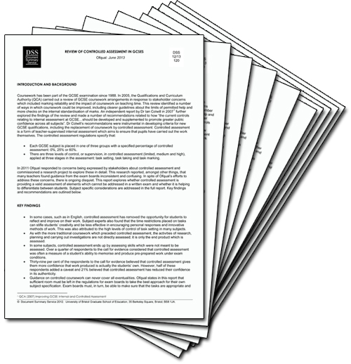


Problem Statement
Very time consuming for human analyst to go through National Plan documents
for each country, in order to find matches in 117 SDG Targets
SDG Targets
National Plan
1. Poverty
1.1 By 2030, eradicate extreme poverty
for all people everywhere
1.2 By 2030, reduce at least by half the
proportion of men, women and children
of all ages living in poverty in all its dimensions
.....
Total: 117 Targets

Slide 3
System Design
Model
Preprocessing
Evaluation
Define Features
Build Feature Lexicon
Similarity Scoring
Top 5 as threshold
Spark to speed up
Tokenization
Stemming
Remove stop words
Up to 4-grams
Part 1
Part 2
Accuracy
Presentation
UI Interface

Slide 4
Model – Part 1- Feature Lexicon
Features & Lexicon
SDG Targets
National Plan
Strong Feature (must include)
3.3 By 2030, end the epidemics of AIDS, tuberculosis, malaria and neglected tropical diseases and combat hepatitis, water-borne diseases and other communicable diseases
Vision 2030 outlines a vision for a healthy,
food-secure and breastfeeding nation, in
which all preventable, infectious and parasitic diseases are under secure control and in which people enjoy a high standard of living, with access to quality health services.
epidemics: epidemics,
communicable, infectious
2. disease: disease, illness
Weak Feature (could include)
AIDS
tuberculosis
malaria

Slide 5
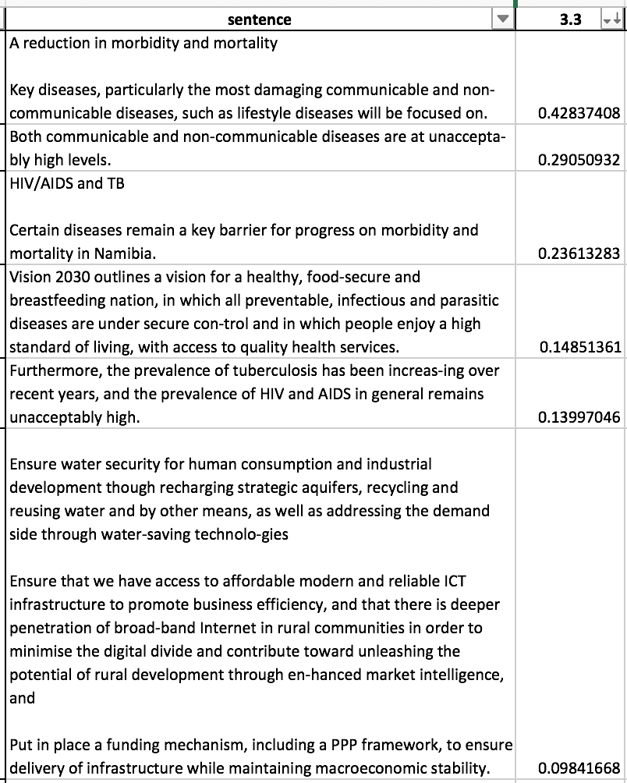
Model - Part 2- Similarity Ranking
Similarity Score
Rank sentence using similarity
Similarity Algorithm:
Tf-idf matrix
+ CWSS (concept weighted sentence similarity)
Use Spark to speed up: 0.1s/target

Slide 6
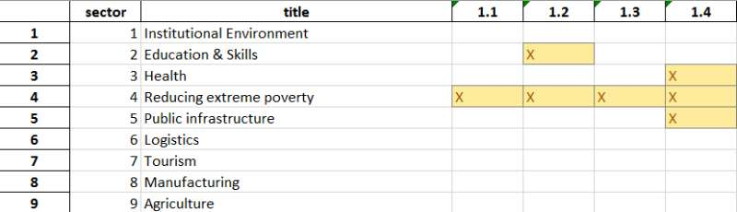
Result & Evaluation
Template 1
Evaluation
Target 3.1-3.9
Testing set: Namibia National Plan
Threshold: Top5 sentence
Accuracy Rate: 26/45 58%

Slide 7
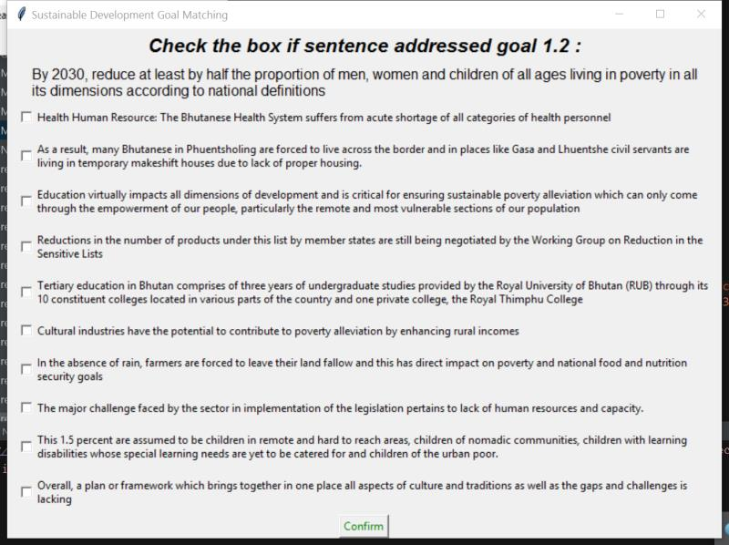
UI Interface

Slide 8
Thank you

