Slide 1
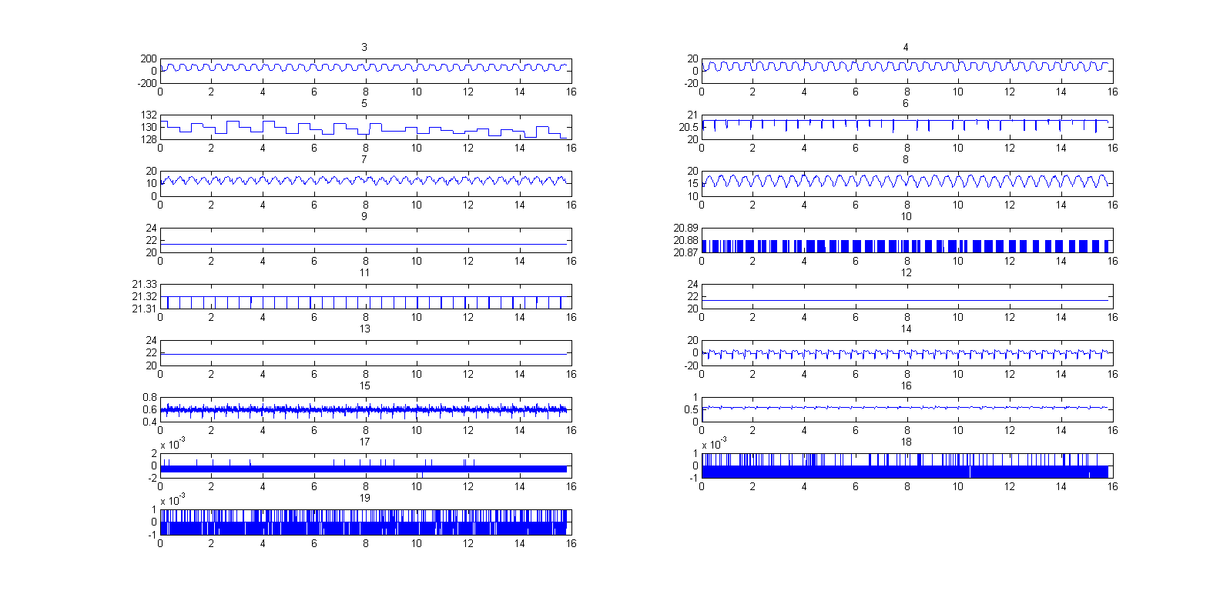
Haemodynamic Data Processing
ET7 Myocardial Infarct Study
Showing all channels of data.
LV Pressure trace (kPa)
LV Pressure trace (mmHg)
Potential image trigger signal

Slide 2
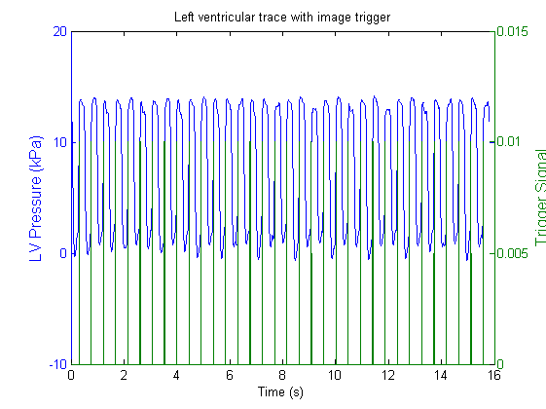
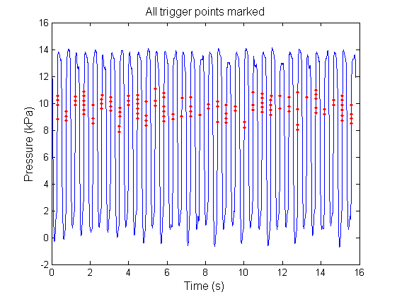
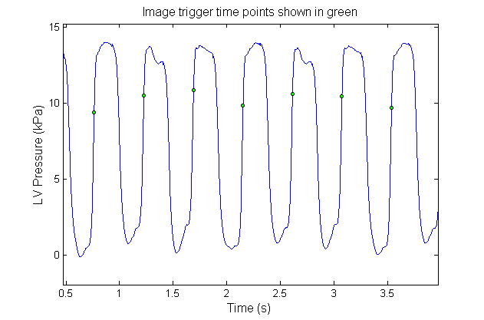
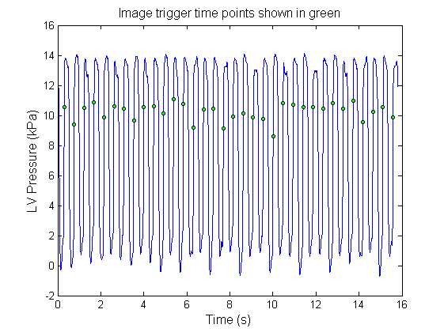
Haemodynamic Data Processing
ET7 Myocardial Infarct Study
Overlay trigger signal with trace

Slide 3
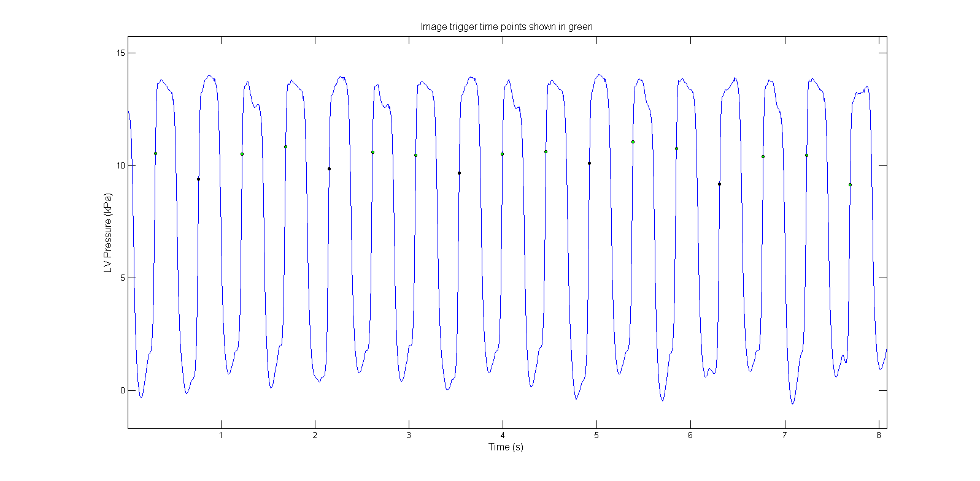
Haemodynamic Data Processing
ET7 Myocardial Infarct Study

Slide 4
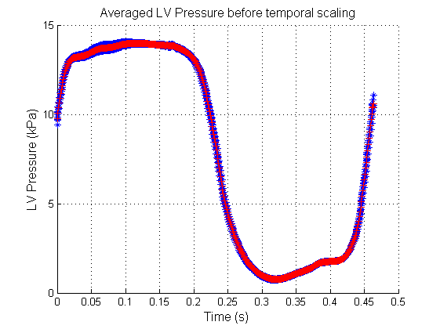
Haemodynamic Data Processing
ET7 Myocardial Infarct Study

Slide 5
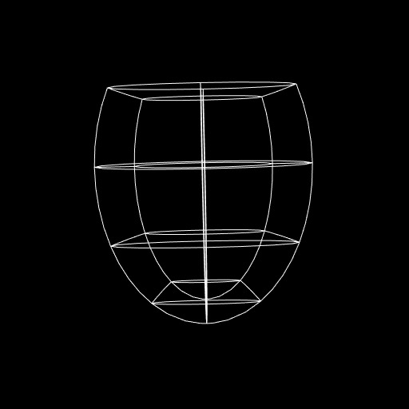
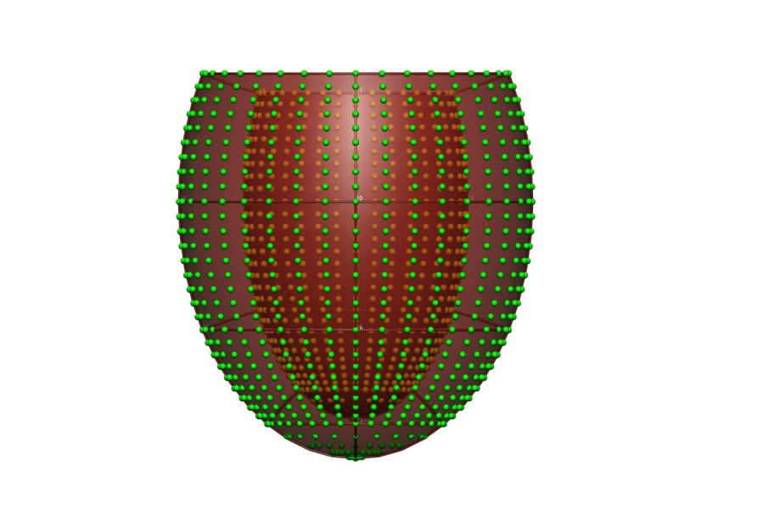
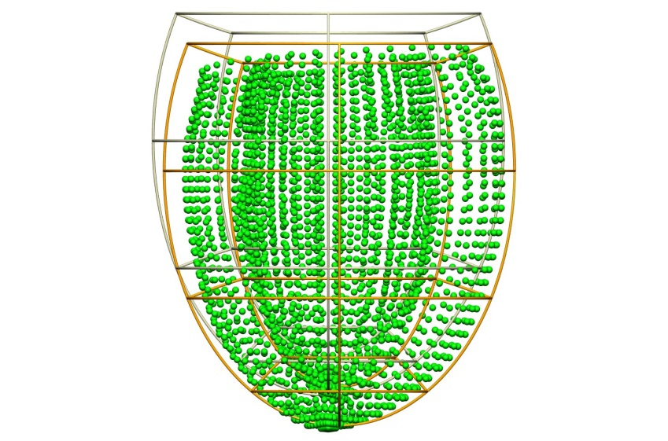
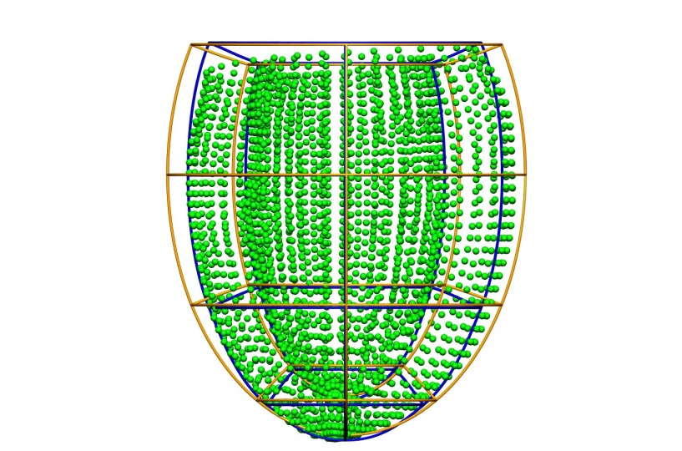
MICCAI Challenge
Geometric Fitting
Prolate spheroid regular model in rectangular Cartesian coordinate system.
Generate regular model surface points
Register to challenge surface data
Scale to match general dimensions of data

Slide 6
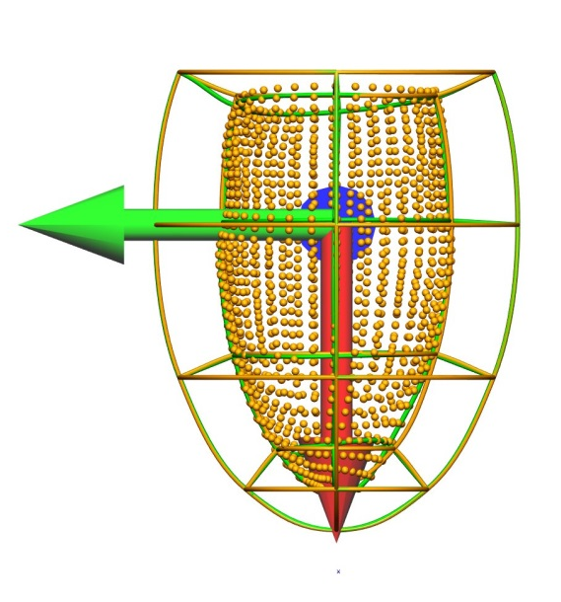
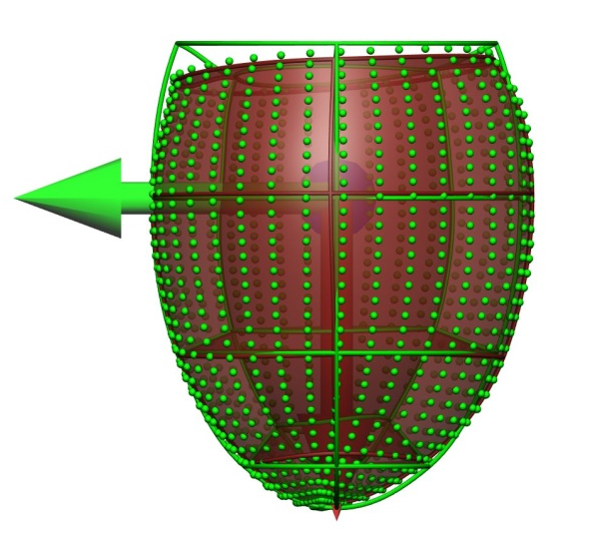
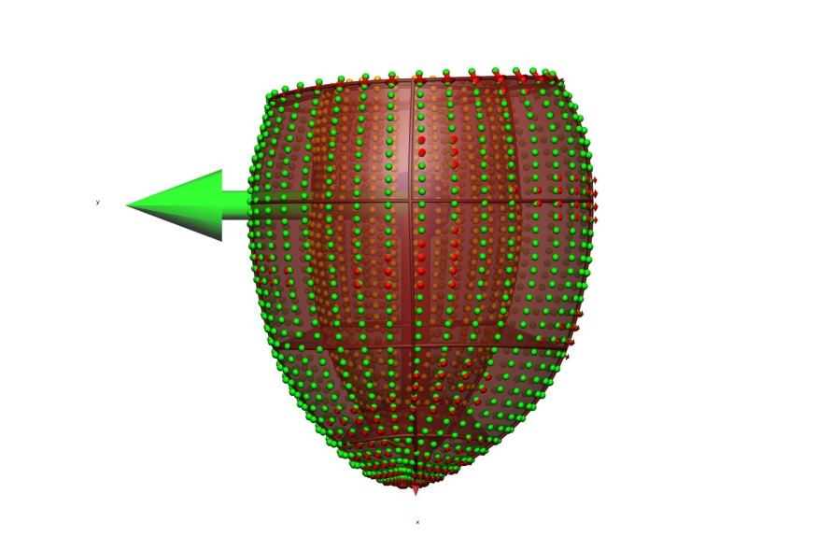
MICCAI Challenge
Geometric Fitting
Registered and scaled regular model
Fit to endocardial data
Fit to epicardial data
RMSE = 0.23 mm (2 d.p.)
Geometrically Fitted Model + fitting errors (in red)

Slide 7
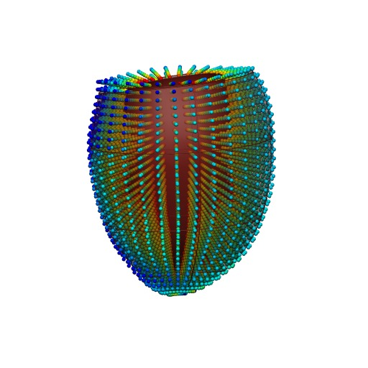

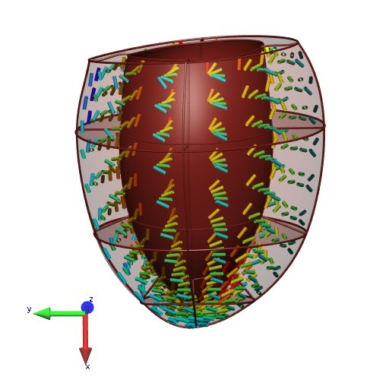
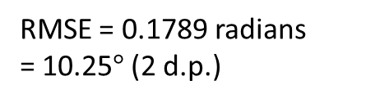
MICCAI Challenge
Fibre Fitting
Geometrically Fitted Model
Fibre angles calculated through vector-wall projection
RMSE = 0.1789 radians
= 10.25$°$ (2 d.p.)
Fibre Fitted Model

Slide 8
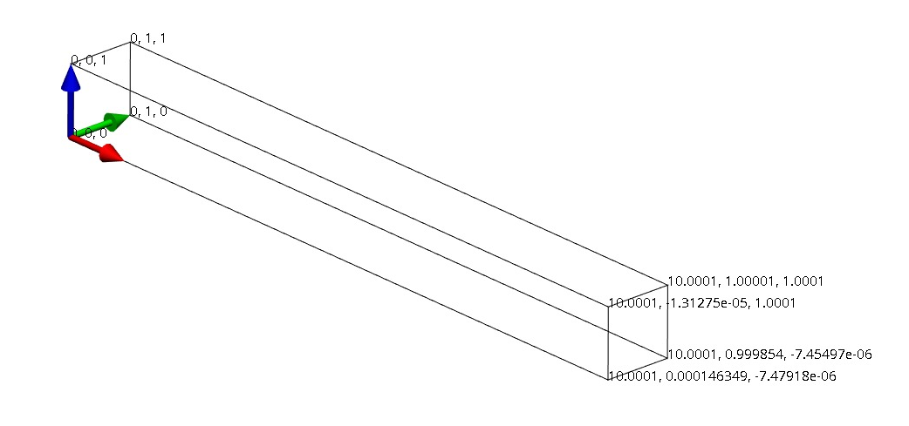
Benchmark Problem
Dirichlet boundary conditions: the left face (x=0) is fixed.
Pressure boundary condition: 0.004 kPa pressure is applied to the bottom (z=0) face. Please note that the direction of the pressure boundary condition scales with the deformed normal, and its magnitude with deformed area.
Using Guccione’s transversely isotropic constitutive law
W = C/2 (e^Q - 1)
Q = b_f E11^2 + b_t (E_22^2 + E33^3 + E23^2+ E32^2) + b_fs (E_12^2 + E_21^2
where C = 0.876 kPa, b_f = 18.48, b_t = 3.58, b_fs = 1.627

Slide 9
OpenCMISS CellML
OpenCMISS specifies that there must be 2 components for the material field when the constitutive law is defined in CellML.
A fix was made by modifying the source code.
However, due to a unknown problem, the modified code is not being executed. Memory leakage problems are suspected.

Slide 10
St. Francis Studies
4 New studies from St. Francis have come in.
Jane says:
‘Of note all these are clinical cases. Few are normal in a strict sense. I selected them because they do not have cardiovascular history, no gross abnormalities on cardiac MRI or on cath. And they have decent tracings.’
Currently processing CIM models.

