Slide 1
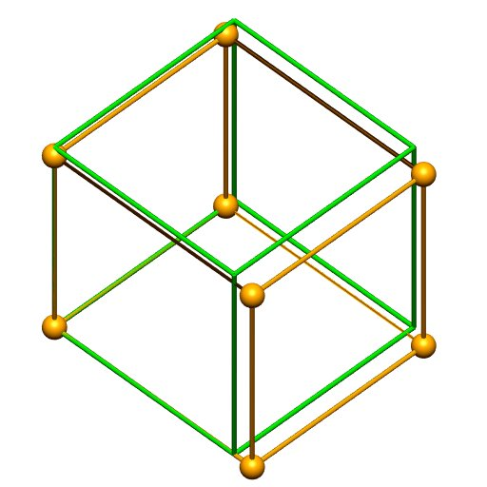
Uniaxial extension, trilinear lagrange element.

Slide 2
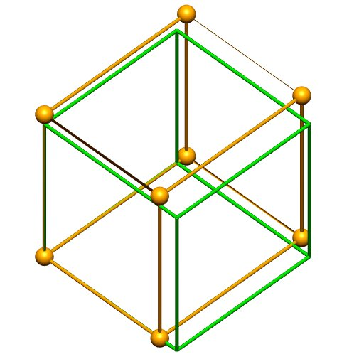
Uniaxial force (nodal loading), trilinear lagrange element.

Slide 3
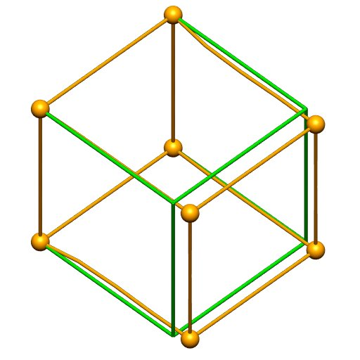
Uniaxial extension, tricubic hermite element.

Slide 4
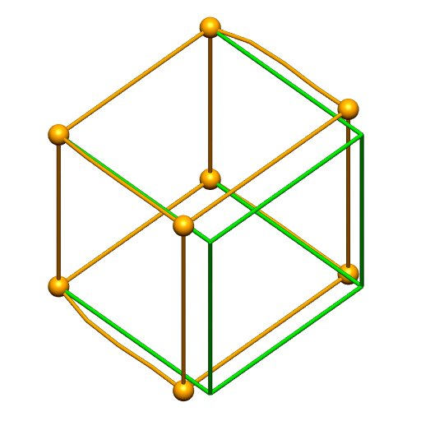
Uniaxial force (nodal loading), tricubic hermite element.

Slide 5
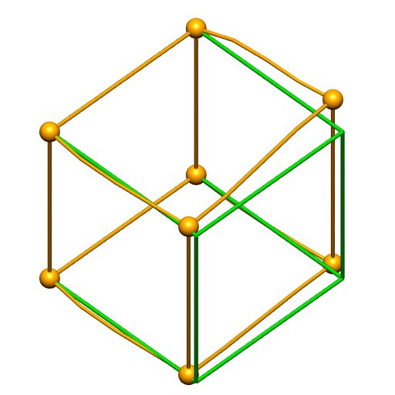
Uniaxial uneven force (nodal loading), tricubic hermite element.

