Slide 1
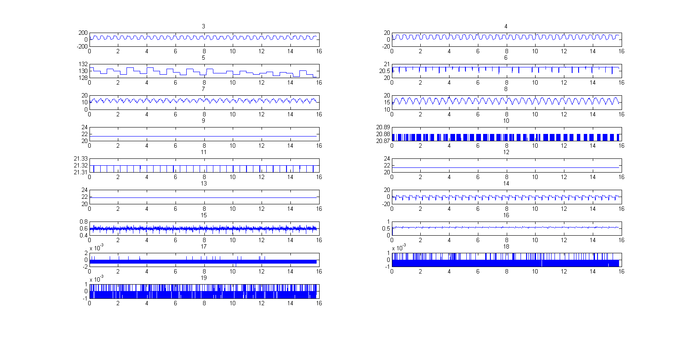
Haemodynamic Data Processing
ET7 Myocardial Infarct Study
Showing all channels of data.
LV Pressure trace (kPa)
LV Pressure trace (mmHg)
Potential image trigger signal

Slide 2
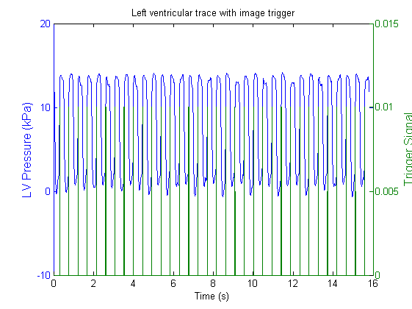
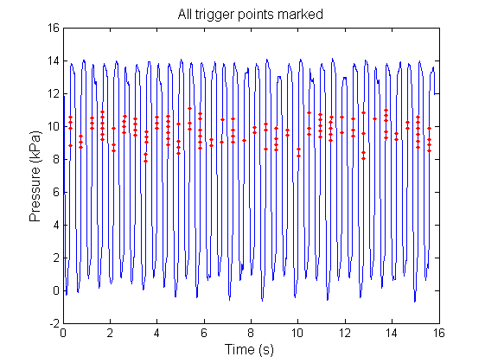
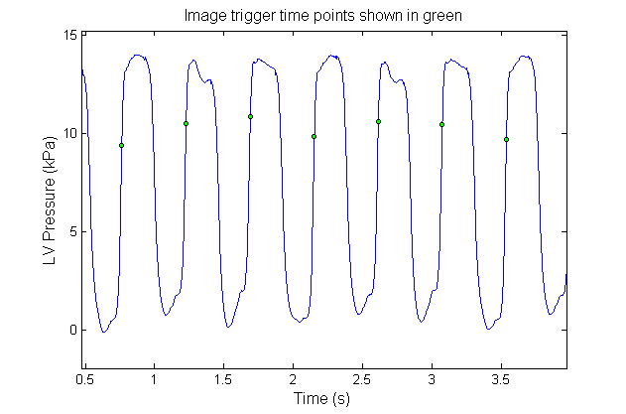
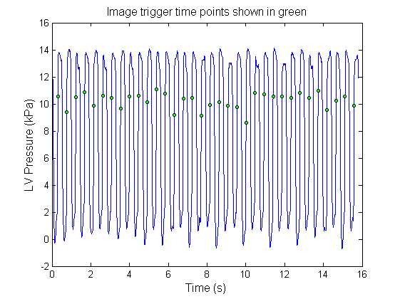
Haemodynamic Data Processing
ET7 Myocardial Infarct Study
Overlay trigger signal with trace

Slide 3
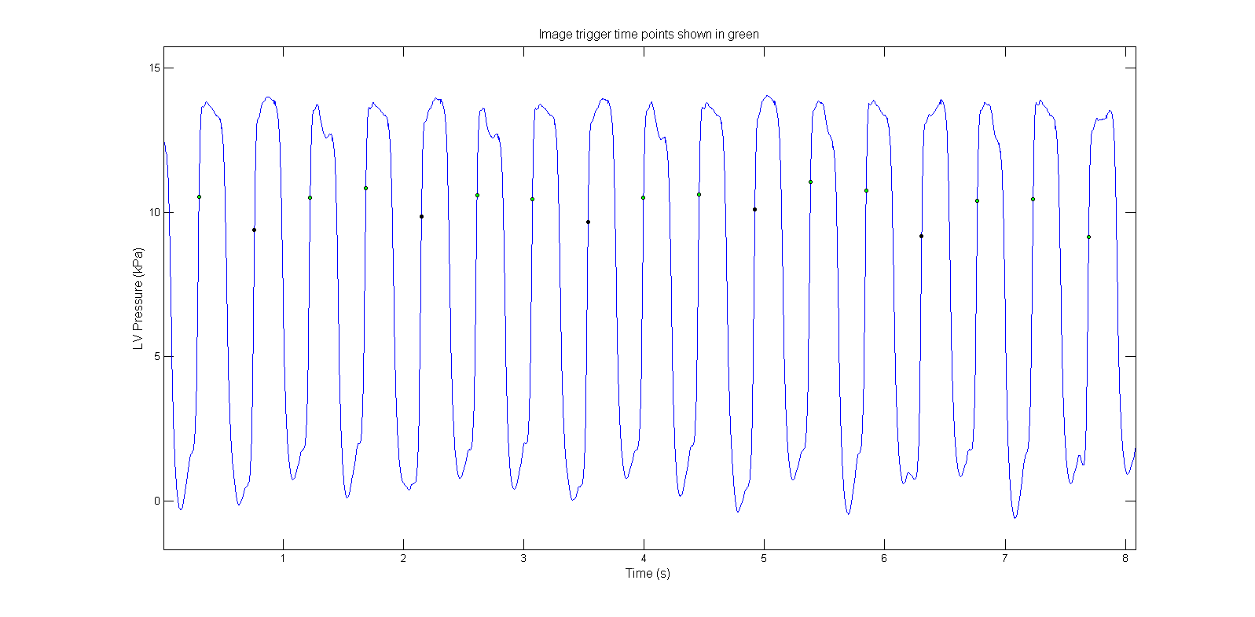
Haemodynamic Data Processing
ET7 Myocardial Infarct Study

Slide 4
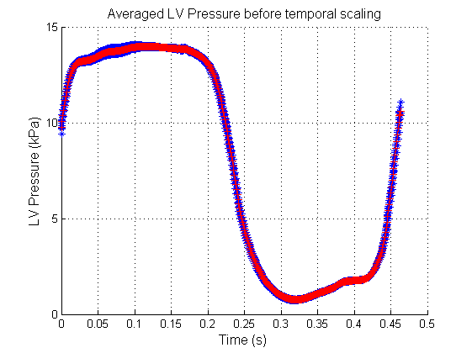
Haemodynamic Data Processing
ET7 Myocardial Infarct Study

