Slide 1
20th March 2014

Slide 2
Learnt about:
Hydrostatic pressure – Lagrange multiplier
Volumetric locking – (cubic-quadratic...)
Pressure BC application
CMGUI fibre visualisation
Github version control
Documentation of code
To Fix:
Nightlytest.py for python examples
Find actual formulation of constitutive models – passive and contractile.

Slide 3
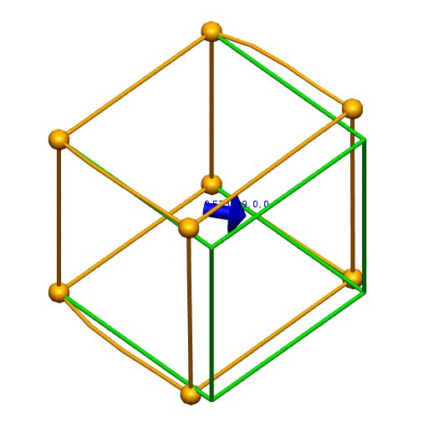
Transversely Isotropic
Constitutive formulation? 5 coefficients

Slide 4
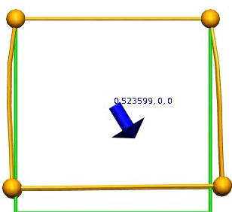
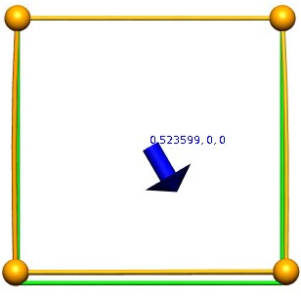
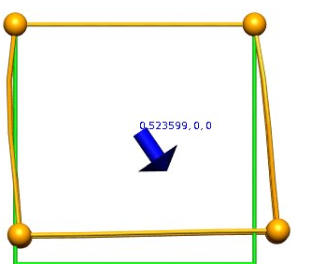
Increase C2 to 20
Increase C3 to 20

Slide 5
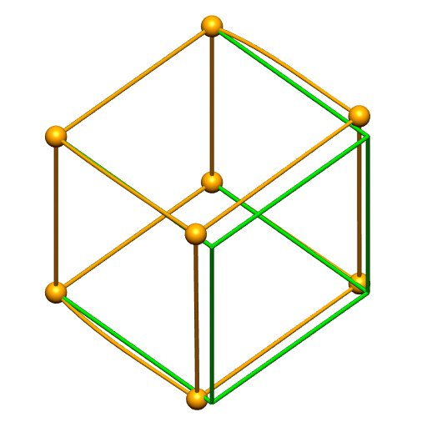
Pressure application
- using pressure type BC

Slide 6
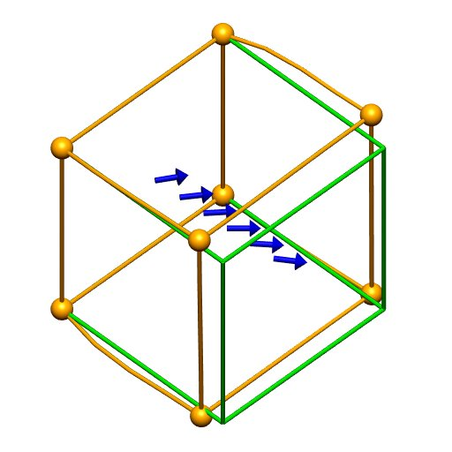
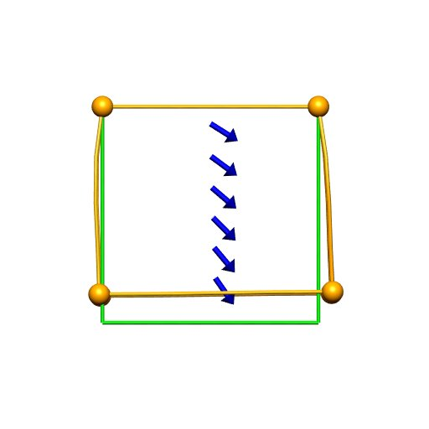
Heterogeneous Fibre Distribution

Slide 7
Next steps
Validate against old CMISS examples
Active Contraction
Orthotropy (?)
Using cylinder geometry (with tricubic hermite):
Unaxial extension
Torsion
Pressure Inflation

