Slide 1
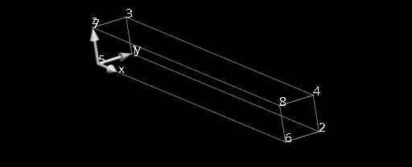
Benchmark problem
z
y
x
Dirichlet boundary conditions: the left face (x=0) is fixed.
Pressure boundary condition: 0.004 kPa pressure is applied to the bottom (z=0) face.Please note that the direction of the pressure boundary condition scales with the deformed normal, and its magnitude with deformed area.
Using Guccione’s transversely isotropic constitutive law
W = C/2 (e^Q - 1)
Q = b_f E11^2 + b_t (E_22^2 + E33^3 + E23^2+ E32^2) + b_fs (E_12^2 + E_21^2
where C = 0.876 kPa, b_f = 18.48, b_t = 3.58, b_fs = 1.627
Fully incompressible.

Slide 2
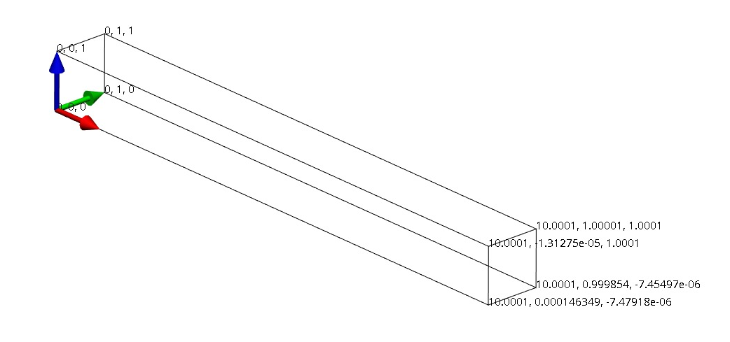
Using trilinear mesh

Slide 3
OpenCMISS CellML
Transversely isotropic uniaxial load problem in CellML.
Problems with compiler/totalview – unable to run modified source code properly.

Slide 4
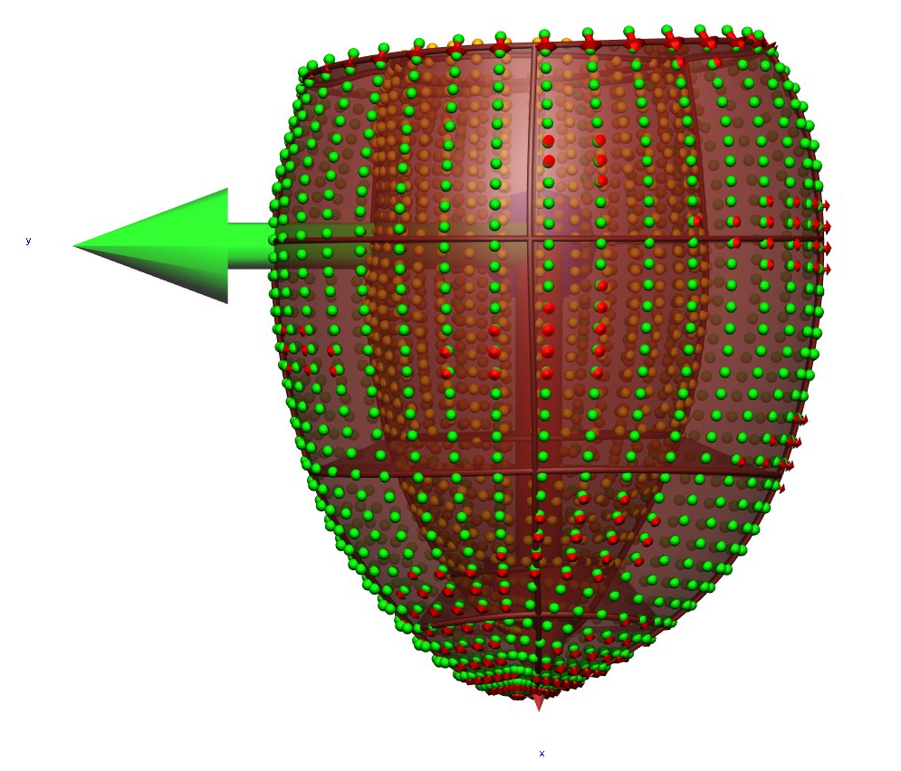
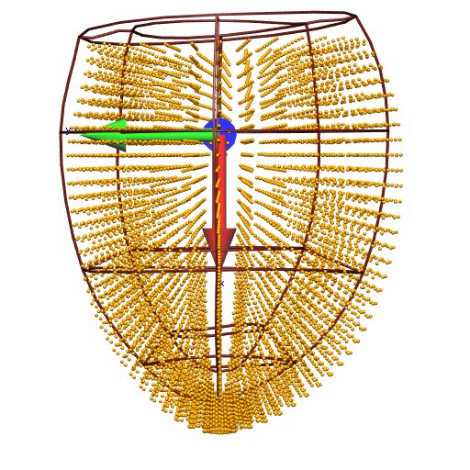
MICCAI Challenge
Geometric fitting done.
Fibre fitting – how to correlate data cloud with nodal fibre values? - how to convert vector into angles with respect to circumferential axis.

Slide 5
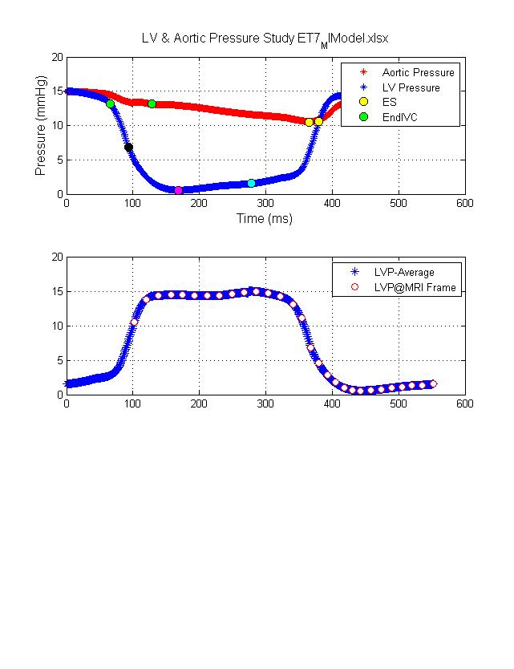
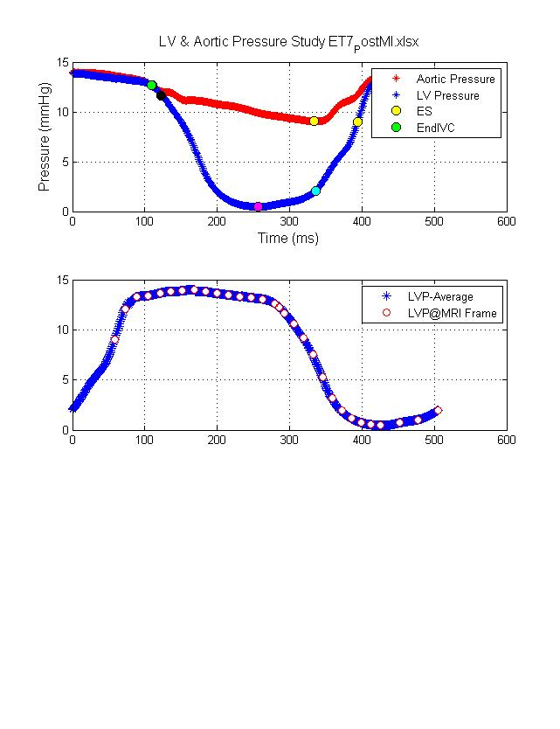
Pressure Registration

