Slide 1
Natural Language Processing for Question & Answer Websites
Jenny Li

Slide 2
Problem Statement
Build a robust model for our question-and-answer website that can categorize advice columns and explanatory forums based on the language of Reddit’s two subreddits: r/explainlikeimfive and r/advice
Figure out what language differentiates these two subreddits

Slide 3
Advice and Explanation
r/Advice
Ask for advice on many subjects and get an answer from the Reddit community*
Subjects range from friendship questions, social behavior, car advice, and exercise tips just to name a few
r/ExplainLikeImFive
Best forum and archive on the internet for layperson-friendly explanations*
Subjects range from science, math, and physics to law, philosophy, and government
Notes:
fksdjhfalsjhdfj

Slide 4
Overall Process
Data Extraction
Data Cleaning
Data Modeling
Using Pushshift API, run a function* that extracts 5000 submissions from each subreddit
Create a Pandas dataframe
Save as .csv file
Impute missing values with ‘None’ in ‘SelfText’ column as these are likely intentional since users sometimes don’t have a description
Concatenate the columns ‘selftext’ and ‘title’
Count Vectorizer
Tfidf Vectorizer
Logistic Regression
Multinomial Naive Bayes
Bagging Classifier
Random Forest Classifier
AdaBoost Classifier
*Graciously given by Paulene -- thanks Paulene!

Slide 5
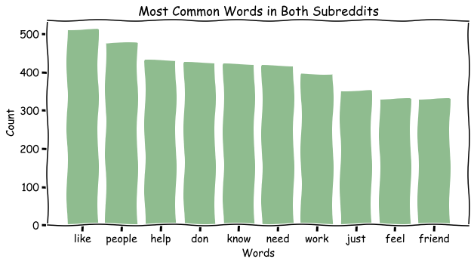
Common Words Across Both Subreddits
Notes:
Common words were found by using Count Vectorizer without using a Porter Stemmer as an analyzer

Slide 6
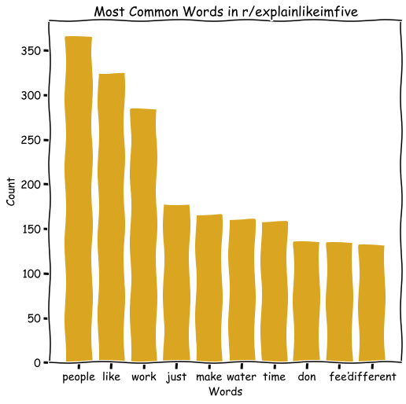
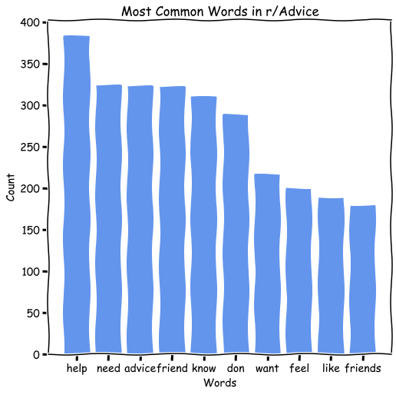
Common Words
Notes:
We can see there are indeed some common words such as ‘like’ and ‘feel’. But the advice subreddit definitely had more precise words that Explain Like I’m Five doesn’t have such as ‘don’t’, ‘know’, ‘need’, ‘help’. And this is great because it gives us a differentiation between any 2 posts.

Slide 7
Regression & Bayes
Test Score | Score 1 | Score 2 | Score 3 | Score 4
Count Vectorizer | X | X
Log-ression | X | X | X
MB |  |  |  | X
Porter Stemmer |  | X
Tfidf Vectorizer |  |  | X | X
Score | 0.9236 | 0.9892 | 0.9176 | .9244
Using a Logistic Regression and Multinomial Naive Bayes, I changed around several different variables while just using the ‘title’ column:
CountVectorizer vs. TfidfVectorizer
Logression vs. Multinomial Bayes
PorterStemmer
Best Hyper-Parameters
Max Features | 10,000
N-Gram Range | (1, 1)
Stop Words | ‘English’ + ‘Eli5’
Notes:
So one thing to note about my models. I want to point out that when I was using logistic regression and multinomial bayes algorithms, I only used the ‘title’ column which is the post title. On the next slide, I will introduce some ensemble machine learning algorithms that include title AND self text which is the description that users put in their posts. Sometimes this can be an image or video and sometimes it can be an elaboration on what they want to talk about.
So on this slide on the table to the right, I mainly wanted to see the difference between Count Vectorizer/Tfidf and MB and Logistic Regression. We can see that holding the estimator the same, we can see that Count Vectorizer beats Tfidf by 1%. But the biggest surprise of them all was using a Porter Stemmer. I was actually checking the rubric to see if I needed to use any lemmatizing transformers and it was sort of on there so just to be safe, I ran a model with a Porter Stemmer as the analyzer in Count Vectorizer and you guys, this was pretty amazing. I increased the score of the model by quite a lot at 98.9% and that was indeed my best score.

Slide 8
Test Scores | Score 1A* | Score 2A | Score 2B | Score 3A | Score 3B
Count Vectorizer |  | X | X | X | X
Tfidf Vectorizer | X
With Selftext | X | X |  | X
Bagging Classifier | X
Random Forest |  | X | X
AdaBoost |  |  |  | X | X
Scores | 0.9248 | 0.9512 | .9192 | 0.9472 | .8956
Ensemble Models
Notes:
The Ensemble models didn’t help me -- much to my disappointment. But the main thing to note here is not the models themselves but how they performed with extra data. So in these models, I decided to pull in the selftext (which remember is the description of the post). You can see that between Score 2A and 2B, everything was held the same except for adding the selftext and we can see that the score jumps quite a bit. With Adaboost, it’s quite a big jump between the two. So it seems like more data is definitely more power for ensemble models -- which sort of makes sense since these models are either resampling with replacement from the data you provide or they are iterating through previous weak learners. Finally, the bagging classifier took way too long for my short patience so I did not end up getting a score for that one.

Slide 9
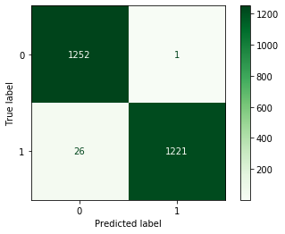
Confusion Matrix w/ highest test score parameters
In the future, we would want to decrease false negatives. That is, we predicted it to be in the wrong subreddit when it actually was in the right one.
Advice = 0 | Explain = 1
hyperparameters
Count Vectorizer
Porter Stemmer
Logistic Regression
Max Features | 10,000
N-Gram Range | (1, 1)
Stop Words | ‘English’ + ‘ELI5’
Notes:
Specificity was lower than our sensitivity. But I think specificity and sensitivity would do well if there was a positive class. And we technically do have a positive class which is explainlikeimfive but I think using a metric like sensitivity or specificity would be better used if we were classifying something like is this random post in this subreddit or not. Because that way we could actually say false positive means that we predicted it to be in the subreddit when it’s actually not. In our case, it just means that we misclassified the post. So for this problem statement if we are making a bot to look over an advice forum, I would say that we should decrease false negatives which means we predicted it to be in the wrong subreddit when it actually was in the right one. I would want to decrease this because I wouldn’t want user-experience to be affected by the bots. And if i few stray posts goes through the advice forum, so be it.

Slide 10
Conclusion
To make a robust model, it is highly recommended that the company use a Porter Stemmer or some sort of lemmatizing device.
Logistic regression and Multinomial Naive Bayes yielded better results with smaller amounts of information
With “self text” column pulled in, Random Forest, Boosting, and Bagging seemed to work well
The two subreddits shared a few common words (e.g. feel, like). However, the advice subreddit had more words pertaining to advice (e.g. don’t, know, need, help)

