Slide 1
WVUP College QuesT - SToryboard
Completing a Quest

Slide 2
Use Case
Use Case: | Gameplay – Completing a Quest
Actor: | Player
Pre-Condition: | Player has completed a quest as required by the tasks of the quest.
Post Condition: | All data as described in the description will be saved to the database.
Description | Player will receive EXP (and an increase in a level if they have acquired enough EXP) for successfully completing a quest, and will receive a notification upon doing so.

Slide 3
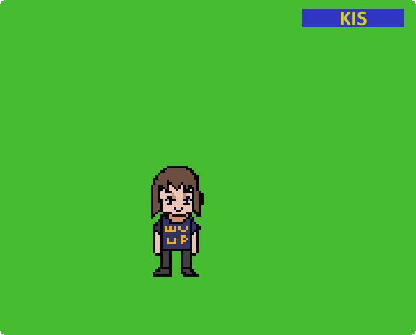
User is currently in game upon successful login. They click the KIS button that is always located in the upper right hand corner.

Slide 4
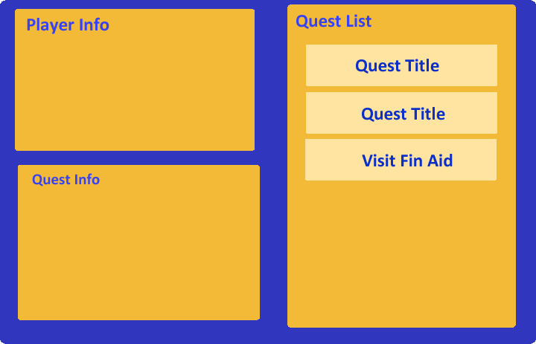
Upon clicking the button, the user is directed to a screen that navigates the KIS system.
It contains:
Player info
Quest List
Quest Info
The user will have the ability to click a quest as seen on the left.

Slide 5
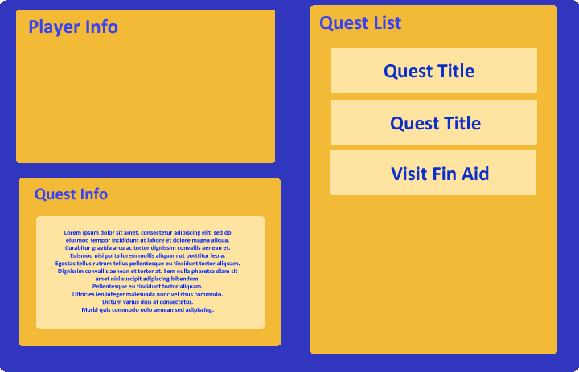
When the user clicks the application quest on the quest list, the quest info will display text that describes what the quest entails, and what the user must do to complete it.

Slide 6
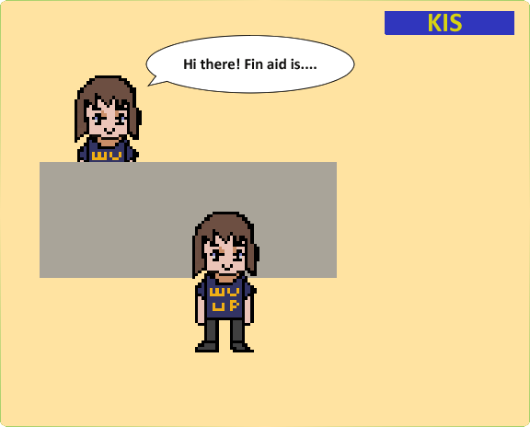
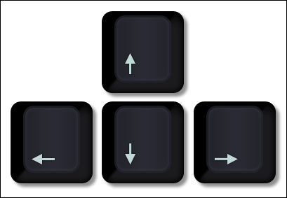
The user navigates player with movement to the corresponding room with the arrow keys.
In this instance, the player clicks on the financial aid officer to achieve quest, which involves getting information on financial aid.

Slide 7
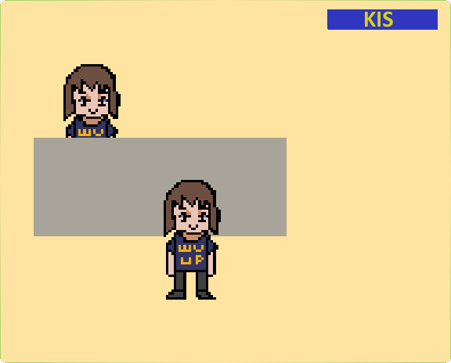
When the user completes the quest, a notification appears above their head, indicating they have completed their quest.
They can visit the KIS window again to also verify this, and view other quests.

Slide 8
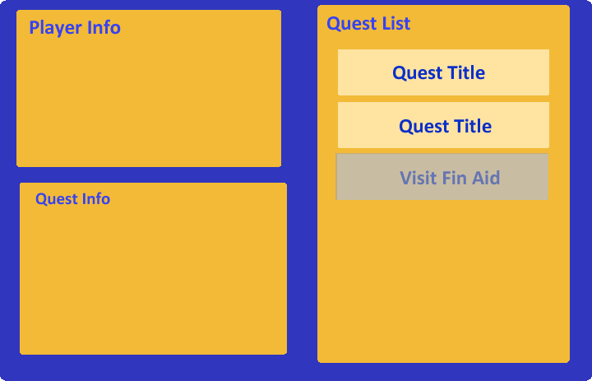
As seen here, the quest is verified as completed, as the quest in this list is grayed out.

